Slide 1
Welcome to my class
MS: Phạm Thị Hà

Slide 3
Unit 16: Weather
Leson 1 (1,2,3)

Slide 4
New words

Slide 5
rainy
: có mưa

Slide 6
sunny
: có nắng

Slide 7
: có mây
cloudy

Slide 8
windy
: có gió

Slide 9
- rainy
: có mưa
- sunny
: có nắng
- cloudy
: có mây
- windy
: có gió

Slide 10
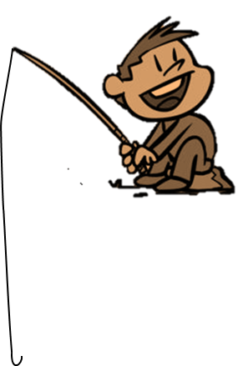
FISHING GAME

Slide 11
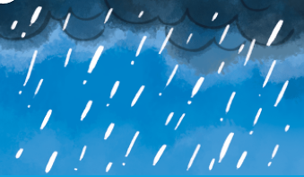
C. rainy
A. sunny
D. cloudy
C. rainy
B. windy

Slide 12
D. windy
A. cloudy
B. rainy
D. windy
C. sunny

Slide 13
A. sunny
A. sunny
D. cloudy
C. windy
B. rainy

Slide 14
D. cloudy
A. rainy
B. sunny
D. cloudy
C. windy

Slide 15
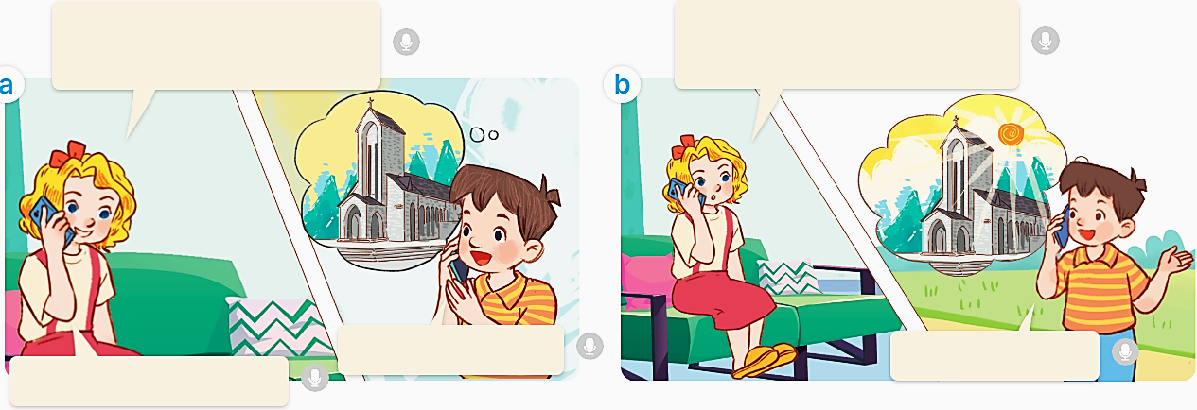

Slide 16
Hi, Minh. Where were you last weekend?
What was the weather like in Sa Pa?
I was in Sa Pa.
Greet! I like Sa Pa.
It was sunny.

Slide 17
Hi, Minh. Where were you last weekend?
What was the weather like in Sa Pa?
I was in Sa Pa.
Greet! I like Sa Pa.
It was sunny.

Slide 18
* Hỏi đáp thời tiết đã xảy ra.
- What was the weather like last weekend ?
It was
+ _____.
sunny

Slide 20
A: What was the weather like last weekend?
B: It was _______.

Slide 21
_____.
____?
B
A

Slide 22
_____?
____.
B
A

