Slide 1
Friday, December 6th ,2024
MsPham
0936082789
Unit 8
IN OUR
CLASSROOM
MsPham
0936082789
Lesson 2 – Part 1, 2, 3
Teacher: Nguyen Thi Xanh

Slide 2
Table of contents
MsPham
0936082789
1
Warm-up and review
2
Look, listen and repeat
MsPham
0936082789
3
Listen, point and say
4
Let’s talk
5
Fun corner and wrap-up

Slide 3
MsPham
0936082789
1
Warm-up
and review
MsPham
0936082789

Slide 4
https://www.youtube.com/watch?v=eHNqGNDKpYU

Slide 5
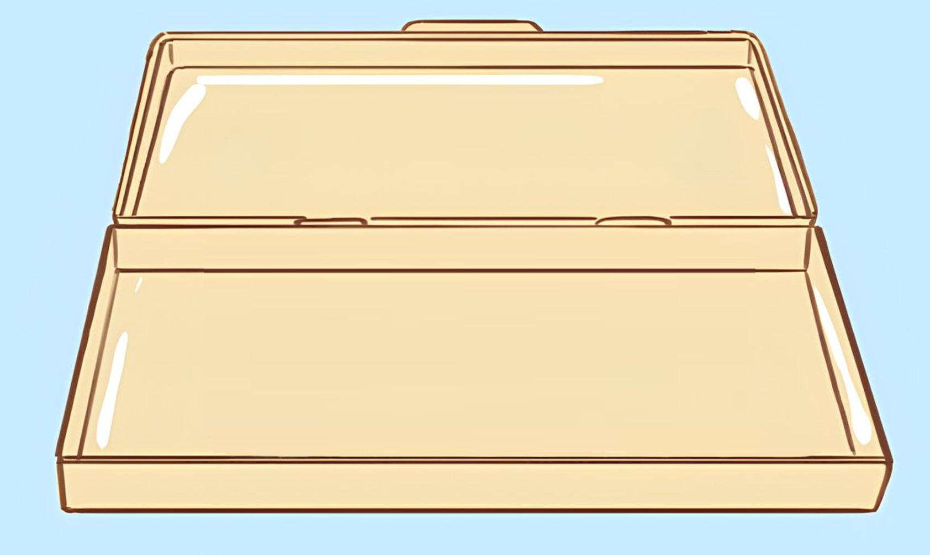
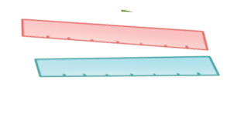
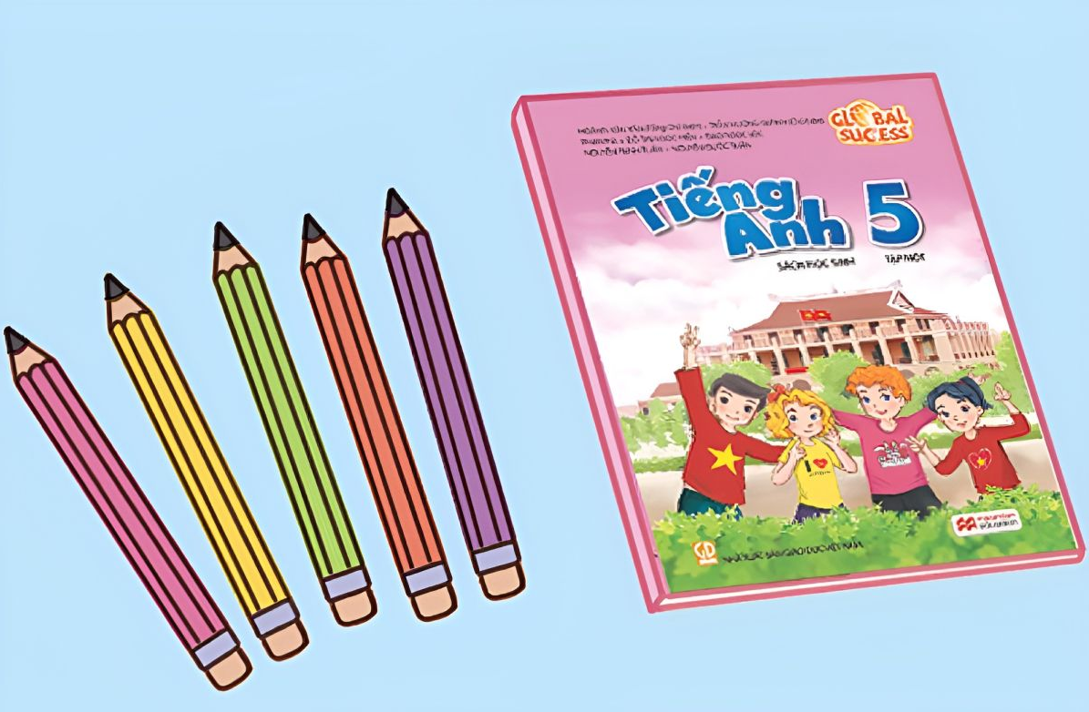
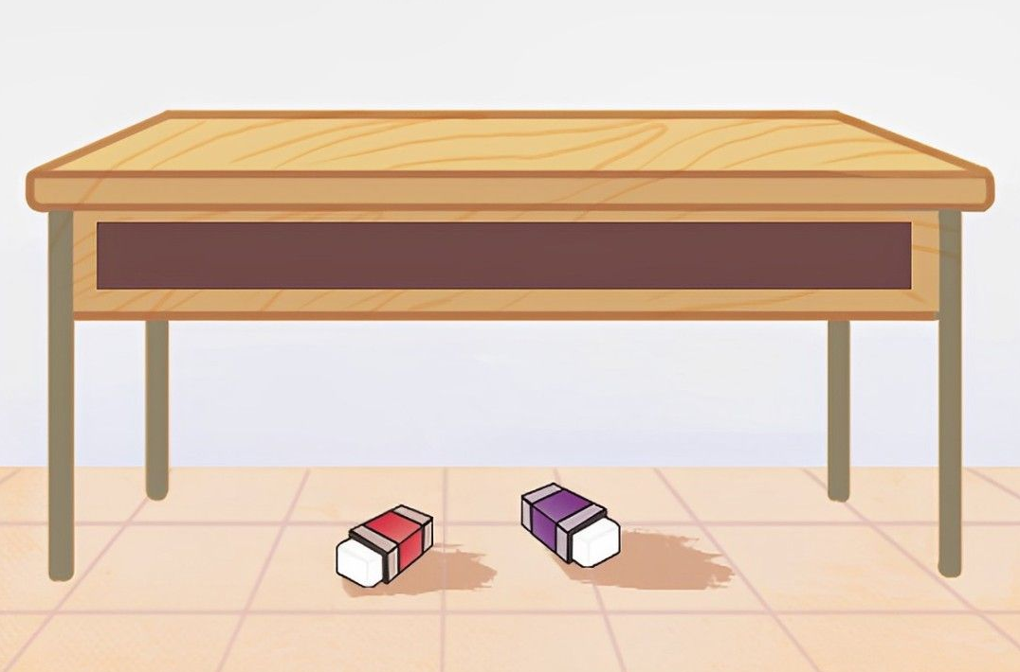
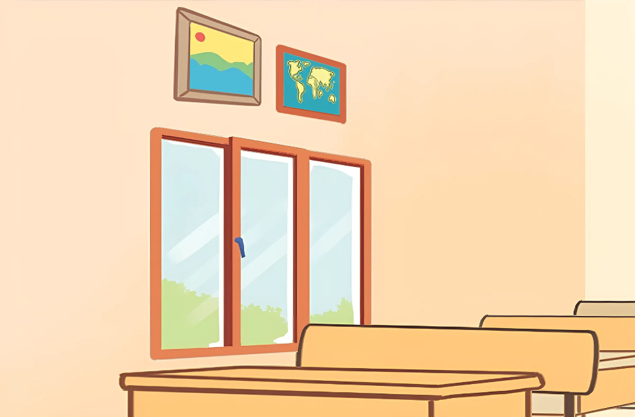
Review
in the
pencil case
on the desk
school bags
rulers
in front of
the clock
Where are the ______?
They’re _______.
MsPham
0936082789
pencils
beside the book
erasers
pictures
pens
under the desk
above the window
Notes:
MsPham-0936082789

Slide 6
Vocabulary
glue stick
/ɡluː stɪk/
MsPham
0936082789
keo dán, hồ dán

Slide 7
Vocabulary
crayon
/ˈkreɪən/
MsPham
0936082789
bút màu

Slide 8
Vocabulary
set square
/ˈset skweə(r)/
MsPham
0936082789
thước đo độ

Slide 9
Vocabulary
pencil sharpener
/ˈpɛnsl ˈʃɑːpənə/
MsPham
0936082789
Gọt bút chì

Slide 10
Vocabulary
pencil sharpener
: gọt bút chì
crayon
: bút màu
glue stick
: keo dán, hồ dán
set square
: thước đo độ

Slide 11
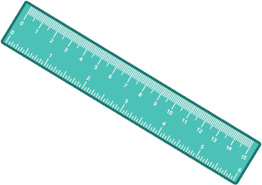
Vocabulary check:
Listen and circle
1
2
3
4
MsPham
0936082789
5
6
7
8

Slide 12
Vocabulary check:
Listen and circle
1
2
3
4
MsPham
0936082789
5
6
7
8

Slide 13
Vocabulary check:
Listen and circle
1
2
3
4
MsPham
0936082789
5
6
7
8

Slide 14
Vocabulary check:
Listen and circle
1
2
3
4
MsPham
0936082789
5
6
7
8

Slide 15
Vocabulary check:
Listen and circle
1
2
3
4
MsPham
0936082789
5
6
7
8

Slide 16
Vocabulary check:
Listen and circle
1
2
3
4
MsPham
0936082789
5
6
7
8

Slide 17
Vocabulary check:
Listen and circle
1
2
3
4
MsPham
0936082789
5
6
7
8

Slide 18
Vocabulary check:
Listen and circle
1
2
3
4
MsPham
0936082789
5
6
7
8

Slide 19
MsPham
0936082789
2
Look, listen and repeat
MsPham
0936082789

Slide 20
Look and listen.
MsPham
0936082789

Slide 21
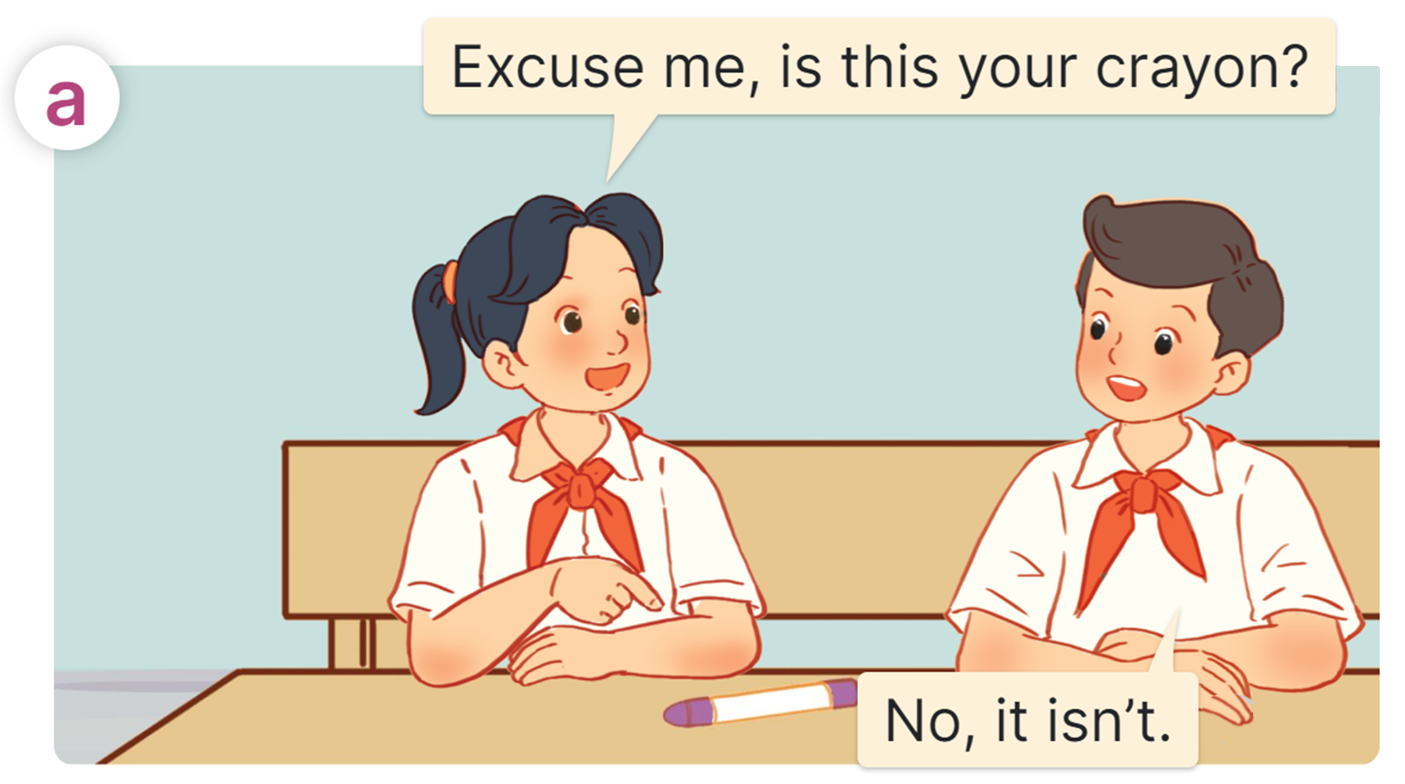
Listen and repeat.
MsPham
0936082789

Slide 22
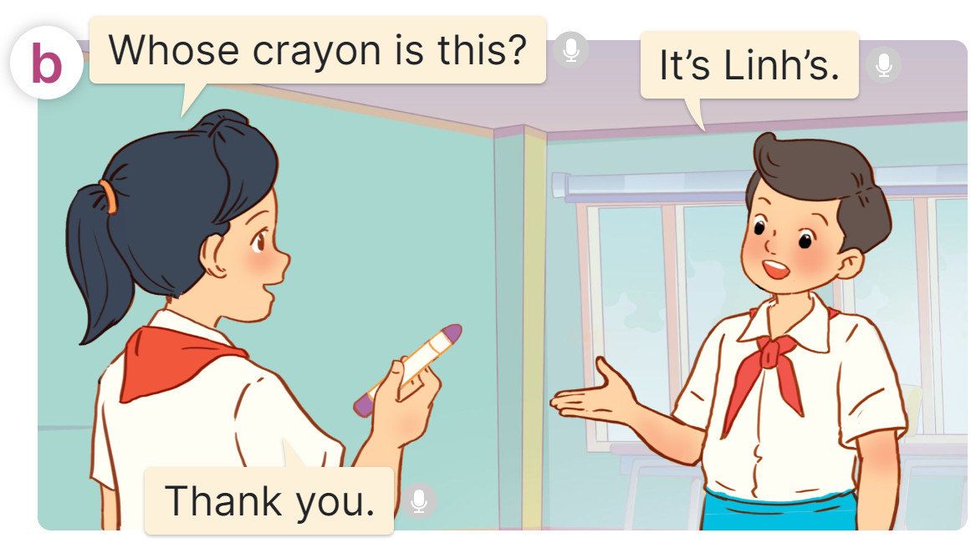
Listen and repeat.
MsPham
0936082789
MsPham
0936082789

Slide 23
Look and read.
MsPham
0936082789

Slide 24
Sentence patterns:
Cách hỏi và trả lời (một) đồ vật này là của ai:
Whose + (tên đồ vật) + is this / that?
(Cái ________ này/kia là của ai?)
It’s + (tên người sở hữu)’s.
(Nó là của _______)
Note:
It’s = It is : Nó là ;
MsPham
0936082789
(tên người sở hữu)’s: của ai đó;
’s KHÔNG PHẢI là viết tắt của is
Eg: Bill’s: của Bill
https://www.facebook.com/msphampowerpoint

Slide 25
MsPham
0936082789
3
Listen, point and say
MsPham
0936082789

Slide 26
Listen, point and say
Whose _____ is this?
MsPham
0936082789
glue stick / Mary's
crayon / Bill's
It’s _______.
set square / Nam's
pencil sharpener / Mai's

Slide 27
Listen, point and say
Whose _____ is this?
Whose glue stick is this?
It’s _______.
It’s Mary's.
MsPham
0936082789

Slide 28
Listen, point and say
Whose _____ is this?
Whose crayon is this?
It’s _______.
It’s Bill's.
MsPham
0936082789

Slide 29
Listen, point and say
Whose _____ is this?
Whose set square is this?
It’s _______.
It’s Nam's.
MsPham
0936082789

Slide 30
Listen, point and say
Whose _____ is this?
Whose pencil sharpener
is this?
It’s _______.
It’s Mai's.
MsPham
0936082789

Slide 31
Listen, point and say
Whose _____ is this?
MsPham
0936082789
glue stick / Mary's
crayon / Bill's
It’s _______.
set square / Nam's
pencil sharpener / Mai's

Slide 32
MsPham
0936082789
4
Let’s talk
MsPham
0936082789

Slide 33
Let’s talk.
Who are they?
Bill
Minh
Lucy
Linh
MsPham
0936082789

Slide 34
Let’s talk.
Is this your set square?
No, it isn’t.
Bill
Whose set square is this?
It’s Minh’s.
Minh
Lucy
Linh
MsPham
0936082789

Slide 35
Let’s talk.
Is this your crayon?
No, it isn’t.
Bill
Whose crayon is this?
It’s Lucy’s.
Minh
Lucy
Linh
MsPham
0936082789

Slide 36
Let’s talk.
Is this your pencil sharpener ?
No, it isn’t.
Whose pencil sharpener is this?
Bill
It’s Linh’s.
Minh
Lucy
Linh
MsPham
0936082789

Slide 37
Let’s talk.
Is this your glue stick?
No, it isn’t.
Bill
Whose glue stick is this?
It’s Bill’s.
Minh
Lucy
Linh
MsPham
0936082789

Slide 38
MsPham
0936082789
5
Fun corner
and wrap-up
MsPham
0936082789

Slide 39
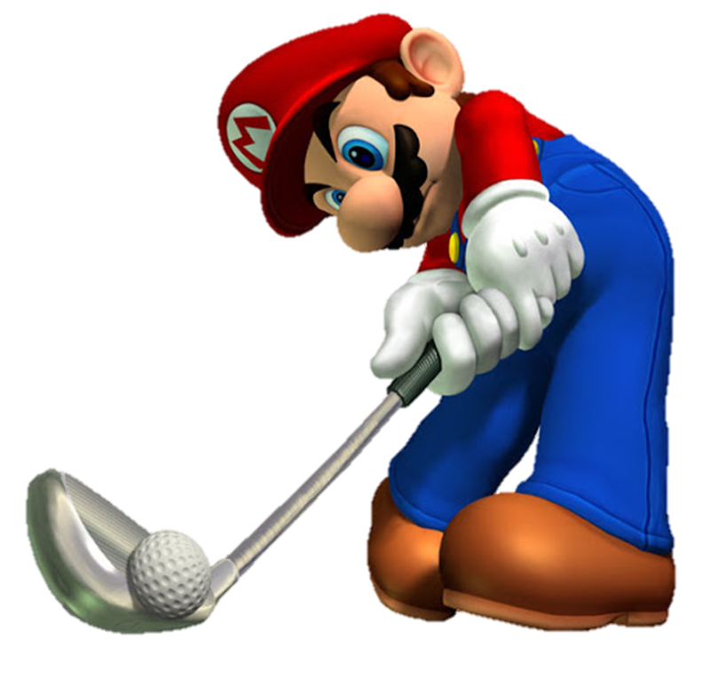

Slide 40
Whose _____ is this?
set square
pencil sharpener
glue stick

Slide 41
Whose _____ is this?
set square
crayons
crayon

Slide 42
Whose _____ is this?
set square
glue stick
pencil sharpener

Slide 43
Whose _____ is this?
pencil sharpener
glue stick
crayon

Slide 44
Mai
_____ school bag is this?
Whom
Who
Whose

Slide 45
Whose pencil sharpener is this?
It’s _______.
Linh’s
Mai’s
Lucy’s

Slide 46
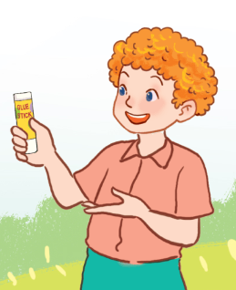
Whose glue stick is this?
It’s _______.
Bills’
Bill’s
Bill is

Slide 47
Whose crayon is this?
It’s _______.
Lucy is
Lucys
Lucy’s

Slide 48
Whose set square is this?
It’s _______.
Minh’s
Tom’s
Bill’s

Slide 49
Good job!

Slide 50
Review
my brother’s
my sister’s
school bag
book
pencil sharpener
set square
Whose _____ is this?
It’s _______.
MsPham
0936082789
Linh’s
Minh’s
crayon
glue stick
Lucy’s
Bill's

Slide 51
MsPham
0936082789
Thank you
MsPham
0936082789
For joining!

