Slide 1
Song Ve Town Primary School
WELCOME TO
OUR CLASS 3
Teacher: Nguyen Thi Xanh
Made by
Thanh Tam

Slide 2
Wednesday, December 4th ,2024
UNIT 8:
MY SCHOOL THINGS
LESSON 1( P: 1, 2, 3)

Slide 3
CONTENTS
1
WARM -UP
2
VOCABULARY
3
LOOK, LISTEN AND REPEAT
4
LISTEN, POINT AND SAY
5
LET’S TALK
6
PLAY GAME
Notes:
MADE BY FACEBOOK :TRAN THI THANH TAM

Slide 4
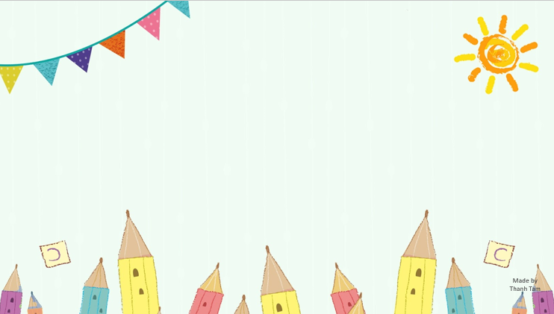
Warm - up

Slide 5
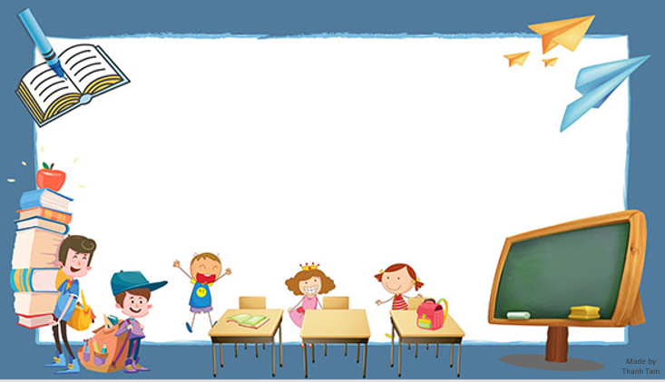
LET ’S PLAY
Chinese Whispers

Slide 6
Chinese Whispers
Group 1
Group 2
Open your book.
Close your book.
Notes:
Made by Facebook: TRAN THI THANH TAM

Slide 7
Chinese Whispers
Group 1
Group 2
Sit down, please.
Stand up , please.
Notes:
Made by Facebook: TRAN THI THANH TAM

Slide 9
pen /pen/:cây bút

Slide 10
book /bʊk/: quyển sách

Slide 11
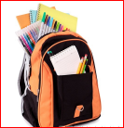
school bag /ˈskuːl.bæɡ/: cái cặp

Slide 12
ruler /ˈruː.lər/: cây thước

Slide 13
Let's play
MATCHING
Notes:
MADE BY FACEBOOK :TRAN THI THANH TAM

Slide 14
CHECK VOCABULARY:MATCHING
pen
book
school bag
ruler

Slide 15
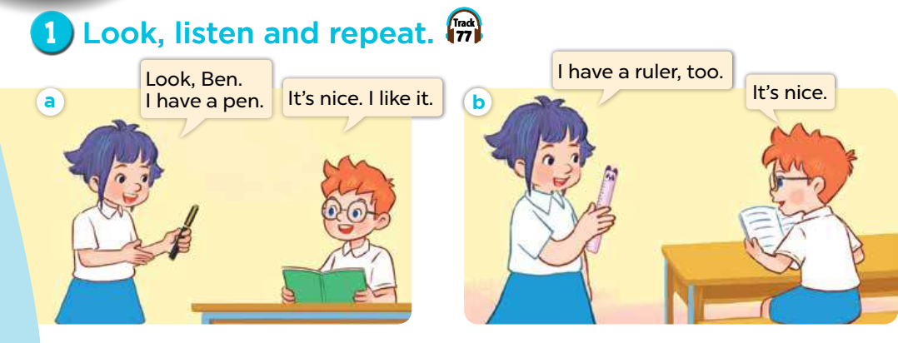

Slide 16
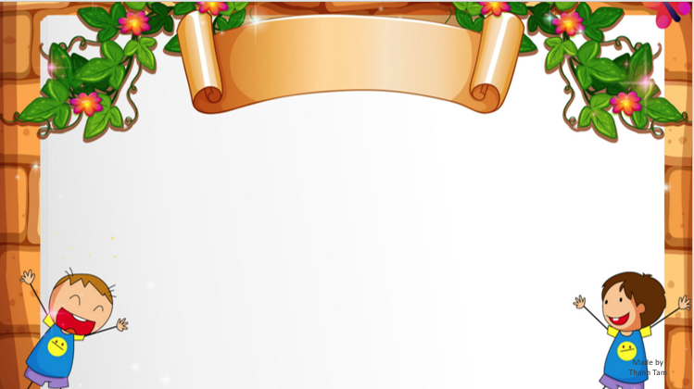
SENTENCE PATTERNS

Slide 17
* Sentence patterns:
Nói mình có đồ dùng học tập gì .
I have a schoog bag.
(Tôi có một cái cặp.)

Slide 19
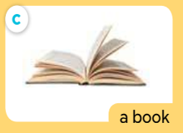
I have a _____
book
Notes:
MADE BY FACEBOOK :TRAN THI THANH TAM

Slide 20
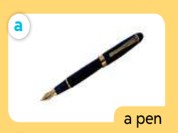
I have a _____
pen
Notes:
MADE BY FACEBOOK :TRAN THI THANH TAM

Slide 21
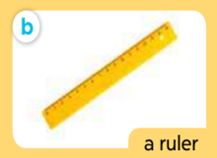
I have a _____
ruler
Notes:
MADE BY FACEBOOK :TRAN THI THANH TAM

Slide 22
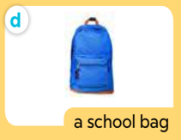
I have a _________
school bag
Notes:
MADE BY FACEBOOK :TRAN THI THANH TAM

Slide 23
I have a school bag.
I have a book.

Slide 24
Fun corner
and wrap-up
Who’s faster?
Notes:
Made by Facebook: TRAN THI THANH TAM

Slide 25
QUESTION 01
pen
A
book
B
School bag
C
Notes:
Made by FACEBOOK: TRAN THI THANH TAM

Slide 26
QUESTION 02
book
A
pen
B
School bag
C

Slide 27
QUESTION 03
pen
A
ruler
B
book
C
Notes:
Made by FACEBOOK: TRAN THI THANH TAM

Slide 28
QUESTION 04
book
A
ruler
B
pen
C

Slide 29
Review

Slide 30
Notes:
MADE BY FACEBOOK :TRAN THI THANH TAM

Slide 31
Song Ve Town Primary School
WELCOME TO
OUR CLASS 3
Teacher: Nguyen Thi Xanh

Slide 32
Thursday, December 5th ,2024
UNIT 8:
MY SCHOOL THINGS
LESSON 1 ( P: 4, 5, 6)

Slide 33
CONTENTS
1
WARM -UP
2
LISTEN AND TICK
3
LOOK, COMPLETE AND READ
4
LET’S SING
5
PLAY GAME
Notes:
MADE BY FACEBOOK :TRAN THI THANH TAM

Slide 34
Warm - up
Notes:
Made by Facebook: TRAN THI THANH TAM

Slide 35
Let's play
WHAT’S MISSING?
Notes:
MADE BY FACEBOOK :TRAN THI THANH TAM

Slide 36
pen
?
Notes:
MADE BY FACEBOOK :TRAN THI THANH TAM

Slide 37
ruler
?
Notes:
MADE BY FACEBOOK :TRAN THI THANH TAM

Slide 38
?
school bag
Notes:
MADE BY FACEBOOK :TRAN THI THANH TAM

Slide 39
book
?
Notes:
MADE BY FACEBOOK :TRAN THI THANH TAM

Slide 40
✓
✓

Slide 41
pen
a book
have a ruler.
I have a bag

Slide 43
Fun corner
and wrap-up

Slide 44
GAME
Choose the best answer

Slide 45
Question 1
Choose the best answer
A. pen
B. ruler
C. school bag
C. school bag
Answer
Next
Very Good!

Slide 46
Question 2
Choose the best answer
A. ruler
B. pen
B. pen
C. book
Answer
Next
Very Good!

Slide 47
Question 2
Choose the best answer
A. pen
B. book
B. book
C. ruler
Answer
Next
Very Good!

Slide 48
Question 4
Choose the best answer
A. ruler
A. ruler
B. pen
C. book
Answer
Next
Very Good!

Slide 49
Review

Slide 50
The bye bye song
Bye, bye.
See you tomorrow.
Bye, bye.
See you tomorrow.
Bye, bye.
See you tomorrow.
Bye, bye. Bye, bye.
The bye bye song

Slide 51
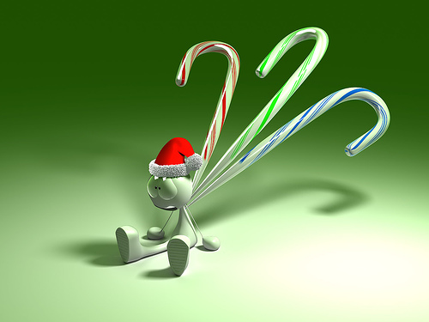
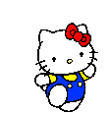
GOODBYE,
SEE YOU AGAIN !
Made by Thanh Tam

