Slide 1
01
Warm-up

Slide 2
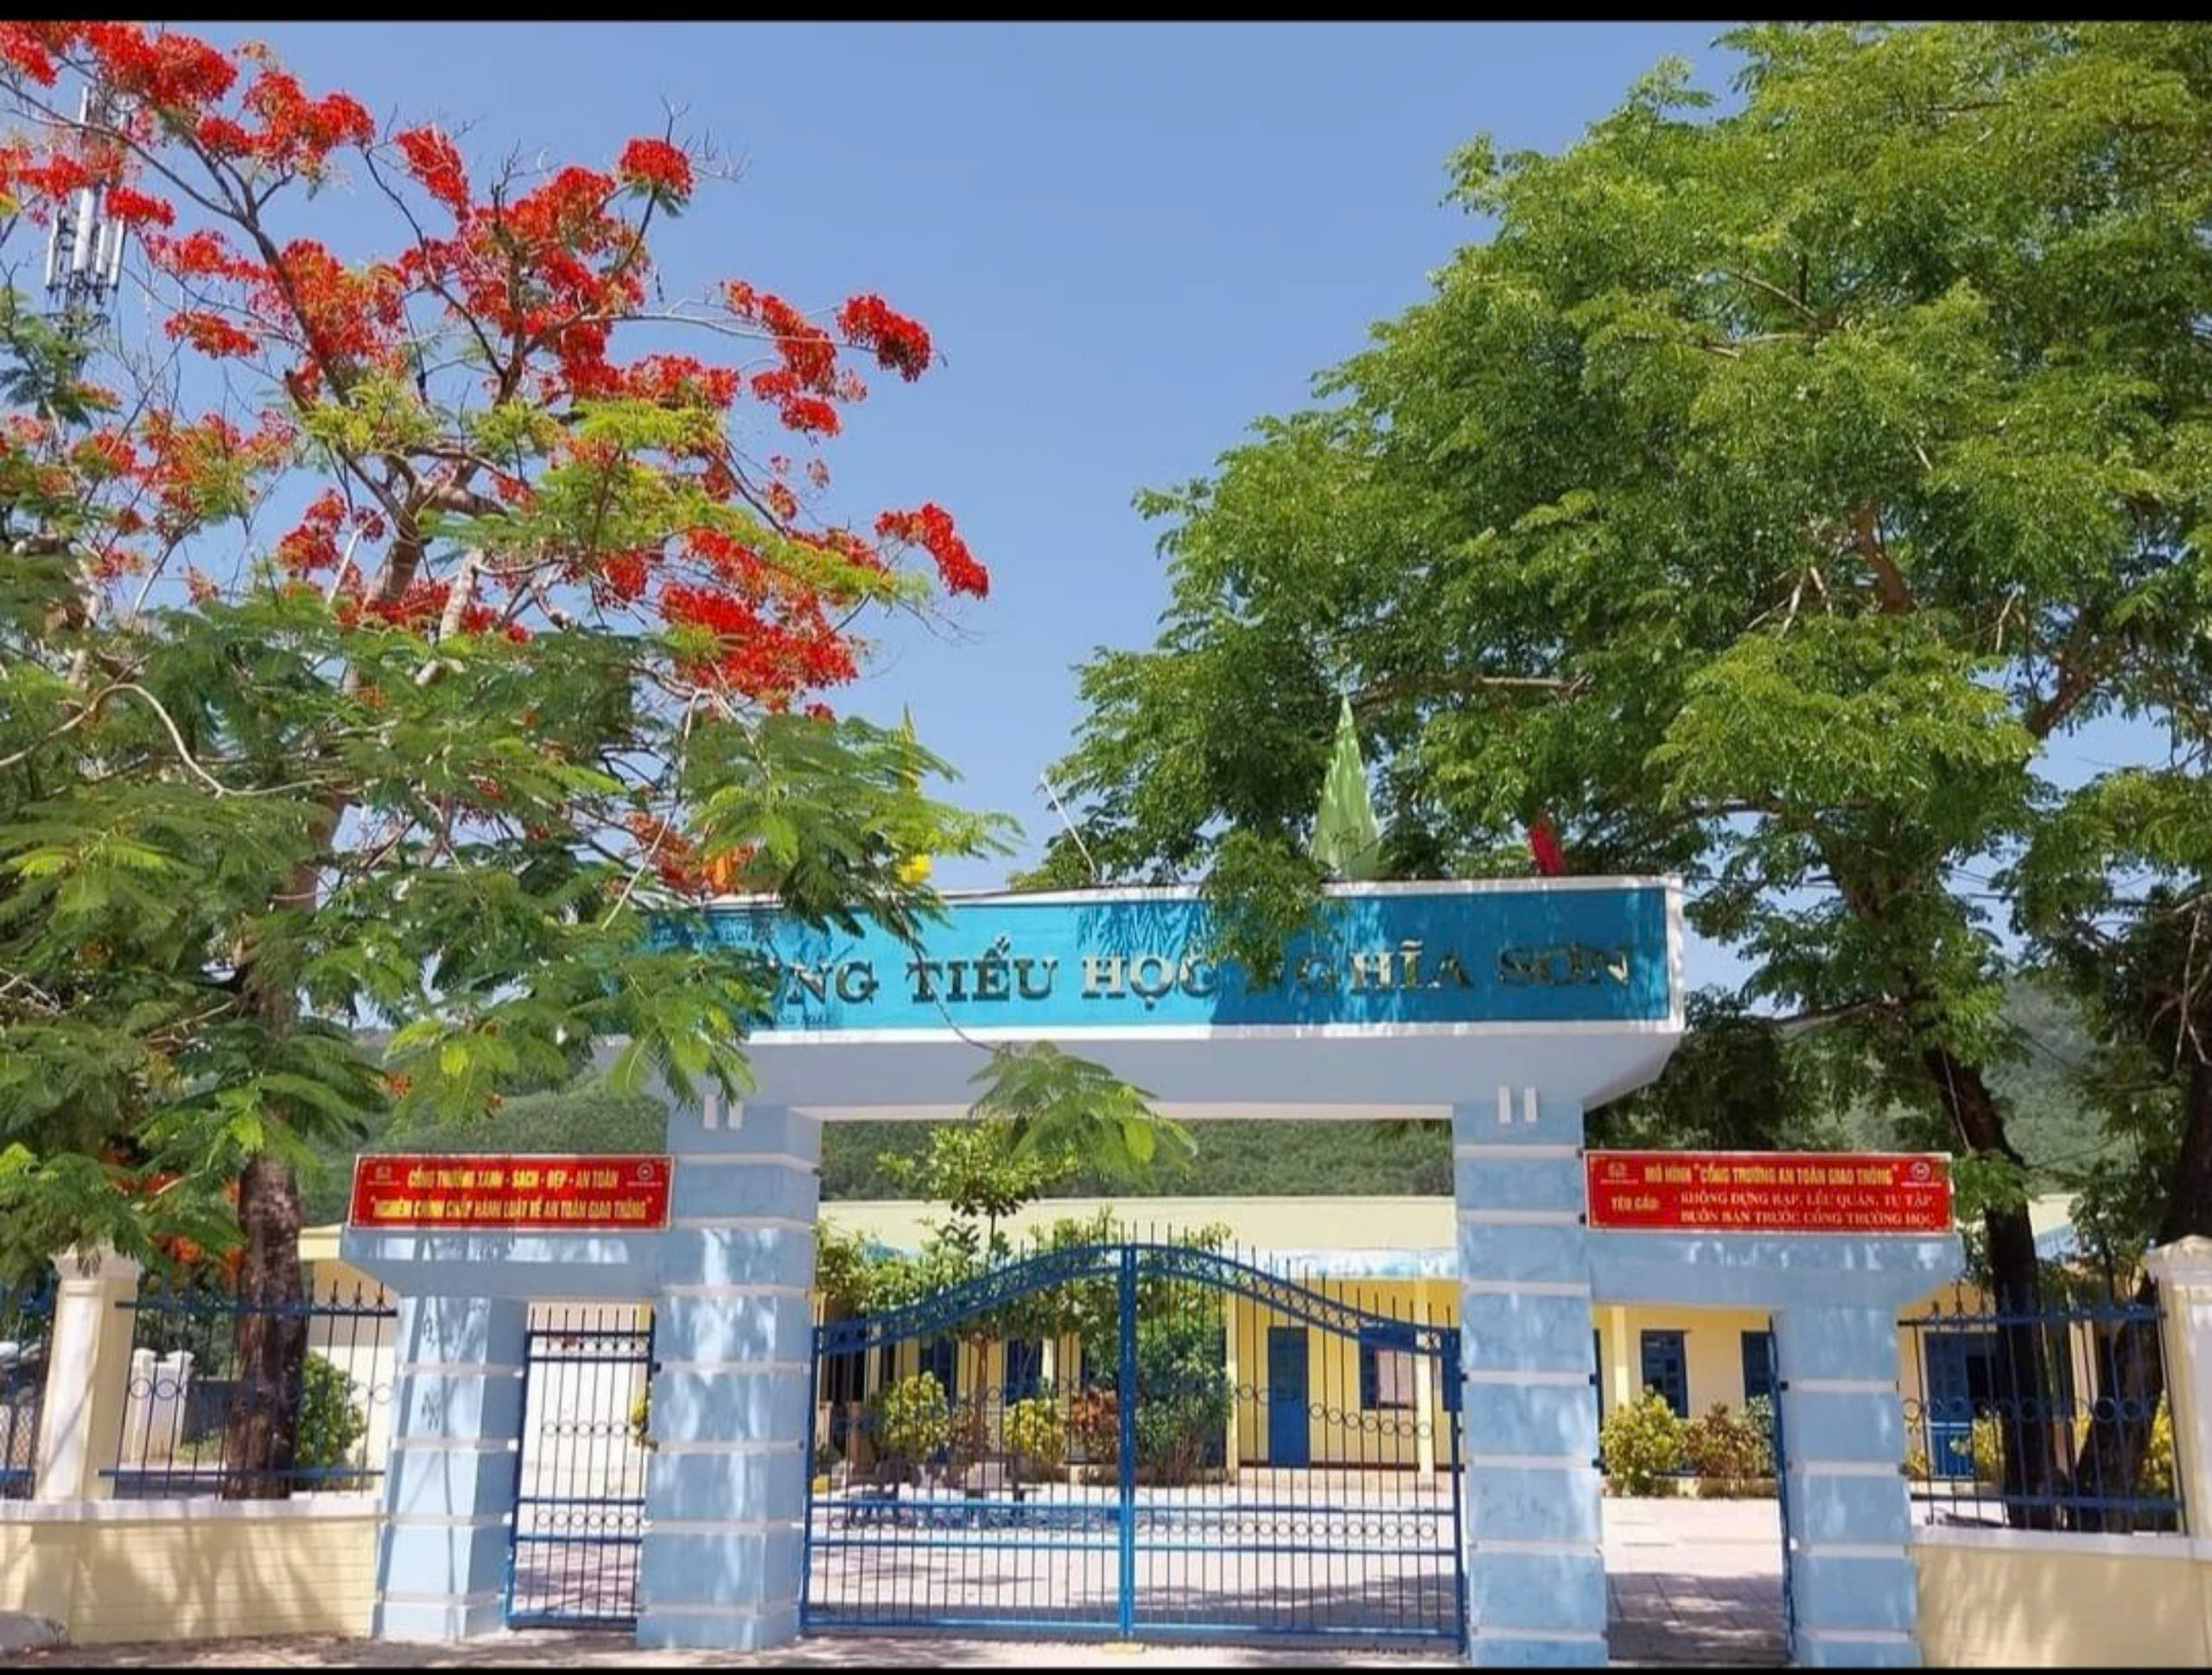

Slide 3
Our school facilities
6
Lesson 1 – Parts 1,2,3

Slide 4
Vocabulary

Slide 5
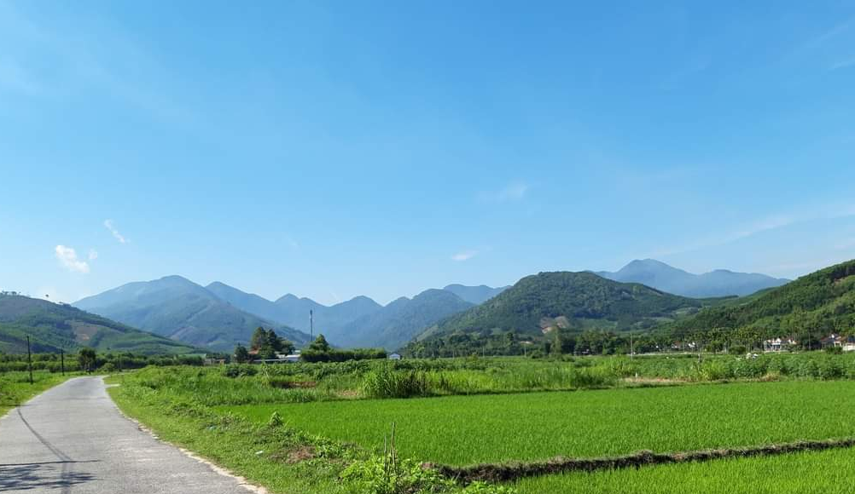
mountains
: vùng núi

Slide 6
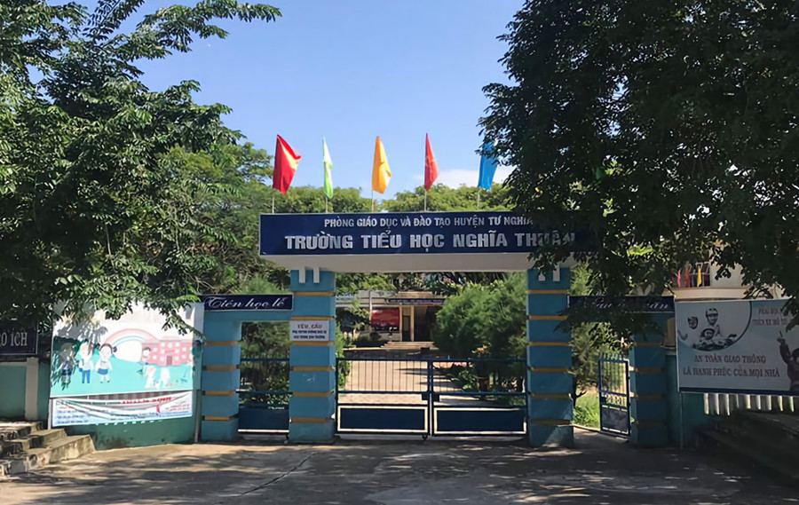
: vùng làng quê
village

Slide 7
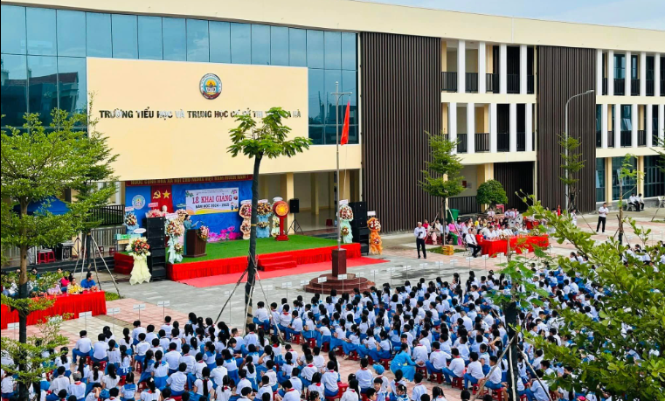
: thị trấn
town

Slide 8
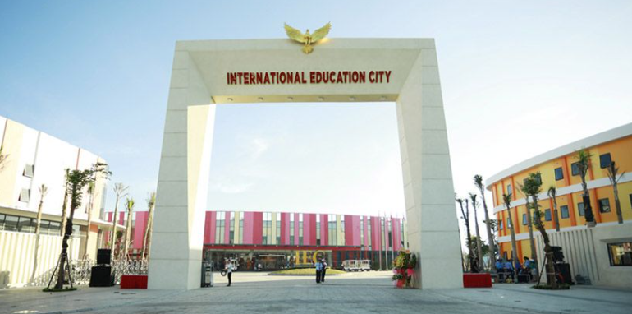
: thành phố
city

Slide 9
* Vocabulary:
Tuesday, November 12th, 2024
Unit 6: Our school facilities
Lesson 1: parts 1,2,3
mountains: vùng núi
village: vùng làng quê
town: thị trấn
city: thành phố

Slide 10
* Check vocabulary
village
town
mountains
city

Slide 11
02
Activity 1
Look, listen and repeat.

Slide 12
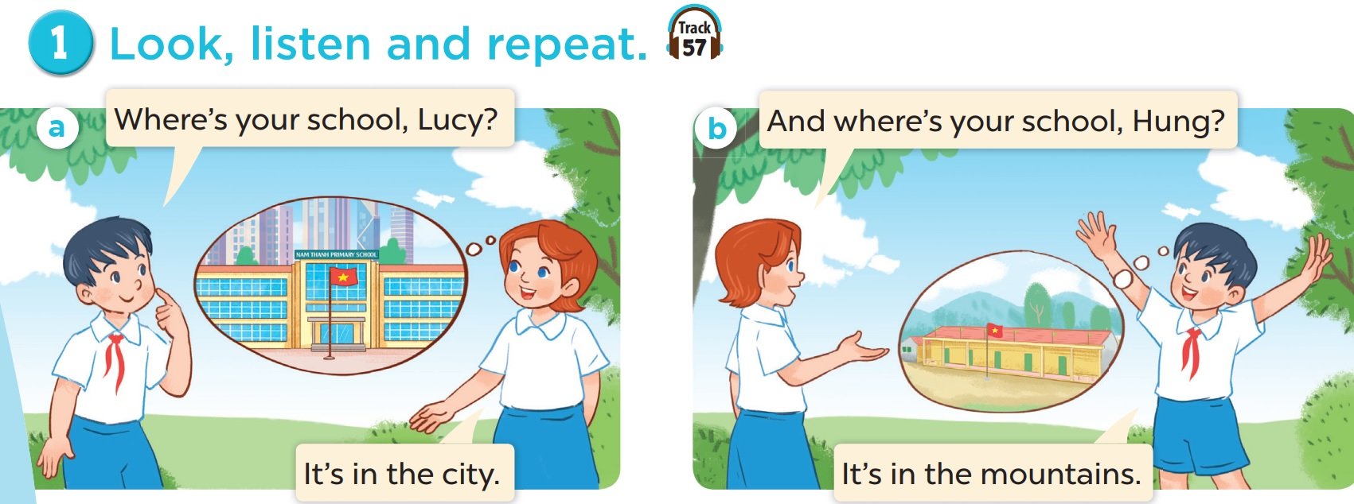
Tuesday, November 12th, 2024
Unit 6: Our school facilities
Lesson 1: parts 1,2,3
Hung and Lucy are talking about their schools.
Listen.
Where’s your school, Lucy?
And where’s your school, Hung?
It’s in the city.
It’s in the mountains.

Slide 13
03
Activity 2
Listen, point and say

Slide 14
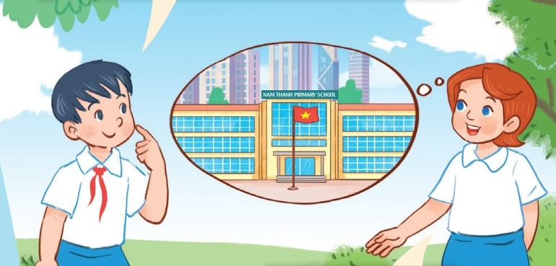
2. Listen, point and say:
Where’s your school?
It’s in the city.
Where’s your school?
* Model sentences:
Dùng để hỏi và trả lời về vị trí của trường bạn ở đâu.
city
It’s in the city.

Slide 15
Where’s your school?
➔ It’s in the mountains

Slide 16
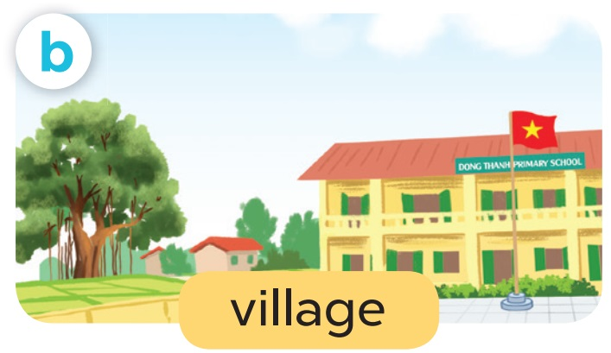
Tuesday, November 12th, 2024
Unit 6: Our school facilities
Lesson 1: parts 1,2,3
2.Listen, point and say:

Slide 17
Where’s your school?
It’s in the mountains.

Slide 18
Where’s your school?
It’s in the village.

Slide 19
Where’s your school?
It’s in the city.

Slide 20
Where’s your school?
It’s in the town.

Slide 21
04
Activity 3
Tuesday, November 12th, 2024
Unit 6: Our school facilities
Lesson 1: parts 1,2,3
Let’s talk

Slide 22
Where’s your school?
It’s in the_____

Slide 23
Where’s your school?
It’s in the_____

Slide 24
THANK YOU
Website: hoclieu.vn
Fanpage: facebook.com/www.tienganhglobalsucces.vn
Website: sachmem.vn; hoclieu.vn
Fanpage: www.facebook.com/sachmem.vn

