Slide 2








Unit 14: STAYING HEALTHY
Lesson 1 - Period 2

Slide 3




01
Warm-up and Review.

Slide 4




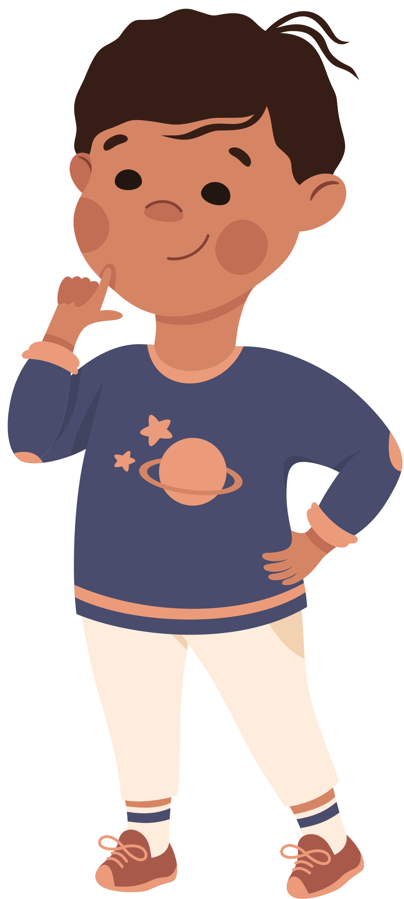
QUESTIONS
and
ANSWERS

Slide 5

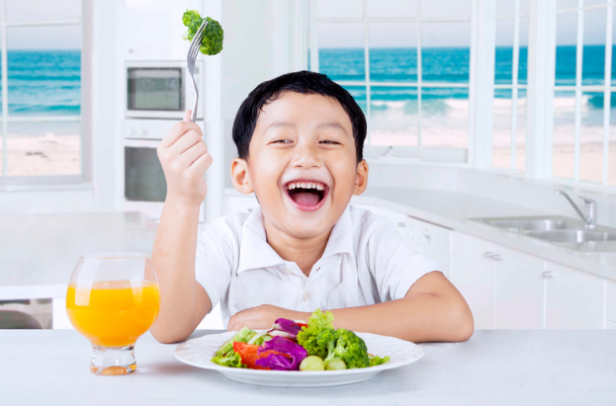


What does your brother stay healthy?
He eats healthy food.

Slide 6
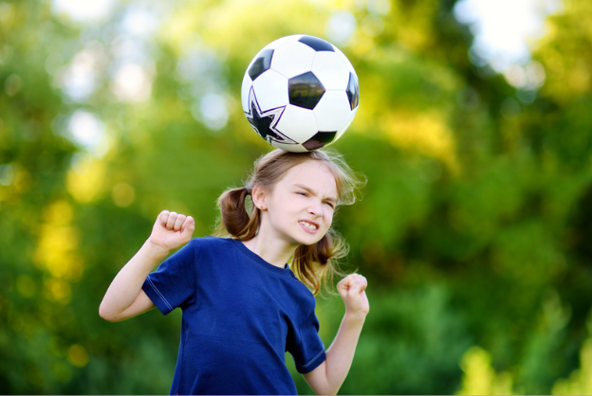


What does your sister stay healthy?
She plays sports.

Slide 7
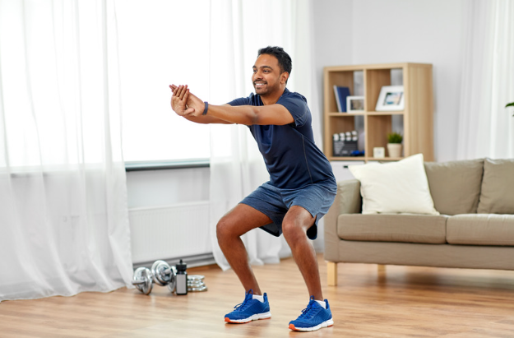


What does your father stay healthy?
He does morning exercise.

Slide 8


What does your mother stay healthy?
She drinks fresh juice.

Slide 9

GREAT!

Slide 10
02
Activity 4
Listen and match.

Slide 11


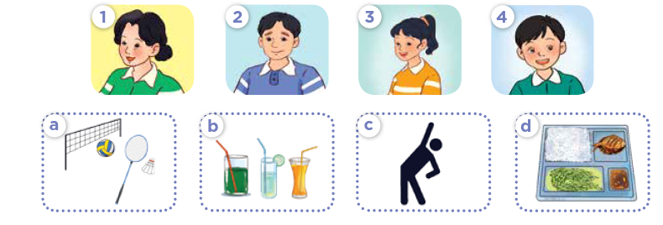


Look and say.
Notes:
Step 1: Draw pupils’ attention to the pictures and ask questions such as What do you see? to elicit the characters and the activities in the pictures. Remind them to look at the set of pictures a, b, c and d and the set of pictures 1, 2, 3 and 4 to contrast. Elicit the words mum, dad, sister, and brother in the first set of pictures, and sports, juice, morning exercise and food in the second set.

Slide 12

Listen and match.
Notes:
Step 2: Play the recording all the way through. Then play the recording again for pupils to listen and match the correct pictures that the characters in the conversations do to stay healthy.

Slide 13

Swap books.
Notes:
Step 3: Get pupils to swap books with a partner and check their answers before checking as a class. Have pupils explain the answers by asking questions, for example, Who are they talking about? How does she stay healthy? What does she do?

Slide 14
Listen and check.
Notes:
Extension (For advanced level): Play the recording, pausing after each question and have pupils recall the answer. Check if they can give the correct answer. Correct their pronunciation where necessary.

Slide 15
03
Activity 5
Look, complete and read.

Slide 16


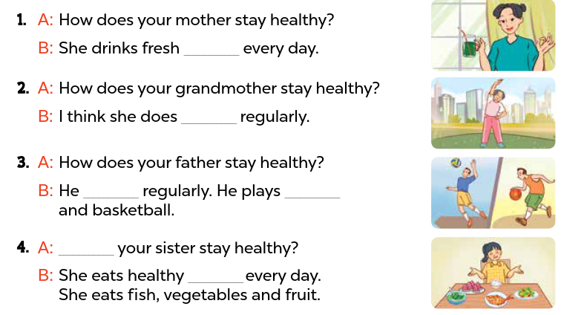


Look and say.
Notes:
Step 1: Model the first gapped exchange as an example. Have pupils read the dialogue and guess the missing words, for example, a kind of drinks, water, juice, coconut water. Then draw pupils’ attention to the picture and elicit the phrases to fill in the gaps (juice).

Slide 17
Look, complete and read.
Notes:
Step 2: Give pupils a time limit to complete the gapped exchanges 2, 3, and 4 independently. Go around the classroom and help where necessary.

Slide 18
Swap books.
Notes:
Step 3: Get pupils to swap books with a partner and check their answers before checking as a class. Invite one pupil to write the answers on the board. Check the answers. Ask questions to have pupils explain why they choose the answers. For example, for picture B, ask Why do you choose morning exercise? – Because in the picture, she’s doing morning exercise. What is he/ she doing in the picture?

Slide 19
Check the answers.
juice
morning exercise
plays sports
volleyball
volleyball
How does
food
Notes:
Step 3: Get pupils to swap books with a partner and check their answers before checking as a class. Invite one pupil to write the answers on the board. Check the answers. Ask questions to have pupils explain why they choose the answers. For example, for picture B, ask Why do you choose morning exercise? – Because in the picture, she’s doing morning exercise. What is he/ she doing in the picture?

Slide 20
04
Activity 6
Listen, complete and sing.

Slide 21




Introduce the song.
Staying healthy
My sister wants to stay healthy.
She does (1) __________ daily.
She eats healthy food,
And drinks fresh juice.
My brother wants to stay healthy.
He plays (2) __________ every day.
He eats healthy (3) __________,
And drinks fresh juice.
Notes:
Step 1: Tell pupils the aim of the activity: They listen to the song and fill in the gaps in the lyrics and sing it with correct pronunciation, rhythm and melody.

Slide 22
Look and guess.
Staying healthy
My sister wants to stay healthy.
She does (1) __________ daily.
She eats healthy food,
And drinks fresh juice.
My brother wants to stay healthy.
He plays (2) __________ every day.
He eats healthy (3) __________,
And drinks fresh juice.
Notes:
Step 2: Have pupils read the lyrics and guess the word(s) to fill in the gaps with the help of the picture.

Slide 23
Listen, complete and sing.
Staying healthy
My sister wants to stay healthy.
She does (1) ______________ daily.
She eats healthy food,
And drinks fresh juice.
My brother wants to stay healthy.
He plays (2) ________ every day.
He eats healthy (3) _________,
And drinks fresh juice.
morning exercise
sports
fruits
Notes:
Step 3: Have them listen to the song and fill in the gaps. Play the recording of the gapped sentences twice for pupils to fill in if necessary.
Step 4: Play the recording and let them listen to and practise singing the song, line by line, until they feel confident. Then have pupils listen to and sing the whole song while clapping their hands.

Slide 24
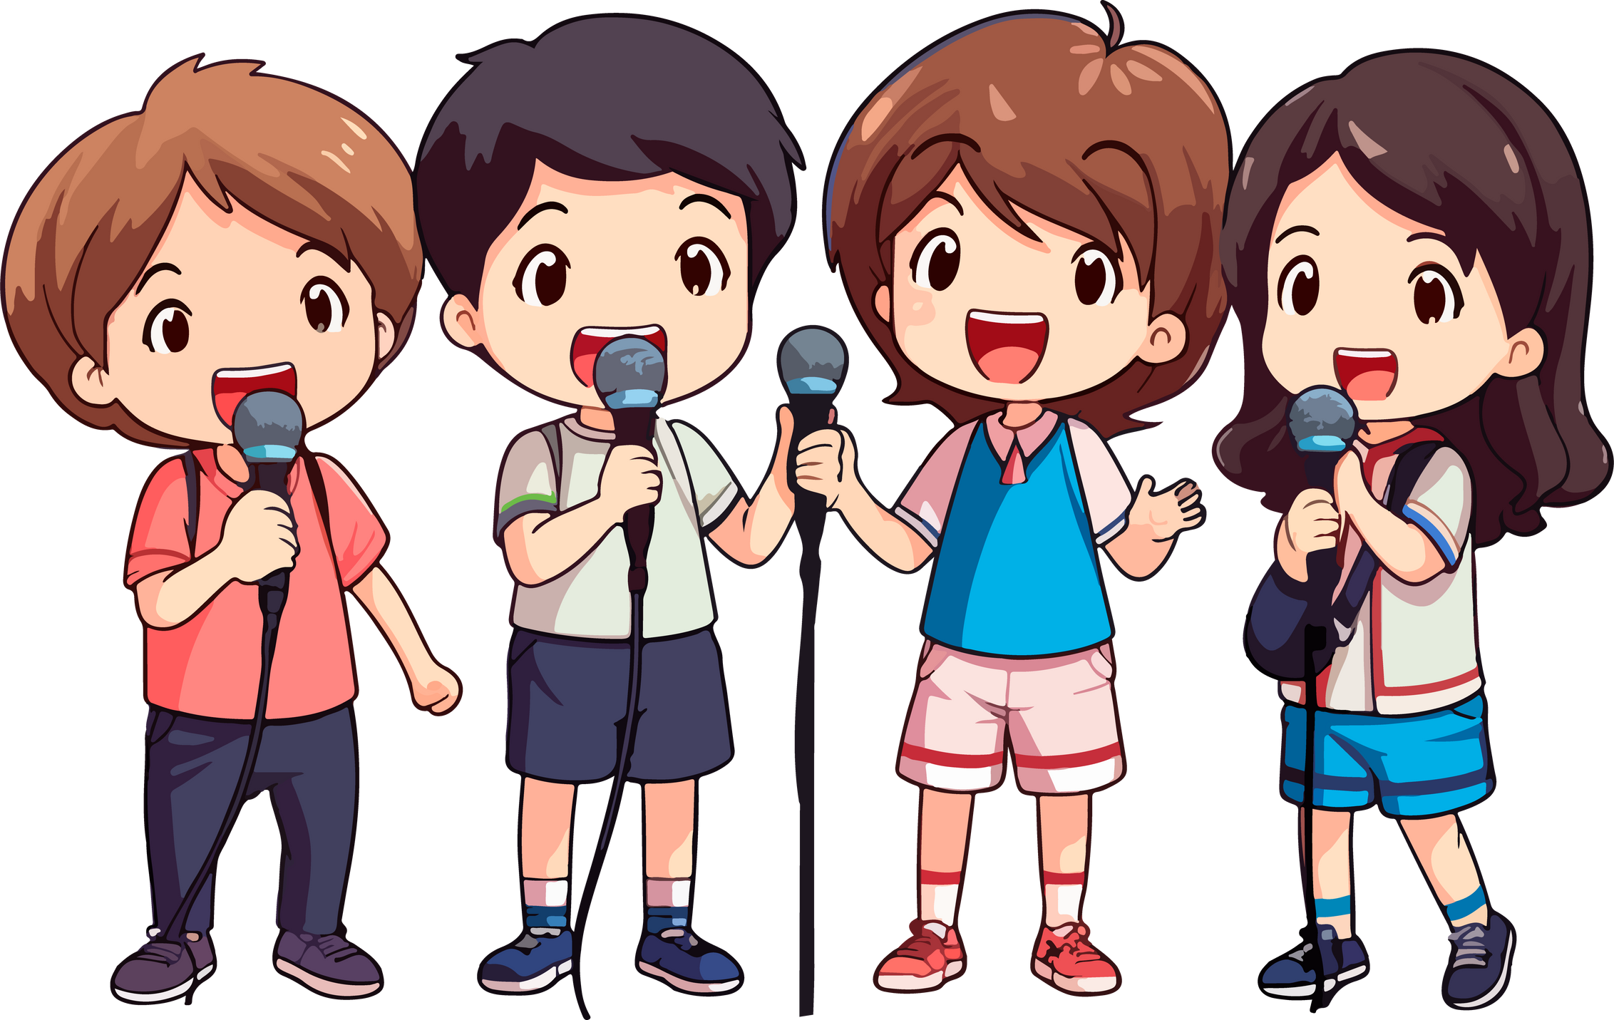

Perform the song.
Staying healthy
My sister wants to stay healthy.
She does (1) ______________ daily.
She eats healthy food,
And drinks fresh juice.
My brother wants to stay healthy.
He plays (2) ________ every day.
He eats healthy (3) _________,
And drinks fresh juice.
morning exercise
sports
fruit
Notes:
Step 5: Invite a few groups to the front of the class to sing the song. The class may sing along and clap to reinforce the activity.

Slide 25
05
Fun corner and wrap-up.

Slide 26






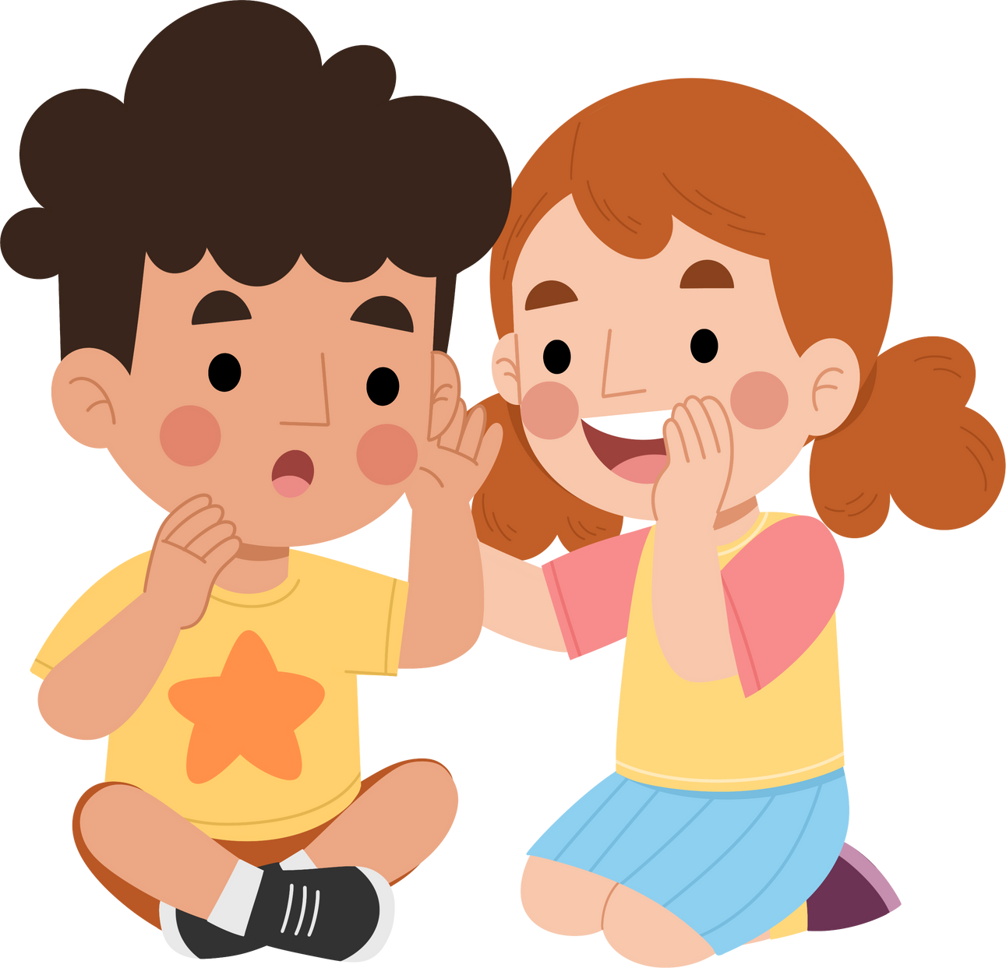

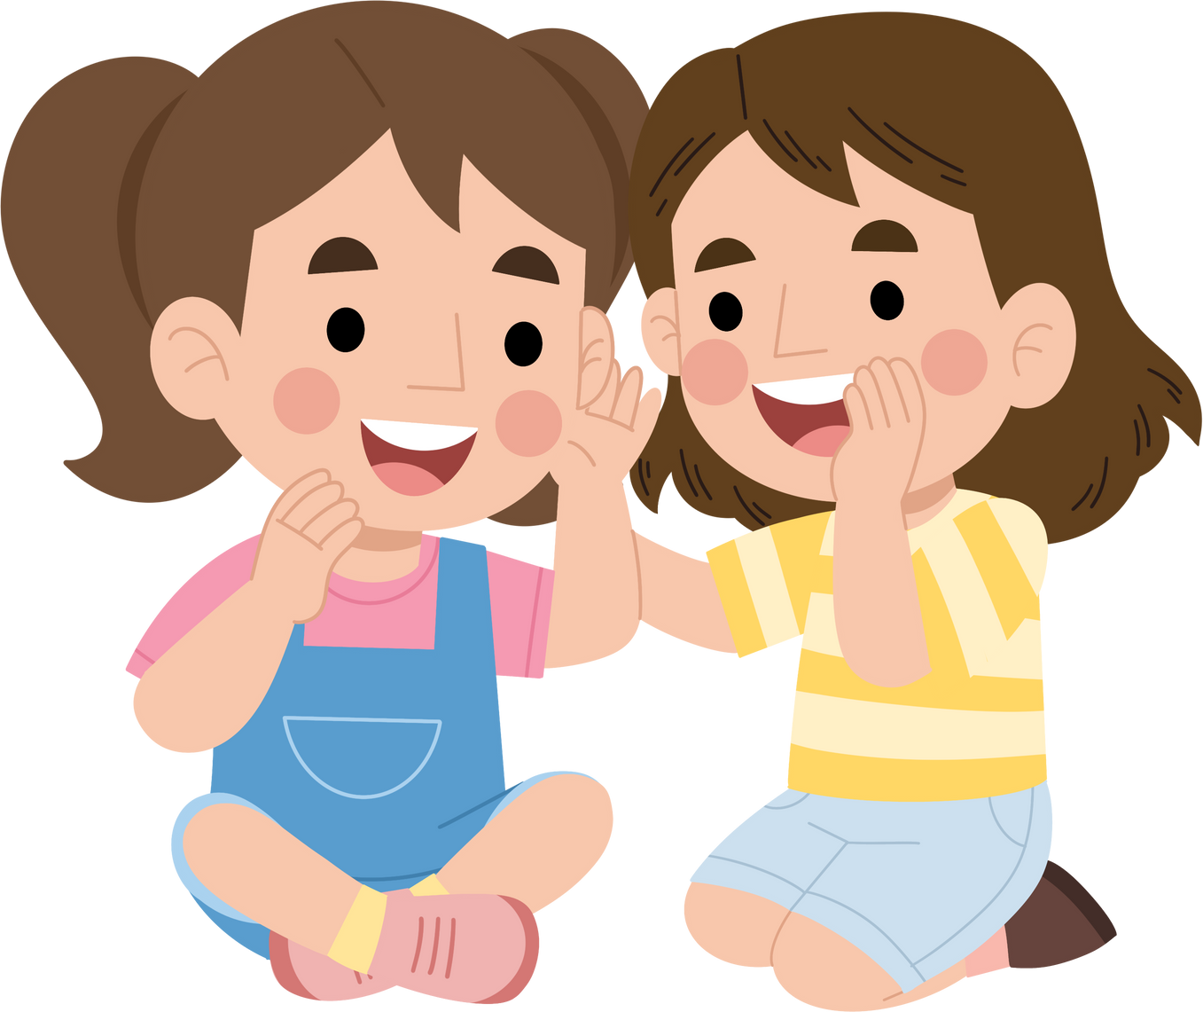
WHISPER GAME

Slide 27




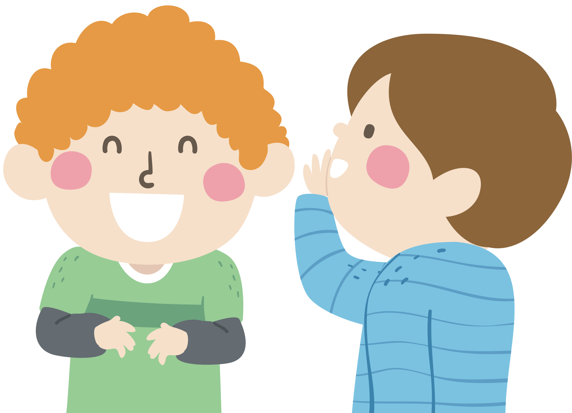
Round 1
My mother does morning exercise every day.

Slide 28



Round 2
My father plays sports every day.

Slide 29


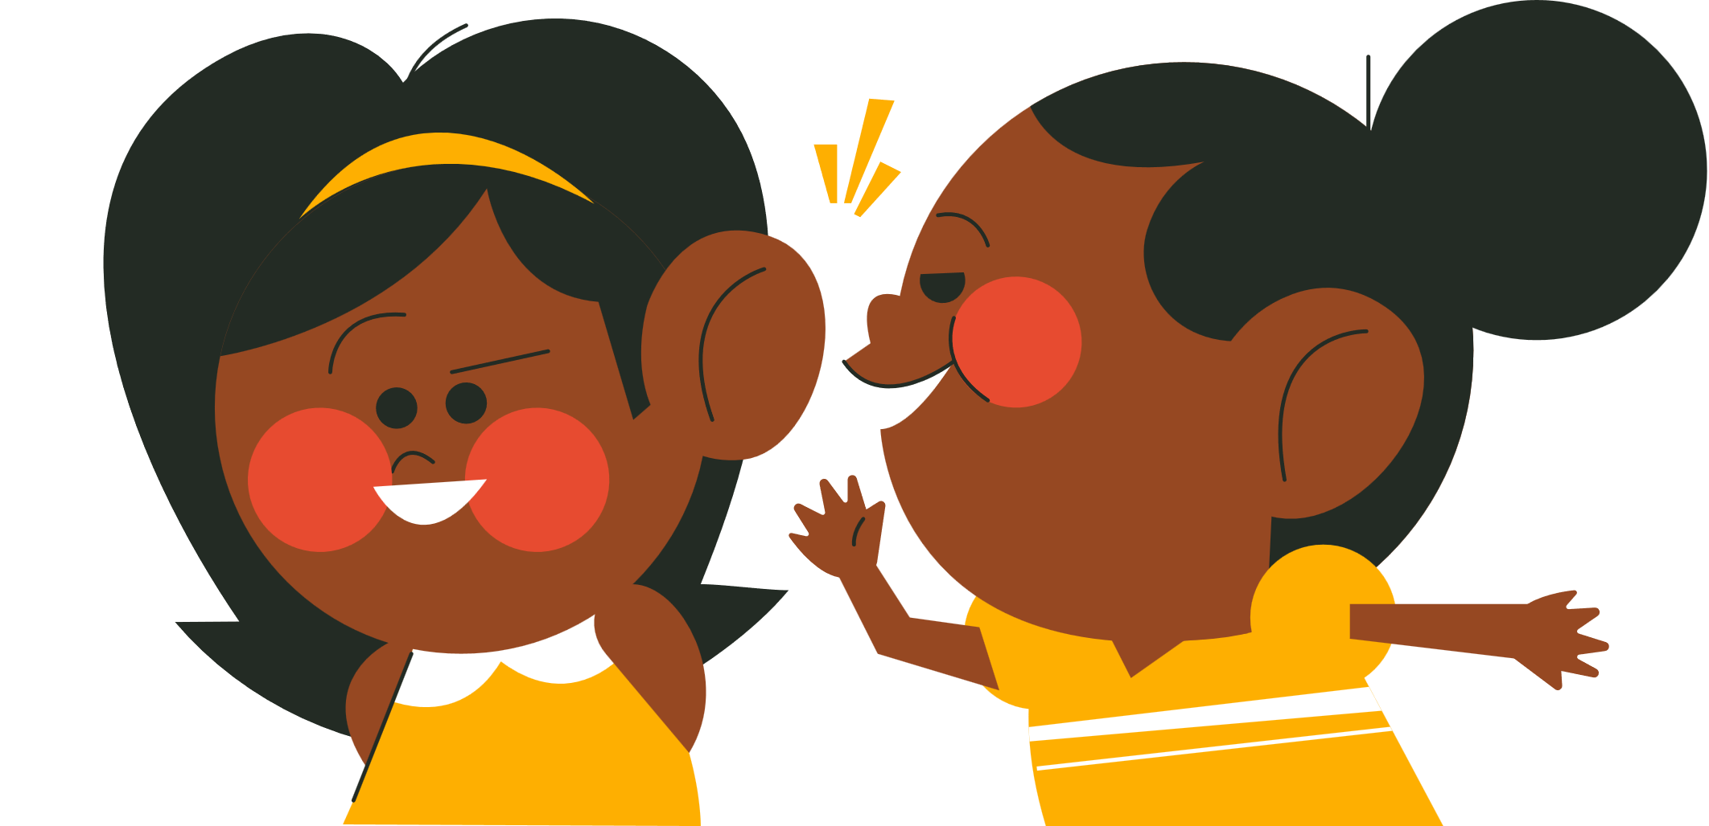
Round 3
My grandmother drinks fresh juice every day.

Slide 30



Round 4
My grandfather eats healthy food every day.

Slide 31
Website: hoclieu.vn
Fanpage: https://www.facebook.com/tienganhglobalsuccess.vn/

Slide 32



THANK YOU FOR PLAYING!

