Slide 1



WARMLY WELCOME TO SOME TEACHERS !
Tinh Tra secondary school
GD
ENGLISH 8
Teacher: NGUYEN THI ANH GIANG
WELCOME TO OUR CLASS!

Slide 2








Kim’s Game

Slide 3


Slide 4
Facebook
Microsoft Teams
Kim’s Game
Zoom
Instagram
Zalo
Google meet
Viber
Yahoo

Slide 5
Thursday, March 14th , 2024
UNIT 10: COMMUNICATION IN THE FUTURE
Lesson 1: Getting started

Slide 6

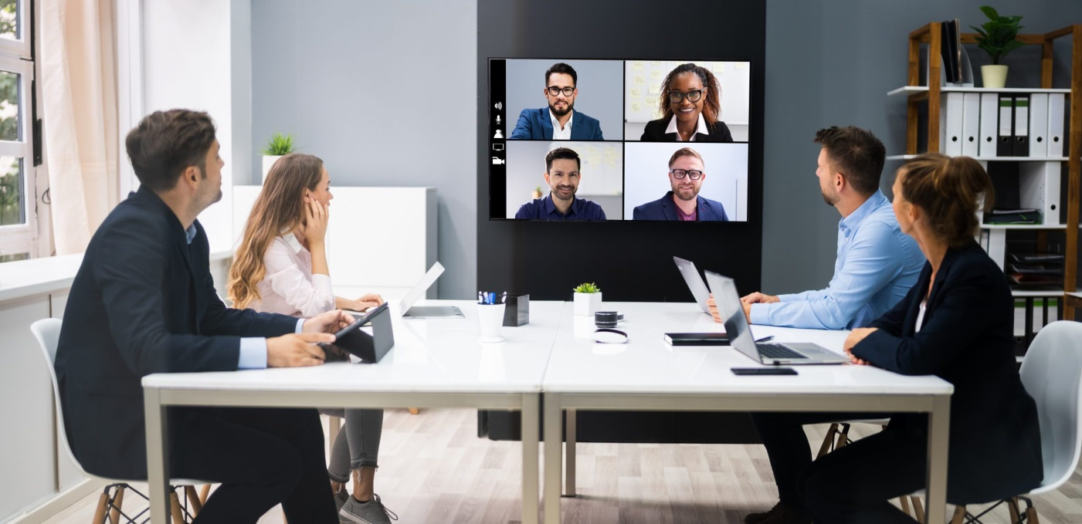
PRESENTATION
1. VOCABULARY
video conference
/ˈvɪdiəʊ ˌkɒnfərəns/
: họp trực tuyến

Slide 7
PRESENTATION
1. VOCABULARY
- video conference (n)
/ˈvɪdiəʊˌkɒnfərəns/
: họp trực tuyến
- webcam (n)
/ˈweb kæm/:
thiết bị ghi / truyền hình ảnh

Slide 8

PRESENTATION
1. VOCABULARY
- video conference (n)
/ˈvɪdiəʊˌkɒnfərəns/
: họp trực tuyến
- webcam (n)
/ˈweb kæm/:
thiết bị ghi / truyền hình ảnh
- internet connection (n)
/ˈɪntənet kəˈnekʃən/ :
kết nối mạng

Slide 9
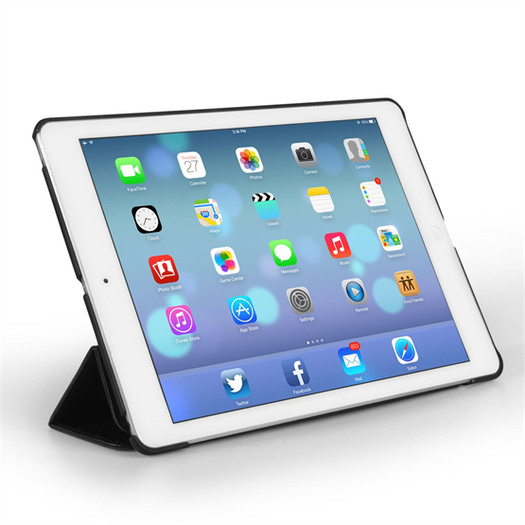
PRESENTATION
1. VOCABULARY
- video conference (n)
/ˈvɪdiəʊˌkɒnfərəns/
: họp trực tuyến
- webcam (n)
/ˈweb kæm/:
thiết bị ghi / truyền hình ảnh
- internet connection (n)
/ˈɪntənet kəˈnekʃən/ :
kết nối mạng
- tablet (v)
/ˈtæblət/ :
máy tính bảng

Slide 10
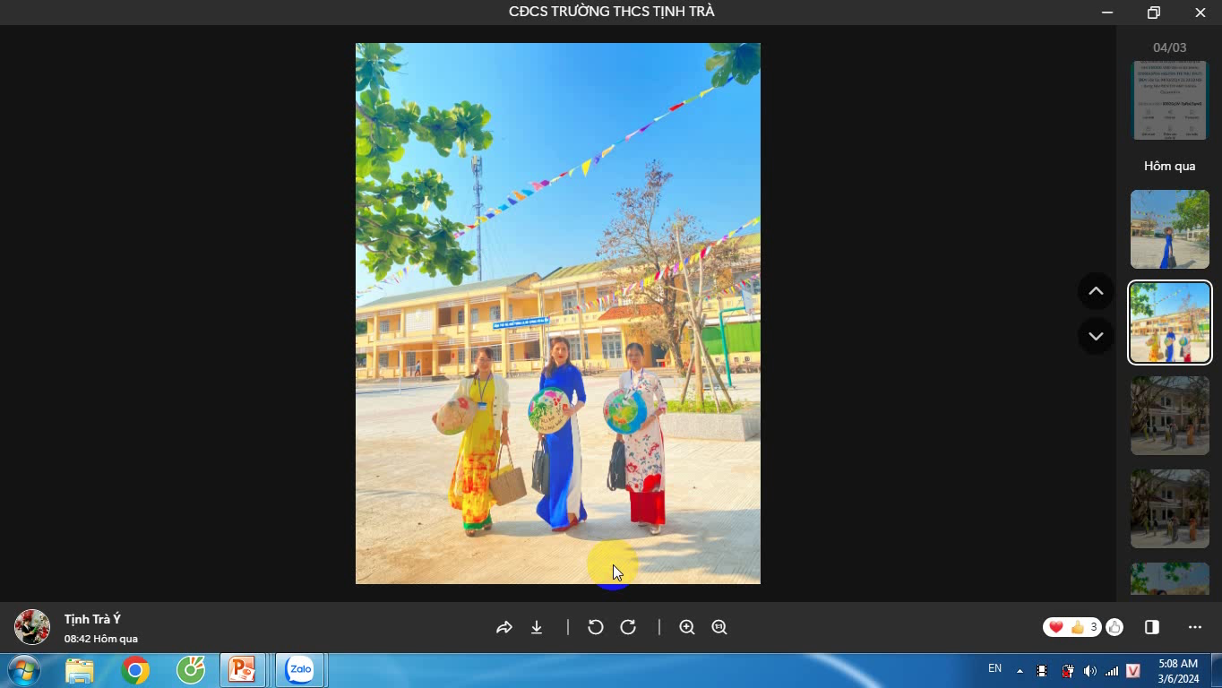
PRESENTATION
1. VOCABULARY
- video conference (n)
/ˈvɪdiəʊˌkɒnfərəns/
: họp trực tuyến
- webcam (n)
/ˈweb kæm/:
thiết bị ghi / truyền hình ảnh
- internet connection (n)
/ˈɪntənet kəˈnekʃən/ :
kết nối mạng
- tablet (v)
/ˈtæblət/ :
máy tính bảng
- zoom in (v)
/zum ɪn/ :
phóng to

Slide 12
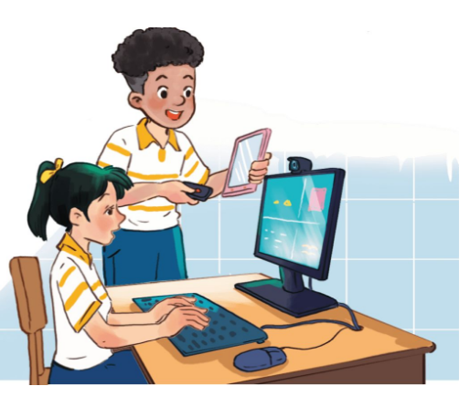

Slide 13

1
Listen and read.
Trang: Mark, we’re having a video conference with Tech Savvy next Thursday, but ...
Mark: Hold on. Is that the technology club at the Japanese school?
Trang: Exactly. But I’m a bit worried. I’ve never had a video conference call.
Mark: You’re kidding! Who doesn’t know how to make a video call? Alright, let’s do a practice call now.
Trang: Hmm, what do I need to do first?
Mark: It’s a piece of cake, Trang. Now, you sit in front of the computer. I’ll connect with you via one of my tablets and ...
Trang: Sorry, but how can I adjust this webcam? It’s focusing on my forehead.
Mark: Use this button to move it up or down, and this to zoom in or out.
Trang: Thanks. And can you see me clearly on your tablet?
Mark: Yes, of course. We have a high-speed Internet connection here.
Trang: I hope the conference goes smoothly.
Mark: I’m sure it will. We should hold more video conferences like this in the future.
Trang: That’s exactly how I feel.

Slide 14
PRACTICE
2
Read the conversation again and circle the correct answer A, B, or C.
1. What are Trang and Mark doing?
A. Practising a video call.
B. Making a call with Tech Savvy.
C. Learning how to use a tablet.
2. What device does Trang need help with?
A. The tablet. B. The computer. C. The webcam.
3. Mark says that they should ______ in the future.
A. have more video conferences
B. do more practice calls
C. have a high-speed Internet connection

Slide 15
3
Circle the words/ phrases which are CLOSEST in meaning to the underlined words/ phrases.
1. Our English exam was a piece of cake. I got full marks on it.
A. easy B. difficult
2. You’re kidding! I can’t believe Ms Mai and you are sisters.
A. serious B. joking
3. I can’t read the text on the computer screen. Can you zoom in on it?
A. make it bigger B. make it smaller
4. We need a high-speed Internet connection to make video calls.
A. fast B. slow
5. That’s exactly how I feel. It’s true that video conferences are very convenient.
A. I don’t think so. B. You are absolutely right.

Slide 16
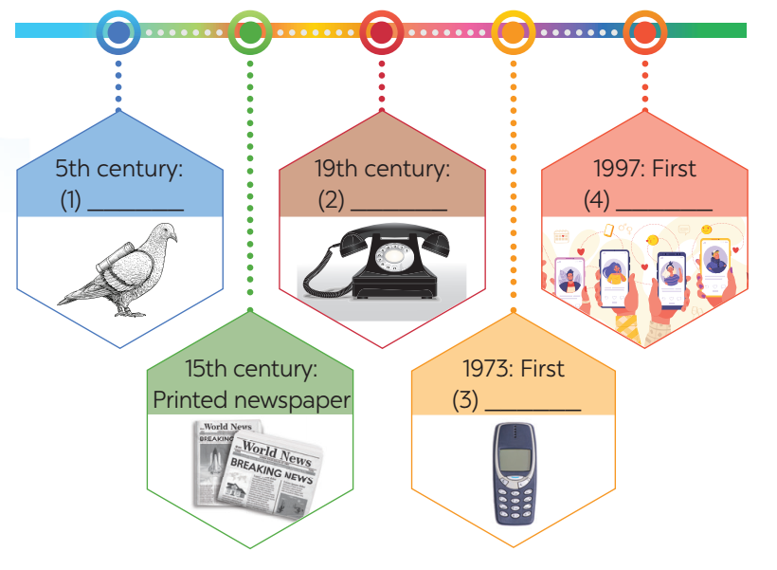
4
Work in groups. Complete the diagram of the history of communication technology with the words and phrases from the box.
carrier pigeon mobile phone
telephone social network

Slide 17
2 PHUÙT
HEÁT GIÔØ

Slide 18
4
Work in groups. Complete the diagram of the history of communication technology with the words and phrases from the box.
carrier pigeon mobile phone
telephone social network
Answer:
1. carrier pigeon
2. telephone
3. mobile phone
4. social network

Slide 19

LESSON 1: GETTING STARTED
WARM-UP
Game: Kim’s Game.
PRESENTATION
Vocabulary
Task 1: Listen and read.
Task 2: Read again and circle the correct answer.
Task 3: Match the words and phrases in the conversation with their pictures.
Task 4: Circle the words/ phrases which are CLOSEST in meaning to the underlined words/ phrases.
PRACTICE
FURTHER PRACTICE
Task 5: Complete the diagram of the history of communication technology.
CONSOLIDATION
Wrap-up
Homework

Slide 20


HOMEWORK
- Learn the new words.
- Practice reading the conversation again.
- Do the exercises in the workbook
- Prepare for Unit 10: Lesson 2 A closer look 1
+

Slide 21




The bye bye song
Thanks for your attention.
Goodbye!
Notes:
21

