Slide 1
NGUYEN CHANH SECONDARY SCHOOL
CLASS: 9.6

Slide 3
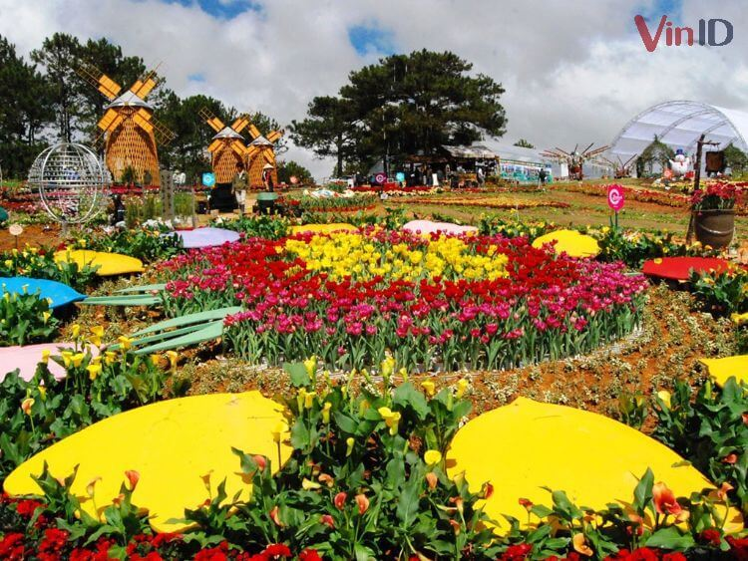
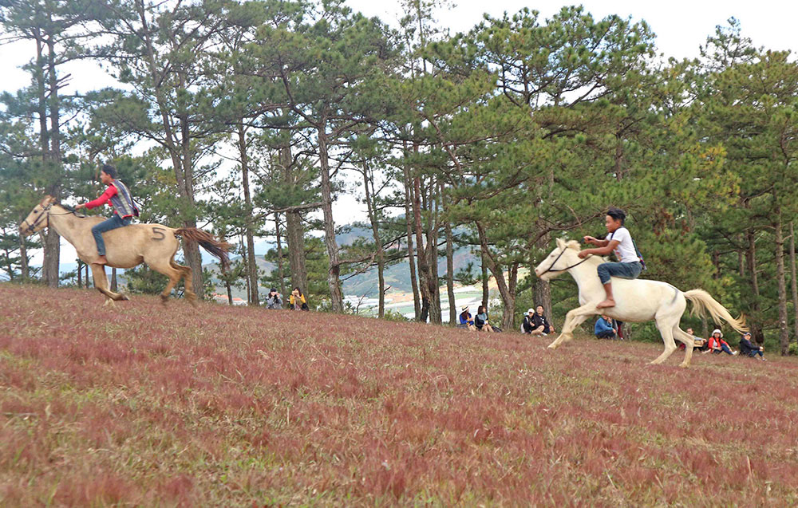
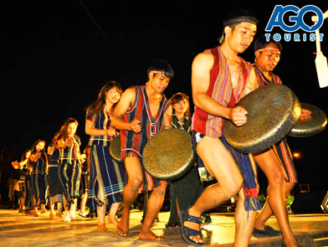
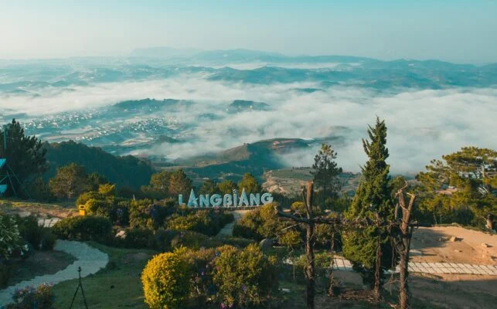
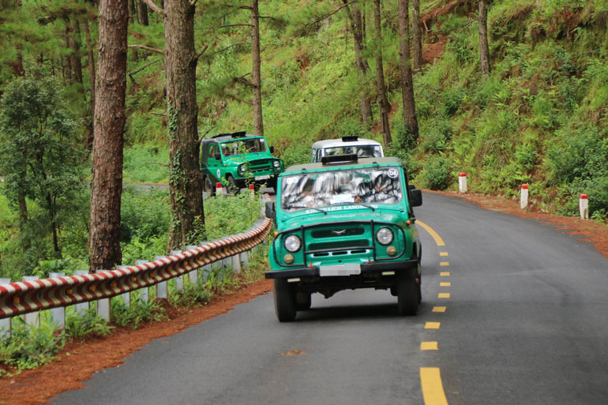
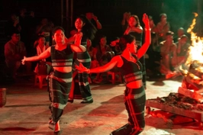
Open the piece of number and say what activity of each picture is about?
Which province do these images belong to?
2
1
3
7
6
4
5

Slide 4
Which province do these images belong to?

Slide 5
Unit
5
OUR EXPERIENCES
LESSON 1: GETTING STARTED
Experiences in Da Lat
1

Slide 6
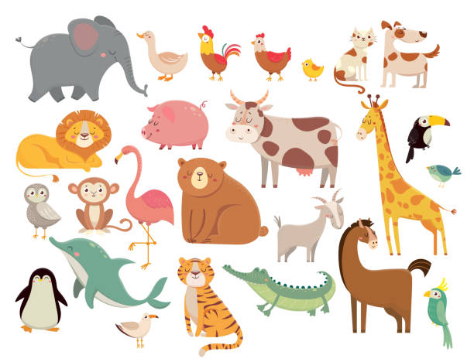
* Vocabulary

Slide 7
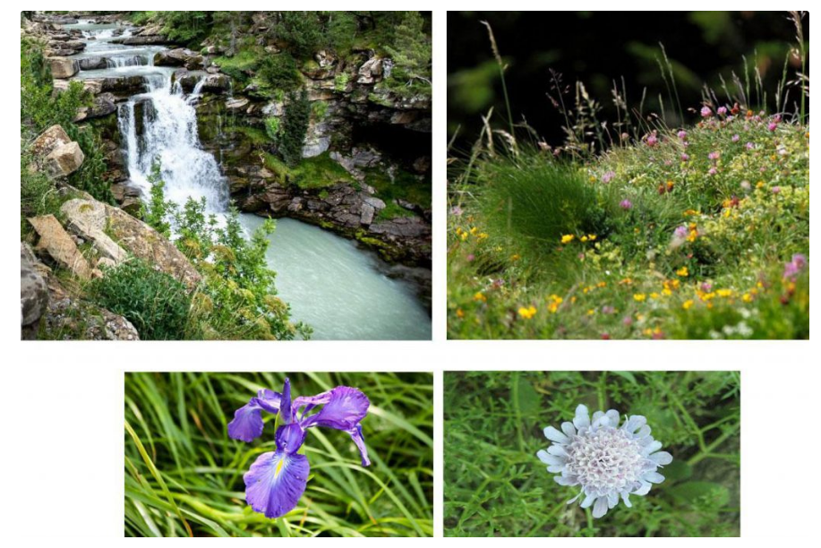
* Vocabulary
flora

Slide 8
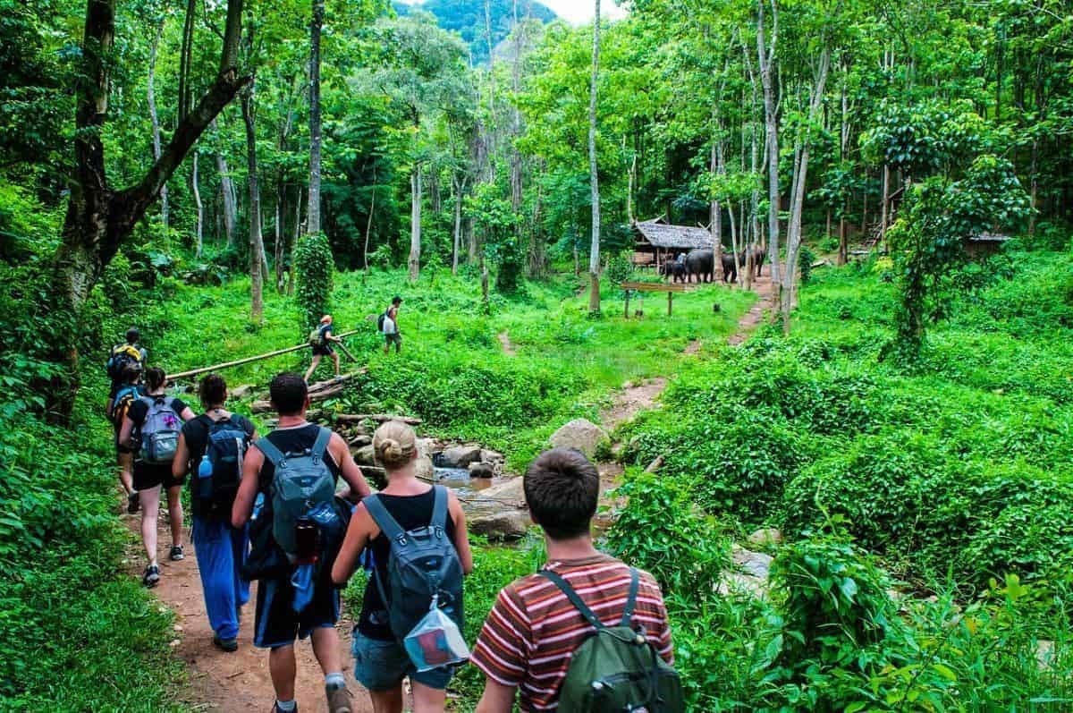
* Vocabulary

Slide 9
* Vocabulary
<=>forgettable (adj)

Slide 10
* Vocabulary

Slide 11
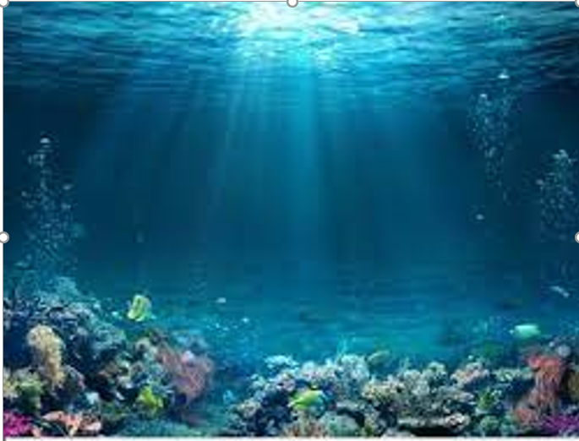
* Vocabulary

Slide 12
* Vocabulary
sự trải nghiệm

Slide 13
* Vocabulary
New words | Pronunciation | Meaning
1. fauna (n) | /ˈfɔːnə/ | tất cả động vật của một khu vực
2. flora (n) | /ˈflɔːrə/ | tất cả thực vật của một khu vực
3. eco-tour (n) | /ˈiːkəʊ ˌtʊə/ | du lịch sinh thái
4. memorable (adj) | /ˈmemərəbl/ | đáng nhớ
5. brilliant (adj) | /ˈbrɪliənt/ | rất ấn tượng
6. seabed (n) | /ˈsiːbed/ | đáy biển
7. experience (n) | /ɪkˈspɪəriəns/ | sự trải nghiệm

Slide 14
Vocabulary checking
2
flora
1
3
eco-tour
memorable
7
experience
6
fauna
4
brilliant
5
seabed

Slide 15
* Prediction
Name places Tom’s family visited in Da Lat.

Slide 16
1. Listen and read
1
Tom: Hi,Mi. I’ve been back from Da Lat. I have some local specialities for you.
Mi: Thanks,Tom. I guess you and your family had a great time there.
Tom: Yeah. We visited LangBiang Mountain, and Cu Lan Village. We saw a gong show in the evening.
Mi: What did you do on LangBiang Mountain?
Tom: We rode a jeep to the top. It was a thrilling ride up there. Then we took an eco-tour of LangBiang Mountain. They said that the area is rich in flora and fauna with more than 150 plant and animal species.

Slide 17
1. Listen and read
Mi: Sounds amazing! What did you do then?
Tom: We took pictures of the magnificent scenery. It was really enjoyable!
Mi: Then did you explore Cu Lan Village?
Tom: Yes. We had a brilliant tour around the village. We also rode horses and a jeep along a stream.
Mi: That must have been exciting, Tom.
Tom: It definitely was. In the evening,we saw an interesting gong show. We danced and sang with the locals. And we tried grilled pork. It was a really memorable evening. I’ll show you some pictures I took there.
Mi: Cool!

Slide 18
2. T (True) or F (False)
1. Mi and Tom had a great time in Da Lat. ______
2. Tom had an eco-tour of Langbiang Mountain. ______
3. There are more than 150 plant and animal species ______
on Langbiang Mountain.
4. Tom didn’t like his experiences in Cu Lan Village. ______
5. Tom danced and sang with the local people ______
at a gong show.
F

Slide 19
Mi: Sounds amazing! What did you do then?
Tom: We took pictures of the magnificent
scenery. It was really enjoyable!
Mi: Then did you explore Cu Lan Village?
Tom: Yes. We had a brilliant tour around
the village. We also rode horses and
a jeep along a stream.
Mi: That must have been exciting, Tom.
Tom: It definitely was. In the evening we
saw an interesting gong show. We
danced and sang with the locals. And
we tried grilled pork. It was a really
memorable evening. I’ll show you
some pictures I took there.
Mi: Cool!
Tom: Hi, Mi. I’ve been back from Da Lat . I
have some local specialities for you.
Mi: Thanks Tom. I guess you and your family
had a great time there.
Tom: Yeah. We visited LangBiang Mountain,
and Cu Lan Village. We saw a gong
show in the evening.
Mi: What did you do on LangBiang
Mountain?
Tom: We rode a jeep to the top. It was a thrilling ride up there. Then we took an eco-tour of LangBiang Mountain. They said that the area is rich in flora and fauna with more than 150 plant and animal species.
1. Mi and Tom had a great time in Da Lat. (F)

Slide 20
2. T (True) or F (False)
1. Mi and Tom had a great time in Da Lat. ______
2. Tom had an eco-tour of Langbiang Mountain. ______
3. There are more than 150 plant and animal species ______
on Langbiang Mountain.
4. Tom didn’t like his experiences in Cu Lan Village. ______
5. Tom danced and sang with the local people ______
at a gong show.
F
T

Slide 21
Mi: Sounds amazing! What did you do then?
Tom: We took pictures of the magnificent
scenery. It was really enjoyable!
Mi: Then did you explore Cu Lan Village?
Tom: Yes. We had a brilliant tour around
the village. We also rode horses and
a jeep along a stream.
Mi: That must have been exciting, Tom.
Tom: It definitely was. In the evening we
saw an interesting gong show. We
danced and sang with the locals. And
we tried grilled pork. It was a really
memorable evening. I’ll show you
some pictures I took there.
Mi: Cool!
Tom: Hi, Mi. I’ve been from Da Lat. I
have some local specialities for you.
Mi: Thanks Tom. I guess you and your family
had a great time there.
Tom: Yeah. We visited LangBiang Mountain,
and Cu Lan Village. We saw a gong
show in the evening.
Mi: What did you do on LangBiang
Mountain?
Tom: We rode a jeep to the top. It was a thrilling ride up there. Then we took an eco-tour of LangBiang Mountain. They said that the area is rich in flora and fauna with more than 150 plant and animal species.
2. Tom had an eco-tour of Langbiang Mountain. (T)

Slide 22
2. T (True) or F (False)
1. Mi and Tom had a great time in Da Lat. ______
2. Tom had an eco-tour of Langbiang Mountain. ______
3. There are more than 150 plant and animal species ______
on Langbiang Mountain.
4. Tom didn’t like his experiences in Cu Lan Village. ______
5. Tom danced and sang with the local people ______
at a gong show.
F
T
T

Slide 23
Mi: Sounds amazing! What did you do then?
Tom: We took pictures of the magnificent
scenery. It was really enjoyable!
Mi: Then did you explore Cu Lan Village?
Tom: Yes. We had a brilliant tour around
the village. We also rode horses and
a jeep along a stream.
Mi: That must have been exciting, Tom.
Tom: It definitely was. In the evening we
saw an interesting gong show. We
danced and sang with the locals. And
we tried grilled pork. It was a really
memorable evening. I’ll show you
some pictures I took there.
Mi: Cool!
Tom: Hi, Mi. I’m back from Da Lat now. I
have some local specialities for you.
Mi: Thanks Tom. I guess you and your family
had a great time there.
Tom: Yeah. We visited LangBiang Mountain,
and Cu Lan Village. We saw a gong
show in the evening.
Mi: What did you do on LangBiang
Mountain?
Tom: We rode a jeep to the top. It was a thrilling ride up there. Then we took an eco-tour of LangBiang Mountain. They said that the area is rich in flora and fauna with more than 150 plant and animal species.
3. There are more than 150 plant and animal species on Langbiang Mountain. (T)

Slide 24
2.T (True) or F (False)
1. Mi and Tom had a great time in Da Lat. ______
2. Tom had an eco-tour of Langbiang Mountain. ______
3. There are more than 150 plant and animal species ______
on Langbiang Mountain.
4. Tom didn’t like his experiences in Cu Lan Village. ______
5. Tom danced and sang with the local people ______
at a gong show.
F
T
T
F

Slide 25
Mi: Sounds amazing! What did you do then?
Tom: We took pictures of the magnificent
scenery. It was really enjoyable!
Mi: Then did you explore Cu Lan Village?
Tom: Yes. We had a brilliant tour around
the village. We also rode horses and
a jeep along a stream.
Mi: That must have been exciting, Tom.
Tom: It definitely was. In the evening we
saw an interesting gong show. We
danced and sang with the locals. And
we tried grilled pork. It was a really
memorable evening. I’ll show you
some pictures I took there.
Mi: Cool!
Tom: Hi, Mi. I’ve been back from Da Lat . I
have some local specialities for you.
Mi: Thanks Tom. I guess you and your family
had a great time there.
Tom: Yeah. We visited LangBiang Mountain,
and Cu Lan Village. We saw a gong
show in the evening.
Mi: What did you do on LangBiang
Mountain?
Tom: We rode a jeep to the top. It was a thrilling ride up there. Then we took an eco-tour of LangBiang Mountain. They said that the area is rich in flora and fauna with more than 150 plant and animal species.
4. Tom didn’t like his experiences in Cu Lan Village. (F)

Slide 26
2. T (True) or F (False)
1. Mi and Tom had a great time in Da Lat. ______
2. Tom had an eco-tour of Langbiang Mountain. ______
3. There are more than 150 plant and animal species ______
on Langbiang Mountain.
4. Tom didn’t like his experiences in Cu Lan Village. ______
5. Tom danced and sang with the local people ______
at a gong show.
F
T
T
F
T

Slide 27
Mi: Sounds amazing! What did you do then?
Tom: We took pictures of the magnificent
scenery. It was really enjoyable!
Mi: Then did you explore Cu Lan Village?
Tom: Yes. We had a brilliant tour around
the village. We also rode horses and
a jeep along a stream.
Mi: That must have been exciting, Tom.
Tom: It definitely was. In the evening we
saw an interesting gong show. We
danced and sang with the locals. And
we tried grilled pork. It was a really
memorable evening. I’ll show you
some pictures I took there.
Mi: Cool!
Tom: Hi, Mi. I’ve been back from Da Lat . I
have some local specialities for you.
Mi: Thanks,Tom.I guess you and your family
had a great time there.
Tom: Yeah. We visited LangBiang Mountain,
and Cu Lan Village. We saw a gong
show in the evening.
Mi: What did you do on LangBiang
Mountain?
Tom: We rode a jeep to the top. It was a thrilling ride up there. Then we took an eco-tour of LangBiang Mountain. They said that the area is rich in flora and fauna with more than 150 plant and animal species.
5. Tom danced and sang with the local people at a gong show . (T)

Slide 28
2. T (True) or F (False)
1. Mi and Tom had a great time in Da Lat. ______
2. Tom had an eco-tour of Langbiang Mountain. ______
3. There are more than 150 plant and animal species ______
on Langbiang Mountain.
4. Tom didn’t like his experiences in Cu Lan Village. ______
5. Tom danced and sang with the local people ______
at a gong show.
F
T
T
F
T

Slide 29
* Grid
Langbiang Mountain | Cu Lan Village
riding a jeep to the top
- taking an eco-tour
taking pictures
exploring a site
- riding horses and a jeep
seeing an interesting gong show
dancing and singing with the locals (local people)
trying grilled pork
3. Write activities under the pictures.

Slide 30
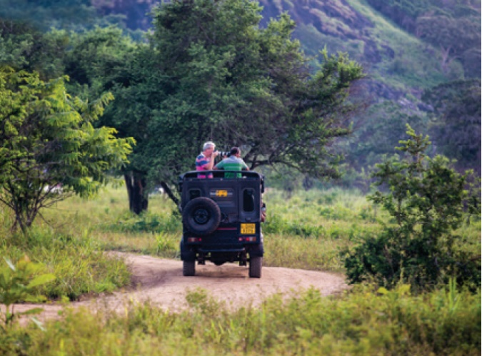
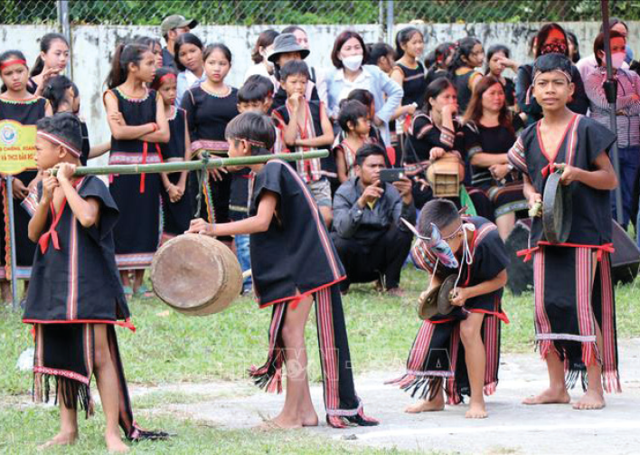
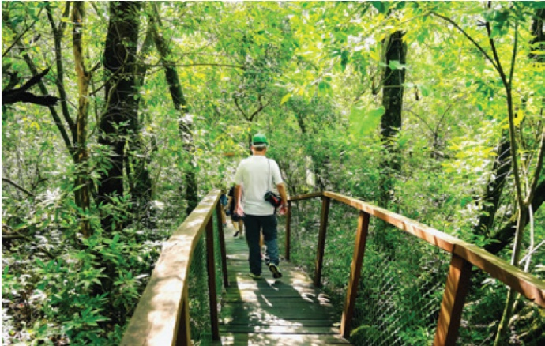
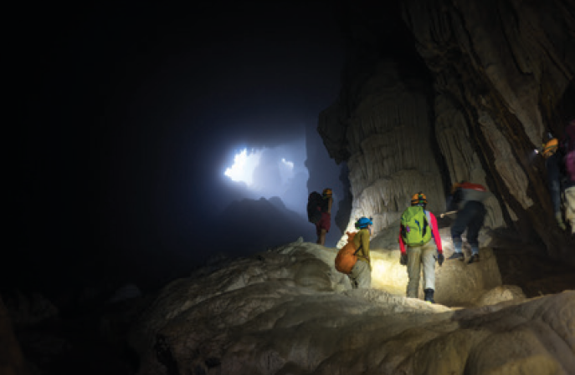
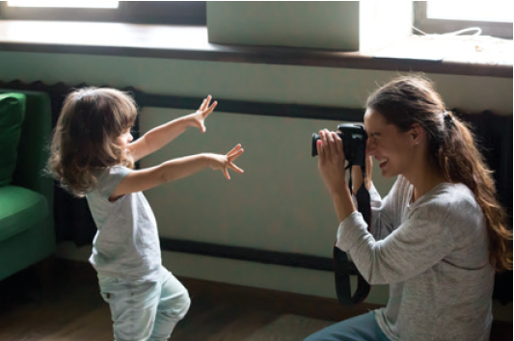
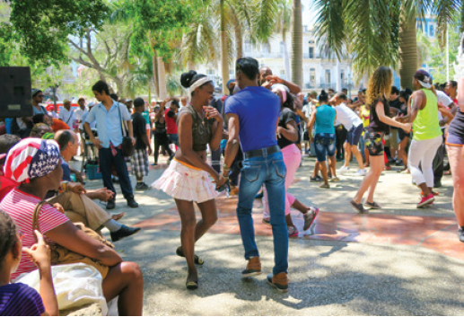
3. Write activities under the pictures.
1. __________________
2. _________________
riding a jeep
3. _________________
seeing a gong show
taking an eco-tour
6. ____________________
exploring a site
5. _________________
dancing with local people
4. _________________
taking photos/ pictures

Slide 31
4.Matching the activities with the adjectives.
1. riding a jeep | a. enjoyable
2. seeing a gong show | b. thrilling
3. taking an eco-tour | c. amazing
4. exploring a site | d. interesting
5. taking pictures | e. brilliant

Slide 32
4. Matching the activities with the adjectives .
1.
riding a jeep
b. thrilling
2.
seeing a gong show
d. interesting

Slide 33
4. Matching the activities with the adjectives.
3.
taking an eco-tour
c. amazing
4.
exploring a site
e. brilliant

Slide 34
4. Matching the activities with the adjectives.
5.
taking photos/ pictures
a. enjoyable

Slide 35
4. Matching the activities with the adjectives.
1. riding a jeep | b. thrilling
2. seeing a gong show | d. interesting
3. taking an eco-tour | c. amazing
4. exploring a site | e. brilliant
5. taking pictures | a. enjoyable

Slide 36
5. Survey.
Work in groups. Carry out a survey. Then report your group’s findings to the class.
 | YES | NO
1. climbing a mountain
2. taking an eco-tour
3. exploring the seabed
4. taking photos from a mountain top
5. seeing a tribal dance show
Example:
We did a survey with our group members. Two like climbing a mountain, 3 like taking eco-tours, nobody likes exploring the seabed….

Slide 37
HOMEWORK
2
Learn by heart Vocabulary;
Make a list of adjectives to describe experience;
Preparing for A Closer Look 1 of Unit 5.

Slide 38
Website: hoclieu.vn
Fanpage: facebook.com/tienganhglobalsuccess.vn/

