Slide 1


Slide 2


NGUYEN CHANH LOWER SECONDARY SCHOOL
TEACHER: MAI THI NHU HAI

Slide 3
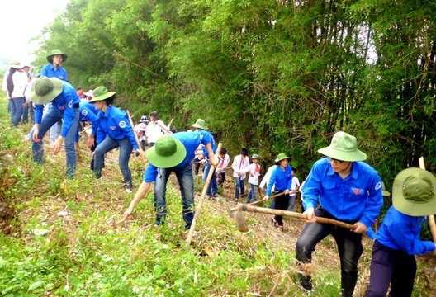
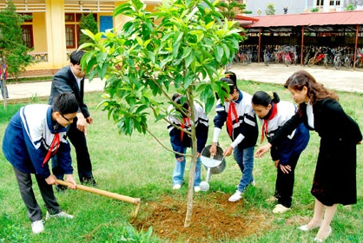
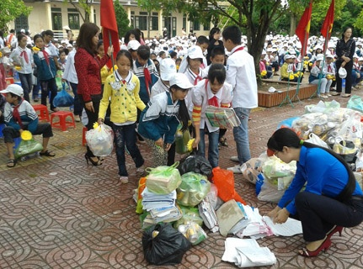
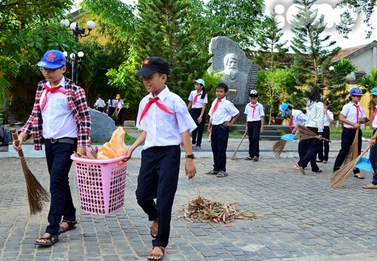
The volunteers are cleaning the rubbish
Students are planting a tree
Students are collecting used paper
Students are cleaning the park

Slide 4



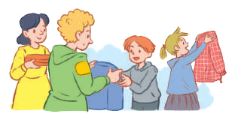
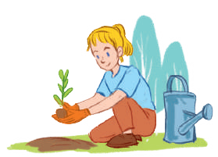
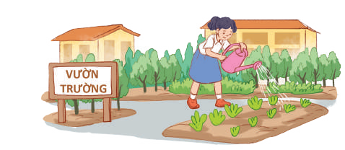
Unit
3
COMMUNITY SERVICE
LESSON 1: GETTING STARTED
Sounds like great work!
Unit
HOBBIES

Slide 5

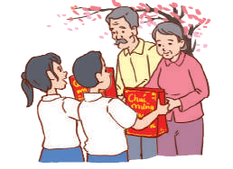
What’s Community service?
LESSON 1: GETTING STARTED
(It’s the work that people do without payment to help other people)

Slide 6


Slide 7
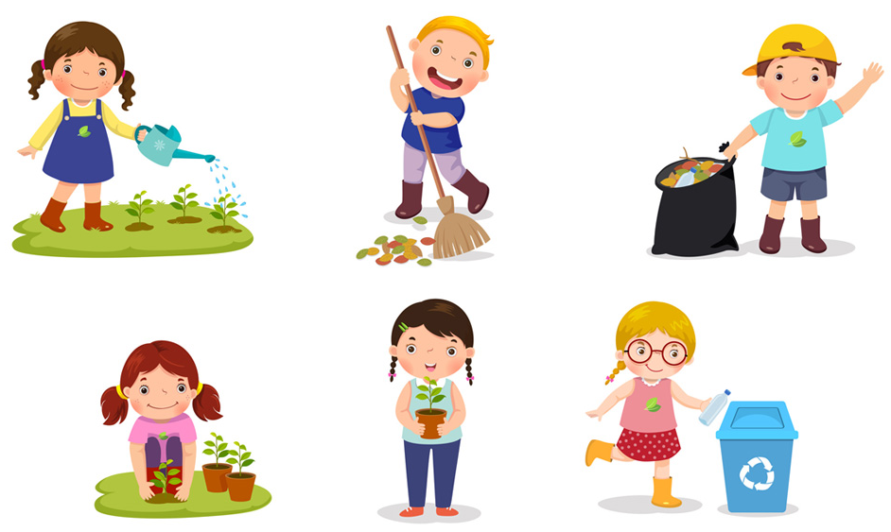

I/ Vocabulary:
- community activity (n.phr.)
/kəˈmjuːnɪti ækˈtɪvɪti/
hoạt động cộng đồng

Slide 8

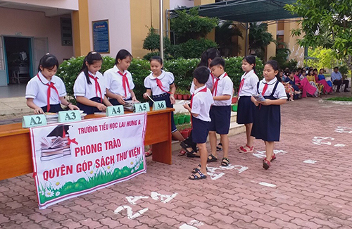
I/ Vocabulary:
- (to) donate
/dəʊˈneɪt/
quyên góp, ủng hộ

Slide 9
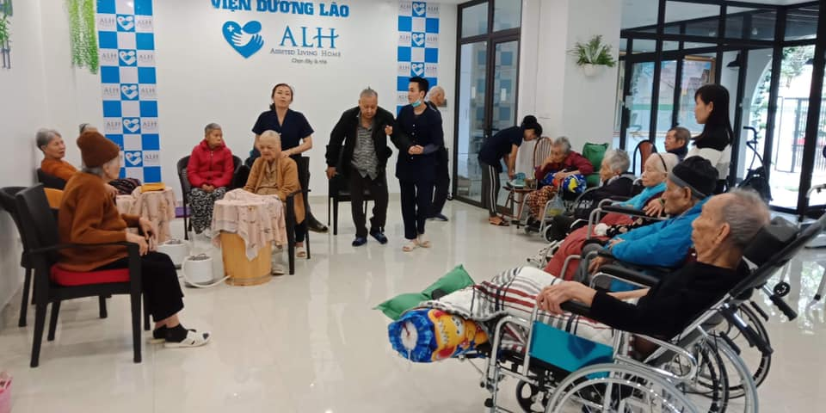
I/ Vocabulary:
- nursing home (n)
/ˈnɜːsɪŋ həʊm/
viện dưỡng lão

Slide 10
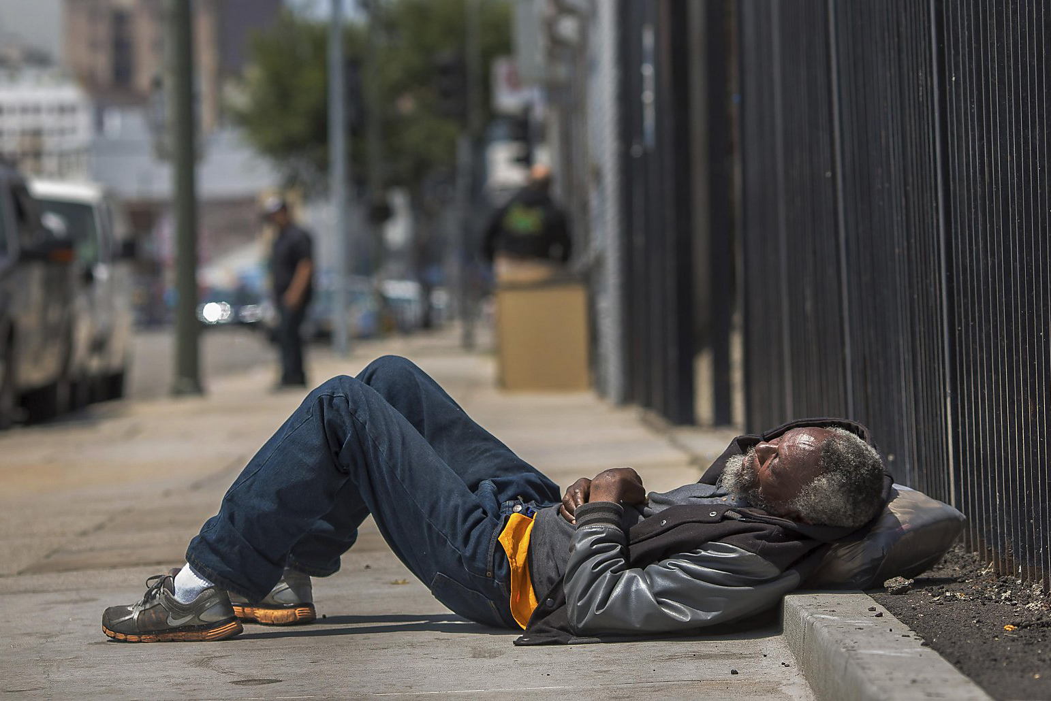
I/ Vocabulary:
- homeless (adj)
/ˈhəʊmləs/
vô gia cư

Slide 11
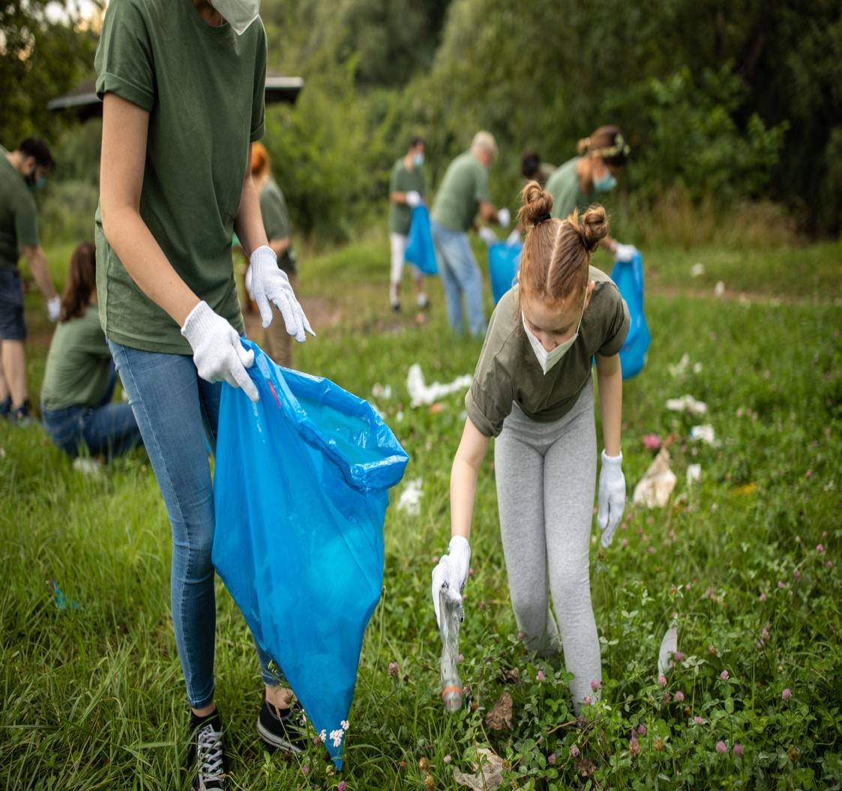
I/ Vocabulary:
- (to) pick up litter /pɪk ʌp ˈliːtə/:
nhặt rác

Slide 12
I/ Vocabulary:
New words | Pronunciation | Meaning
community activity(n) | /kəˈmjuːnɪti ækˈtɪvɪti/ | hoạt động cộng đồng
(to) donate | /dəʊˈneɪt/ | quyên góp, ủng hộ
nursing home (n) | /ˈnɜːsɪŋ həʊm/ | viện dưỡng lão
homeless (adj) (to)pick up litter | /ˈhəʊmləs/ /pɪk ʌp ˈliːtə/ | vô gia cư nhặt rác

Slide 13
1
Listen and read.
Minh: Hi, Tom. Are you back in Ha Noi?
Tom: Yes. I came back yesterday. Can we meet up this Sunday morning? I bought you a board game.
Minh: Sure, I can’t wait! But our Green School Club will have some community activities on that morning.
Tom: What activities does your club do?
Minh: Well, we pick up litter around our school and plant vegetables in our school garden.
Tom: School gardening? That’s fantastic!
Minh: Yes. We donate the vegetables to a nursing home. Does your school have any activities like these?
Tom: Yes. We donate books to homeless children. We also have English classes. Last summer, we taught English to 30 kids in the area.
Minh: Sounds like great work!
Tom: Thanks.
Minh: ... So, let’s meet in the afternoon then.

Slide 14

2
Read the conversation again and tick the appropriate box.
Community activity | Minh’s club | Tom’s club
1. picking up litter
2. planting vegetables
3. donating books
4. donating vegetables
5. teaching English

Slide 15
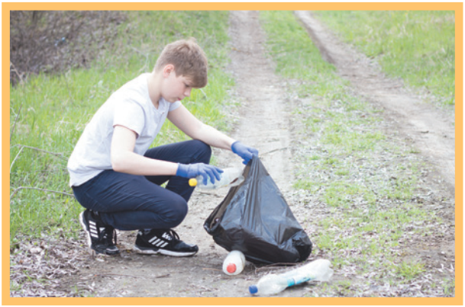
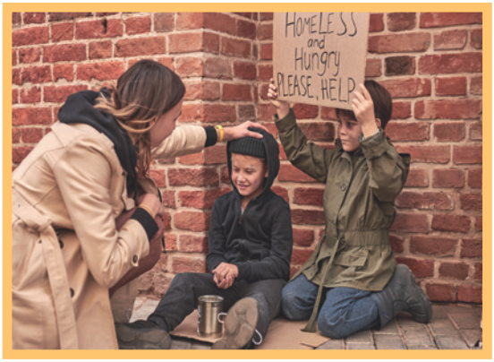
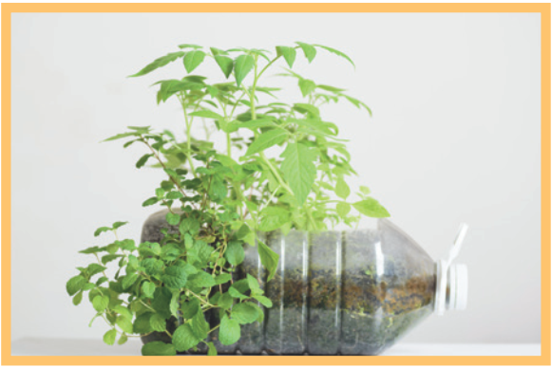
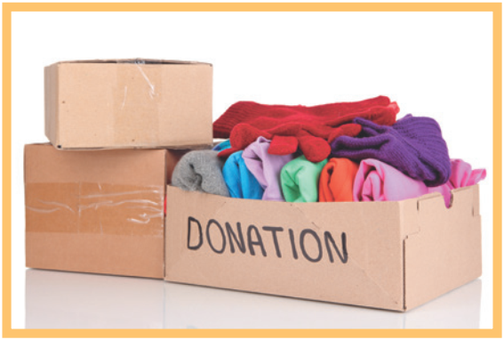
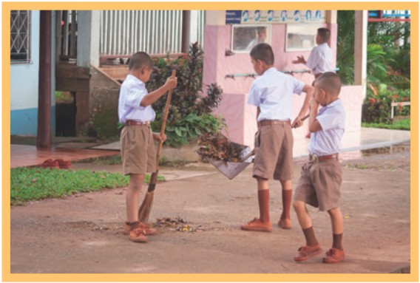
3
Complete the phrases under the pictures with the verbs below.
pick up clean donate recycle help
help
2. ______ homeless children
recycle
pick up
3. _______ plastic bottles
1. ________ litter
donate
4. _________ clothes
clean
5. ________ the playground

Slide 16
4
Complete the sentences with the correct words or phrases below.
old people- homeless children – planted - litter- taught
1. We collected clothes and gave them to _________________.
2. Those students picked up all the __________ on the street.
3. We helped ____________ in the nursing home last Sunday.
4. The club members ________ maths to primary students during school holidays.
5. We __________ a lot of trees in the park last summer.
homeless children
litter
old people
taught
planted

Slide 17
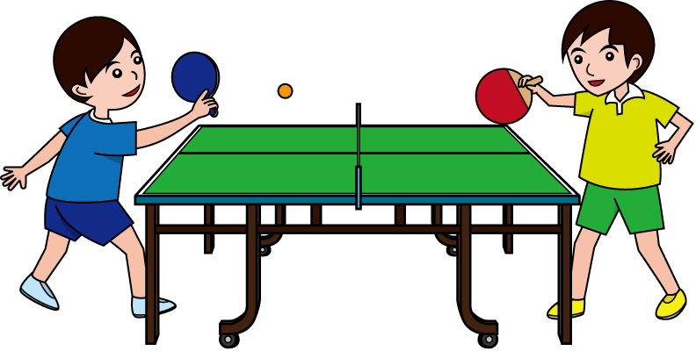
5
Game: Vocabulary Ping-pong
Work in two teams.
Team A provides a cue word.
Team B makes up a sentence with it.
Then switch roles.
Example:
Team A: Litter
Team B: We often pick up litter in the park. Trees
Team A: We plant trees in our school every year. Book
Team B: …
We donate books to homeless children.
vegetables
Team A: ……..

Slide 18

CONSOLIDATION
1
WRAP-UP
What have we learnt in this lesson?
identify the topic of the unit
use lexical items related to community activities
identify the language features that are covered in the unit

Slide 19
2
HOMEWORK
Think about community activities that students can do (at least 3 activities)
Prepare for the Project lesson

Slide 20
Homework
Learn by heart the new words.
Practice reading the dia
Prepare: A closer look 1.

