Slide 1
WELCOME TO OUR CLASS
ENGLISH 7

Slide 3
Brainstorming:
hydro energy
wind energy
coal
Types of energy sources
Solar energy
oil
Natural gas

Slide 4
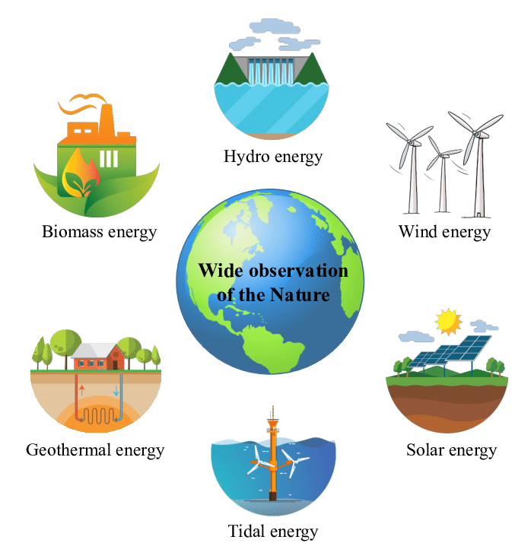
Unit
10
ENERGY SOURCES
LESSON 5: SKILLS 1
Unit

Slide 5
Unit 10: ENERGY SOURCES – LESSON 5: SKILLS 1
* Vocabulary:
- produce (v)
: sản xuất
- available (adj)
: có sẵn
- advantage
>< disadvantage
: thuận lợi >< bất lợi
- limited (adj)
: bị hạn chế

Slide 6
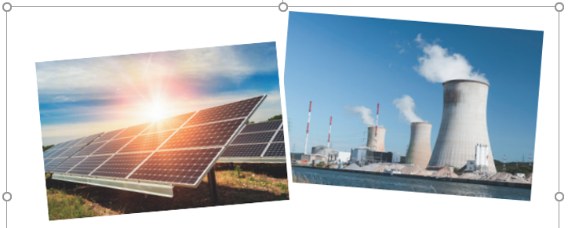
Unit 10: ENERGY SOURCES – LESSON 5: SKILLS 1
1. Prediction
1. What are the main energy sources in Viet Nam?
=>They are hydro energy and energy from coal.
2. What type(s) of energy sources will we use in the future?
=>We will use solar energy and wind energy.

Slide 7
Unit 10: ENERGY SOURCES – LESSON 5: SKILLS 1-READING
2. Mr Lam is giving a lecture on energy sources. Read the text and choose the best option (A, B, or C) to complete the sentences.
Hello, class. Today I'd like to tell you about two energy sources. They are non-renewable sources and renewable sources.
Non-renewable sources are coal, oil and natural gas. We can use these sources to produce energy. They are cheap and easy to use. People use them a lot. But they are very limited and will run out soon.
Renewable sources come from the sun, wind or water. When energy comes from the sun, we call it solar energy. Wind energy comes from the wind, and hydro energy comes from water. Renewable sources are available, clean and safe to use. But they are expensive to produce.
In the future we will rely more on renewable energy sources. They are better for the environment and they will not run out.

Slide 8
Unit 10: ENERGY SOURCES – LESSON 5: SKILLS 1-READING
1. Prediction
1. What are the main energy sources in Viet Nam?
=>They are hydro energy and energy from coal.
2. What type(s) of energy sources will we use in the future?
=>We will use solar energy and wind energy.

Slide 9
Unit 10: ENERGY SOURCES – LESSON 5: SKILLS 1-READING
2. Mr Lam is giving a lecture on energy sources. Read the text and choose the best option (A, B, or C) to complete the sentences.
Hello, class. Today I'd like to tell you about two energy sources. They are non-renewable sources and renewable sources.
Non-renewable sources are coal, oil and natural gas. We can use these sources to produce energy. They are cheap and easy to use. People use them a lot. But they are very limited and will run out soon.
Renewable sources come from the sun, wind or water. When energy comes from the sun, we call it solar energy. Wind energy comes from the wind, and hydro energy comes from water. Renewable sources are available, clean and safe to use. But they are expensive to produce.
In the future we will rely more on renewable energy sources. They are better for the environment and they will not run out.

Slide 10
Unit 10: ENERGY SOURCES – LESSON 5: SKILLS 1-READING
* Read the text and choose the best option to complete the sentences.
1. Non-renewable sources are cheap and ______.
A. available B. easy to use C. expensive
2. ______ come from the sun, wind or water.
A. Renewable sources B. All energy sources C. Non-renewable sources
3. When energy comes from water, we call it ______.
A. wind energy B. solar energy C. hydro energy
4. Renewable energy sources are better for ______.
A. the environment B. our cars C. hydro energy

Slide 11
Unit 10: ENERGY SOURCES – LESSON 5: SKILLS 1-READING
2. Mr Lam is giving a lecture on energy sources. Read the text and choose the best option (A, B, or C) to complete the sentences.
Hello, class. Today I'd like to tell you about two energy sources. They are non-renewable sources and renewable sources.
Non-renewable sources are coal, oil and natural gas. We can use these sources to produce energy. They are cheap and easy to use. People use them a lot. But they are very limited and will run out soon.
Renewable sources come from the sun, wind or water. When energy comes from the sun, we call it solar energy. Wind energy comes from the wind, and hydro energy comes from water. Renewable sources are available, clean and safe to use. But they are expensive to produce.
In the future we will rely more on renewable energy sources. They are better for the environment and they will not run out.

Slide 12
Unit 10: ENERGY SOURCES – LESSON 5: SKILLS 1-READING
* Read the text and choose the best option to complete the sentences.
1. Non-renewable sources are cheap and ______.
A. available B. easy to use C. expensive
2. ______ come from the sun, wind or water.
A. Renewable sources B. All energy sources C. Non-renewable sources
3. When energy comes from water, we call it ______.
A. wind energy B. solar energy C. hydro energy
4. Renewable energy sources are better for ______.
A. the environment B. our cars C. hydro energy

Slide 13
Unit 10: ENERGY SOURCES – LESSON 5: SKILLS 1-READING
2. Mr Lam is giving a lecture on energy sources. Read the text and choose the best option (A, B, or C) to complete the sentences.
Hello, class. Today I'd like to tell you about two energy sources. They are non-renewable sources and renewable sources.
Non-renewable sources are coal, oil and natural gas. We can use these sources to produce energy. They are cheap and easy to use. People use them a lot. But they are very limited and will run out soon.
Renewable sources come from the sun, wind or water. When energy comes from the sun, we call it solar energy. Wind energy comes from the wind, and hydro energy comes from water. Renewable sources are available, clean and safe to use. But they are expensive to produce.
In the future we will rely more on renewable energy sources. They are better for the environment and they will not run out.

Slide 14
Unit 10: ENERGY SOURCES – LESSON 5: SKILLS 1-READING
* Read the text and choose the best option to complete the sentences.
1. Non-renewable sources are cheap and ______.
A. available B. easy to use C. expensive
2. ______ come from the sun, wind or water.
A. Renewable sources B. All energy sources C. Non-renewable sources
3. When energy comes from water, we call it ______.
A. wind energy B. solar energy C. hydro energy
4. Renewable energy sources are better for ______.
A. the environment B. our cars C. hydro energy

Slide 15
Unit 10: ENERGY SOURCES – LESSON 5: SKILLS 1-READING
2. Mr Lam is giving a lecture on energy sources. Read the text and choose the best option (A, B, or C) to complete the sentences.
Hello, class. Today I'd like to tell you about two energy sources. They are non-renewable sources and renewable sources.
Non-renewable sources are coal, oil and natural gas. We can use these sources to produce energy. They are cheap and easy to use. People use them a lot. But they are very limited and will run out soon.
Renewable sources come from the sun, wind or water. When energy comes from the sun, we call it solar energy. Wind energy comes from the wind, and hydro energy comes from water. Renewable sources are available, clean and safe to use. But they are expensive to produce.
In the future we will rely more on renewable energy sources. They are better for the environment and they will not run out.

Slide 16
Unit 10: ENERGY SOURCES – LESSON 5: SKILLS 1-READING
* Read the text and choose the best option to complete the sentences.
1. Non-renewable sources are cheap and ______.
A. available B. easy to use C. expensive
2. ______ come from the sun, wind or water.
A. Renewable sources B. All energy sources C. Non-renewable sources
3. When energy comes from water, we call it ______.
A. wind energy B. solar energy C. hydro energy
4. Renewable energy sources are better for ______.
A. the environment B. our cars C. hydro energy

Slide 17
Unit 10: ENERGY SOURCES – LESSON 5: SKILLS 1-READING
2. Mr Lam is giving a lecture on energy sources. Read the text and choose the best option (A, B, or C) to complete the sentences.
Hello, class. Today I'd like to tell you about two energy sources. They are non-renewable sources and renewable sources.
Non-renewable sources are coal, oil and natural gas. We can use these sources to produce energy. They are cheap and easy to use. People use them a lot. But they are very limited and will run out soon.
Renewable sources come from the sun, wind or water. When energy comes from the sun, we call it solar energy. Wind energy comes from the wind, and hydro energy comes from water. Renewable sources are available, clean and safe to use. But they are expensive to produce.
In the future we will rely more on renewable energy sources. They are better for the environment and they will not run out.

Slide 18
Unit 10: ENERGY SOURCES – LESSON 5: SKILLS 1-READING
3. Read the text again and answer the questions.
1. How many energy sources are there? What are they?
_________________________________________________________
2. What do non-renewable sources include? _________________________________________________________
3. What are the advantages of renewable energy?
_________________________________________________________
4. What will we rely more on in the future?
_________________________________________________________
There are two. They are non-renewable and renewable.
They include coal, oil and natural gas.
It’s available, clean, and safe to use.
We will rely more on renewable energy sources in the future.

Slide 19
Unit 10: ENERGY SOURCES – LESSON 5: SKILLS 1-SPEAKING
4. Work in groups. Discuss and put the following words or phrases in the appropriate columns.
run out limited easy to use cheap expensive
available safe to use good for the environment
Advantages | Disadvantages
easy to use
run out
cheap
limited
available
expensive
safe to use
good for the environment

Slide 20
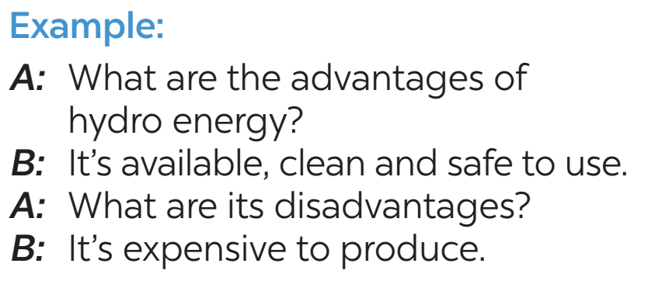
Unit 10: ENERGY SOURCES – LESSON 5: SKILLS 1-SPEAKING
5. Work in pairs. Ask and answer questions about the advantages and disadvantages of different energy sources
Advantages | Disadvantages
easy to use | run out
cheap | limited
available | expensive
safe to use
good for the environment

Slide 21
Energy sources
Unit 10: ENERGY SOURCES – LESSON 5: SKILLS 1
*Word webs
Renewable
Non-Renewable
Sun/ solar energy
Water/ hydro energy
natural gas
Wind/wind energy
coal
oil
Available, clean and safe to use but they are expensive to produce
Cheap and easy to use but they are very limited and will run out

Slide 22
Unit 10: ENERGY SOURCES – LESSON 5: SKILLS 1
HOMEWORK
Learn vocabulary by heart.
Do exercises in the workbook.
Prepare for the next lesson: Skills 2

Slide 23
Website: hoclieu.vn
Fanpage: facebook.com/www.tienganhglobalsuccess.vn/

