Slide 1
NGUYEN BA LOAN LOWER SECONDARY SCHOOL
Welcome to our class
English 6
Class 6D
Teacher: Vo Thi Xuan Lan

Slide 2
e
Unit 6:
OUR TET HOLIDAY
( A CLOSER LOOK 1)

Slide 3
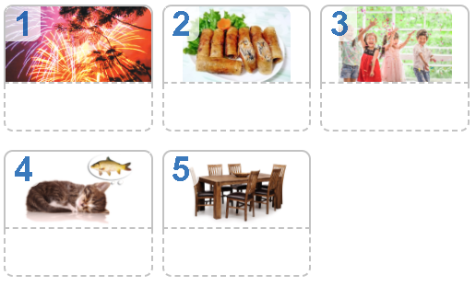
Unit 6 : OUR TET HOLIDAY (A closer look 1)
1. Match the words / phrases in the box under the pictures.
wish
fireworks
furniture
fun
special food

Slide 4
Unit 6 : OUR TET HOLIDAY (A closer look 1)
2. Match the verbs with the nouns.
Verbs
1. have
2. visit
3. give
4. make
5. clean
6. watch
nouns
a. a wish
b. fireworks
c. the furniture
d. lucky money
e. relatives
f. fun

Slide 5
Unit 6 : OUR TET HOLIDAY (A closer look 1)
3 .Complete the sentences with the words in the box.
shopping
clean
celebrate
peach
food
1. In Viet Nam, we ………………. Tet in January or February.
2. At Tet, we decorate our houses with …………… flowers.
3. Children should help their parents to …………… their houses.
4. People do a lot of …………………. before Tet.
5. My mother usually cooks special …………….. during Tet.

Slide 6
shopping
spring
special
wish
rice
celebrate
shopping
spring
special
wish
rice
celebrate
shopping
spring
special
wish
rice
celebrate
Unit 6 : OUR TET HOLIDAY (A closer look 1)
Pronunciation:
/s/
/ʃ/
1
2
see
she
4. Listen and repeat the words.
shopping special rice spring wish celebrate

Slide 7
Unit 6 : OUR TET HOLIDAY (A closer look 1)
Listen and practise reading the poem. Pay attention to the sounds /∫/ and /s/.
Spring is coming!
Tet is coming!
She sells peach flowers.
Her cheeks shine.
Her eyes smile.
Her smile is shy.
She sells peach flowers.

Slide 8
Unit 6 : OUR TET HOLIDAY (A closer look 1)
Learn by heart the new words
- Do the lesson a gain
- Prepare for A Closer Look 2

