Slide 1


NGUYEN BA LOAN LOWER SECONDARY SCHOOL
WELCOME TO OUR CLASS
TEACHER: LY THI NHUNG

Slide 2
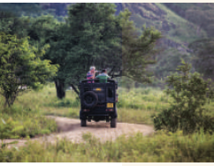
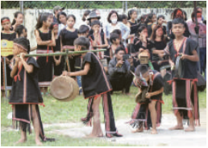
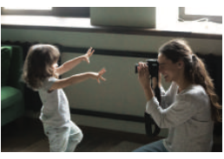
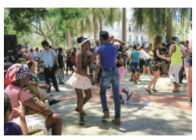
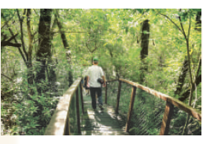
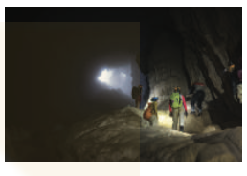
Warm up : Kim’s game
Write activities you see in pictures.

Slide 3
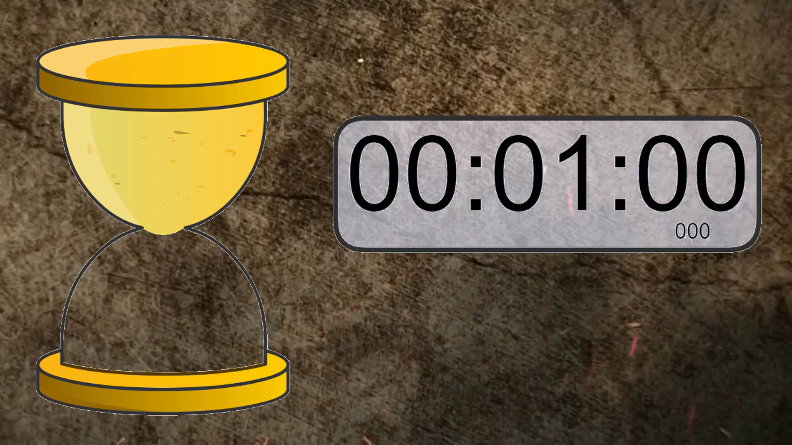

Slide 4
Warm up : Kim’s game
Write activities you see in pictures.
riding a jeep
seeing a gong show
taking photos
dancing with local people
taking an eco-tour
exploring a site

Slide 5
UNIT 5:OUR EXPERIENCES
LESSON 2: A CLOSER LOOK 1
1

Slide 6


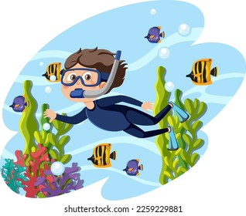

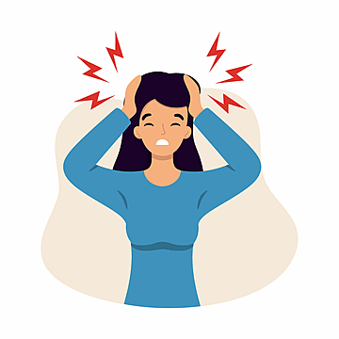
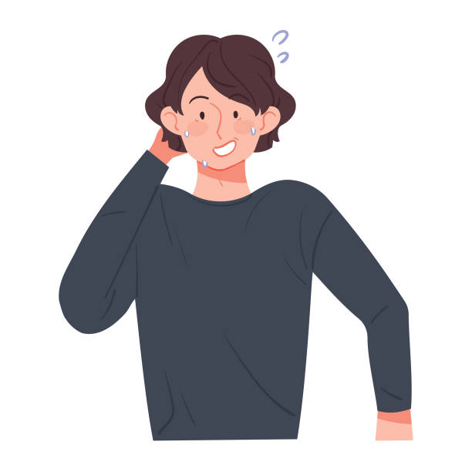
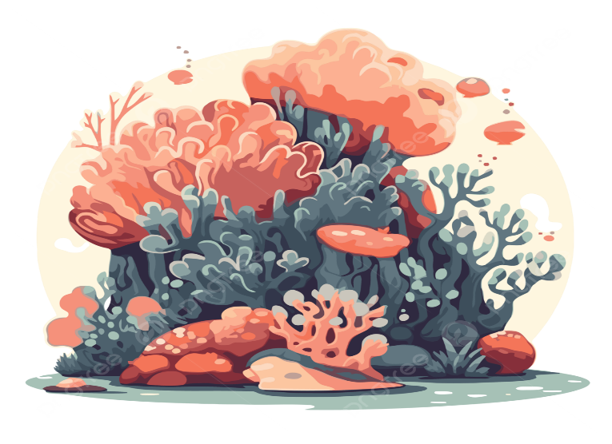
I. Vocabulary:
- Leraning by rote /lɜːnɪŋ baɪ rəʊt/ (phr)
: học thuộc lòng
- snorkelling /ˈsnɔːkəlɪŋ/ (n)
: lặn với ống thở
: đầy phấn khích
- exhilarating /ɪɡˈzɪləreɪtɪŋ/ (adj
- embarrassing /ɪmˈbærəsɪŋ/
: ngượng ngùng.
- unpleasant (adj) / ʌnˈpleznt /
: không thoải mái
- coral reef / ˈkɒrəl riːf /(n):
: rặng san hô
- campus /ˈkæmpəs/ (n)
: khuôn viên trường học

Slide 7

Check vocabulary
learning by rote (phr)
/ˈlɜːnɪŋ baɪ rəʊt/

Slide 8
vocabulary
campus (n)
/ˈkæmpəs/

Slide 9
vocabulary
snorkelling (n)
/ˈsnɔːkəlɪŋ/

Slide 10
vocabulary
exhilarating (adj)
/ɪɡˈzɪləreɪtɪŋ/

Slide 11
vocabulary
embarrassing
(adj)
/ɪmˈbærəsɪŋ/
.

Slide 12
vocabulary
unpleasant (adj)
/ ʌnˈpleznt /

Slide 13

vocabulary
coral reef (n)
/ ˈkɒrəl riːf /

Slide 14
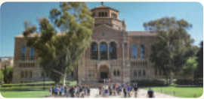
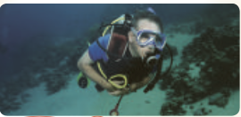

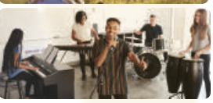
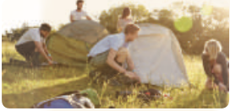
1. Write an activity next to each picture
learning by rote
putting up tents
touring a campus
going snorkelling
giving a performance
touring a campus
3. ____________
1. ___________
going snorkelling
learning by rote
2. ____________
putting up tents
5. ____________
4. ___________
giving a performance

Slide 15
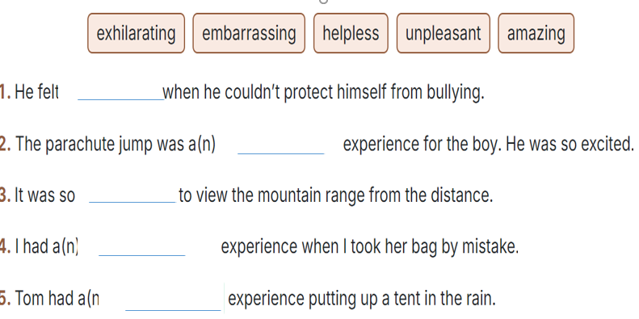
2. Complete each sentence with an adjective in the box.
helpless
exhilarating
amazing
embarrassing
unpleasant

Slide 16
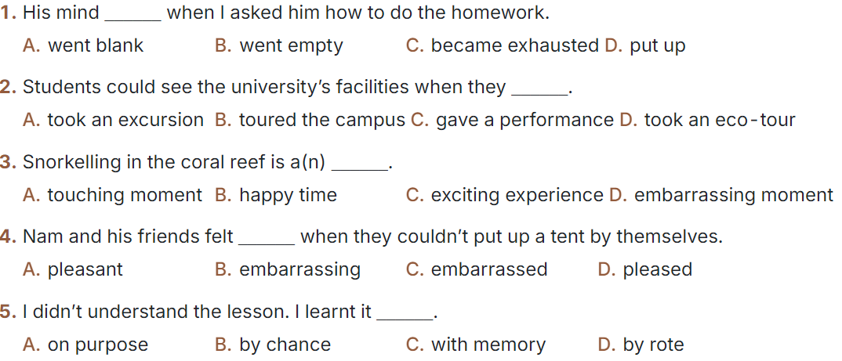
3. Choose the correct answer A, B, C, or D.

Slide 17
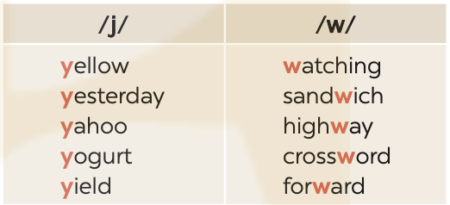
PRONUNCIATION
4
Listen and repeat the words. Pay attention to the sounds /j/ and /w/.

Slide 18
PRONUNCIATION
5
Listen to the sentences. Underline the words with /j/ and circle the words with /w/. Practise the sentences.
He tried sailing a yacht, and he did it well.
We’ve made a class yearbook. It looks wonderful.
They awarded him a gold medal yesterday.
Youngsters should be aware of their responsibilities.
5. They haven’t yet understood the role of wildlife.

Slide 19

CONSOLIDATION
1
Wrap-up
What have we learnt in this lesson?
Vocabulary: The lexical items related to experiences
Pronunciation: How to correctly pronounce words that contain the sounds: /j/ and /w/

Slide 20

CONSOLIDATION
2
Homework
Do exercises in the workbook.
Find 10 more words describing experiences that have the sound /j/ or /w/.

Slide 21
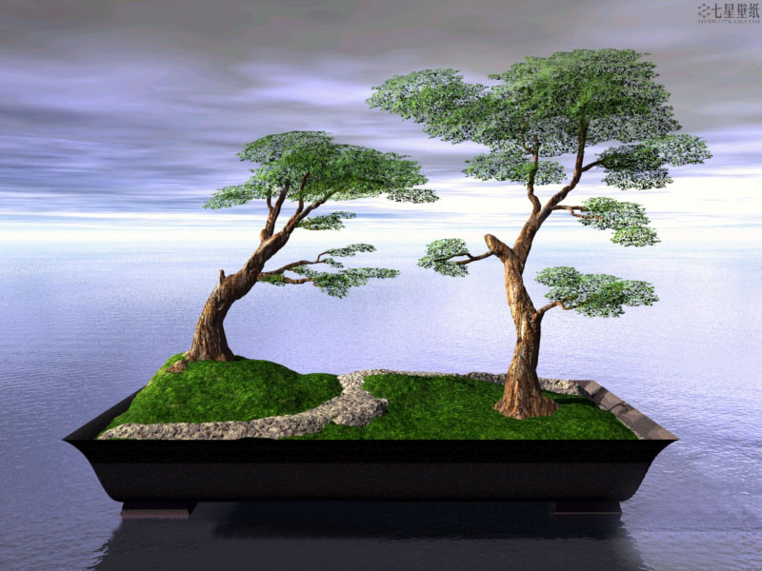
Thank you for your attention!
Good bye

