Slide 1


NGUYEN BA LOAN LOWER SECONDARY SCHOOL
WELCOME TO OUR CLASS
TEACHER: LY THI NHUNG

Slide 2
Warm up:
Brainstorming
activities to help community
picking up litter

Slide 3
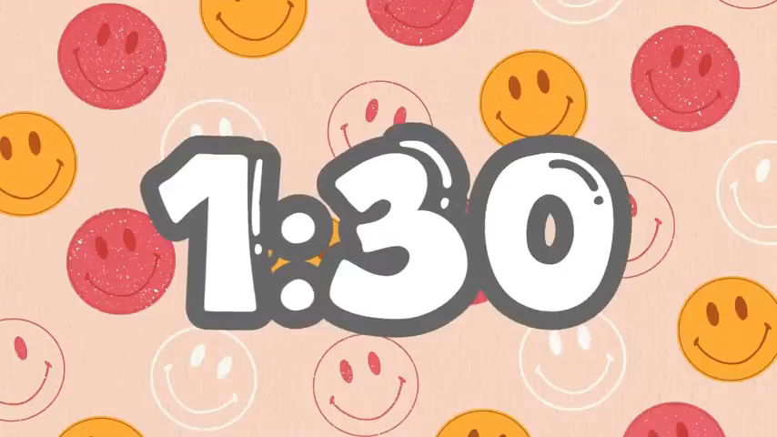

Warm up:
Game: Who is faster?
Brainstorming
activities to help community
picking up litter

Slide 4
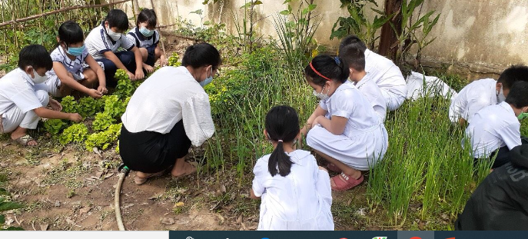

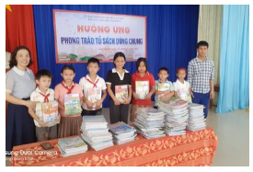
1
2
3
1.Growing vegetables
in the school garden
2.Tutoring other
students
3.Collecting books for school library
Circle the activities you would like to do at your school.
Now answer the question :
What activities would you like to do at school?

Slide 5

Unit 3: COMMUNITY SERVICE
LESSON 5 : SKILLS 1

Slide 6


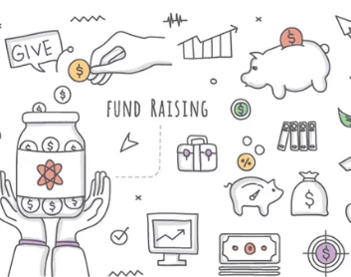
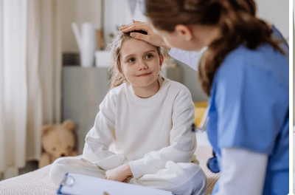
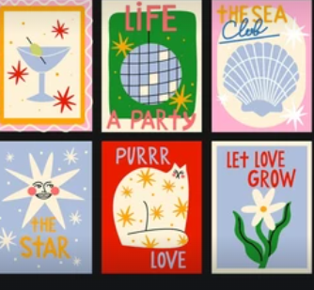
Vocabulary
postcard ( n) :
bưu thiếp
look after ( v) :
= take care of
: chăm sóc
raise money( v) :
góp tiền
develop ( v) :
phát triển
proud (adj) : = pleased
: tự hào /hài lòng
believe (v) :
tin tưởng

Slide 7
Checking up vocabulary
postcard

Slide 8
Check vocabulary
raise money

Slide 9
Check vocabulary
look after

Slide 10
Check vocabulary
proud = pleased

Slide 11
Check vocabulary
phát triển
develop

Slide 12
Check vocabulary
tin tưởng
believe

Slide 13
2. Read the passage and match the highlighted words with their meanings.

Slide 14
1. give
2. give and receive
3. every month
4. pleased
5. teach
Bright Future School has many community activities for students. The school believes that a good way for students to develop themselves is through community service. All students can join any of these different projects:
– Tutoring: Upper grade students tutor ……………. lower grade students.
– Postcard-to-Help: Students make and sell postcards to raise money for local children.
– Visit-to-Read: Students visit a nursing home monthly …………... ......and read books to the elderly.
– Garden-to-Give: Students grow vegetables and donate ……………..... them to local schools.
– Paper-Plant-Exchange: Students collect paper and exchange ………….......…... ...it for plants. They then look after the plants in their school garden.
Students learn that they can help people and the world around them when they do community service. They feel useful and proud …………...…….. because they do good things

Slide 15
3. Read the passage again and tick (v)T (True) or F (False).
 | T | F
1. Community service allows students to develop themselves.
2. Each student can join only one project.
3. They tutor younger students.
4. Local children receive postcards from the Postcard-to-Help project.
5. Students receive plants when they give paper.

Slide 16
Bright Future School has many community activities for students. The school believes that a good way for students to develop themselves is through community service. All students can join any of these different projects:
– Tutoring: Upper grade students tutor lower grade students.
– Postcard-to-Help: Students make and sell postcards to raise money for local children.
– Visit-to-Read: Students visit a nursing home monthly and read books to the elderly.
– Garden-to-Give: Students grow vegetables and donate them to local schools.
– Paper-Plant-Exchange: Students collect paper and exchange it for plants. They then look after the plants in their school garden.
Students learn that they can help people and the world around them when they do community service. They feel useful and proud because they do good things
1. Community service allows students to develop themselves.
T

Slide 17
Bright Future School has many community activities for students. The school believes that a good way for students to develop themselves is through community service. All students can join any of these different projects:
– Tutoring: Upper grade students tutor lower grade students.
– Postcard-to-Help: Students make and sell postcards to raise money for local children.
– Visit-to-Read: Students visit a nursing home monthly and read books to the elderly.
– Garden-to-Give: Students grow vegetables and donate them to local schools.
– Paper-Plant-Exchange: Students collect paper and exchange it for plants. They then look after the plants in their school garden.
Students learn that they can help people and the world around them when they do community service. They feel useful and proud because they do good things
2. Each student can join only one project.
F

Slide 18
Bright Future School has many community activities for students. The school believes that a good way for students to develop themselves is through community service. All students can join any of these different projects:
– Tutoring: Upper grade students tutor lower grade students.
– Postcard-to-Help: Students make and sell postcards to raise money for local children.
– Visit-to-Read: Students visit a nursing home monthly and read books to the elderly.
– Garden-to-Give: Students grow vegetables and donate them to local schools.
– Paper-Plant-Exchange: Students collect paper and exchange it for plants. They then look after the plants in their school garden.
Students learn that they can help people and the world around them when they do community service. They feel useful and proud because they do good things
3. They tutor younger students.
T

Slide 19
Bright Future School has many community activities for students. The school believes that a good way for students to develop themselves is through community service. All students can join any of these different projects:
– Tutoring: Upper grade students tutor lower grade students.
– Postcard-to-Help: Students make and sell postcards to raise money for local children.
– Visit-to-Read: Students visit a nursing home monthly and read books to the elderly.
– Garden-to-Give: Students grow vegetables and donate them to local schools.
– Paper-Plant-Exchange: Students collect paper and exchange it for plants. They then look after the plants in their school garden.
Students learn that they can help people and the world around them when they do community service. They feel useful and proud because they do good things
4. Local children receive postcards from the Postcard-to-Help project.
F

Slide 20
Bright Future School has many community activities for students. The school believes that a good way for students to develop themselves is through community service. All students can join any of these different projects:
– Tutoring: Upper grade students tutor lower grade students.
– Postcard-to-Help: Students make and sell postcards to raise money for local children.
– Visit-to-Read: Students visit a nursing home monthly and read books to the elderly.
– Garden-to-Give: Students grow vegetables and donate them to local schools.
– Paper-Plant-Exchange: Students collect paper and exchange it for plants. They then look after the plants in their school garden.
Students learn that they can help people and the world around them when they do community service. They feel useful and proud because they do good things
5. Students receive plants when they give paper.
T

Slide 21
3. Read the passage again and tick (v)T (True) or F (False).
 | T | F
1. Community service allows students to develop themselves.
2. Each student can join only one project.
3. They tutor younger students.
4. Local children receive postcards from the Postcard-to-Help project.
5. Students receive plants when they give paper.
V
V
V
V
V

Slide 22
Bright Future School has many community activities for students. The school believes that a good way for students to develop themselves is through community service. All students can join any of these different projects:
– Tutoring: Upper grade students tutor lower grade students.
– Postcard-to-Help: Students make and sell postcards to raise money for local children.
– Visit-to-Read: Students visit a nursing home monthly and read books to the elderly.
– Garden-to-Give: Students grow vegetables and donate them to local schools.
– Paper-Plant-Exchange: Students collect paper and exchange it for plants. They then look after the plants in their school garden.
Students learn that they can help people and the world around them when they do community service. They feel useful and proud because they do good things

Slide 23
SPEAKING
4.Read about these students. Write the names of the projects
you think they should join in the Projects column.
 | project
2. Ann is very good at maths and literature. She also
loves children.
1.Nick likes reading books. He has a very nice voice and he is also patient.
3. Minh loves collecting and making postcards.
4. Mark loves nature. He likes watching programmes
about plants. He also likes being outdoor.
5. Tom likes collecting newspapers

Slide 24
A. Tutoring
B. Postcard-to-Help
C. Visit to -Read
D. Garden- to-Give
E. Paper-Plant-exchange
Project
1.Nick likes reading books. He has a very nice voice and he is also patient.
C
2. Ann is very good at maths and literature. She also
loves children.
A
3. Minh loves collecting and making postcards.
B
4. Mark loves nature. He likes watching programmes
about plants. He also likes being outdoor.
D
5. Tom likes collecting newspapers
E

Slide 25
SPEAKING
5. Work in groups. Discuss which project in 4 you would like to join, and why. Report your group’ answer to the class.

Slide 26
A. Tutoring
B. postcard-to-Help
C. Visit to -Read
D. Garden- to-Give
E. Paper-Plant-Exchange
Example:
Name | Project | The reason
Nam: Which project would
you like to join, Lan ?
Lan
- is good at maths and
literature
- loves children
Lan : I’d like to join the
Tutor project.
Tutor project
Nam : Why ?
Lan : Because I am good
at maths and literature,
I also love children.
Hoa
Nam : How about you, Hoa?

Slide 27
Report your group’ answer to the class.
Example:
Name | Project | The reason
Lan will join the Tutor project because she is good at Maths and literature, she also loves children
- is good at maths and literature
- loves children
Lan
Tutor project

Slide 28
Homework:
-Learn by heart vocabulary
-Practise reading the passage in 2 fluently.
-Practise speaking about what you like to do for community.
-Prepare for skills 2

Slide 29

THANK YOU
FOR YOUR ATTENTION !
Goodbye!
Celinne Dion – And so this is Xmax

Slide 30


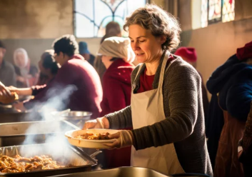
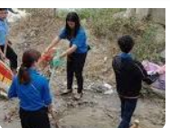
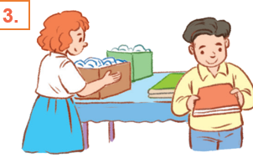
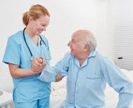

Kim’s game
1
2
3
4
5
6
7
1

Slide 31


