Slide 1
WARM-UPgr
musical instrument - art
guitar - drawing - street
painting - music - dancing
singing -art gallery - paintbrush - camera - performance - photo - culture - drama - show
GAME: RECALLING WORDS

Slide 2
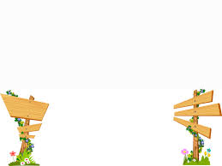
Unit 4:
MUSIC AND ARTS
( LOOKING BACK +)

Slide 3
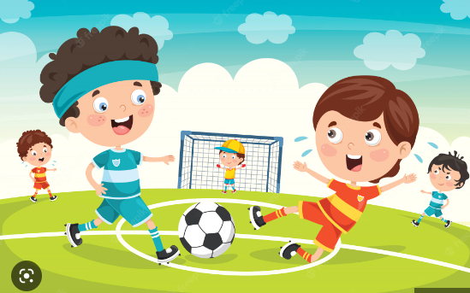
Unit 4: MUSIC AND ARTS (Looking Back )
- What do the boys do?
- They play football.
play:
football
, the piano
,the violin
, the cello …

Slide 4
Unit 4: MUSIC AND ARTS (Looking Back )
Vocabulary:
1 Write a word or phrase in each blank to go with the given verb.gr
Example:
play:
the piano, the violin, the cello…
1. draw :
2. perform:
3. write :
4. watch :
pictures / the house / the buffalo …
water puppetry /the organ / the piano …
the letter/ an email / a story …
the game / the football match / TV …

Slide 5
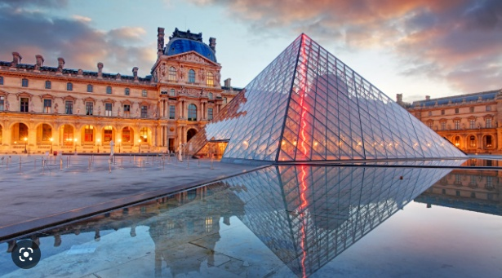
Unit 4: MUSIC AND ARTS (Looking Back )
The Louvre Museum
in Paris

Slide 6
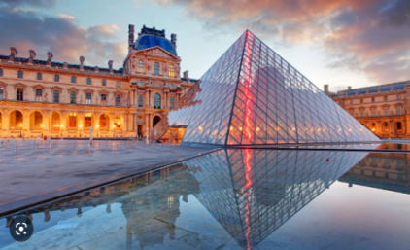
Unit 4: MUSIC AND ARTS (Looking Back )
2 Fill in each blank with a word or phrase from the box to complete the passage. i
The Louvre Museum is the world’s largest art museum. It is in Paris, France. It has one of the most impressive(1) ……………….. …. in history. The museum opened on 10 August 1793 with a(n) (2) ………………. of 537 paintings. The Louvre Museum now contains more than 380,000 objects, and displays 35,000 (3) ………… … .
It exhibits sculptures, objects of art, (4) ………………, drawings, and other valuable works. It is the world’s most visited museum. About 25,000 (5) ……………. come to see it per day. Most of them are foreign tourists.
art collections
works of art
art collections
exhibition paintings
visitors
exhibition
works of art
paintings
visitors
(impressive ( adv) có ấn tượng, exhibit (v) trưng bày, sculptures (n) tác phẩm điêu khắc)

Slide 7
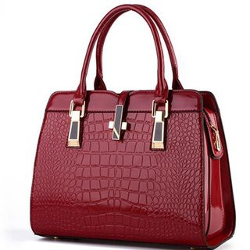
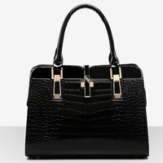
Unit 4: MUSIC AND ARTS (Looking Back )
GRAMMAR REVIEW
1. So sánh bằng
( not) as + adj + as
The red bag is not as big as the black one.
* to show that two things are similar
2. So sánh hơn
+ For short adjective
adj- er + than
The red bag is smaller than the black one.
+ For long adjective
more + adj + than
Nam is more intelligent than me.
(1) (2)=> So sánh không bằng thì bằng sánh hơn
=> Khác nhau => different from
This red bag is different from that black one.

Slide 8
Unit 4: MUSIC AND ARTS (Looking Back )
GRAMMAR
3 Complete the sentences, using the words in brackets. Add the necessary words. gr/i
old as
1. I think the Temple of Literature is as ………… Quan Thanh Temple. (old)
2. I don’t like this film very much. It is …………………. the original book. (different)
3. Some students say maths is ……………………….. than music, but I don’t think so. (important)
4. My grandma thinks modern life is …………………… as life in the past. (not / good)
5. Learning to play the guitar is ………………….... I thought. (not / easy)
different from
more important
not as good
not as easy as

Slide 9
Unit 4: MUSIC AND ARTS (Looking Back )
4 Rewrite the sentences, using the given words. gr
1. Playing video games is not as good as exercising. (better)
2. Duong’s father draws animals better than Duong. (well)
3. This painting is not as valuable as the Mona Lisa. (more)
4. David is more artistic than Nick. (not as)
5. The second version of the play is not different from the first. (like)
Exercising is better than playing video games.
Duong doesn’t draw animals as well as his father.
The Mona Lisa is more valuable than this painting.
Nick is not as artistic as David.
The first version of the play is like the second.

Slide 10
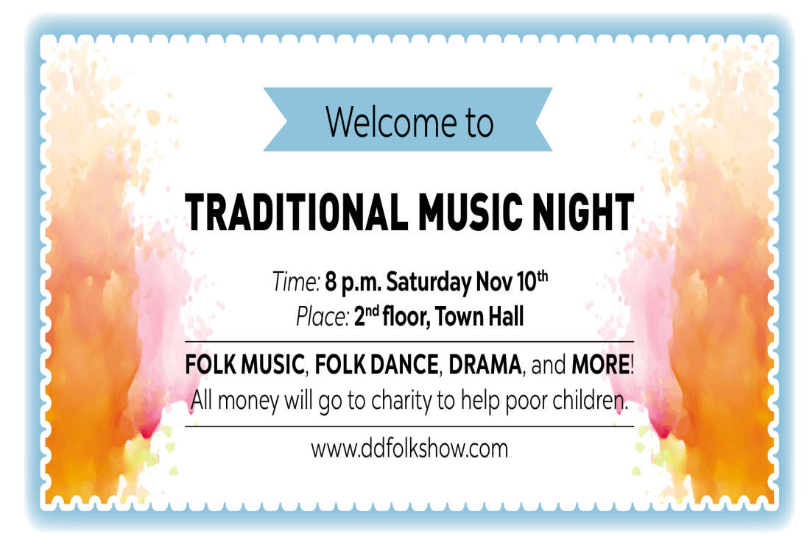
Unit 4: MUSIC AND ARTS (Looking Back )
PROJECT
1 Work in pairs. Look at the invitation below. Talk about the event (the time, place, show...).
This invitation is on traditional music. the performance will be on ………………… ………………………………………………………………………………………………………………………………………………………………………………………………………………………………………………………………………………………………………………………………………………………...
This invitation is on traditional music. the performance will be on Saturday november 10th It takes place in 2nd floor. it last 2 hours. There is folk music, folk dance, drama and more ! In this program, all the money will give to charity to help poor children.

Slide 11
Unit 4: MUSIC AND ARTS (Looking Back )
2. Work in group. Imagine that you are going to organise a music show on TEACHERS’ DAY. Design an invitation then talk about it.
- Name of the show
- Time and place
- Activities
(Invitation)
………………………………………………………………………………………………………………………………………………………………………………………………………………………………………………………………………………………………………………………………………………………………………………………………………………………………………………………………………………………………………………………………………………………………………………………………………………………………………………………………………………………………………………………………………………………………………………………………………………………………………………………………………………………………………………………………………………..

Slide 12
Unit 4: MUSIC AND ARTS (Looking Back )
homeWORK
Design an invitation then talk about it
Do exercise at home
Prepare Vietnamese food and drink

