Slide 1
Unit 4:
MUSIC AND ARTS
(Getting started)

Slide 2
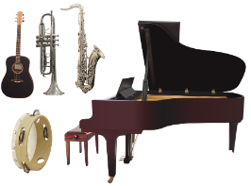
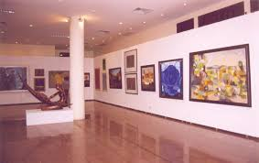
Unit 4: MUSIC AND ARTS (Getting started)
* Vocabulary:
- classical music(n):
nhạc cổ điển
- instruments (n):
dụng cụ âm nhạc
- art gallery (n):
phòng tranh
- paint(v) painting(n)
vẽ- bức họa
- landscapes (n)
cảnh đẹp
- share (v):
chia sẻ

Slide 3
Unit 4: MUSIC AND ARTS (Getting started)
1. Listen and read
TALK ABOUT THE SCHOOL GATE
Trang: Hi, Nick. What are you listening to?
Nick : I’m listening to music. I like classical music, and I often play the piano in my spare time.
Trang: Wow. I can’t play any instruments.
Nick : And what about you? What’s your hobby?
Trang: I like painting and taking photos.
Nick : Taking photos? I’ve never tried it. Is it fun?
Trang: Yeah, it is, but not as fun as painting.
Nick : Right. They seem quite different from each other. What do you normally paint?
Trang: Landscapes and animals, just for pleasure, you know. I sometimes share them with my friends.
Nick : Really? Um, maybe we should go to an art gallery next weekend?
Trang: Sounds good, but I’d prefer to go to the music festival at my school.
Nick : Well... OK. That’s fine.

Slide 4
Unit 4: MUSIC AND ARTS (Getting started)
2 What are Trang and Nick talking about?
A. Playing the piano
B. Drawing and painting
C. Music and arts

Slide 5
Unit 4: MUSIC AND ARTS (Getting started)
3 Complete each of the sentences with a suitable word or phrase from the box.
photos – like - different from - art gallery - musical instruments
1. Nick wants to go to a(n) ……………… next weekend.
2.You can use your smartphone to take ……………
3.This photo is very bright. It is ………………………that dark one.
4. Nick and Trang agree that taking photos is not …………… painting.
5. My friend David is very talented. He plays three ………………………...
art gallery
photos
different from
like
musical instruments

Slide 6
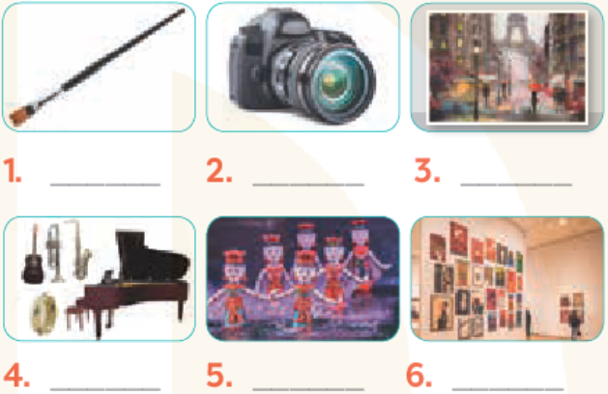
Unit 4: MUSIC AND ARTS (Getting started)
camera- water puppet show - art gallery- painting- musical instruments- paint brush
4 Write the correct word or phrase under each picture. Then listen and repeat.
paint brush
camera
painting
musical instruments
water puppet show
art gallery

Slide 7
Unit 4: MUSIC AND ARTS (Getting started)
5 How artistic are you? Take the quiz to find out.
1. Your hobby is ___________.
A.playing an instrument B.playing computer games
2.Do you like listening to music or playing sports?
A.Listening to music. B.Playing sports.
3.Which of these do you prefer doing?
A.Going to an art gallery. B.Going to a book fair.
4. You describe yourself as ___________.
A.Creative B.hard-working
5. What do you want to be when you grow up?
A. A musician. B.An engineer.
+ For each question, you get two points if your answer is A, zero if your answer is B. Add up your five answers and decide how artistic you are on a scale from 1 – 10.
Not very (0 – 4) Somewhat (6) Very (8 – 10)

Slide 8
Unit 4: MUSIC AND ARTS (Getting started)
homework
- Study vocabulary
- Do exercises.
- Prepare UNIT 4 – A CLOSER LOOK 1.

