Slide 1
Hello everyone !!!

Slide 2
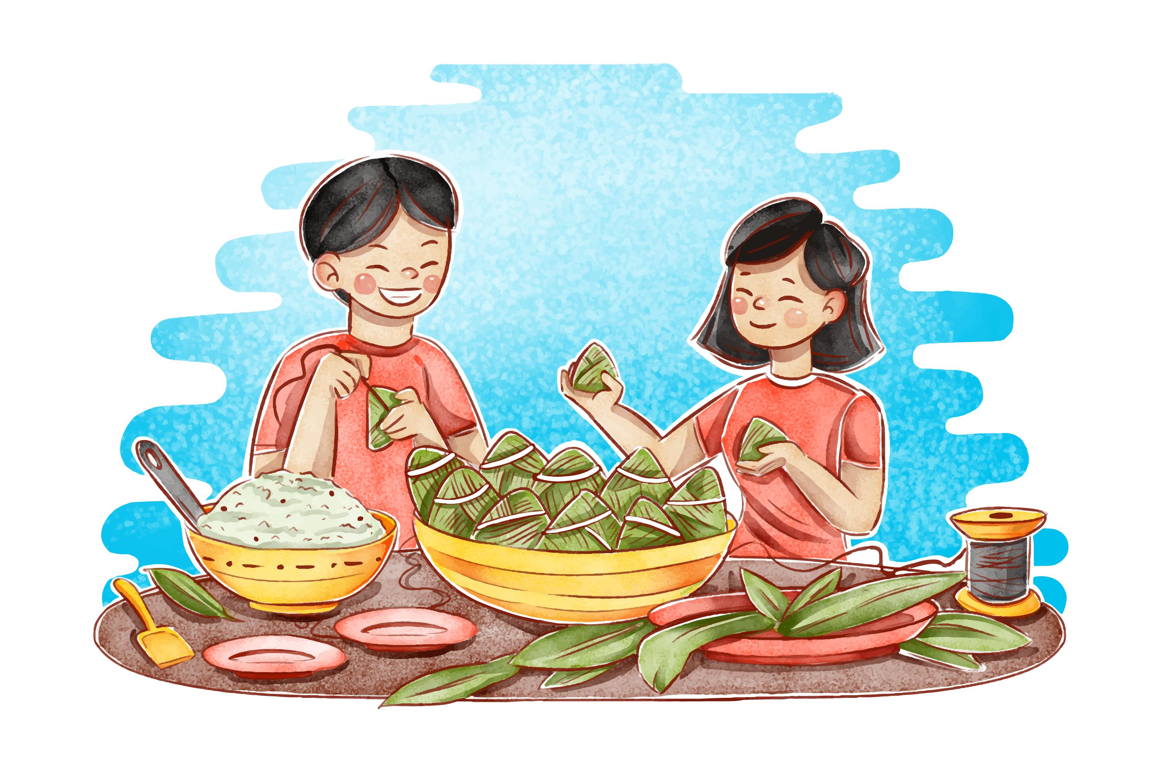
Unit
6
VIETNAMESE LIFESTYLE: THEN AND NOW
LESSON 7: LOOKING BACK & PROJECT

Slide 3
WARM-UP
BRAINSTORMING
- Work in teams
- Members of each team take turns and write as many vocabulary in Unit 6 as possible in ................. minutes.
- The group having more correct answers is the winner.

Slide 4
WARM-UP
* Work in groups
1 minute to start
Put the following verbs in the correct column
enjoy fancy hope finish plan want practice need promise avoid agree like decide prepair start learn
VERBS + TO V | VERBS + V-ING
like love start hope want agree decide learn prepair promise plan need
Enjoy fancy like love start avoid practice finish

Slide 5
VOCABULARY
1
Choose the correct answer A, B, C, or D
1. I love animals and I’m determined to ______ my dream of becoming a vet.
A. have B. pursue C. do D. depend on
2. ______ people tend to put the needs of their families ahead of their own.
A. Independent B. Democratic
C. Kind D. Family-oriented

Slide 6
1
Choose the correct answer A, B, C, or D
3. Rapid changes in society and lifestyle have made the ______ in many families wider.
A. generation gap B. family relation
C. family values D. experiences
4. She has found ______ sources of information about life in Viet Nam a century ago.
extended B. alive C. various D. Long
5. Like adults, children sometimes want some ______.
A. opportunity B. relations
C. values D. privacy

Slide 7
2
Complete the sentences with the correct forms of the words in brackets.
1. My parents taught me not to listen to other people’s __________ conversations. (privacy)
private
2. It’s amazing that the boy can __________all the information in such a short time. (memory)
memorise
3. Living away from home to attend college has made me more ______________(independence).
independent

Slide 8
2
Complete the sentences with the correct forms of the words in brackets.
4. In a modern society, we learn to value a person’s ____________. (free)
freedom
5. In a ___________ classroom, every student has the right to speak as well as the responsibility to listen to others. (democracy)
democratic

Slide 9
3
Circle the correct words or phrases to complete the following sentences.
1. Do you mind turning / to turn the volume down? I’m studying.
2.We decided spending / to spend this whole week learning to cook traditional foods
3. If you want seeing / to see the differences between the past and the present of a city, visit its museum.
4.He stayed in his room to avoid meeting / to meet his parents’ guests.
5. My brother promised taking / to take me to the exhibition of traditional farming tools.

Slide 10
GRAMMAR
4
4
Make complete sentences from the clues. Make any changes and add more words if necessary.
1. we / plan / visit / historical places / Cao Bang.
We plan / are planning to visit some historical places in Cao Bang.
2. we / hope / have / bus station / near / village / soon.
We hope to have a bus station near our village soon.
3. even / grandmother / enjoy / use / Facebook / communicate / her friends.
Even my grandmother enjoys using Facebook to communicate with her
4. last year / I / learn / make cakes / watch / cooking videos / Internet.

Slide 11
GRAMMAR
4
4
Make complete sentences from the clues. Make any changes and add more words if necessary.
4. last year / I / learn / make cakes / watch / cooking videos / Internet.
Last year, I learned to make cakes by watching the cooking videos on the Internet.friends.
5. this morning / I / suggest / do a survey / northern women’s traditional costumes.
This morning, I suggested doing a survey on traditional northern women’s costumes

Slide 12
PROJECT
I KNOW MY ______ WELL!

Slide 13
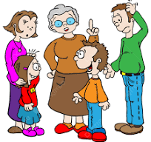
PROJECT
1. Interview one of your family members about his/ her life when he/she was your age now
* Take notes of his/her answers. You may focus on:
what school he/she went to
what learning was like then
how he/she spent his / her free time
what relations among family members were like then

Slide 14
2 . Make a poster, including his / her photo and the information you have noted.
Name: Thu Ba - my mother
School: Nghia Hiep Secondary School
Learning: Traditional approach with books, and chalkboards. Don’t have computers or the internet. Only studying in the morning.
Free Time: Outdoor activities, folk games, sports (football, rope skipping), biking, reading, and drawing
Family Relations: Family bonds were strong. Spending a lot of time with her family, cooking and having dinner with family every day.

Slide 15
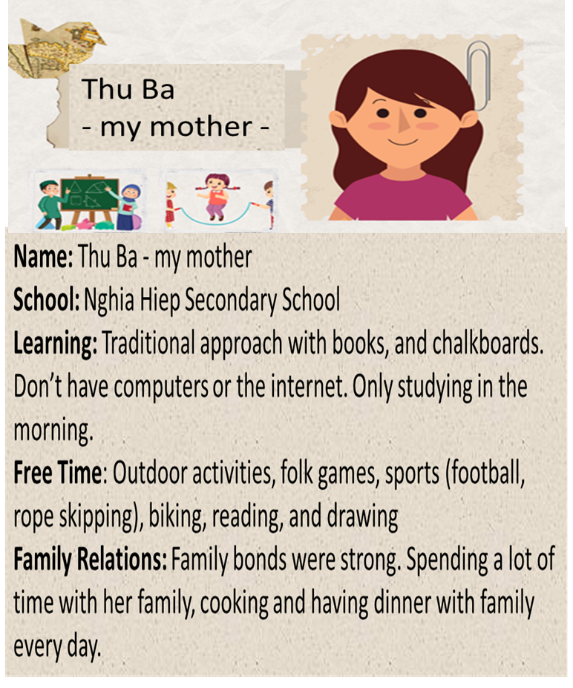
3 . Present your poster to the class.
PRESENTATION

Slide 16
CONSOLIDATION
What have we learnt in this lesson?
Review the vocabulary and grammar of Unit 6
Apply what they have learnt (vocabulary and grammar) into practice through a project.

Slide 17
Homework
Prepare for the next lesson
Prepair Review 2

