Slide 1

ENGLISH 9
Hello everyone !!!

Slide 2

UNSCRAMBLE THE WORD
nacesort
ancestor

Slide 3
UNSCRAMBLE THE WORD
gretahie
heritage

Slide 4
UNSCRAMBLE THE WORD
retcustu
stucture

Slide 5
UNSCRAMBLE THE WORD
turagtide
gratitude

Slide 6
UNSCRAMBLE THE WORD
sveeprer
preserve

Slide 7




Unit
4
REMEMBERING THE PAST
LESSON 7: LOOKING BACK & PROJECT

Slide 8
VOCABULARY
1
Choose the correct answer A, B, C, or D
1. In keeping with ______, we cook five-colour sticky rice on the first day of a lunar month.
A. tradition B. habit
C. ritual D. practice
2. Sam is very interested in history, and he remembers a lot of historical ______and dates.
A. traditions B. events
C. anniversaries D. practices

Slide 9
1
Choose the correct answer A, B, C, or D
3. The fire of London in 1666 destroyed thousands of old ______ and damaged a large part of London’s centre.
A. organisations B. structures
C. Associations D. connections
4. This practice was more common in ______ times than it is now.
A. beginning B. antique
C. historic D. ancient

Slide 10
1
Choose the correct answer A, B, C, or D
5. This complex of buildings was ______ by foreign troops during the war.
A. received B. busy
C. occupied D. filled

Slide 11
2
Finish the sentence by completing each blank with a word. The first letter of each word is given.
1. The custom of w______ ancestors is a beautiful and rich tradition in Vietnamese culture.
2. The custom of sending a greeting card has become a d______ tradition in many western countries.
3. A country’s cultural h______ is a valuable resource
4. Festivals, which are handed down from one g______ to the next, are an important way to promote tourism
5. Besides the key i______, another secret to achieving the perfect fish and chips is the temperature of the oil.
Game

Slide 12
LUCKY NUMBERS
1
2
3
4
5
6
7
8
A
2
4
6
8
10
12
14
B
2
4
6
8
10
12
14
GO

Slide 13
2
Finish the sentence by completing each blank with a word. The first letter of each word is given.
orshiping
1. The custom of w________ ancestors is a beautiful and rich tradition in Vietnamese culture.

Slide 14
2
Finish the sentence by completing each blank with a word. The first letter of each word is given.
2. The custom of sending a greeting card has become a d________ tradition in many western countries.
eep-rooted

Slide 15



Slide 17
2
Finish the sentence by completing each blank with a word. The first letter of each word is given.
3. A country’s cultural h______ is a valuable resource
eritage

Slide 19
2
Finish the sentence by completing each blank with a word. The first letter of each word is given.
4. Festivals, which are handed down from one g_________ to the next, are an important way to promote tourism
eneration

Slide 20
2
Finish the sentence by completing each blank with a word. The first letter of each word is given.
5. Besides the key i______, another secret to achieving the perfect fish and chips is the temperature of the oil.
ngredients

Slide 21
2
Finish the sentence by completing each blank with a word. The first letter of each word is given.
1. The custom of w______ ancestors is a beautiful and rich tradition in Vietnamese culture.
orshiping
2. The custom of sending a greeting card has become a d______ tradition in many western countries.
eep-rooted
3. A country’s cultural h______ is a valuable resource
eritage
4. Festivals, which are handed down from one g______ to the next, are an important way to promote tourism
eneration
5. Besides the key i______, another secret to achieving the perfect fish and chips is the temperature of the oil.
ngredients

Slide 22
THE PAST CONTINUOUS
S + was/were + Ving
=> He was eating rice.
S + was/weren’t + Ving
=> They weren’t playing football
Was/Were + S + Ving?
=> Was she studying all night?

Slide 23
GRAMMAR
3
Put the verb in brackets in the past continuous to complete each sentence.
1. Luckily, the sun (shine) ______________ brightly when we reached the campsite
was shining
2. They (build) ______________ Ho Chi Minh Mausoleum from 1973 to 1975.
were building
weren’t studying
3. When their mum came home, they (not study) ____________; they (chat) _______________noisily.
were chatting

Slide 24
3
Put the verb in brackets in the past continuous to complete each sentence.
Were
4. ______ they still (wait) __________ when the tour guide arrived?
waiting
5. I (think) _________________ of my grandmother for years after she died.
was thinking

Slide 25
WISH + PAST SIMPLE
Subject + wish + subject + past simple
I wish I had enough money to travel around the world.
I wish (that) my mother didn’t have to work so hard.

Slide 26
4
4
Rewrite the following sentences, using wish
1. She doesn’t have an iPhone. She’d like to have one.
She wishes (that) she had an IPhone.
2. I’m sorry that I don’t have a three-month summer holiday as my grandma did.
I wish I had three-month summer holiday as my grandma did.
3. I want my parents to let me make my own decisions, but they don’t.
I wish (that) my parents let me make my own decisions.

Slide 27
4
4
Rewrite the following sentences, using wish
4. Mike wants to play musical instruments, but he can’t.
Mike wishes (that) he could play musical instruments.
5. My dad is very busy. I want him to have more time with me.
I wish (that) my dad was not very busy, and (that) he had more time with me.

Slide 28

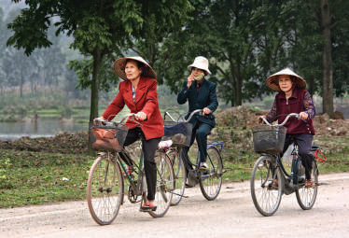
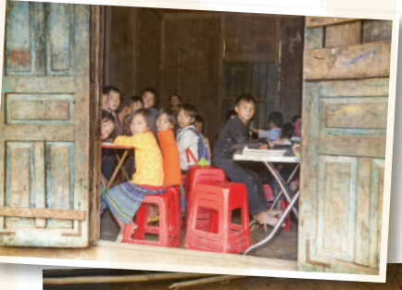
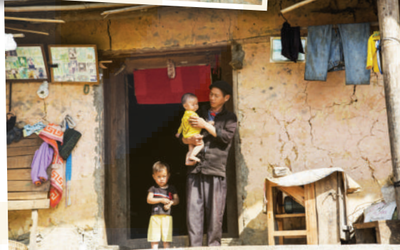
PROJECT
Life in your neighborhood
40 years ago

Slide 29
PROJECT
Task 1: Collect information and pictures about life in your area about 40 years ago.
- Ask your grandparents and / or old people, and / or read books or search the internet to find the information you want.
Information
+ Means of transport (on foot, on horseback, by bicycle, …)
+ Home life (electric devices, cooking, …)
+ Community services (electricity, running water, library, communal house, …)
+ way of cooking
…

Slide 30

PROJECT
Task 2: Make a poster. Write or print the information and stick the pictures on the poster.
- Work in groups to make a poster to introduce the information you have prepared.
PRESENTATION

Slide 31
PROJECT
PRESENTATION

Slide 32
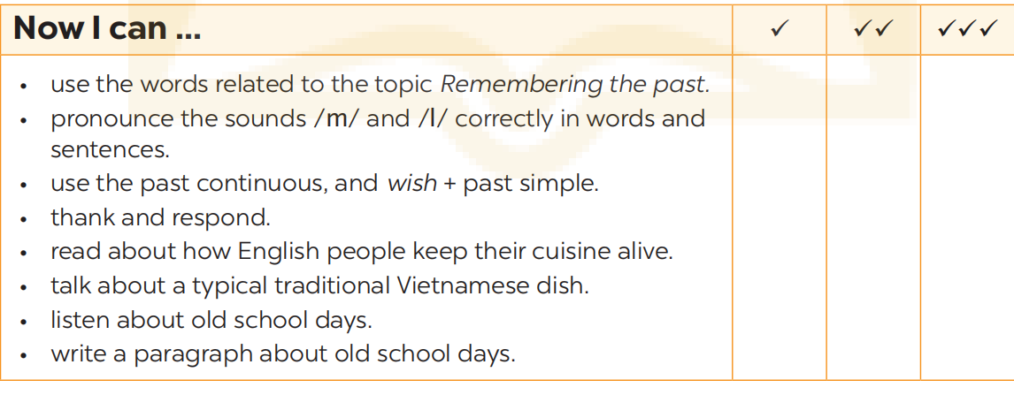
NOW I CAN...
Complete the self-assessment table.

Slide 33

Thanks for your atendance!
Goodbye. See you again
Notes:
33

Slide 34

LESSON 7: LOOKING BACK & PROJECT
LESSON 1: GETTING STARTED
WARM-UP
Brainstorming
Task 1: Choose the correct answer to complete each sentence below.
Task 2: Fill in each gap with a word from the box to complete the passage
VOCABULARY
Task 3: Complete the sentences with the particles in the box. Task 4: Find a grammar mistake in each sentence and correct it.
GRAMMAR
PROJECT
Poster presentation
CONSOLIDATION
Wrap-up
Homework

Slide 35

CONSOLIDATION
1
Wrap-up
What have we learnt in this lesson?
Review the vocabulary and grammar of Unit 4
Apply what they have learnt (vocabulary and grammar) into practice through a project.

Slide 36

CONSOLIDATION
2
Homework
- Prepare for the next lesson

Slide 37
Website: hoclieu.vn
Fanpage: facebook.com/www.tienganhglobalsuccess.vn/

Slide 38
WARM-UP
BRAINSTORMING
- Work in teams
- Members of each team take turns and write as many vocabulary in Unit 4 as possible in ................. minutes.
- The group having more correct answers is the winner.

