Slide 1
ENGLISH 9
Hello everyone !!!

Slide 2
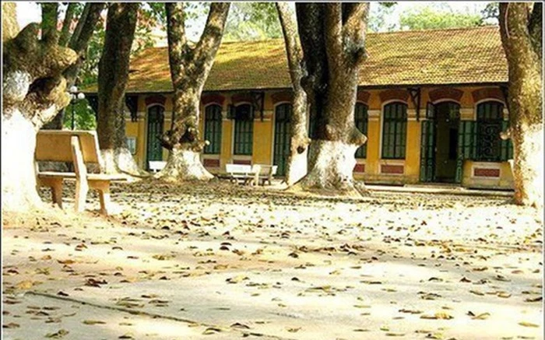
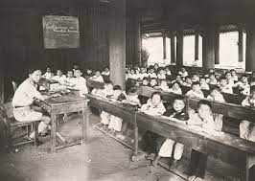
SCHOOL IN THE PAST
What do you know about schools and school days in the past?

Slide 3
SCHOOL IN THE PAST
wear casual clothes
There are no extra classes
white chalk, blackboard;
There are no modern
equipment
maths, language, history, physics, etc.
– school subjects (What …)
– leisure time activities (What …)
– summer holiday (How long …)
– means of transport to school (How …)
traditional games
three months
walk

Slide 4
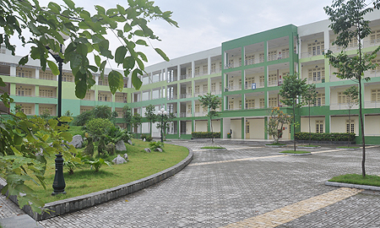
Compare schools in the past and today
in the past
nowadays
- What students wore to school?
- What subjects students studied?
- How students got to school?
….…….

Slide 5
4
Unit
REMEMBERING
THE PAST
LESSON 6: SKILLS 2

Slide 6
I. LISTENING

Slide 7
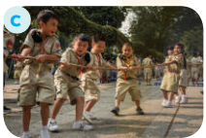
1
Match each phrase with the right picture.
1. walking barefoot
2. talking face to face
3. traditional game

Slide 8
2
Listen to the talk between Thanh and his grandma and tick (√) the things you hear.
1. Three-month summer holiday
2. Lessons in the morning only
3. A lot of extra lessons
4. Walking barefoot
5. Chatting on mobile phones
√
√
√

Slide 9
3
Listen again. Choose the correct answer.
1. The conversation is generally about Thanh’s ________.
A. school days
B. grandma’s school days
C. grandma’s life in the past
2. Thanh’s grandma didn’t have a lot of ______.
A. homework B. lessons C. subjects

Slide 10
3
Listen again. Choose the correct answer.
3. Thanh’s grandma ______ went to school on foot
A. always B. sometimes C. never
4. Students in the past played ______during break time.
A. computer games
B. games on mobile phones
C. traditional games

Slide 11
Audio-script
Thanh: Grandma, you say that you had three months for summer holiday when you were a pupil?
Grandma: Right. And we did lots of things during the summer.
Thanh: Wow, I wish we had a three-month summer holiday! Did you stay at school all day during the school year?
Grandma: No, we had lessons in the morning only.
Thanh: Did you have a lot of homework?
Grandma: Not a lot. And we never had extra lessons.
Thanh:Really? Did you study the same subjects as we do now?
Grandma: Yes and no. We didn’t have music and arts, or computer science.
Thanh: How did you go to school then?
Grandma: Well, we walked all the time. And we didn’t have shoes or sandals. We were walking barefoot.
Thanh: Poor you! But what did you do during break time? Did you chat with your friends
or …?
Grandma:Yes, but … face-to-face. And we played traditional games such as hide-and- seek, tug of war, skipping, etc. There were no mobile phones or iPads then.
Thanh:Well, those were the days …

Slide 12
II. WRITING

Slide 13
4
Work in pairs. Ask and answer about school days in the past.
- Work in pairs. You can use the cues given to ask and answer about school days in the past.
Your talk may include the following:
– school time (When …)
– school subjects (What …)
– leisure time activities (What …)
– summer holiday (How long …)
– means of transport to school (How …)
in the morning only
maths, language, history, physics, etc.
traditional games
three months
walk
- You can refer to the listening text for your answers.

Slide 14
5
Write a paragraph (100 - 120 words) about school days in the past.
- Use the ideas in Activity 4 for your writing.
In the past, students had lessons in the morning only. ___________________________________________
___________________________________________
___________________________________________
___________________________________________
___________________________________________.

Slide 15
In the past, students had lessons in the morning only. ___________________________________________
___________________________________________
___________________________________________
___________________________________________
___________________________________________.
5
Write a paragraph (100 - 120 words) about school days in the past.
Sample paragraph:
In the past, students had lessons in the morning only. In the afternoon, they stayed home and did other things to help their parents. At school, they learned subjects such as maths, language, history, physics, etc. but they did not have music and arts, or sciences. They did not have extra lessons. In their free time they played traditional games such as hide-and-seek, tug of war, skipping, and so on. Every day they went to school on foot. My grandmother told me that they walked barefoot all the time, as they did not have shoes or sandals. They were lucky in that they had a long summer holiday – about three months!

Slide 16
CONSOLIDATION
What have we learnt in this lesson?
Listen for general and specific information about old school days.
Write about old school days.

Slide 17
* Homework
- Rewrite the paragraph in the notebooks.
- Do exercises in the workbook.

Slide 18
Thank you!
Goodbye!

Slide 19
WARM-UP
OPTION 2
COMPARE AND CONTRAST

Slide 21
2. talking face to face
WARM-UP
OPTION 2
- Create a Venn diagram to compare and contrast school days in the past and school days to day with information.
IN THE PAST
TODAY
1. walking barefoot
3. traditional game

