Slide 1
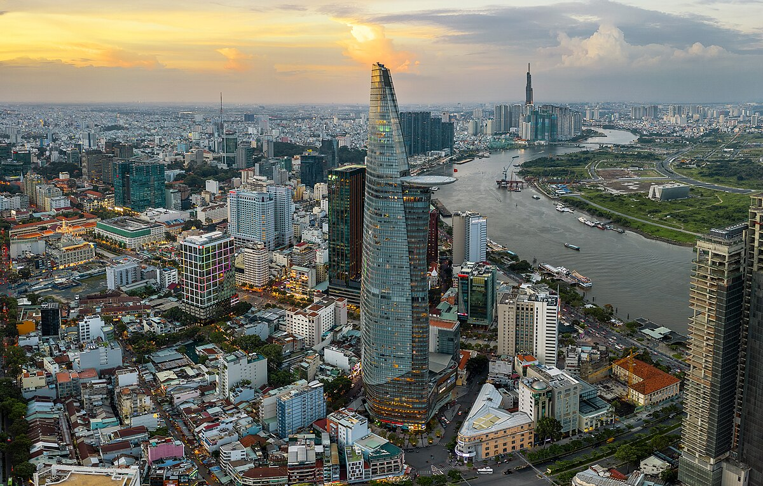


Unit
2
CITY LIFE
LESSON 4:
COMMUNICATION

Slide 2
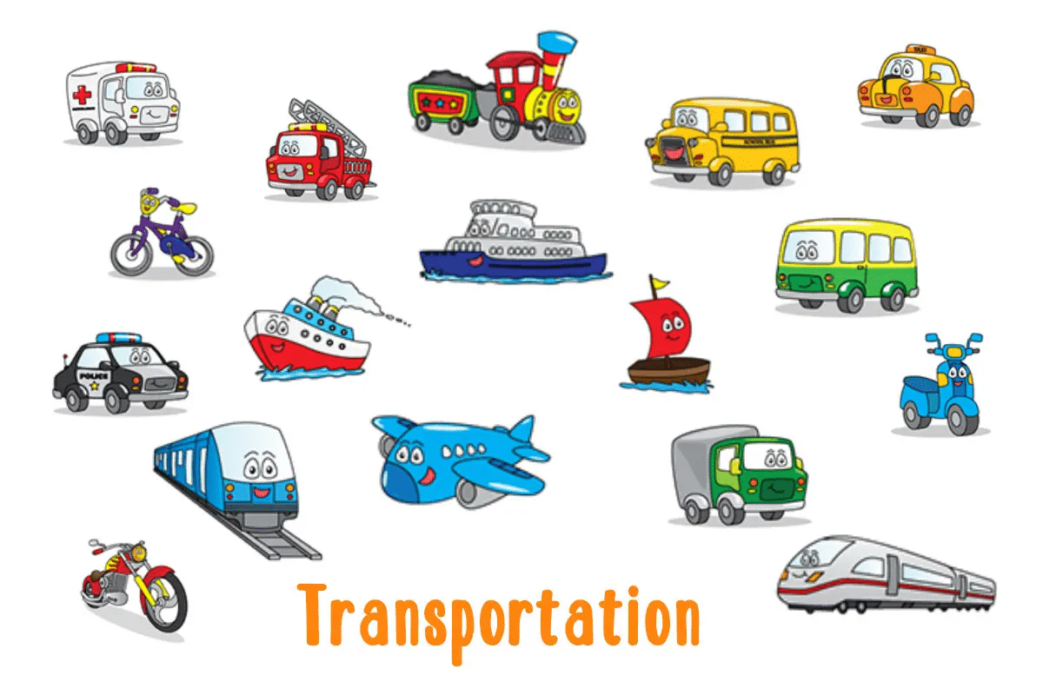

Slide 3
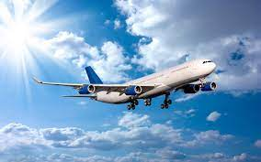
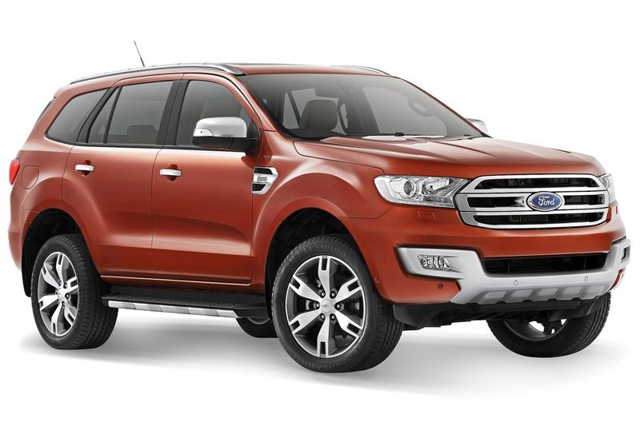
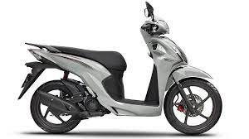
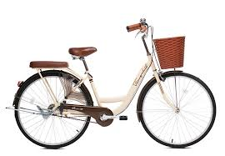
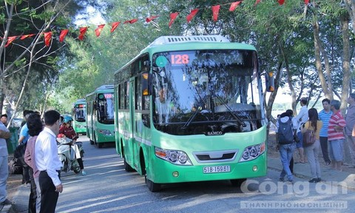
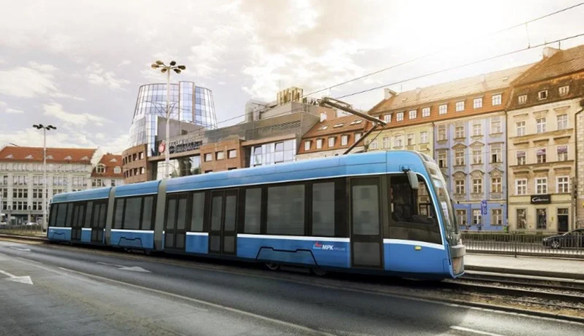

WARM-UP
PELMANISM
1
2
3
4
5
6
means of transport
7
8
9
Motorbike
Bus
Car
10
11
12
Tram
bike
plane

Slide 4
Unit
2
CITY LIFE
LESSON 4:
COMMUNICATION

Slide 5

VOCABULARY
rush hour (n)
the busy part of the day when towns and cities are crowded, either in the morning when people are travelling to work, or in the evening when people are travelling home
/ˈrʌʃ aʊə/
giờ cao điểm

Slide 6

VOCABULARY
an electric vehicle that transports people, usually in cities, and goes along metal tracks in the road
tram (n)
/træm/
xe điện

Slide 7
VOCABULARY
New words | Pronunciation | Meaning
1. rush hour (n) | /ˈrʌʃ aʊə/ | giờ cao điểm
2. tram (n) | /træm/ | xe điện

Slide 8
EVERYDAY ENGLISH
1
Listen and read the conversations below. Pay attention to the highlighted parts.
Situation:
Duong’s best friend is going to Singapore to study there. Duong’s dad knows that Duong wants to go to the airport to see him off.
What will Duong’s dad do?
Try to make some guesses
Might be: Duong’s Dad take him to the airport.
“I can take you to the airport if you like.”
Duong’s dad says this sentence to offer to help him.

Slide 9
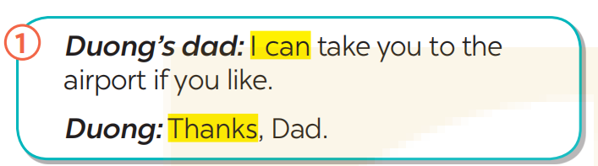
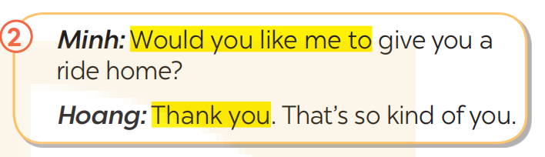
EVERYDAY ENGLISH
Offering help and responding
( Đưa ra sự giúp đỡ và phản hồi)
1
Listen and read the conversations below. Pay attention to the highlighted parts.

Slide 10
These are two common ways to offer help.
How Duong and Hoang say to accept the offers?

Slide 11
2
Work in pairs. Make similar conversations with the following situations
Situation 1:
Your friend doesn't know how to use the library smart card.
You offer to show him/ her.
Situation 2:
A teacher wants to talk to Ms Hoa, but she is not there. You offer to write a note for Ms Hoa.

Slide 12
2
Work in pairs. Make similar conversations with the following situations
Suggested dialogues:
Situation 1:
You: I can show you how to use the library smart card if you like.
Friend: Thanks. That’s so kind of you.
Situation 2:
You: Would you like me to write a note for Ms Hoa?
Friend: Thank you. That’s so kind of you.

Slide 13
Transition from Everyday English to Transport in the city.
- We have A & B.
- Imagine B is new to the city and he/she doesn’t know how to use the public transport system.
- Tell A to offer help to B and B to respond to A’s offer.
They are going to read the opinions of some students about their favourite means of transport in the city.

Slide 14

TRANSPORT IN THE CITY
3
Work in pairs. Read the descriptions of three teenagers about their favourite means of transport. Then complete the table below.
Hoang: I live in the suburbs of Ha Noi. I use my bike to get around. It’s convenient because I can ride it to places where the bus line doesn’t reach. Going by bike might be a bit slow, but I can avoid traffic jams.
Cholada: My favourite means of transport in Bangkok is the sky train. It’s crowded at rush hour, but it’s always on time. It doesn’t get stuck in traffic jams, so I can save time travelling.
Kathy: I love the tram in Melbourne. It offers a discount for students. Sometimes the tram is late, but it always updates its arrival on a smartphone app, so I know in advance and arrange my time easily.

Slide 15
Name of the means of transport
*Complete the table below
Name | Favourite means of transport | Advantage(s) | Drawback(s) | Why using it
Hoang | bike | convenient | slow | avoid (1) _________
Cholada | (2) ___________ | on time | (3)_______ at rush hour | save time travelling
Kathy | (4) ___________ | (5)_________ for students | late | arrange time easily.
traffic jams
crowded
sky train
discount
tram
Its advantage(s) and drawback(s)
Why you choose to use it

Slide 16
TRANSPORT IN THE CITY
3
Work in pairs. Read the descriptions of three teenagers about their favourite means of transport. Then complete the table below.
Hoang: I live in the suburbs of Ha Noi. I use my bike to get around. It’s convenient because I can ride it to places where the bus line doesn’t reach. Going by bike might be a bit slow, but I can avoid traffic jams.
Cholada: My favourite means of transport in Bangkok is the sky train. It’s crowded at rush hour, but it’s always on time. It doesn’t get stuck in traffic jams, so I can save time travelling.
Kathy: I love the tram in Melbourne. It offers a discount for students. Sometimes the tram is late, but it always updates its arrival on a smartphone app, so I know in advance and arrange my time easily.

Slide 17
4
Make notes about a means of transport you are using.
Name of the means of transport
bus ( electric bike)
Its advantage(s) and drawback(s)
near house and school, clean, on time, reduce traffic congestion, air conditioning
Why you choose to use it
reduce traffic congestion Xem thêm tại: https://loigiaihay.com/tieng-anh-9-unit-2-communication-a156721.html

Slide 18
5
Work in groups. Talk to your friends about the means of transport that you use. Use your notes in 4.
- Sit in the groups
- Take turns to talk, using your notes in 4.
Suggested talk
I go to school by bus every day. It is convenient because there are bus stops near my house and my school. The bus is clean and on time. It is very crowded at rush hour, but it has air conditioning so it is cool. That’s why I choose to use it.

Slide 19
5
Work in groups. Talk to your friends about the means of transport that you use. Use your notes in 4.
Suggested talk
My favourite means of transport is electric bike. Electric bikes offer an eco-friendly and cost-effective way to get around. They help reduce pollution, and are low-maintenance. However, drawbacks include the number of charging stations might be limited compared to traditional gas stations. I choose an electric bike for its eco-friendly nature and the flexibility it provides.

Slide 20
EXTRA ACTIVITY
- Which of the three means of transportation in the reading text you have used or would like to use.
- Think of how you felt when you used them and/or why you would like to use them.
- Share your thoughts with your partner.

Slide 21

CONSOLIDATION
What have we learnt in this lesson?
Offer help and respond to an offer;
Talk about means of transport that they use.

Slide 22

Homework
Do exercises in the workbook.
Prepair lesson 5: Skills 1

Slide 23
LESSON 4: COMMUNICATION
LESSON 1: GETTING STARTED
WARM-UP
Option 1: Look and answer.
Option 2: Charades
Vocabulary
Task 1: Listen and read the conversations below. Pay attention to the highlighted parts.
Task 2: Work in pairs. Make similar conversations with the following situations.
EVERYDAY ENGLISH
Task 3: Work in pairs. Read the descriptions of three teenagers about their favourite means of transport. Then complete the table below.
Task 4: Make notes about a means of transport you are using.
Task 5: Work in groups. Talk to your friends about the means of transport that you use. Use your notes in 4.
TRANSPORT IN THE CITY
CONSOLIDATION
Wrap-up
Homework

Slide 24
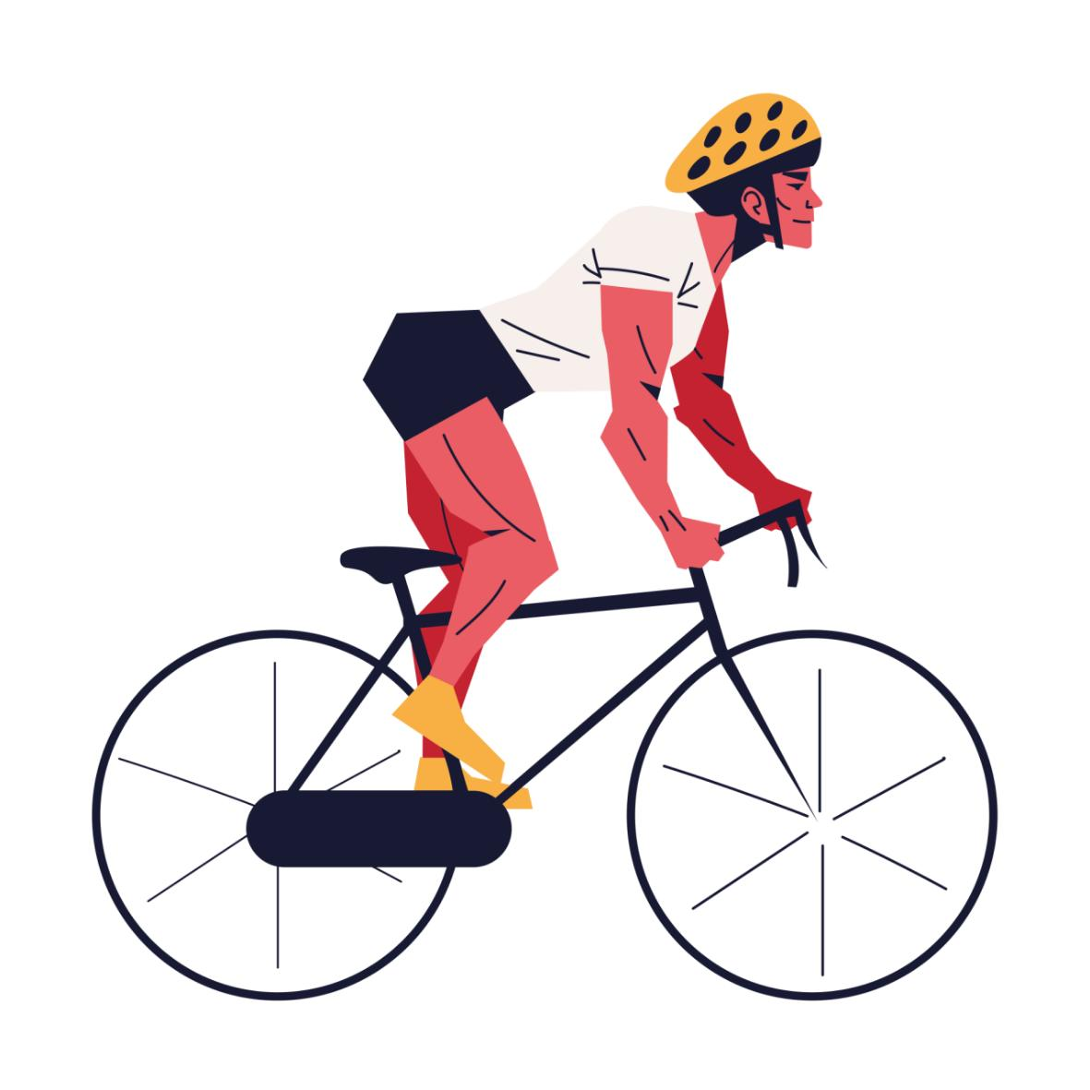
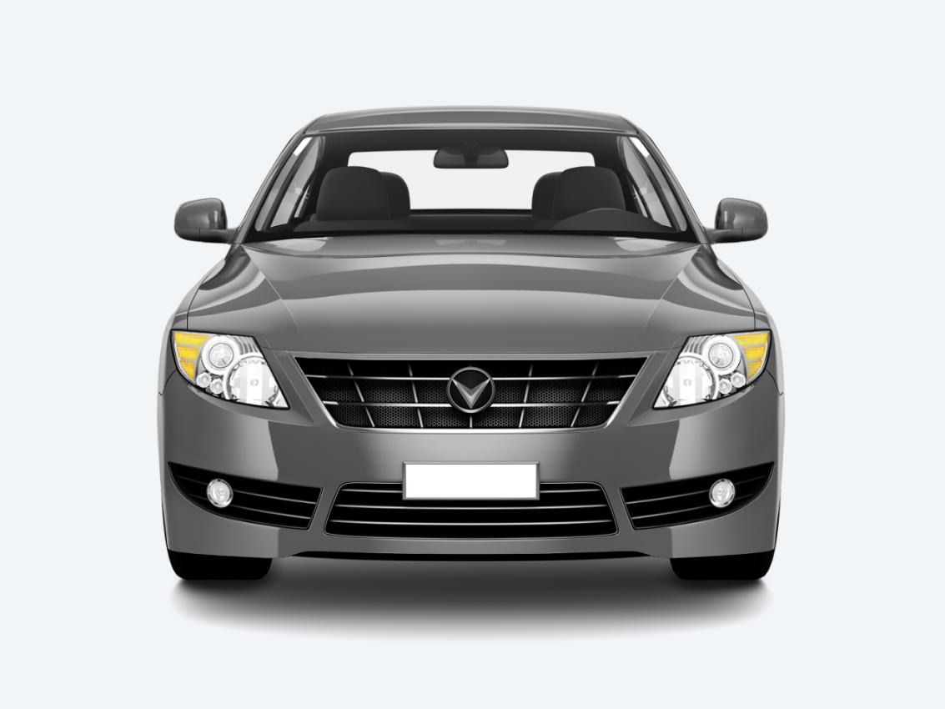
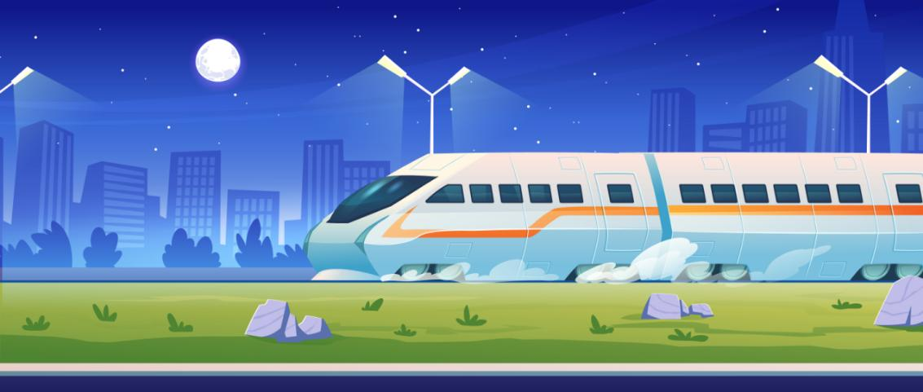
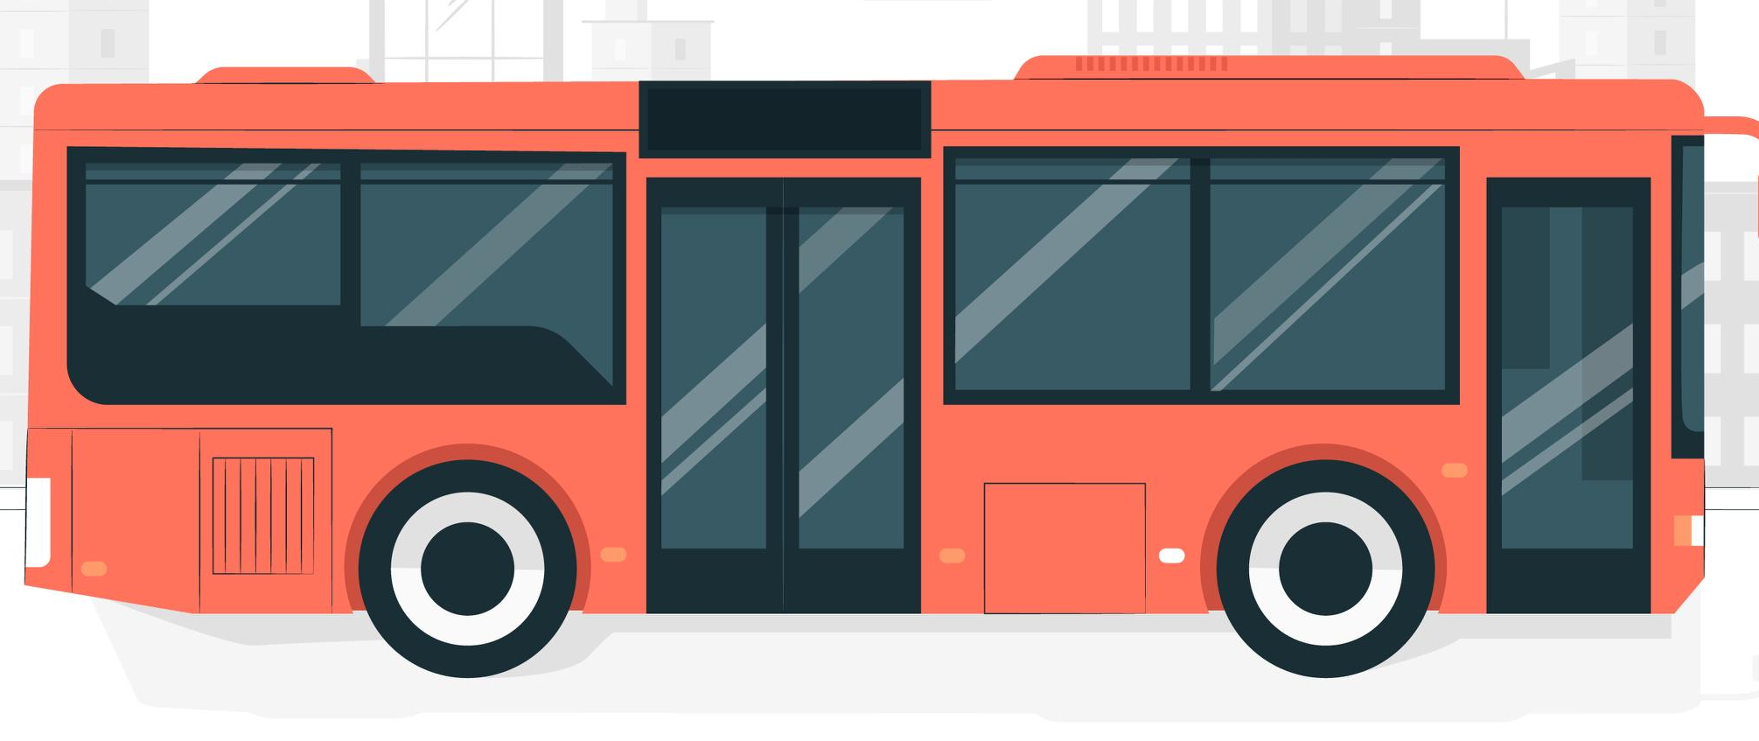
WARM-UP
OPTION 1
- Look at the pictures.

Slide 25
WARM-UP
OPTION 1
- What means of transport do you know?
- What might be common means of transport in the city?

Slide 26

WARM-UP
OPTION 2
CHARADE

Slide 27
WARM-UP
OPTION 2
How to play:
- There are some slips of paper in bag/hat/box.
- One student from each team takes turns to pick a slip and act out the word without speaking.
- The other students from their team have to guess what it is within a time limit.
- If they guess correctly, they get a point. If not, the other team can steal the point by guessing correctly.
- The team with the most points at the end wins.

Slide 28
WARM-UP
OPTION 2
LET’S PLAY

