Slide 1

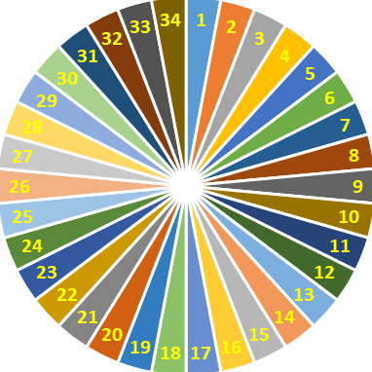
Check out the old lesson by spinning the wheel to call out the name
SPIN
DS lớp Của Quý Thầy, Cô bao nhiêu hs nhờ Côi Nguyễn thiết kế cho nha.

Slide 2
Fill in each blank with a suitable word given in the box.
electrician
artisan
police officer
Community helpers
firefighter
artisan
1. My friend is a talented …………………...who specializes in creating unique jewelry pieces.
Community helpers
2. ………………………., such as police officers and firefighters, play a crucial role in keeping our neighborhoods safe.
electrician
3. After the storm, we had to call an …………..……. to repair the damaged power lines in our neighborhood.
firefighter
4. My brother wants to become a …………………. when he grows up so he can protect others from fires.
police officer
5. The ……………….. visited the local school to educate students about safety and crime prevention

Slide 3


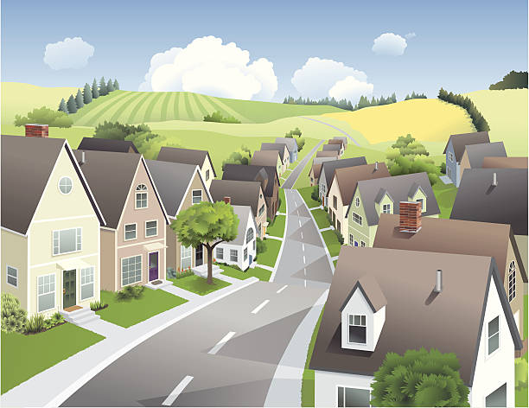
Unit
1
LOCAL COMMUNITY
LESSON 7: LOOKING BACK & PROJECT
1

Slide 4
* VOCABULARY
1
Write a word or phrase for each description below.
1. This person delivers goods to your house.
2. This person stops fires from burning.
3. People visit this place for pleasure usually while they are on holiday.
4. People make these objects out of clay.
5. This person makes things with his/her hands.
delivery person
firefighter
tourist attraction
pottery
artisan

Slide 5
2
Circle the correct word or phrase to complete each sentence.
1. The villagers (preserve / shorten) their traditional weaving techniques.
2. Com Lang Vong has a special (fragrance / function), so it is very popular.
3. Our (firefighters / police officers) help keep law and order in our community.
4. Spring rolls are the (speciality food / fast food) I like best.
5. My home town is famous for (handicrafts / objects), such as paper fans and lanterns.

Slide 6
* GRAMMAR
3
Choose the correct answer A, B, C, or D.
1. You should decide ______ to move to the new house.
A. while B. when C. where D. who
2. Do you know ______ to sort rubbish?
A. who B. which C. how D. what
3. She didn’t tell me ______ to meet, in the library or in the lab.
A. how B. when C. what D. where
4. Could you tell me ______ to do in this situation?
A. what B. when C. where D. who
5. I wonder ______ to ask for advice, my teacher or my parents.
A. where B. when C. who D. what

Slide 7
4
Rewrite each sentence so that it contains the phrasal verb in brackets. You may have to change the form of the verb.
1. In some villages, people reduce the number of steps to make the handicraft. (cut down on)
______________________________
2. My grandparents gave the skills to my parents. (hand down)
______________________________
3. In their community, the eldest child is usually responsible for his or her parents. (take care of)
______________________________
In some villages, people cut down on the number of steps to make the handicraft.
My grandparents handed down the skills to my parents.
In their community, the eldest child usually takes care of his or her parents.

Slide 8
* GRAMMAR
4
Rewrite each sentence so that it contains the phrasal verb in brackets. You may have to change the form of the verb.
4. Before we go to a new place, we always get information about it. (find out)
______________________________
5. They have a good relationship with all neighbours. (get on with)
______________________________
Before we go to a new place, we always find out about it.
They get on with all neighbours.

Slide 9
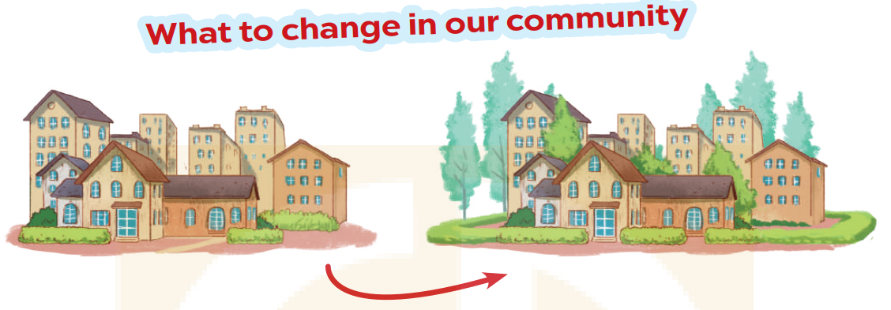
* PROJECT

Slide 10
* PROJECT
1. Interview some students from your class or from other classes about the changes they want to make in their community. Use the questions below
1. Where do you live?
2. What is good about your community?
3. What is not good about your community?
4. What changes do you want to make to improve your community?

Slide 11
* PROJECT
1. Interview some students from your class or from other classes about the changes they want to make in their community. Use the questions below
1. Where do you live?
2. What is good about your community?
3. What is not good about your community?
4. What changes do you want to make to improve your community?
→ I live in the countryside of Hanoi.
→ People in my community tend to be friendly and supportive of each other.
→ One drawback is the limited availability of public spaces and recreational facilities.
→ I would like to see improvements in creating more public spaces, parks, cinemas and entertainment centres.

Slide 12

* PROJECT
2. Collect the answers.
Use the table below.
Students | Question 1 | Question 2 | Question 3 | Question 4
Huong | small town | Friendly neighbors,… | Lack of public parks , outdoor space | more public spaces, parks, cinemas and entertainment centres.
Thu Ba | ……… | …………. | ……….. | …………..

Slide 13

3. Report your group's findings to your class. Use the following questions to guide your report
1. How many students did you interview?
2. What is good about their community?
3. What is not good about their community?
4. What changes do they want to make?
We interviewed 4 students.
Their community has several good aspects: friendly neighbors, peaceful and very cool
he drawbacks of their community are: lack of public parks and outdoor space, limited public transportation options and limited access to quality healthcare
They want their community to have more green spaces and recreational areas, implementing traffic management measures, better public transportation services and more accessible healthcare options.

Slide 14

* CONSOLIDATION
What have we learnt in this lesson?
Review the vocabulary and grammar of Unit 1.
Apply what they have learnt (vocabulary and grammar) into practice through a project.

Slide 15

* Homework
- Do exercises in the Workbook.
- Prepare Unit 2 (Getting started)

Slide 16


Thank you!
Goodbye!

