Slide 1
Song Ve secondary school.
Good morning class!!!
Mrs Thu Ba

Slide 2
English 9 – Global success

Slide 3
WARM-UP
PELMANISM
1
^{up}
1
7
pass
2
2
back
give
8
3
over
3
find
9
4
4
out
10
come
5
5
11
look
down
6
6
12
get
around

Slide 4
WARM-UP
PELMANISM
1
pass
down
2
^{up}
give
3
find
out
4
come
back
5
look
around
6
get
over

Slide 5
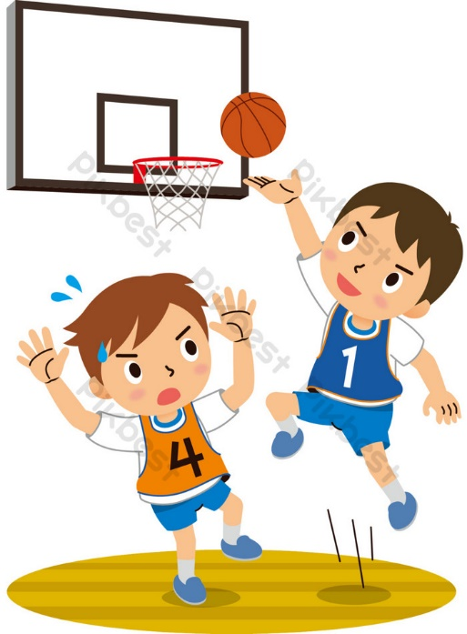
WARM-UP
SET 1
UNIT 3: HEALTHY LIVING FOR TEENS
Notes:
well-balanced life,
optimistic,
a good night's sleep

Slide 6
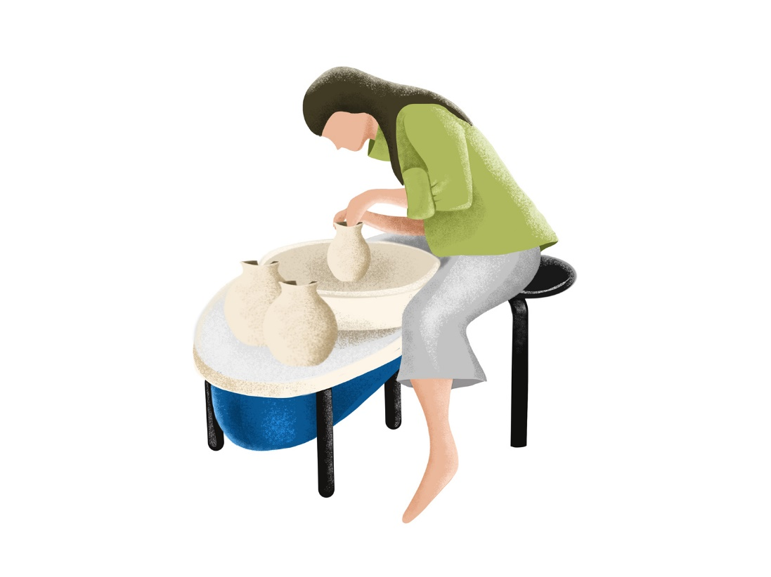
WARM-UP
SET 2
UNIT 1: LOCAL COMMUNITY
Notes:
Speciality/specialty
Artisan
Tourist attraction

Slide 7
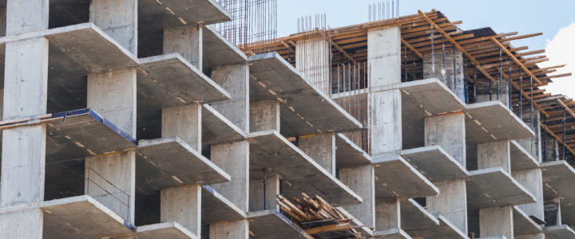
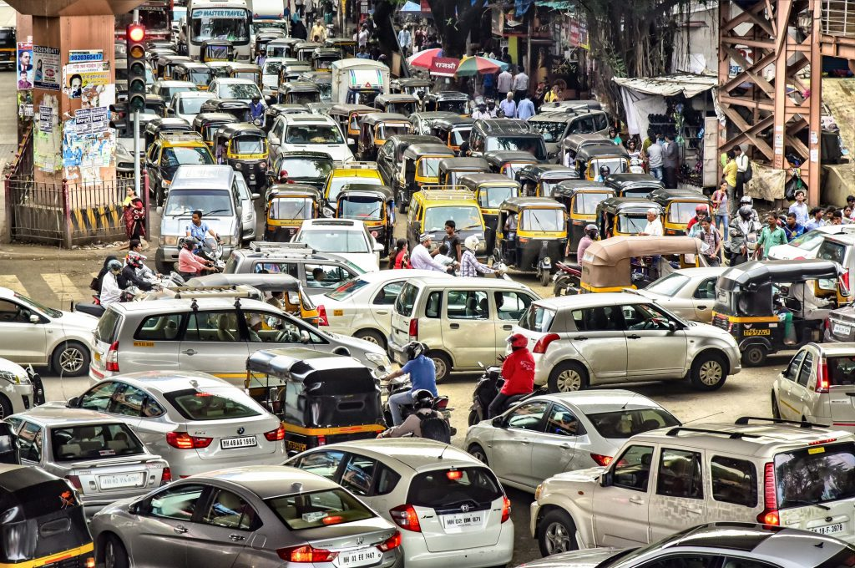
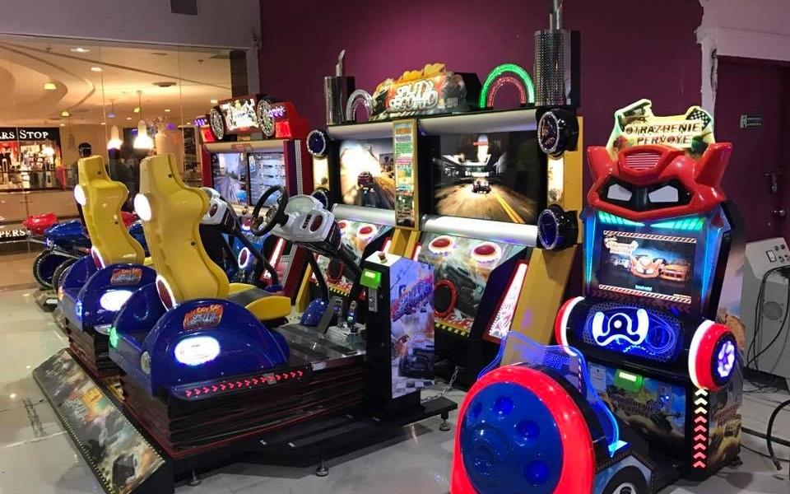
WARM-UP
SET 3
UNIT 2: CITY LIFE
Notes:
concrete jungle,
traffic congestion,
entertainment centre

Slide 8
REVIEW 1
UNITS 1 – 2 – 3
Lesson 1
Language

Slide 9
PRONUNCIATION
Vowel revision: /æ/, /ɑ:/, and /e/
Revision: /aʊ/, /əʊ/, and /eə/
The sounds /h/ and /r/.

Slide 10
1
Choose the word in which the underlined part is pronounced differently.
1. A. below B. down C. town D. nowadays
2. A. ahead B. handicraft C. honour D. hospital
3. A. meat B. read C. heater D. wear
4. A. head B. bread C. leave D. instead
5. A. carry B. garbage C. paragraph D. attraction
Notes:
A
C
D
C
B

Slide 11
VOCABULARY

Slide 12
2
Choose the correct answer A, B, C, or D to complete each sentence.
1. It’s necessary to decide which we should ______ priority to work or study.
A. make B. give
C. bring D. take
2. I don’t like living in this area because it is like a ______ with all these tall buildings.
A. concrete jungle C. concrete wood
B. tourist attraction D. green space

Slide 13
2
Choose the correct answer A, B, C, or D to complete each sentence.
3. They were happy because their children ______ their goal of attending a famous university.
A. administered B. got C. accomplished D. ended
4. There is a sense of ______ in our neighbourhood; we care for and help each other.
A. humour B. community C. responsibility D. duty
5. My grandfather is a skilful ______; he can make unique vases.
A. maker B. worker C. employee D. artisan

Slide 14
3
Fill in each blank with the suitable form of the word given.
1. Bun hen is a local ________________ of this area, so you must try it. (special)
2. My brother is working as an ______________; he repairs electrical equipment very well. (electric)
3. She tried to ______________ my attention from the interesting film on TV. (distraction)
4. There is a ______________ site near our house, so it’s quite noisy. (construct)
5. My neighbourhood is not the best place, but it’s ______________. (live)
speciality
electrician
distract
construction
liveable

Slide 15
GRAMMAR
Question words before to-infinitives
Phrasal verbs
Double comparatives
Modal verbs in first conditional sentences

Slide 16
4
Choose the correct answer A, B, C, or D to complete each sentence.
1. My sister and I are trying to ______ sweet food and soft drinks.
A. carry out B. cut down on
C. hand down D. come down with
2. When we visit a city, we usually ______ its downtown.
A. look after B. find out C. look around D. pass down
3. The ______ he gets, the ______ he becomes.
A. more old; more experienced B. older; experienced
C. more older; more experienced D. older; more experienced

Slide 17
4
Choose the correct answer A, B, C, or D to complete each sentence.
4. The ______ my neighbourhood gets, the ______ I feel.
A. bigger; less secure B. bigger; fewer secure
C. more big; less secure D. more bigger; less secure
5. If you finish reading a book, you ______ put it back on the shelf. It’s necessary.
A. will B. should C. may D. can

Slide 18
5
Write the correct form of each verb in brackets
wants
1. If Lan (want) ________________ to focus on her homework, she should turn off the TV.
2. I don’t know who (ask) _______________ for advice about my future career.
3. If he (continue) _______________ making noise, he must leave immediately.
4. They are wondering what (buy) _______________for their grandmother on her birthday.
5. We can make the air in the city cleaner if we (not use) ________________ our cars as much.
to ask
continues
to buy
don’t use

Slide 19
CONSOLIDATION
What have we learnt in this lesson?
Review the vocabulary and grammar of Unit 1, 2, 3.

Slide 20
Homework
Do the exercises in the workbook.
Prepair lesson 2 (Skills)

