Slide 1
SONG VE SECONDARY SCHOOL
Hello every one !!!
love
NGUYỄN THỊ THU BA

Slide 2
WARM-UP
Game: Who’s faster?

Slide 3
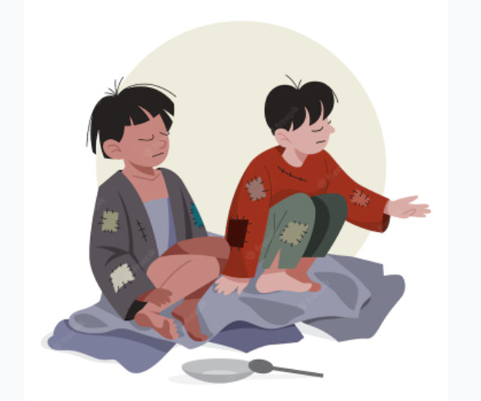
* WARM-UP
2 teams
Look at the pictures and write descriptions .
☞ The winner is who finishes first and has the correct answers.
homeless children
the elderly

Slide 4
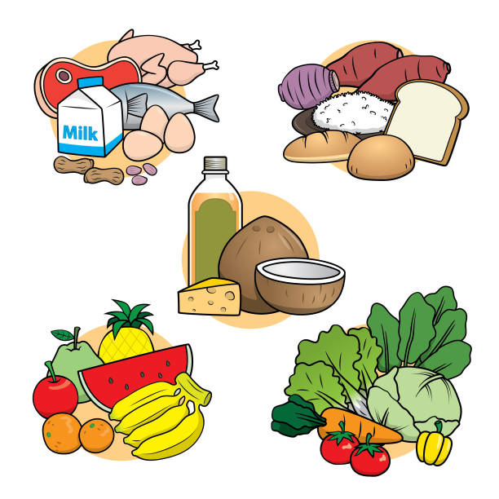
* WARM-UP
2 teams
Look at the pictures and write descriptions .
☞ The winner is who finishes first and has the correct answers.
food
litter

Slide 5
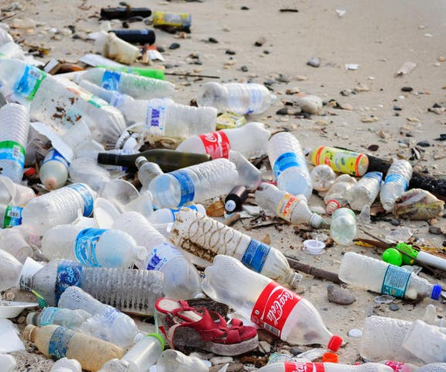
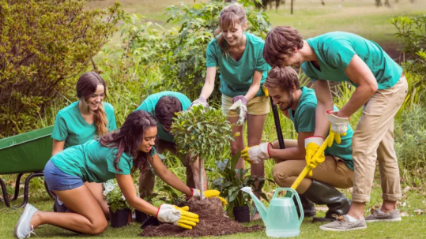
* WARM-UP
2 teams
Look at the pictures and write descriptions .
☞ The winner is who finishes first and has the correct answers.
Plant trees
bottles

Slide 6
* VOCABULARY REVIEW
1
Complete the table with the words and phrases from the box.
help | pick up | donate
homeless children
litter
food
the elderly
bottles
books

Slide 7
2
Complete each sentence with one phrase from Task 1. Remember to use the correct forms of the verbs.
1. The club __________________ to some poor farmers last week. 2. Yesterday, we __________________ around our area and recycled them. 3. We __________________ do the cleaning last summer. 4. Last month, our club __________________ to the community library. 5. In our recent project, we _________________________ learn to read and write.
Game: Lucky number 

Slide 8
LUCKY NUMBER!
1
2
3
4
5
6

Slide 9
LUCKY NUMBER!
you get 2 plus points

Slide 10
2
Complete each sentence with one phrase from Task 1. Remember to use the correct forms of the verbs.
donate food pick up bottles
help the elderly donat books
help homeless children pick up litter
donated food
1. The club ______________ to some poor farmers last week.

Slide 11
2
Complete each sentence with one phrase from Task 1. Remember to use the correct forms of the verbs.
donate food pick up bottles
help the elderly donat books
help homeless children pick up litter
picked up bottles
2. Yesterday, we _______________ around our area and recycled them.

Slide 12
2
Complete each sentence with one phrase from Task 1. Remember to use the correct forms of the verbs.
donate food pick up bottles
help the elderly donat books
help homeless children pick up litter
helped the elderly
3. We __________________ do the cleaning last summer.

Slide 13
2
Complete each sentence with one phrase from Task 1. Remember to use the correct forms of the verbs.
donate food pick up bottles
help the elderly donat books
help homeless children pick up litter
donated books
4. Last month, our club _______________ to the community library.

Slide 14
2
Complete each sentence with one phrase from Task 1. Remember to use the correct forms of the verbs.
donate food pick up bottles
help the elderly donat books
help homeless children pick up litter
5. In our recent project, we ___________________ learn to read
and write.
helped homeless children

Slide 15
2
Complete each sentence with one phrase from Task 1. Remember to use the correct forms of the verbs.
1. The club __________________ to some poor farmers last week. 2. Yesterday, we __________________ around our area and recycled them. 3. We __________________ do the cleaning last summer. 4. Last month, our club __________________ to the community library. 5. In our recent project, we _________________________ learn to read and write.
donated food
picked up bottles
helped the elderly
donated books
helped homeless children

Slide 16
4
Write full sentences about the activities the students did to help their community last year.
1. Mi: singing and dancing for the elderly at a nursing home 2. Mark and his friends: collecting books and setting up a community library 3. Lan and Mai: growing and donating vegetables to a primary school 4. Minh and his friends: giving food to young patients in a hospital 5. Tom: making and sending postcards to the elderly at Christmas
Mi sang and danced for the elderly at a nursing home.
Mark and his friends collected books and set up a community library.
Lan and Mai grew and donated vegetables to a primary school.
Minh and his friends gave food to young patients in a hospital.
Tom made and sent postcards to the elderly at Christmas.

Slide 17
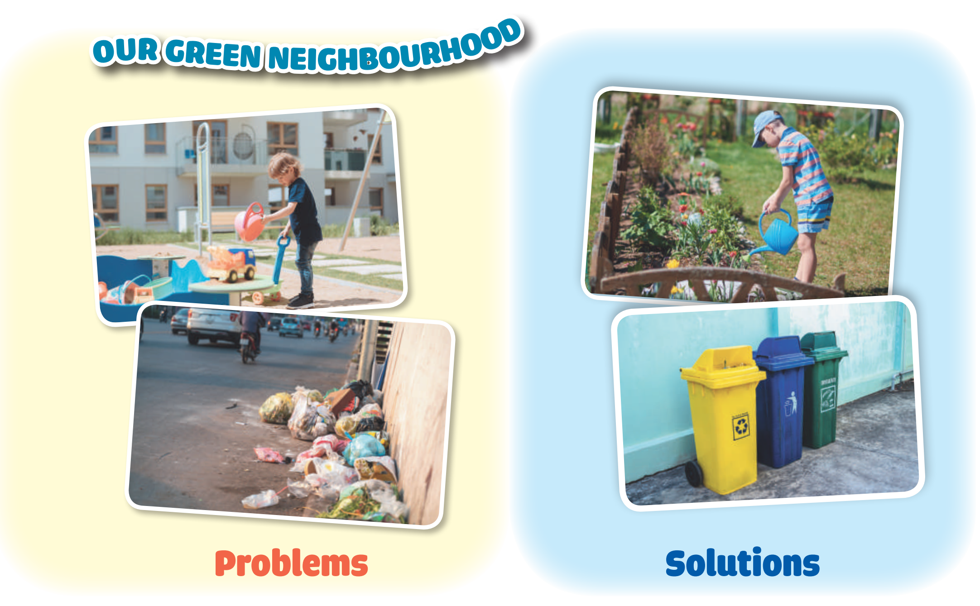
* PROJECT
5
1. Think about some environmental problems in your neighbourhood. 2. Discuss and find the answers to the questions. • What problems can you find? • What do you want to do to solve the problems? • How are you going to do them? 3. Present them to your class.
Work in groups.
1

Slide 18
* CONSOLIDATION
1
WRAP-UP
Words related to community activities
Grammar
Discuss some environmental problems and the solutions to them.
The past simple
Vocabulary
Project

Slide 19
homework
- Redo all the exercises.
- Prepare for the next lesson:
REVIEW 1 ( language)

Slide 20
Thank you!
Goodbye!

