Slide 1
SONG VE SECONDARY SCHOOL
Hello every one !!!
love
NGUYỄN THỊ THU BA

Slide 2
WARM-UP
Alphabet game

Slide 3
* WARM-UP
ALPHABET GAME
A: He asked me my name.
1
2
3
4
A
D
P
T
5
7
C
E
G
F
6
8
H
S
11
12
9
10
L
B

Slide 4
Unit
3
COMMUNITY SERVICE
LESSON 4: COMMUNICATION
EVERYDAY ENGLISH

Slide 5
1
Listen and read the dialogue between Lan and Mark. Pay attention to the highlighted parts.
Lan: What did you do to help your community last summer, Mark? Mark: We planted some trees in the schoolyard and picked up a lot of rubbish along the nearby roads. Lan: Sounds like great work! We collected books and warm clothes for our friends in the mountainous areas. Mark: Wonderful!
2 ways to give compliments:
Sounds like great work!
Wonderful!

Slide 6
2
Work in pairs. Make similar conversations.
1. Mi helped lonely elderly people. 2. Tom and his friends cleaned and decorated parts of their neighbourhood.

Slide 7
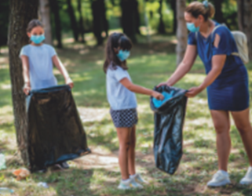
2
Work in pairs. Make similar conversations.
Mi: What did you do to help your community last summer, Tom?
Tom: My friends and I cleaned and decorated parts of our neighbourhood.
Mi: Sounds like great work! I helped lonely elderly people in the area.
Tom: Wonderful!

Slide 8
* CHANGING OUR NEIGHBOURHOOD
3
Work in pairs. Read the poster about the volunteer activities for teenagers at Lending Hand.

Slide 9
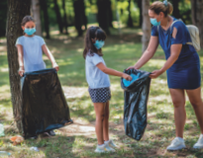
* CHANGING OUR NEIGHBOURHOOD
3
Write the project number (1 – 3) next to its benefit (A – E)
Benefits
______ A. making the elderly less lonely
______ B. making the neighbourhood greener
______ C. helping feed children
______ D. helping children have a better future
______ E. making the neighbourhood cleaner
3
1
2
2
1

Slide 10
* CHANGING OUR NEIGHBOURHOOD
4
Ask and answer which activities in Task 3 you want to join. Give reasons.
Example: Minh: Which activity do you want to join? Lan: I want to join some clean-up activities. Minh: Why do you want to join these activities? Lan: because they make the neighbourhood cleaner

Slide 11
* CHANGING OUR NEIGHBOURHOOD
5
Discuss which activity each member of your group chooses and the benefit(s) of the activity.
4
Example: Mai wants to donate food to street children because this helps feed them. Lan wants to join clean-up activities because these activities make our neighbourhood cleaner …

Slide 12
* CHANGING OUR NEIGHBOURHOOD
5
Discuss which activity each member of your group chooses and the benefit(s) of the activity.
4
Nga wants to donate food to street children and teach them English because this helps feed them and helps them have a better future.

Slide 13
* CONSOLIDATION
1
WRAP-UP
In this lesson, we have learn to:
know how to give compliments
discuss and present the benefits of community activities

Slide 14
homework
Redo all the exercises.
Prepare SKILLS 1.

Slide 15
Thank you!
Goodbye!

