Slide 1
Song Ve secondary school.
Good morning class!!!
Mrs Thu Ba

Slide 2
Unit
3
COMMUNITY SERVICE
Vocabulary
Use words related to community activities
Pronunciation
/t/ , /d/ , /ɪd/
LESSON 2: A CLOSER LOOK 1
Unit
HOBBIES

Slide 3
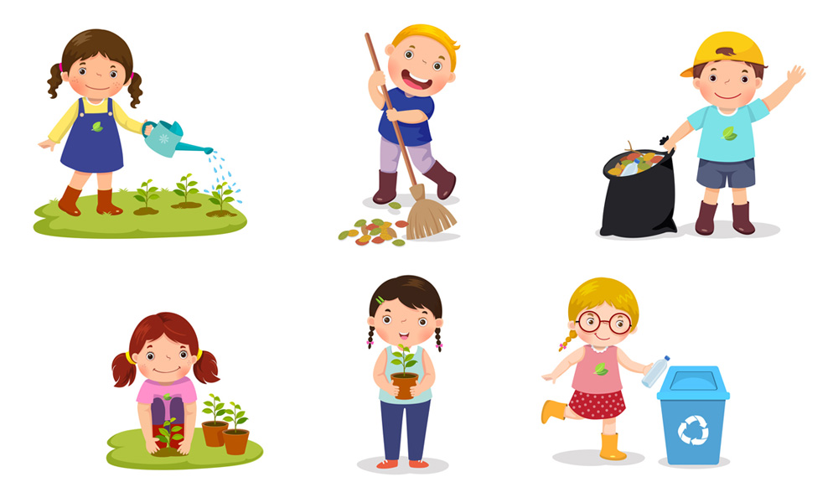
* WARM-UP
Match the verbs with the suitable nouns.
recycle | help | plant
trees | vegetables | small children | old people
books | bottles | cans | homeless children

Slide 4
* WARM-UP
Match the verbs with the suitable nouns.
recycle
books
bottles
cans
help
small children
homeless children
old people
plant
trees
vegetables

Slide 5
* VOCABULARY
- exchange (v):
trao đổi
/ɪksˈʧeɪnʤ/

Slide 6
* VOCABULARY
- pick up (phr. v.):
/pɪk ʌp/
nhặt lên

Slide 7
* VOCABULARY
- tutor (v):
/ˈtjuːtə/
dạy kèm

Slide 8
* VOCABULARY
New words | Pronunciation | Meaning
1. exchange (v) | /ɪksˈʧeɪnʤ/ | trao đổi
2. pick up (phr. v.) | /pɪk ʌp/ | nhặt lên, hái (hoa)
3. tutor (v) | /ˈtjuːtə/ | dạy kèm

Slide 9
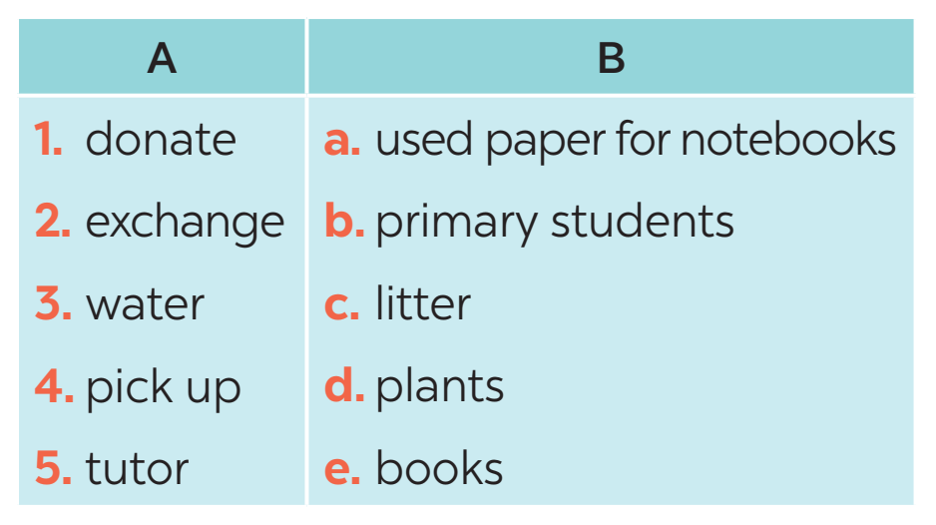
1
Match a verb in a with a word or phrase in B.
1. e
2. a
3. d
4. c
5. b
Notes:
Wordwall game: https://wordwall.net/resource/27241481

Slide 10
2
Complete each of the sentences with a suitable word or phrase from the box.
tutor litter water donate used paper for notebooks
1. We pick up ____________ at the local park every Sunday. 2. Children in our village exchange ____________________________ every school year. 3. Tom and his friends ____________ the plants in their neighbourhood every weekend. 4. We ____________ old textbooks to children in rural areas. 5. Minh and his friends often ____________ small children in their village.
Game: Lucky number

Slide 11
Lucky number Game
1
6
2
Team A
Team B
8
2
8
10
4
4
6
2
10
6
5
3
4
TIẾP

Slide 12
2
Complete each of the sentences with a suitable word or phrase from the box.
tutor litter water donate used paper for notebooks
1. We pick up ____________ at the local park every Sunday.
litter

Slide 13
2
Complete each of the sentences with a suitable word or phrase from the box.
tutor litter water donate used paper for notebooks
used paper for notebooks
2. Children in our village exchange _____________________ school year.

Slide 14
2
Complete each of the sentences with a suitable word or phrase from the box.
tutor litter water donate used paper for notebooks
3. Tom and his friends ____________ the plants in their neighbourhood every weekend
water

Slide 15
2
Complete each of the sentences with a suitable word or phrase from the box.
tutor litter water donate used paper for notebooks
donate
4. We ____________ old textbooks to children in rural areas.

Slide 16
2
Complete each of the sentences with a suitable word or phrase from the box.
tutor litter water donate used paper for notebooks
5. Minh and his friends often ____________ small children in their village.
tutor

Slide 17
LUCKY NUMBER!

Slide 18
2
Complete each of the sentences with a suitable word or phrase from the box.
tutor litter water donate used paper for notebooks
1. We pick up ____________ at the local park every Sunday. 2. Children in our village exchange ____________________________ every school year. 3. Tom and his friends ____________ the plants in their neighbourhood every weekend. 4. We ____________ old textbooks to children in rural areas. 5. Minh and his friends often ____________ small children in their village.
litter
used paper for notebooks
water
donate
tutor
Game: Lucky number

Slide 19
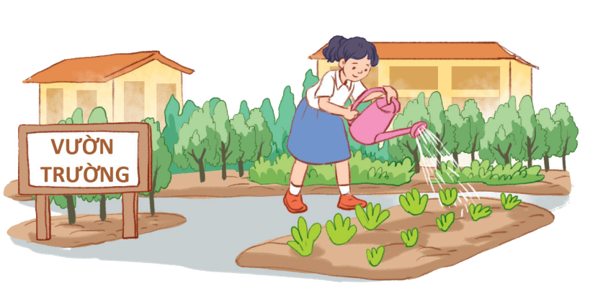
3
Use the phrases from the box to write full sentences under the correct pictures.
0. watering vegetables in the school garden
1. giving gifts to old people
2. exchanging used paper for notebooks
3. planting trees in the park
4. reading books to the elderly
5. donating clothes to poor children
Example:
0. Lan is watering vegetables in the school garden.

Slide 20
3
Use the phrases from the box to write full sentences under the correct pictures.
0. watering vegetables in the school garden
1. giving gifts to old people
2. exchanging used paper for notebooks
3. planting trees in the park
4. reading books to the elderly
5. donating clothes to poor children
1.
1. She’s reading books to the elderly.

Slide 21
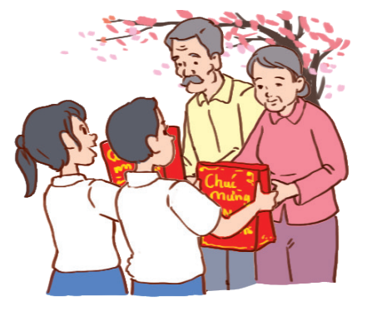
3
Use the phrases from the box to write full sentences under the correct pictures.
0. watering vegetables in the school garden
1. giving gifts to old people
2. exchanging used paper for notebooks
3. planting trees in the park
4. reading books to the elderly
5. donating clothes to poor children
2.
2. They’re giving gifts to old people.

Slide 22
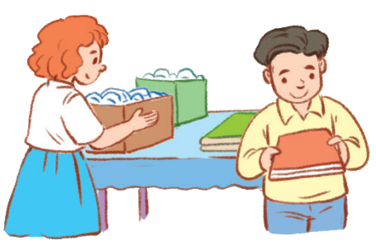
3
Use the phrases from the box to write full sentences under the correct pictures.
0. watering vegetables in the school garden
1. giving gifts to old people
2. exchanging used paper for notebooks
3. planting trees in the park
4. reading books to the elderly
5. donating clothes to poor children
3.
3. They are exchanging used paper
for notebooks.

Slide 23
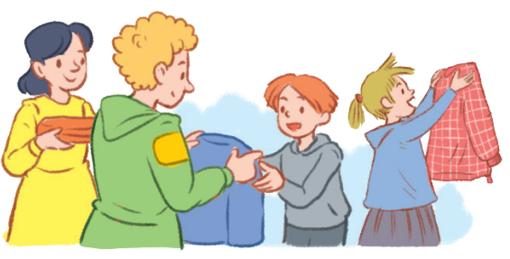
3
Use the phrases from the box to write full sentences under the correct pictures.
0. watering vegetables in the school garden
1. giving gifts to old people
2. exchanging used paper for notebooks
3. planting trees in the park
4. reading books to the elderly
5. donating clothes to poor children
4.
4. They’re donating clothes to poor children.

Slide 24
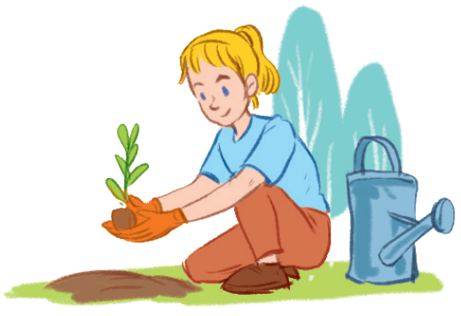
3
Use the phrases from the box to write full sentences under the correct pictures.
0. watering vegetables in the school garden
1. giving gifts to old people
2. exchanging used paper for notebooks
3. planting trees in the park
4. reading books to the elderly
5. donating clothes to poor children
5.
5. She’s planting trees in the park.

Slide 25
LESSON 2: A CLOSER LOOK 1
WARM-UP
Matching game
Task 1: Match a verb in A with a word or phrase in B.
Task 2: Complete each of the sentences with a suitable word or phrase from the box.
Task 3: Use the phrases from the box to write full sentences under the correct picture.
VOCABULARY
Task 4: Listen and repeat. Pay attention to the sounds /t/, /d/ and /ɪd/.
Task 5: Listen to the sentences and pay attention to the underlined parts. Tick the appropriate sounds. Practise the sentences.
PRONUNCIATION

Slide 26
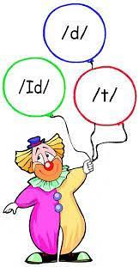
* PRONUNCIATION

Slide 27
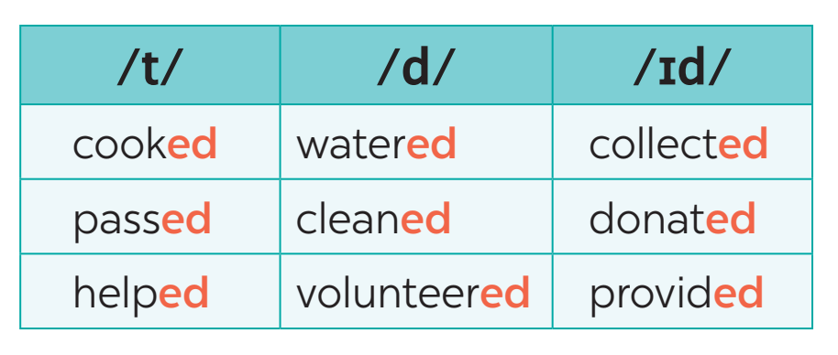
* PRONUNCIATION
4
Listen and repeat. Pay attention to the sounds /t/, /d/, and /ɪd/.

Slide 28
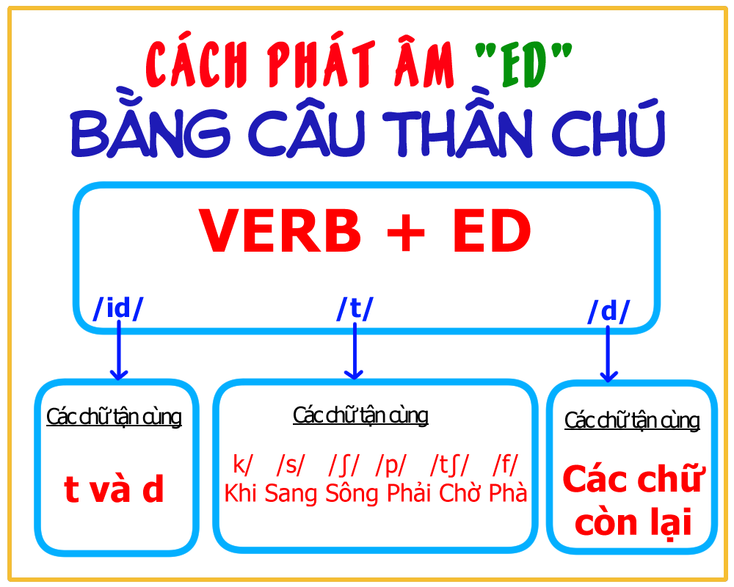

Slide 29
* PRODUCIATION
5
Listen to the sentences and pay attention to the underlined parts. Tick the appropriate sounds. Practise the sentences.

Slide 30
PRODUCIATION
Game: Broken telephone
/t/ | /d/ | /ɪd/
picked, booked, helped | tutored, watered, exchanged | donated, planted

Slide 31
* CONSOLIDATION
Vocabulary
Use words related to community activities
Pronunciation
/t/, /d/, /ɪd/
1
WRAP-UP

Slide 32
2
HOMEWORK
What can you do to make your neighbourhood to be a greener place? Write at least 3 activities.

Slide 33
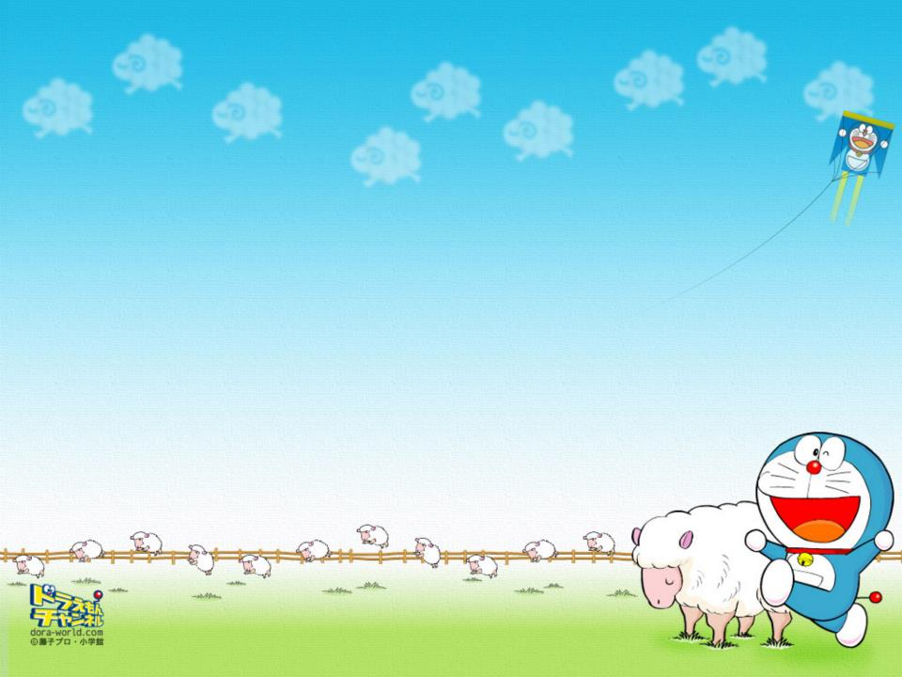

Slide 34
Mrs Thu Ba - liên hệ fb ( Côi Nguyễn ) để mua giáo án chính chủ nhé
Gmail : thubahai@gmail.com

