Slide 1
SONG VE SECONDARY SCHOOL
Hello every one !!!
love
NGUYỄN THỊ THU BA

Slide 2
Unit
2
HEALTHY LIVING
LESSON 7: LOOKING BACK & PROJECT
1.
Vocabulary review
2.
Grammar review
3.
Project: Build healthy habits

Slide 3
WARM-UP
Watch a video clip and write 5 healthy habits

Slide 4
Please give some more healthy habits that you know
- Go to bed early and get enough sleep.
Eat more fruit and vegetables, and less fast food.
Drink enough water, but not soft drinks.
Do exercise regularly.
……………..

Slide 5
* VOCABULARY REVIEW
1
Complete the sentences with the verbs below.
are exercise avoid affects keeps
1. Healthy food and exercise help people ______________ fit.
2. Weather that is too cold or too hot ___________ your skin condition.
3. Children should ____________ fast food and soft drinks.
4. Bad habits like eating too much sweetened food and going to bed late ____________ harmful to our health.
5. We can _____________ indoors and outdoors.
keep
affects
avoid
are
exercise

Slide 6
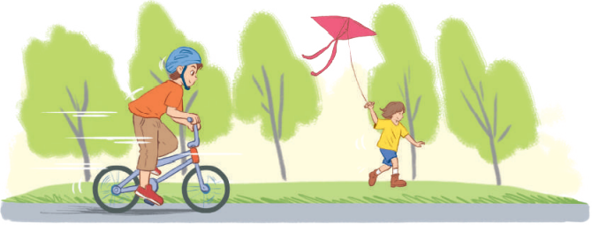
2
Write the words below next to their definitions
tidy active fit dirty healthy
1. always busy doing things, especially physical activities __________
2. good for your health __________
3. everything in order __________
4. in good shape __________
5. not clean __________
Game: Lucky number

Slide 7
LUCKY NUMBER!
1
2
3
5
6
4

Slide 8
2
Write the words below next to their definitions
tidy active fit dirty healthy
1. always busy doing things, especially physical activities: __________
active

Slide 9
2
Write the words below next to their definitions
tidy active fit dirty healthy
2. good for your health: __________
healthy

Slide 10
2
Write the words below next to their definitions
tidy active fit dirty healthy
3. everything in order : __________
tidy

Slide 11
2
Write the words below next to their definitions
tidy active fit dirty healthy
4. in good shape : __________
fit

Slide 12
2
Write the words below next to their definitions
tidy active fit dirty healthy
5. not clean : __________
dirty

Slide 13
LUCKY NUMBER!

Slide 14
2
Write the words below next to their definitions
tidy active fit dirty healthy
1. always busy doing things, especially physical activities: __________
2. good for your health: __________
3. everything in order: __________
4. in good shape: __________
5. not clean: __________
active
healthy
tidy
fit
dirty

Slide 15
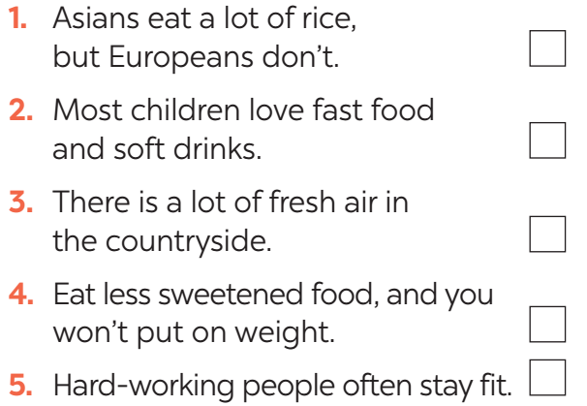
* GRAMMAR REVIEW
3
Tick the simple sentences.

Slide 16
* GRAMMAR REVIEW
4
Change the following sentences into simple ones.
1. You are active, and your brother is active too.
→ Both you and ______________________________.
2. Your room looks dark, and it looks untidy too.
→ Your room _________________________________.
3. The Japanese work hard, and they exercise regularly.
→ The Japanese _______________________________.
4. My mother eats a lot of fruit, and she eats a lot of vegetables too.
→ My mother eats _____________________________.
your brother are active
looks dark and untidy
work hard and exercise regularly
a lot of fruit and vegetables

Slide 17
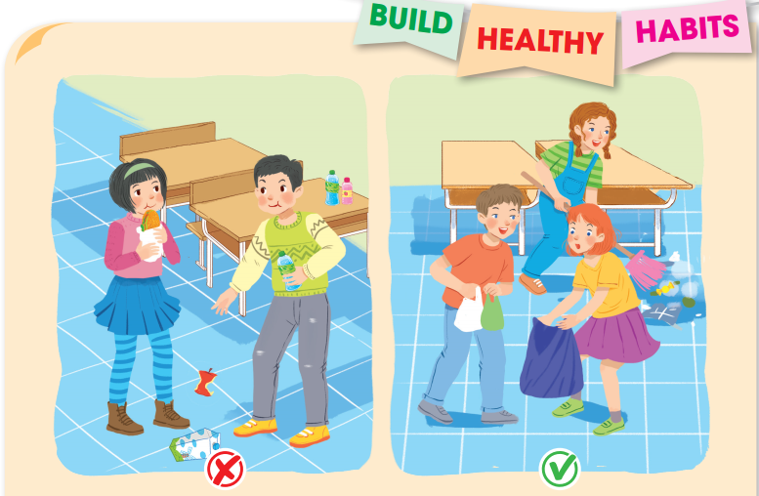
* PROJECT
5
Your class is starting a campaign to make your school a healthier place. In groups, make a poster about a bad habit that the students in your school often do and give some tips to change that habit.
Discuss and find a bad habit and some tips to change it.

Slide 18
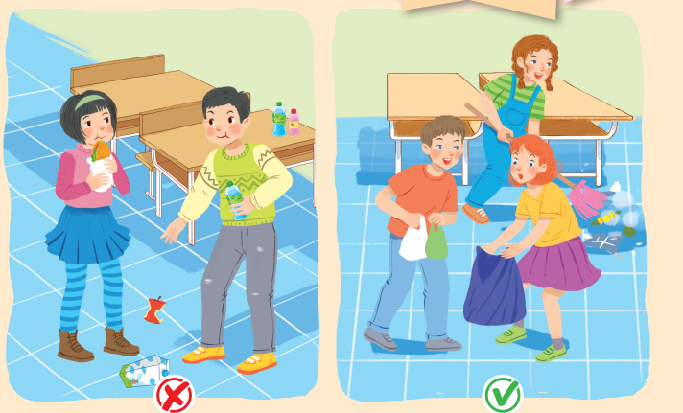
* PROJECT
5
5
Posters exhibition
- Show your group’s poster about a bad habit that the students in your school often do and give some tips to change that habit.
- Present your poster to the class.

Slide 19
* Project
BUILD HEALTHY HABITS
1. Discuss and find a bad habit and some tips to change it.
2. Find or draw a picture to illustrate your idea.
3. Present your poster to the class.

Slide 20
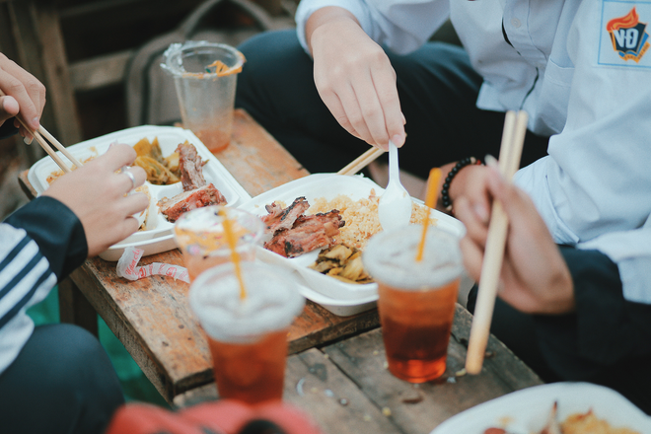
* Project
BUILD HEALTHY HABITS
1. A bad habit: Eating unhealthy food
* Tips to change it:
- Eat healthy food.
- Drink more water.
- Eat a nutritious diet.
- Eat less fast food.

Slide 21
* Project
BUILD HEALTHY HABITS
There are many bad habits that the students in my school often do. However, eating unhealthy food is the most common. An unhealthy diet can affect our health. Here are some tips to change it:
- Eat healthy food
- Drink more water
- Eat a nutritious diet
- Avoid drinking soft drinks.
- Eat less fast food.

Slide 22
*CONSOLIDATION
Vocabulary review
Grammar review
Project: Design film posters

Slide 23
* HOMEWORK
Revision all exercises.
Prepare for the next lesson: Unit 3 – Getting started.

Slide 24
GOODBYE.
SEE YOU AGAIN.

