Slide 1

Song Ve secondary school.
Good morning class!!!
Mrs Thu Ba

Slide 2






Warm up:
Game: Pelmanism
2
4
3
5
healthy habits
6
7
Eat more fruit and vegetable.
Get enough sleep
8
9
10
Drink enough water
Wash your hand with soap
Do exercise regularly

Slide 3




Unit
2
HEALTHY LIVING
LESSON 6: SKILLS 2
LISTENING
SPEAKING

Slide 4

OBJECTIVES
By the end of the lesson, students will be able to:
listen for specific information about some advice about healthy habits
write some advice to avoid viruses

Slide 5

I. LISTENING
1
Discuss and tick the habits you think are good for your health.
1. Eat a lot of meat and cheese.
2. Drink soft drinks every day.
3. Get ten hours of sleep daily.
4. Be active and exercise every day.
✓
✓

Slide 6

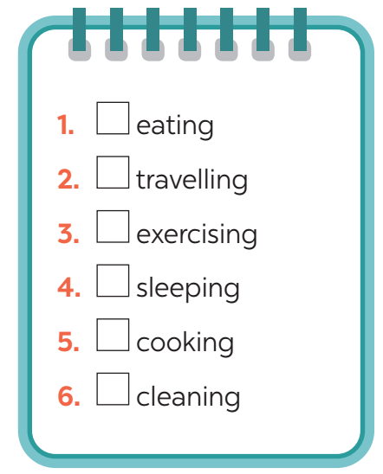

2
Listen and tick the habits mentioned.

Slide 7
3
Listen again and answer the questions with no more than THREE words.
1. What do healthy habits help you avoid?
2. What do fruit and vegetables provide you with?
3. How many hours do you need to sleep a day?
4. How should you keep your room?

Slide 8

THE BIG WHEEL GAME
QUESTIONS
10
40
1
30
50
2
SPIN
20
10
3
-15
-20
4
05
60

Slide 9
QUESTIONS
1. What do healthy habits help you avoid?
disease

Slide 10
QUESTIONS
2. What do fruit and vegetables provide you with?
(lots of) vitamins

Slide 11
QUESTIONS
3. How many hours do you need to sleep a day?
8 / eight hours

Slide 12
QUESTIONS
4. How should you keep your room?
tidy and clean

Slide 13
AUDIO SCRIPT
Healthy habits help us keep fit and avoid disease. Here is some advice.
Eat more fruit and vegetables, especially coloured ones like carrots and tomatoes. They provide a lot of vitamins.
Eat meat, eggs, and cheese, but not too much. You may put on weight.
Drink enough water, but not soft drinks.
Be active and exercise every day. Do outdoor activities like cycling, swimming, or playing sports. They keep you fit.
Go to bed early and get about 8 hours of sleep daily, so you will not feel tired.
Keep your room tidy and clean. Open windows to let in fresh air and sunshine on fine days.

Slide 14
3
Listen again and answer the questions with no more than THREE words.
1. What do healthy habits help you avoid?
2. What do fruit and vegetables provide you with?
3. How many hours do you need to sleep a day?
4. How should you keep your room?
disease
(lots of) vitamins
8 / eight hours
tidy and clean

Slide 15
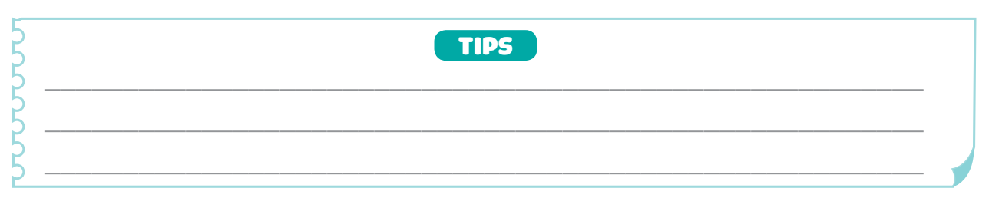
II. WRITING
4
Discuss and make notes of the tips from the listening. Then share them with the class.
e.g. Don’t eat too much meat and cheese.

Slide 16
II. WRITING
Work in groups
4
Discuss and make notes of the tips from the listening. Then share them with the class.
- Drink enough water, but not soft drinks.
- Be active and exercise every day.
- Do outdoor activities like cycling, swimming, or playing sports.
- Go to bed early and get about 8 hours of sleep daily.
-Keep your room tidy and clean.

Slide 17
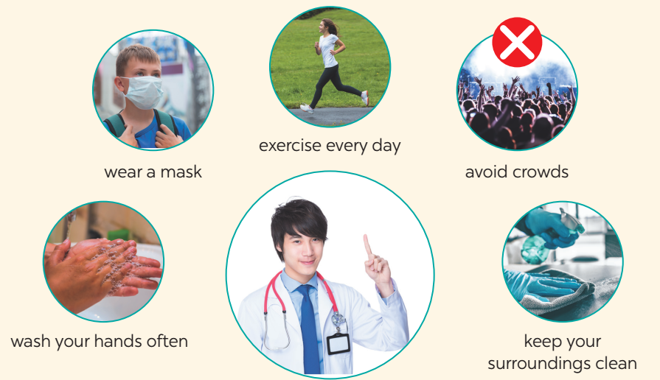

5
Discuss and brainstorm ideas.
How to avoid viruses???

Slide 18
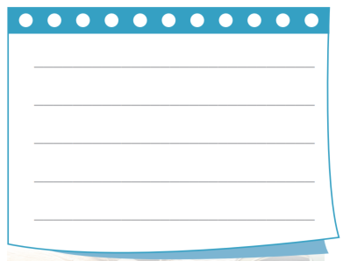

6
Write a passage of about 70 words to give advice on how to avoid viruses.

Slide 19

6
Write a passage of about 70 words to give advice on how to avoid viruses.
* Model writing.
We can do a lot of things to avoid viruses. First, always keep your surroundings clean. Sweep your house, clean your furniture, and change your pillow covers and bedsheets often. Remember to take a bath daily. Wash your hands with soap regularly. Drink a lot of water and eat more fruit and vegetable. Exercise three times a day for at least 15 minutes each time. When you go out, wear a mask and avoid crowds.

Slide 20

CLASS GALLERY
Students can:
go and see other’s work
give comments to each other

Slide 21

CONSOLIDATION
1
WRAP-UP
In this lesson, we have learnt to:
listen for special information about healthy habits.
write some advice to avoid viruses.

Slide 22

2
HOMEWORK
Rewrite the passage on the notebook.

Slide 23

Goodbye.
See you again

Slide 24


