Slide 1
Song Ve secondary school.
Good morning class!!!
Mrs Thu Ba

Slide 2
* WARM-UP
Game: Brainstorming
2 Groups
toothache
toothache
HEALTH PROBLEMS
HEALTH PROBLEMS
* Suggested answers:
Asthma, a backache, a broken leg, a cold, a cough, an earache, a headache, a sore throat, a toothache, sunburn, etc.

Slide 3
Unit
2
HEALTHY LIVING
LESSON 4: COMMUNICATION
Unit
HOBBIES
How to ask for and give health tips.

Slide 4
OBJECTIVES
By the end of the lesson, students will be able to:
learn how to ask for and give health tips.
practise using some grammar points and vocabulary related to the topic.

Slide 5
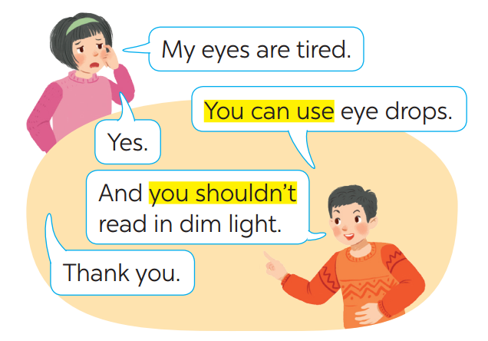
* EVERYDAY ENGLISH
1
Listen and read the conversations. Pay attention to the highlighted sentences.

Slide 6
1
1
Listen and read the conversations. Pay attention to the highlighted sentences.
You can use eye drops.
You shouldn’t read in dim light.
- What do these sentences mean?
- When do we use these sentences?
Giving tips for health problems.
* Structure: to give advice
- You should/ shouldn’t + V
- You can + V

Slide 7
2
Work in pairs. Make similar conversations with the following situations.
I’m tired.
A: I’m tired.
B: You can take a rest.
A: Yes.
B: You shouldn’t go out.
A: I am tired.
B: You can drink some milk.
A: Yes.
B: And you should have a nap.
A: Thank you.

Slide 8
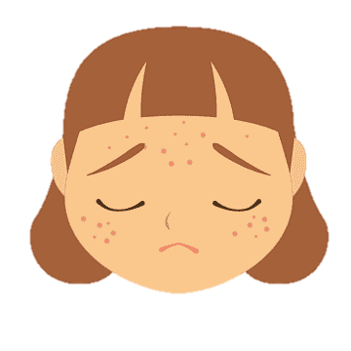
2
Work in pairs. Make similar conversations with the following situations.
I have acne.
A: I have acne.
B: You should wash your face.
A: Yes.
B: You shouldn’t touch your face with dirty hands

Slide 9
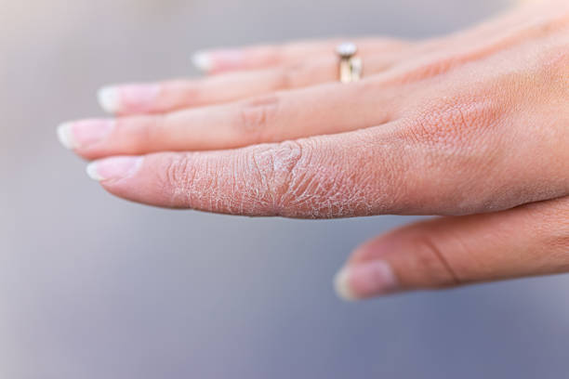
2
Work in pairs. Make similar conversations with the following situations.
My hands are chapped.
A: My hands are chapped.
B: You can use hand cream.
A: Yes.
B: You shouldn’t use chemical soaps.

Slide 10
TIPS FOR A HEALTHY LIFE
3
Read the passage and choose the correct title for it.
The Japanese live long lives. The main reason is their diet. They eat a lot of fish and vegetables. They cook fish with little cooking oil. They also eat a lot of tofu, a product from soybeans. Tofu has vegetable protein and vitamin B. It doesn’t have any fat. The Japanese work hard and do a lot of outdoor activities too. This helps them keep fit.
sản phẩm từ đậu nành.
A. How to live long
B. What food to eat
In this passage, the author mentions to the way to live long including diet and outdoor activities.

Slide 11
TIPS FOR A HEALTHY LIFE
4
Discuss and make a list for the tips which help the Japanese live long lives.
(1) They eat a lot of fish and vegetable.
(2) They cook fish with little cooking oil.
(3) They also eat a lot of tofu.
(4) The Japanese work hard and do a lot of outdoor activities.
Group work

Slide 12
5
Discuss and make a list for the tips that the Vietnamese can do to live longer.
- Go to bed early.
- Drink more water.
- Get daily exercise.
- Eat vegetables.
Laugh a lot.
- Drink less soft drink and eat less fastfood

Slide 13
* CONSOLIDATION
1
WRAP-UP
In this lesson, we have learn to:
learn how to ask for and give health tips
practise using some grammar points and vocabulary related to the topic.

Slide 14
CONSOLIDATION
2
HOMEWORK
Do exercises in the workbook.

