Slide 1
Hello every one !!!

Slide 2
Mrs Thu Ba

Slide 3
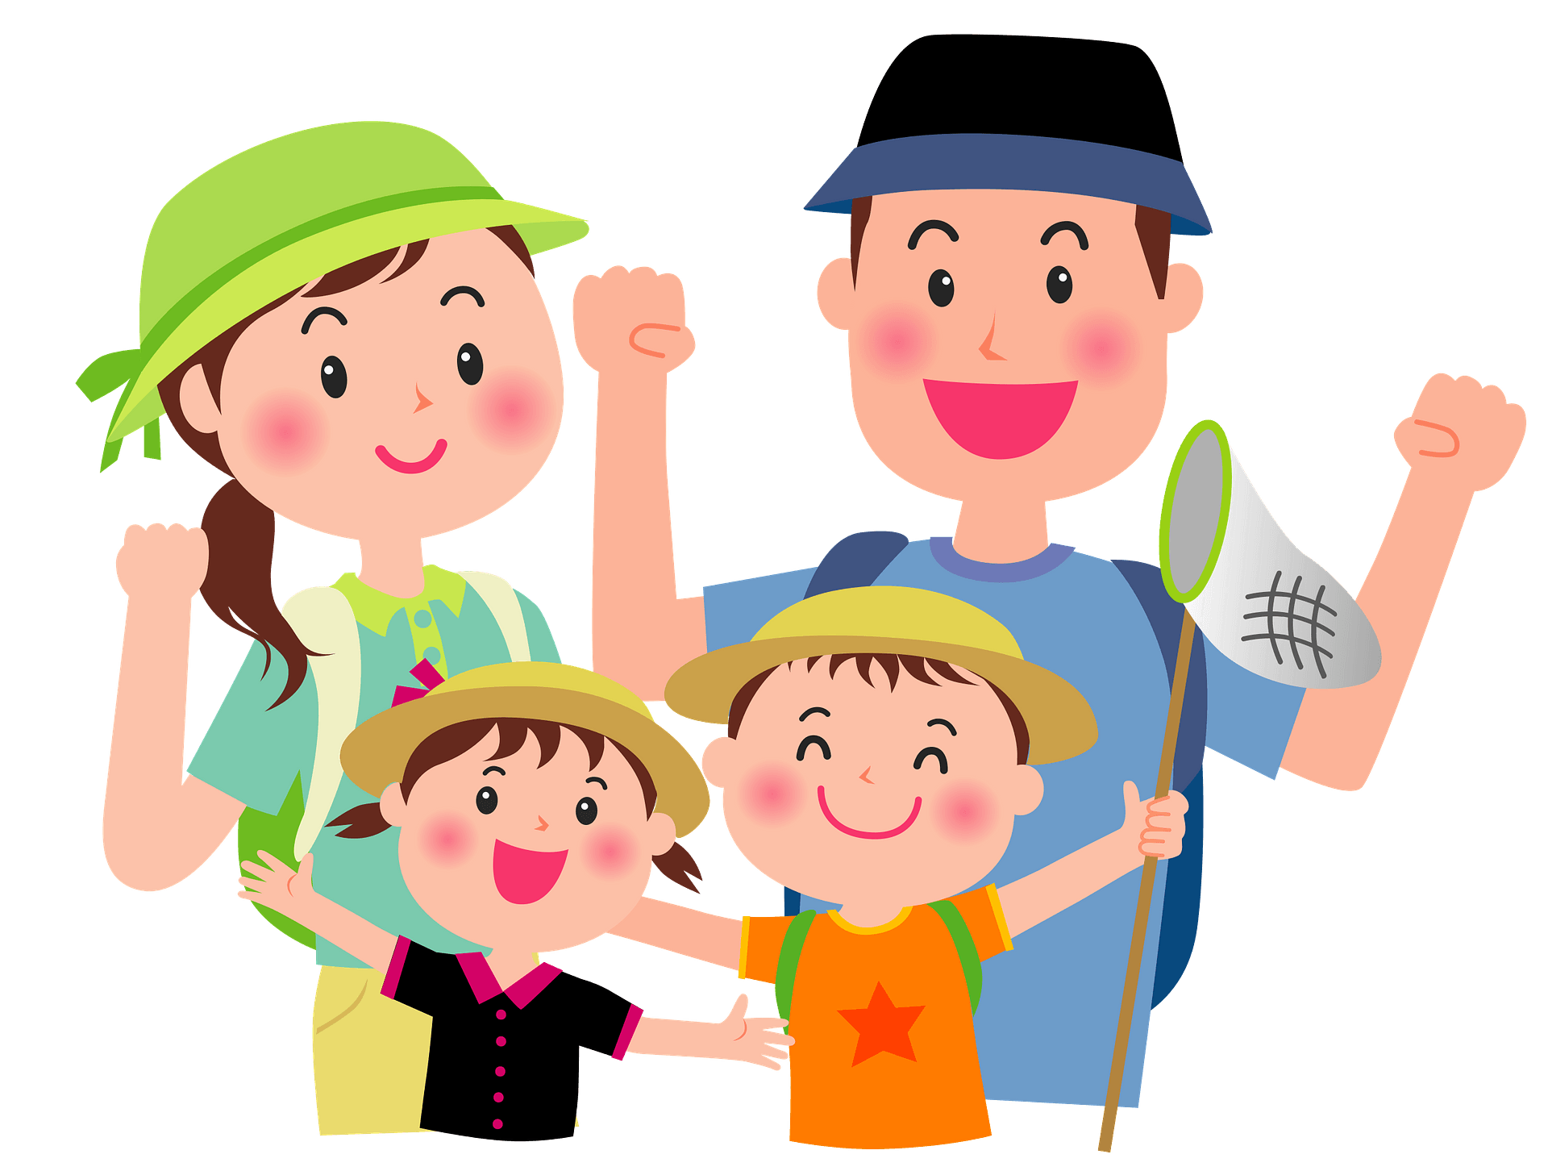
Unit
2
HEALTHY LIVING
LESSON 1: GETTING STARTED
Let’s go out!
Unit
HOBBIES

Slide 4
WARM-UP: BRAINSTORMING
exercise
eating
drinking
HEALTH
traveling
ill
strong
medicine
weak
sick

Slide 5
* VOCABULARY
- popular (a)
/ˈpɒpjələ(r)/
: phổ biến, nổi tiếng

Slide 6
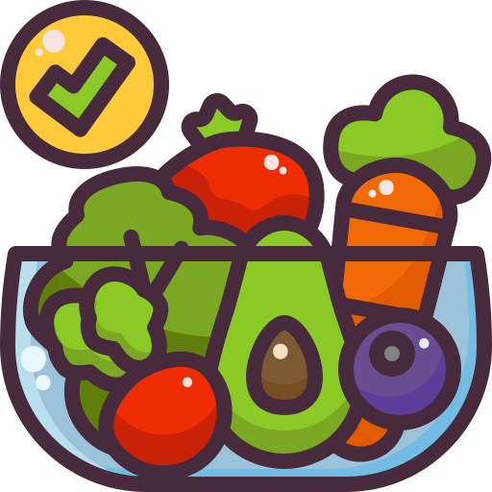
fresh (a)
/freʃ/
: tươi, mới

Slide 7
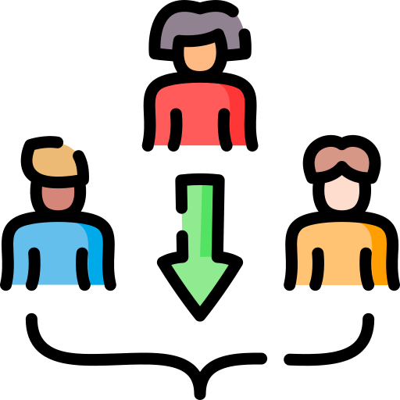
- join (v)
: tham gia
/dʒɔɪn/

Slide 8
* VOCABULARY
New words | Pronunciation | Meaning
popular (a) | /ˈpɒpjələr/ | phổ biến, nổi tiếng
fresh (a) | /freʃ/ | tươi, trong lành
join (v) | /dʒɔɪn/ | tham gia

Slide 9
1. LISTEN AND READ.
Mi: This is a nice picture, Mark.
Mark: That’s my dad and I boating at Yen So Park.
Mi: It also see a lot of people exercise there.
Mark: Yes, it’s a popular place for people in my neighbourhood.
Mi: Outdoor activities are good for our health. My family often goes cycling in the countryside. It’s quiet and there’s a lot of fresh air.
Mark: It sounds interesting.
Mi: Yes, it’s lots of fun. We also bring fruit, water, and a lunch box with us.
Mark: I’d love to join you next time.
Mi: Sure. Bring along a hat and suncream.
Mark: Why suncream?
Mi: It’s really hot and sunny at noon so you might get sunburn.
Mark: I see.

Slide 10
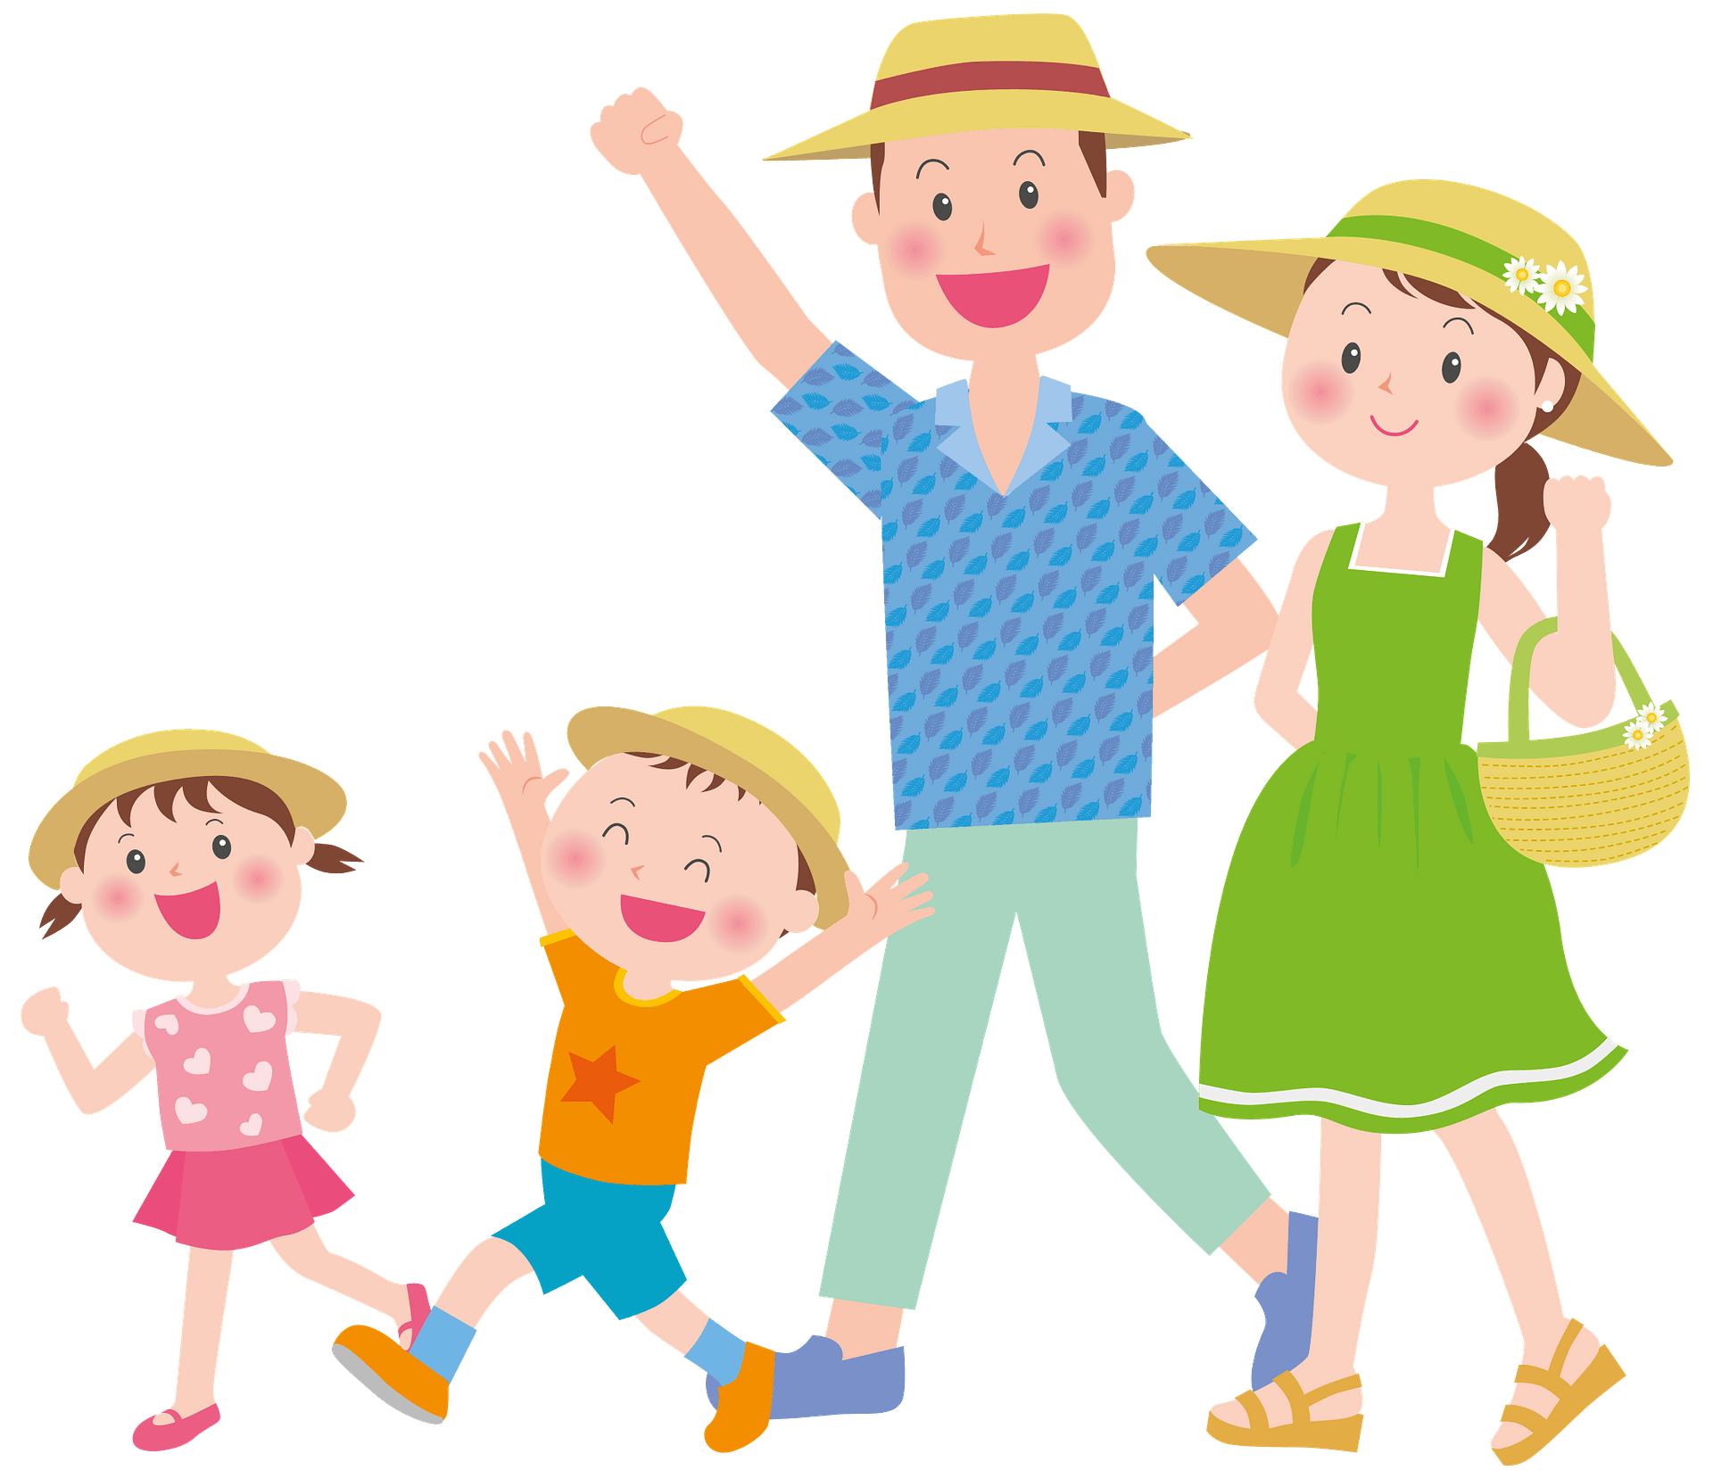
2
What are Mark and Mi talking about?
A. Health problems B. Healthy activities C. Sports and games
Mi: I also see a lot of people exercising there. Mark: Yes, it’s a popular place for people in my neighbourhood.
Mi: Outdoor activities are good for our health

Slide 11
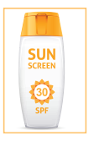
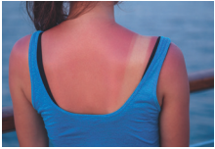
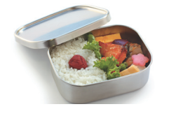
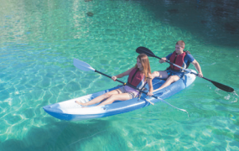
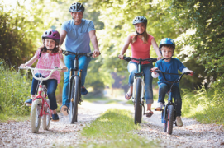
3
Write a word or phrase from the box under its picture.
boating suncream lunch box sunburn cycling
1.
sunburn
2.
suncream
3.
lunch box
4.
boating
5.
cycling

Slide 12
4
Complete each sentence with a word from the conversation.
1. In the picture, Mark and his father are __________.
boating
Mi: This is a nice picture, Mark.
Mark: That’s my dad and I boating at Yen So Park.
2. The people in Mark’s neighbourhood love to go to the ______.
park
Mi: It also see a lot of people exercise there.
Mark: Yes, it’s a popular place for people in my neighbourhood.
3. Mi’s family often goes cycling in the ___________.
countryside
Mi: Outdoor activities are good for our health. My family often goes cycling in the countryside. It’s quiet and there’s a lot of fresh air.

Slide 13
3
Complete each sentence with a word from the conversation.
4. - I don’t want to get sunburn.
- Wear a hat and use __________.
suncream
Mi: Sure. Bring along a hat and suncream.
Mark: Why suncream?
Mi: It’s really hot and sunny at noon so you might get sunburn.
5. Fruit and water are good for our _________ .
health
Mi: Yes, it’s lots of fun. We also bring fruit, water, and a lunch box with us.

Slide 14
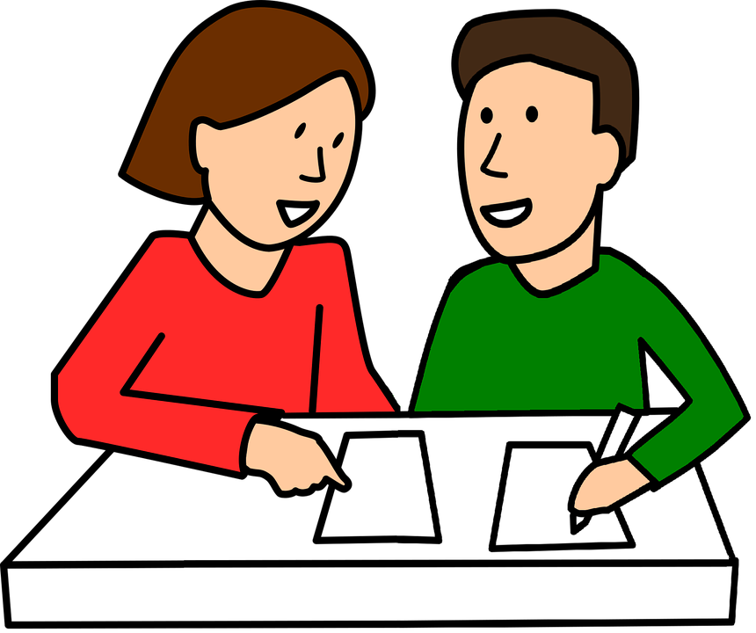
* PRODUCTION
4
Survey: Good or bad for health.
Example: A: I walk to school. B: I think it’s good for your health. A: I rarely eat breakfast. B: It’s not good. Breakfast is very important. It gives us energy for the day.

Slide 15
4
4
Survey: Good or bad for health.
A: I walk to school .
B: It’s good for your health
A: I usually stay up late.
B: It’s bad for your health
Minh: I usually eat fast food.
Nam: It’s not good for you.
Minh: I and my brother go swimming.
Nam: It’s a good activity. It makes you stronger.

Slide 16
* PRODUCTION
4
Survey: Good or bad for health.
Daily activities | How often | Good | Bad
Walking to school | Every day | √

Slide 17
* CONSOLIDATION
1
WRAP-UP
HEALTHY LIVING
Things to go out
Healthy activities
Topic of the unit
Vocabulary

Slide 18
* HOMEWORK
Learn new words by heart
Prepare for the next lesson: A closer look 1.

Slide 19
* EXERCISE
GROUP WORK
1. Drink / lots / water / be / good / our health.
Drinking lots of water is good for our health.
2. Watch / much / TV / not / good / your eyes.
Watch too much TV is not good for your eyes.
3. Do / exercise / regularly / help / you / stay / healthy.
4 GROUPS
Doing exercise regularly helps you stay healthy.
4. Healthy food / love / laughter / bring / healthy life.
Healthy food, love, and laughter bring a healthy life.

Slide 20
