Slide 1
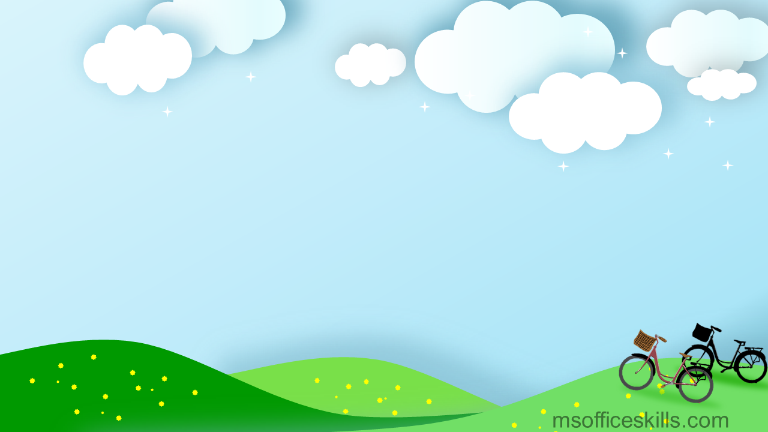
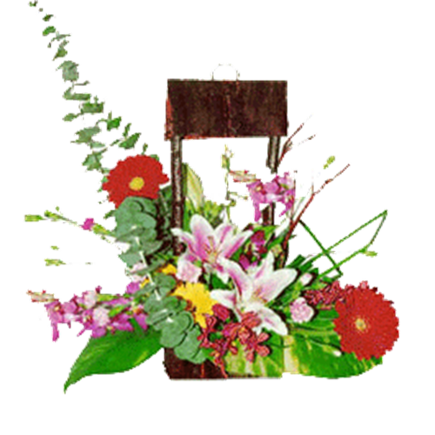
Hello every one !!!
NGUYỄN THỊ THU BA

Slide 2
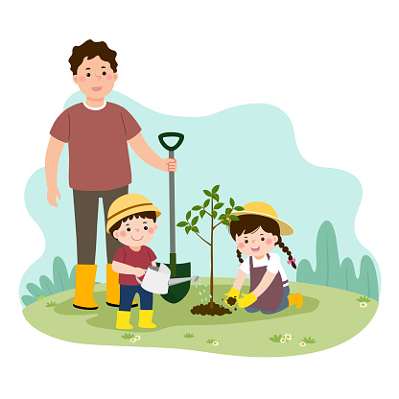
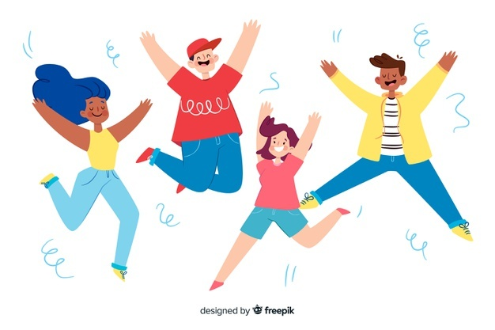
Unit
1
HOBBIES
LESSON 5: SKILLS 1
READING
SPEAKING
Unit
Gardening as a hobby
Benefits of hobbies

Slide 3
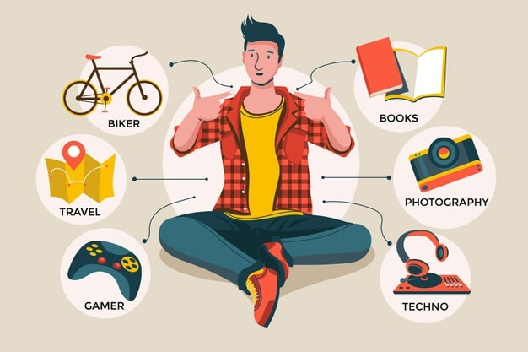
* WARM-UP
List out as many hobbies that you know as possible in 1 minute.
- playing badminton - playing tennis - playing football - playing basketball - riding a bike - taking photos - arranging flowers - ice – skating - gardening - listening to music …………. | - collecting dolls - collecting bottles -. collecting stamps - collecting coins - carving wood - reading book - playing games - cooking - . playing the guitar - cycling ……………….
- -

Slide 4
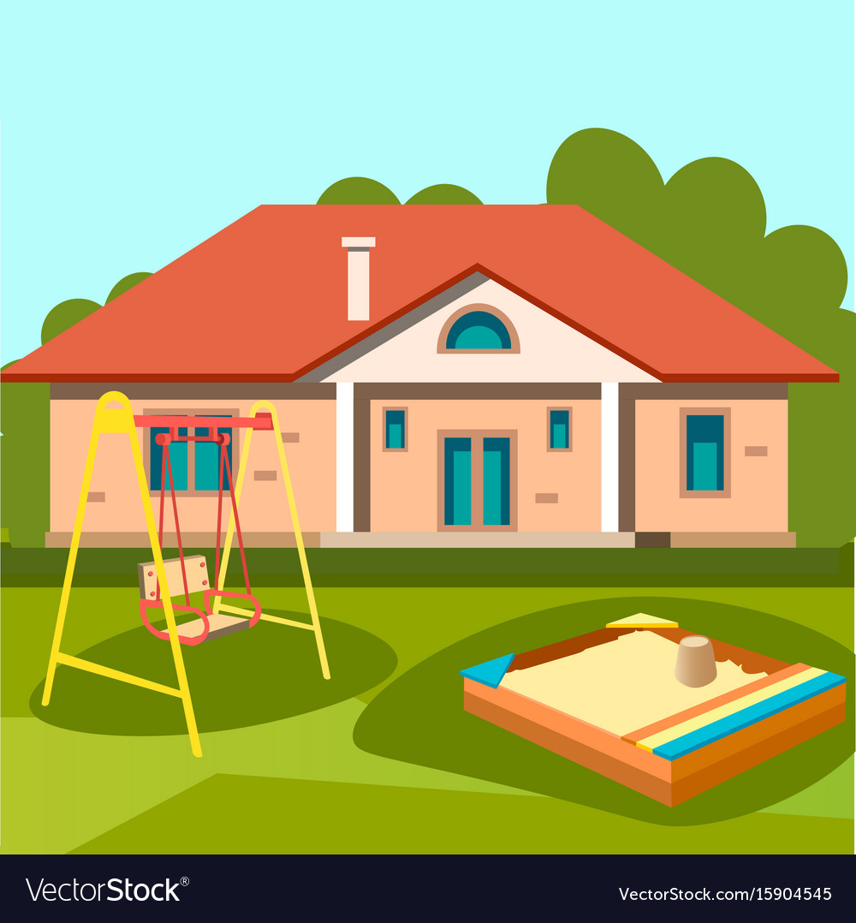
* Vocabulary
- outdoor (adj)
: ngoài trời
/ˈaʊtdɔː(r)/

Slide 5
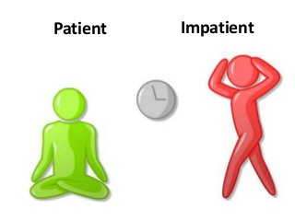
patient (adj)
/ˈpeɪʃnt/
: kiên nhẫn

Slide 6
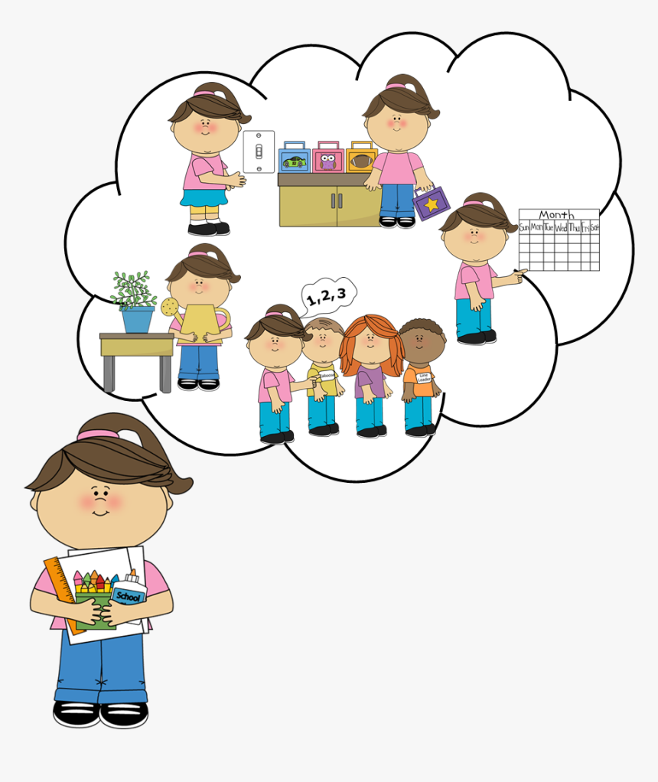
- responsibility (n)
: trách nhiệm
/rɪˌspɒnsəˈbɪləti/

Slide 7
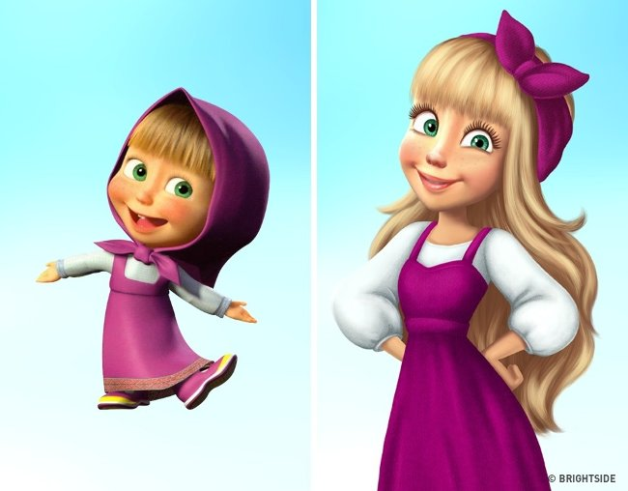
- maturity (n)
: sự trưởng thành
/məˈtjʊərəti/

Slide 8
- valuable (adj)
: quý giá, quan trọng, hữu ích
/ˈvæljuəbl/

Slide 9
* Vocabulary
New words | Pronunciation | Meaning
1. outdoor (adj) | /ˈaʊtdɔː(r)/ | ngoài trời
2. patient (adj) | /ˈpeɪʃnt/ | kiên nhẫn
3. responsibility (n) | /rɪˌspɒnsəˈbɪləti/ | trách nhiệm
4. maturity (n) | / məˈtjʊərəti/ | sự trưởng thành
5. valuable (adj) | /ˈvæljuəbl/ | quý giá, quan trọng, hữu ích

Slide 10
* Checking vocabulary
New words | Pronunciation | Meaning
1. | /ˈaʊtdɔː(r)/ | ngoài trời
2. | /ˈpeɪʃnt/ | kiên nhẫn
3. | /rɪˌspɒnsəˈbɪləti/ | trách nhiệm
4. | / məˈtjʊərəti/ | sự trưởng thành
5. | /ˈvæljuəbl/ | quý giá, quan trọng, hữu ích
outdoor (adj)
patient (adj)
responsibility (n)
maturity (adj)
valuable (adj)

Slide 11
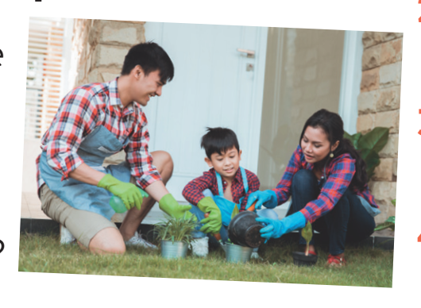
I. READING
1
Work in pairs. Look at the picture and discuss the questions below.
1. What can you see in the picture? 2. In your opinion, what is good about gardening?
1. In the picture, I can see 3 people. Maybe It’s a family. They are gardening together. There are a lot of plants around.
2. In my opinion, gardening is very good. It helps people protect our environment. Gardening can help us have clean food to eat.

Slide 12
I. READING
2
Read the text about gardening. Match each word in column A with its definition in column B.
People divide hobbies into four big groups: doing things, making things, collecting things, and learning things. Gardening belongs to the most popular group - doing things.
Gardening is one of the oldest outdoor activities. It has something for everyone, even for children. Gardening teaches children about flowers, fruits, and vegetables. They can also learn about insects and bugs. When gardening, children learn to be patient and take on responsibility. They learn to wait for the plants to grow to maturity And if they don’t water their plants, their plants will die. This teaches them valuable lessons about responsibility.
Gardening is also good because everyone in the family can join in and do something together. My mum and I love gardening. We usually spend an hour a day in our garden. It really makes us happy, and we love spending time together.

Slide 13
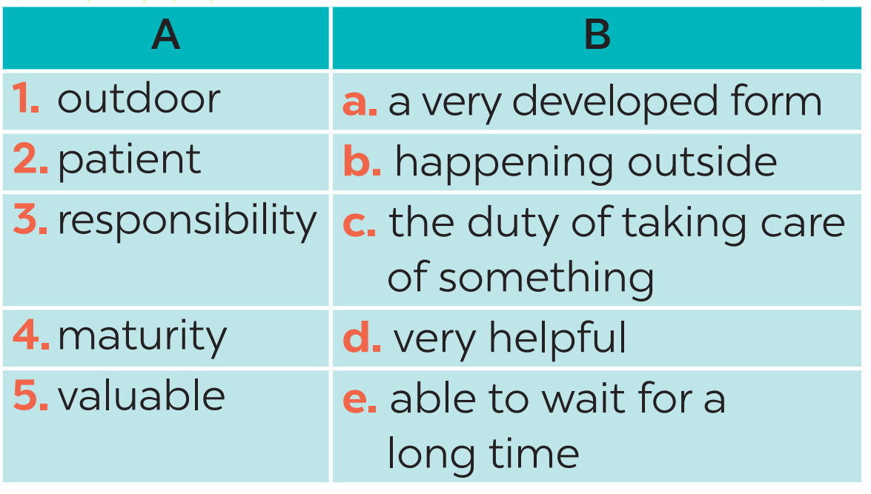
II. READING
2
Read the text about gardening. Match each word in column A with its definition in column B.
1. b
2. e
3. c
4. a
5. d

Slide 14
I. READING
3
Read the text again. Complete each sentence with no more than THREE words.
1. Gardening belongs to the group of _______________. 2. Gardening teaches children about flowers, fruits, vegetables, _______________. 3. Gardening makes children become ______________ and responsible. 4. It is an activity that everyone in the family can ______________. 5. The author and her mother usually garden for ______________ a day.
doing things
insects and bugs
patient
join in
an hour

Slide 15
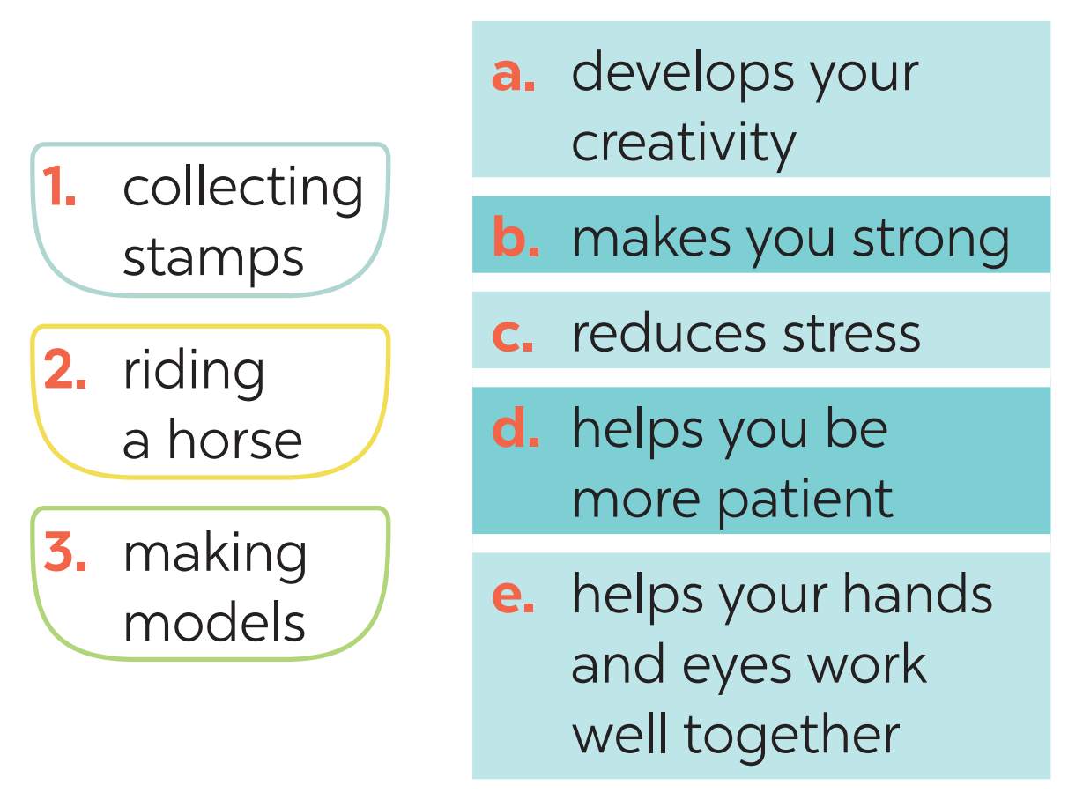
II. SPEAKING
4
Work in pairs. Match each hobby with its benefit(s). One hobby may have more than one benefit.
1. c, d
2. b, c
3. a, c, d, e

Slide 16
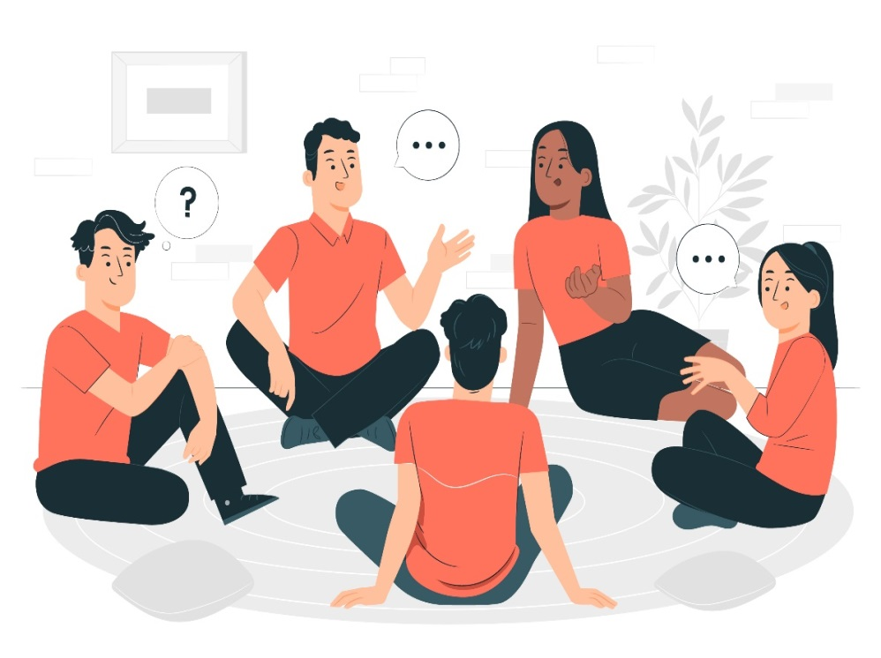
II. SPEAKING
5
Work in groups. Ask one another the following questions. Then present your partners’ answers to the class.
What is your favourite hobby?
What are its benefits? Example: My friend Mi’s favourite hobby is
collecting stamps. It helps her be more patient.

Slide 17
II. SPEAKING
5
Work in groups. Ask one another the following questions. Then present your partners’ answers to the class.
1. What is your favourite hobby?
My favourite hobby is playing football.
2. What are its benefits?
It makes me strong.
My friend Phong’s favourite hobby is playing football.
lt makes him strong

Slide 18
II. SPEAKING
5
Work in groups. Ask one another the following questions. Then present your partners’ answers to the class.
1. What is your favourite hobby?
My favourite hobby is listening to English music
2. What are its benefits?
It makes me happy and helps me improve my english
My friend Hoa’s favourite hobby is listening to music
lt makes her happy and helps me improve my english

Slide 19
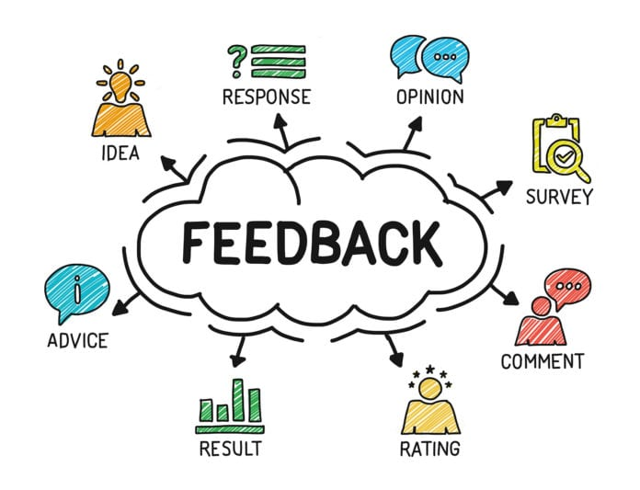
PRODUCTION
Let’s give comments for your friends and vote for the most interesting and informative presentation.

Slide 20
CONSOLIDATION
1
WRAP-UP
READING
SPEAKING
Gardening as a hobby
Benefits of hobbies

Slide 21
2
HOMEWORK
Write down your opinions about carving eggshells.
Search for more information about this unique hobby.

Slide 22
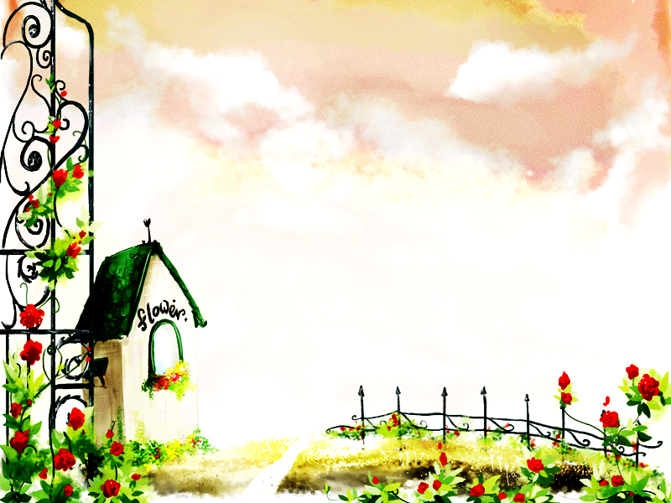
HOMEWORK
Learn new words by heart .
Do more exercises in workbook.
Prepare: Skills 2

Slide 23
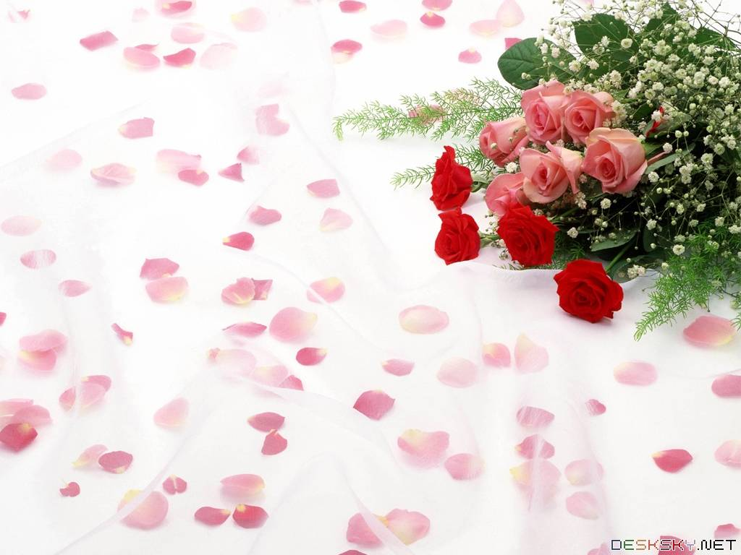
Goodbye.
See you again

