Slide 1
SONG VE SECONDARY SCHOOL
Hello every one !!!
love
NGUYỄN THỊ THU BA

Slide 2
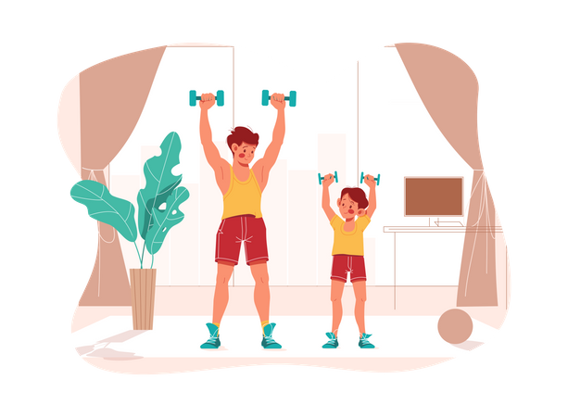
Unit
1
HOBBIES
LESSON 4: COMMUNICATION

Slide 3
* WARM-UP
Arrange the following verbs of liking in descending order of preference.
like
adore
hate
dislike
love
detest

Slide 4
WARM-UP
Arrange the following verbs of liking in descending order of preference.
adore
love
like
dislike
hate
detest

Slide 5
EVERYDAY ENGLISH
VERBS OF LIKING + V-ING
We often use the –ing form after verbs of liking and disliking.
Example: I like going to the cinema.
She hates cleaning the floors.

Slide 6
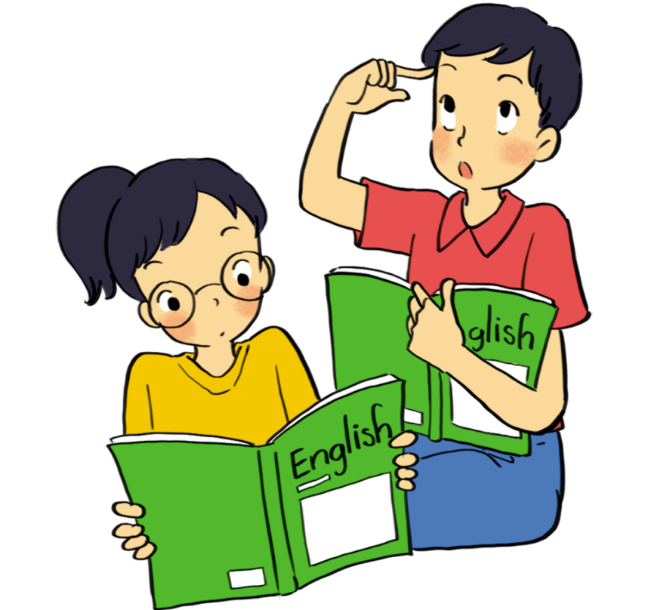
EVERYDAY ENGLISH
1
Listen and read the dialogue below. Pay attention to the questions and answers.
Mi: Do you like reading books? Ann: Yes, very much, especially books about science. Mi: What about painting? Do you like it? Ann: No, I don’t. I’m not interested in art.

Slide 7
EVERYDAY ENGLISH
2
Work in pairs. Ask and answer questions about what you like and don’t like doing.

Slide 8
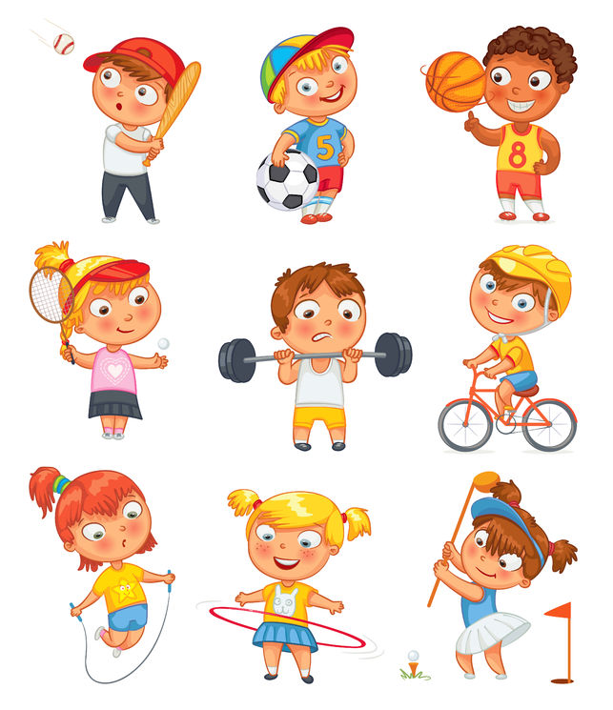
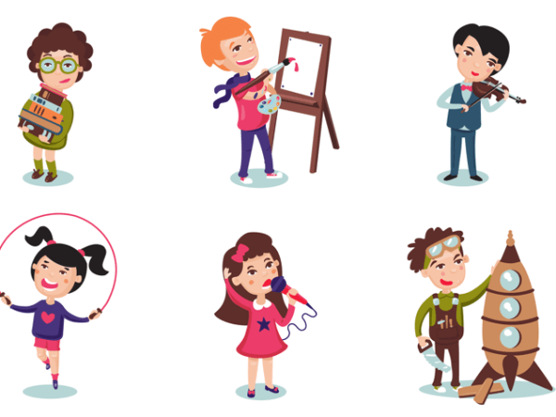
Linh: Do you like watching movies?
Dung: Yes, I do. I enjoy going to the movie theater with my friends at weekends.
How about you? What do you do in your free time?
Linh: I don’t like watching movies, but I love going outside with my friends.
Nam: Do you like playing soccer?
Hai: Yes, I love it. I love playing football with my friends every Sunday.
Nam: What about playing guitar? Do you like it?
Hai: No, I don't

Slide 9
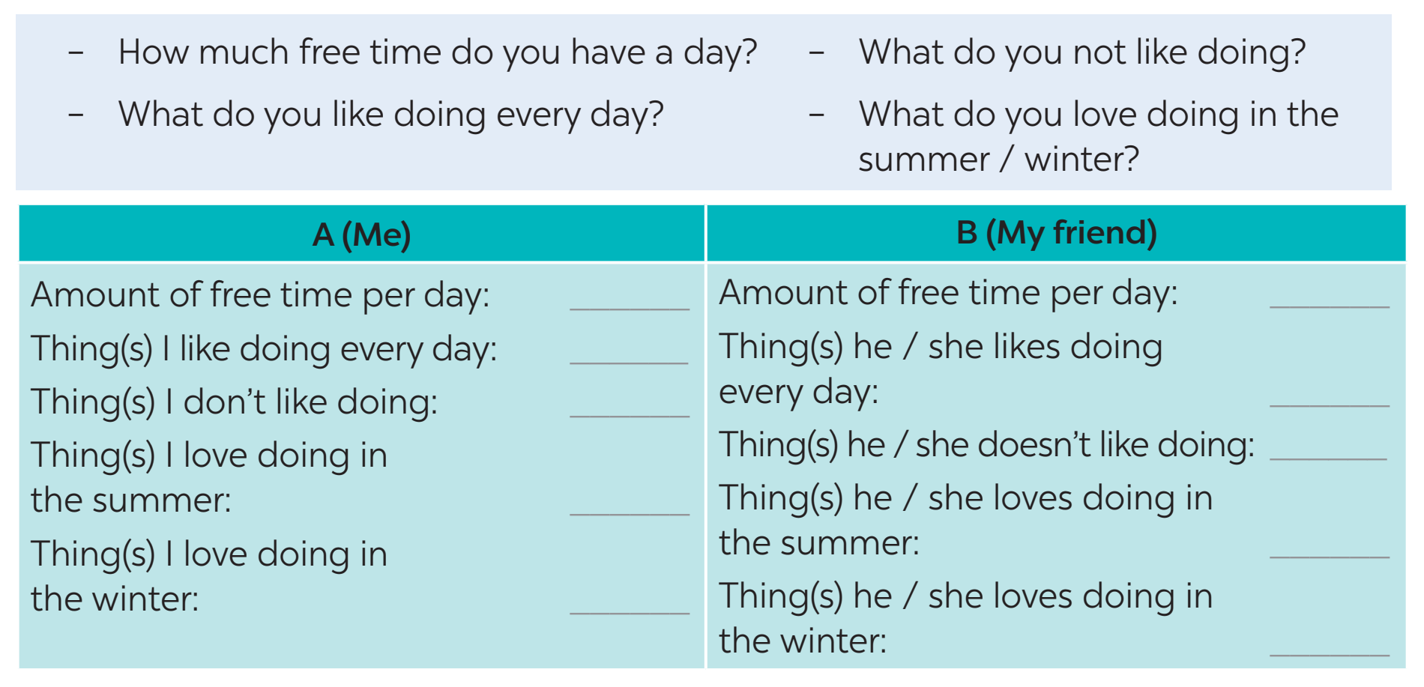
ALL ABOUT YOUR HOBBIES
3
Answer the questions. Fill in column A with your answers.

Slide 10
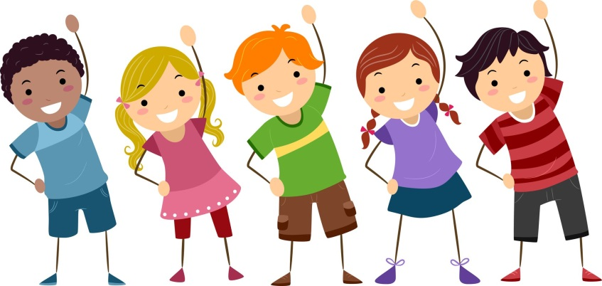
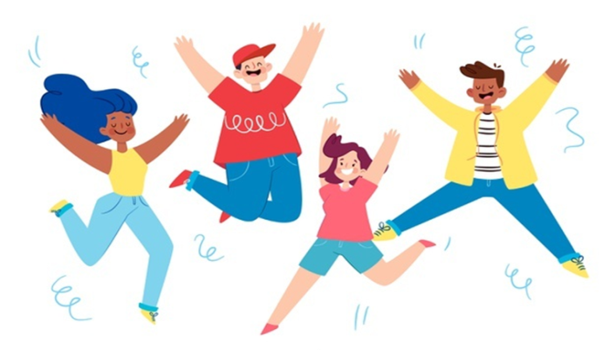
A (Me)
- Amount of free time per day: 2 hours
- Thing(s) you like doing every day: reading books, listening to music, playing sports
- Thing(s) you don't like doing: washing the dishes, cooking
- Thing(s) you love doing in the summer: eating ice cream, going swimming
- Thing(s) you love doing in the winter: lying under the warm blanket, drinking hot chocolate

Slide 11
ALL ABOUT YOUR HOBBIES
4
Now interview your friend, using the questions in Task 3. Write his / her answers in column B.

Slide 12
4
Now interview your friend, using the questions in Task 3. Write his / her answers in column B.
B (My friend)
- Amount of free time per day: 3 hours
- Thing(s) he/she likes doing every day: listening to music, arranging flowers
- Thing(s) he/she doesn't like doing: doing homework, clearning the house
- Thing(s) he/she loves doing in the summer: making cold drink, going to the beach
- Thing(s) he/she loves doing in the winter: making a snowman, cooking

Slide 13
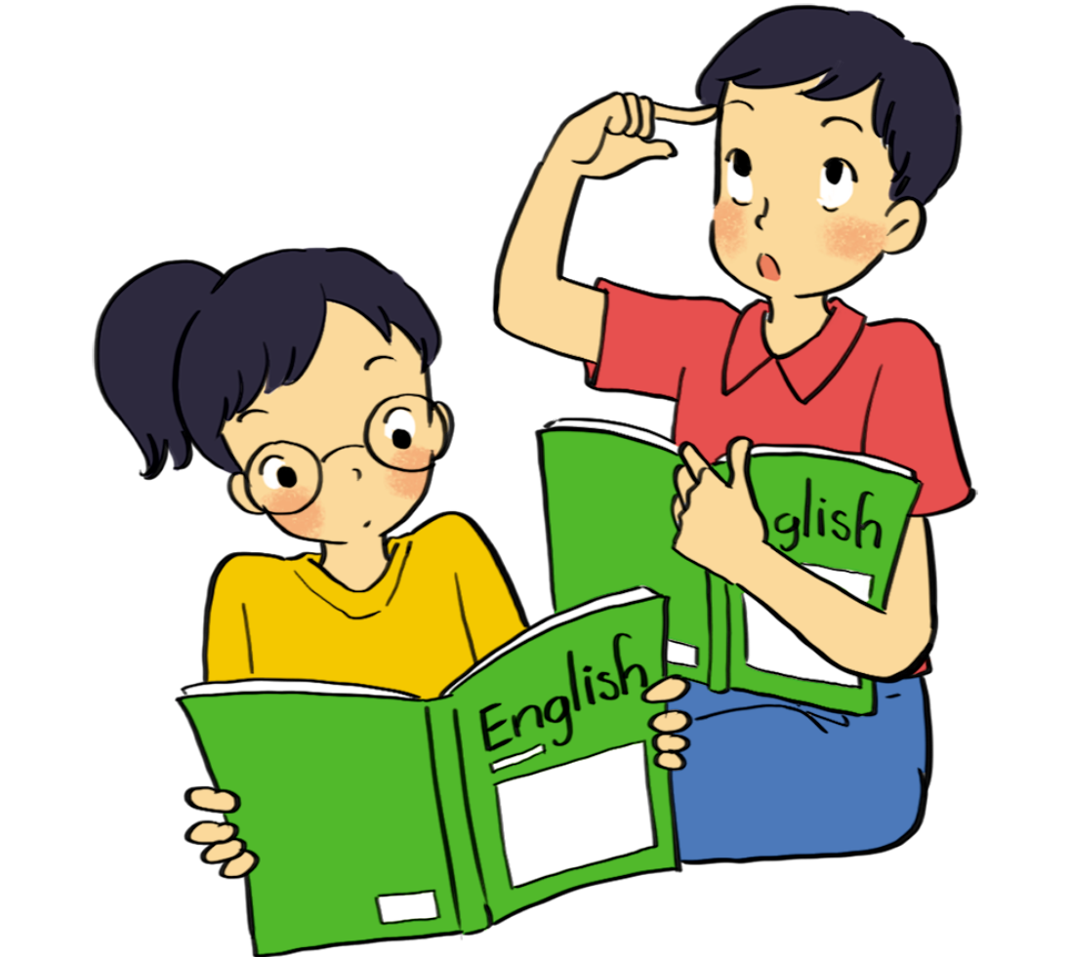
* PRODUCTION
5
Compare your answers with your friend’s. Then present them to the class.
Example: I have only one hour of free time a day, but my friend Lan has about 3 hours. I like listening to music every day, and Lan likes it , too. I don’t like reading, but Lan does. In the winter, I like lying in the warm blanket but Ly likes cooking.

Slide 14
* CONSOLIDATION
1
WRAP-UP
In this lesson, we have learn to:
use the lexical items related to the topic Hobbies
describe and give opinions about hobbies

Slide 15
2
HOMEWORK
use the lexical items related to the topic Hobbies
talk about likes and dislikes
ask and answer about hobbies

