Slide 1
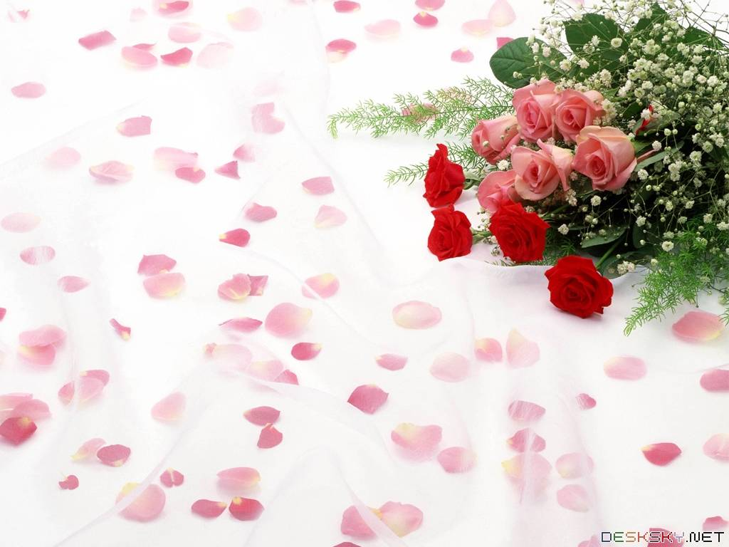
Hello every one!

Slide 2
Mrs Thu Ba

Slide 3
WARM-UP
1. What is your favourite hobby?
2. When did you start your hobby?

Slide 4
Unit
1
HOBBIES
LESSON 2
A CLOSER LOOK 1
VOCABULARY
PRONUNCIATION

Slide 5
* VOCABULARY
- jogging (n) :
/ˈdʒɒɡɪŋ /
đi/ chạy bộ thư giãn
- coin (n):
/kɔɪn/
đồng xu

Slide 6
* VOCABULARY
New words | Pronunciation | Meaning
1. jogging (n) | / ˈdʒɒɡɪŋ / | đi, chạy bộ thư giãn
2. coin (n) | / kɔɪn / | đồng xu

Slide 7
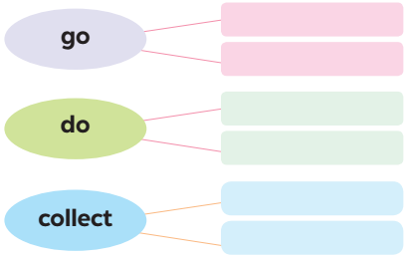
VOCABULARY
1
Complete the word webs below with the words from the box.
dolls
jogging
coins
judo
swimming
yoga

Slide 8
Can you add
more words?
- do housework , do homework ,...
- go fishing , go shopping...
- collect comic books , collect greeting cards...

Slide 9
VOCABULARY
Verbs of liking + V - ing

Slide 10
VOCABULARY
2
Complete the sentences, using the –ing form of the verbs from the box.
go play collect do make
1. My dad has a big bookshelf because he loves _________ old books. 2. My sister likes _________ camping at the weekend. 3. My best friend hates _________ computer games. 4. Does your brother like _________ models? 5. My mum enjoys _________ yoga every day to keep fit.

Slide 11
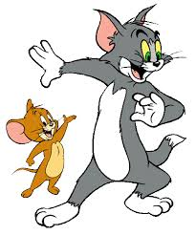
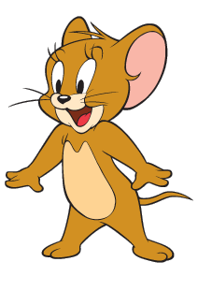
Questions: Lucky numbers
1
2
3
4
5
6
7
8

Slide 12
VOCABULARY
2
Complete the sentences, using the –ing form of the verbs from the box.
go play collect do make
1. My dad has a big bookshelf because he loves _________ old books.
collecting

Slide 13
VOCABULARY
2
Complete the sentences, using the –ing form of the verbs from the box.
go play collect do make
2. My sister likes _________ camping at the weekend.
going

Slide 14
VOCABULARY
2
Complete the sentences, using the –ing form of the verbs from the box.
go play collect do make
3. My best friend hates ________computer games.
playing

Slide 15
VOCABULARY
2
Complete the sentences, using the –ing form of the verbs from the box.
go play collect do make
4. Does your brother like _________ models?
making

Slide 16
VOCABULARY
2
Complete the sentences, using the –ing form of the verbs from the box.
go play collect do make
5. My mum enjoys ________yoga every day to keep fit.
doing

Slide 17
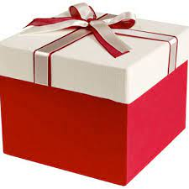
LUCKY NUMBER
YOU GET A GIFT

Slide 18
LUCKY NUMBER!

Slide 19
LUCKY NUMBER!

Slide 20
VOCABULARY
2
Complete the sentences, using the –ing form of the verbs from the box.
go play collect do make
1. My dad has a big bookshelf because he loves _________ old books. 2. My sister likes _________ camping at the weekend. 3. My best friend hates _________ computer games. 4. Does your brother like _________ models? 5. My mum enjoys _________ yoga every day to keep fit.
collecting
going
playing
making
doing

Slide 21
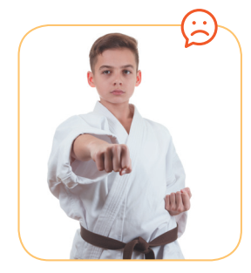
VOCABULARY
3
Look at the pictures and say the sentences. Use suitable verb of liking or disliking and the –ing form.
He hates / doesn’t like doing judo.

Slide 22
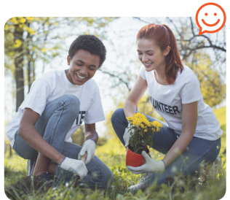
VOCABULARY
3
Look at the pictures and say the sentences. Use suitable verb of liking or disliking and the –ing form.
They love / like / enjoy gardening.

Slide 23
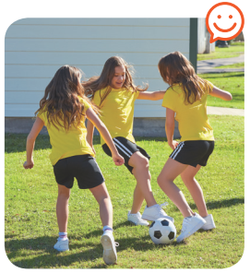
VOCABULARY
3
Look at the pictures and say the sentences. Use suitable verb of liking or disliking and the –ing form.
They like / love / enjoy playing football.

Slide 24
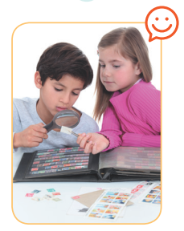
VOCABULARY
3
Look at the pictures and say the sentences. Use suitable verb of liking or disliking and the –ing form.
They enjoy / like / love collecting stamps.

Slide 25
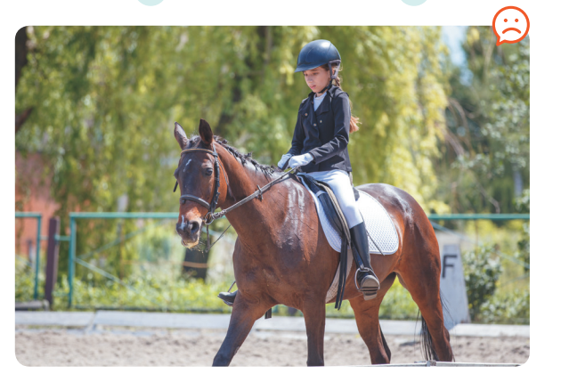
VOCABULARY
3
Look at the pictures and say the sentences. Use suitable verb of liking or disliking and the –ing form.
She hates / doesn’t like riding a horse / horse riding.

Slide 26
* PRONUNCIATION
/ə/ and /ɜ:/
Aims of the stage:
to help Ss identify how to pronounce the sounds /ə/ and /ɜ:/
to help Ss practise pronouncing these sounds in words & sentences

Slide 27
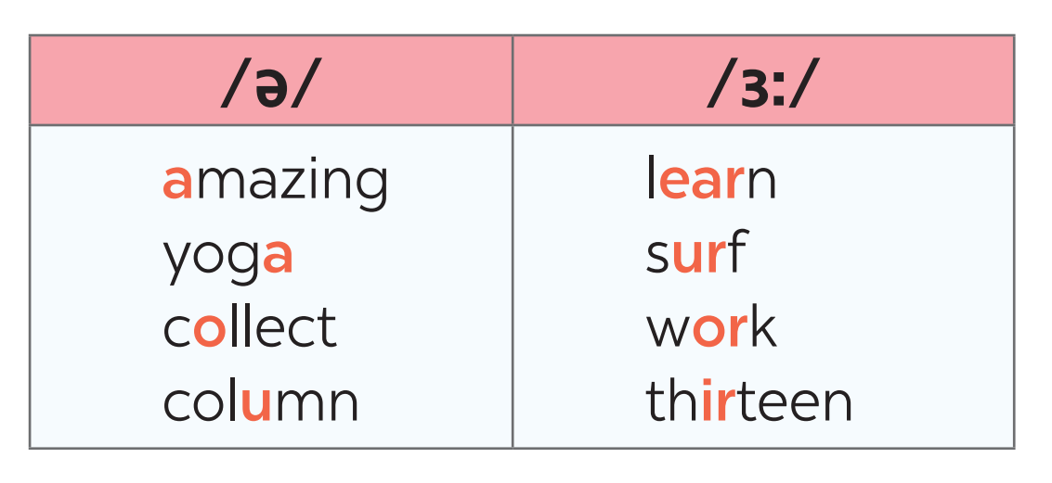
* PRONUNCIATION
4
Listen and repeat. Pay attention to the sounds /ə/ and /ɜ:/.

Slide 28
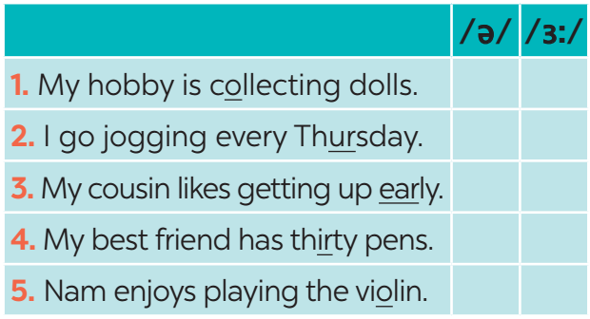
* PRONUNCIATION
5
Listen to the sentences and pay attention to the underlined parts. Tick (✓) the appropriate sounds. Practise the sentences.
/ə/ and /ɜ:/
✔
✔
✔
✔
✔

Slide 29
* PRODUCTION
Game: Who is faster?
Work in groups of four
Write sentences including: hobbies and one of the sounds /ə/ and /ɜ:/
(e.g: Listening to music is a very common hobby.)
The group with the most correct sentences is the winner.

Slide 30
* CONSOLIDATION
* HOMEWORK
- Learn new words by heart
- Find 3 more words relating to hobbies that have the sound /ə/ or /ɜ:/.

Slide 31
