Slide 1
Mrs Thu Ba

Slide 2
WARM UP
Watch a video and write the names of hobbies

Slide 3
Answer the questions:
1. What do you like doing in your free time?
2. Do you like collecting dolls?
3. Do you like collecting glass bottles?
4. Do you enjoy mountain climbing?
HOBBY

Slide 5
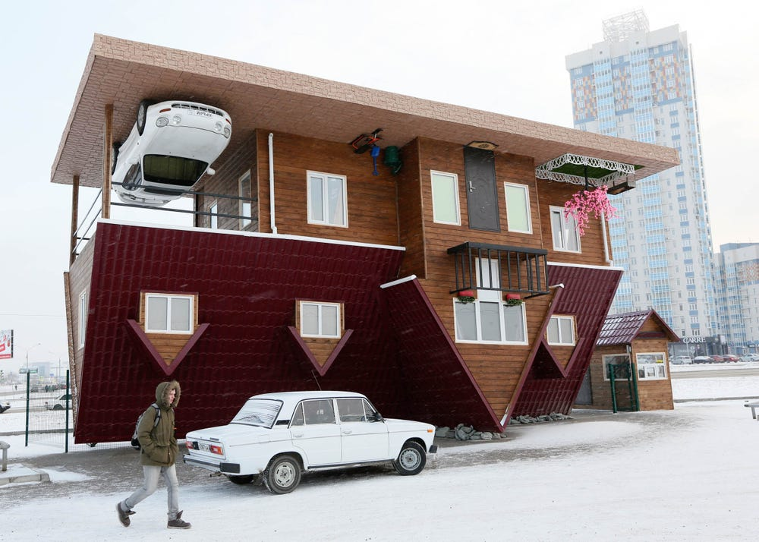
* Vocabulary
- unusual (adj)
/ʌnˈjuːʒuəl/
: khác thường

Slide 6
- creativity (n)
/ˌkriːeɪˈtɪvəti/
:sự sáng tạo

Slide 7
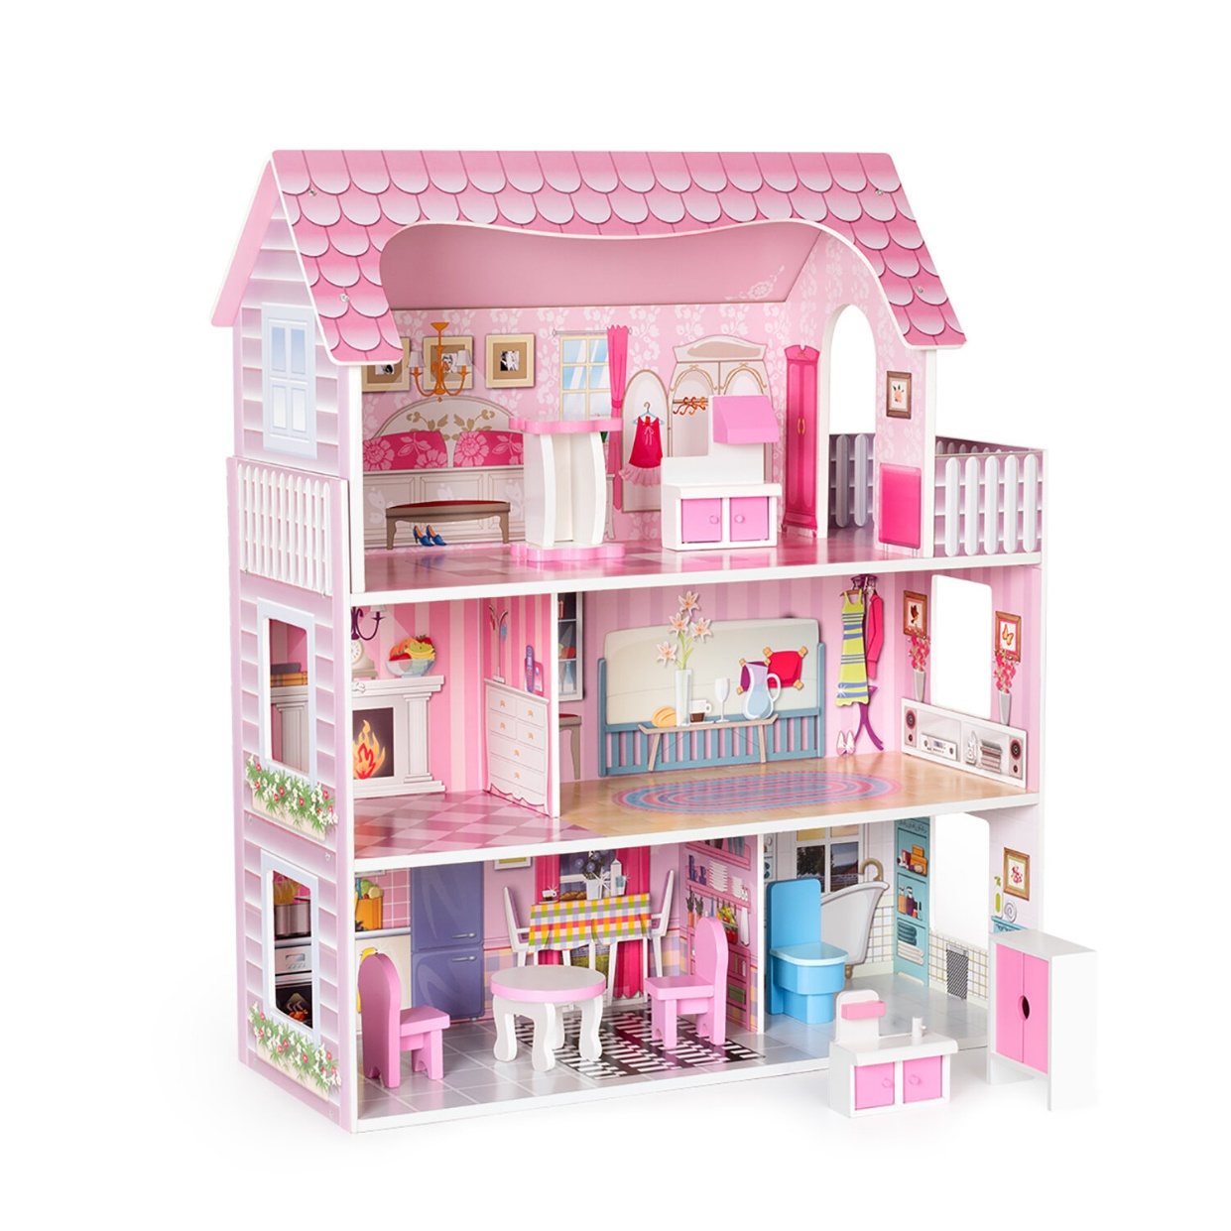
-dollhouse (n)
/ ˈdɒlhaʊs/
: nhà búp bê

Slide 8
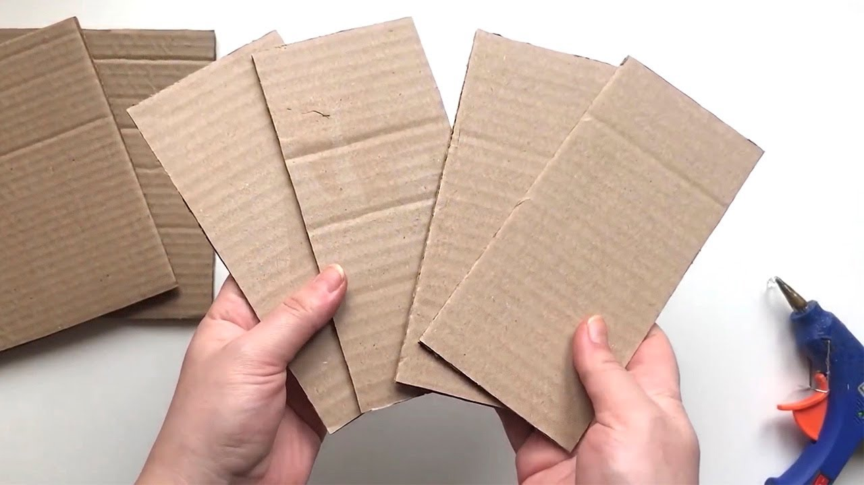
- cardboard (n)
/ˈkɑːdbɔːd/
: bìa các tông

Slide 9
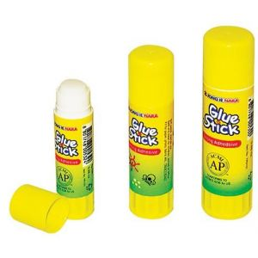
- glue (n)
/ɡluː/
: keo dán, hồ

Slide 10
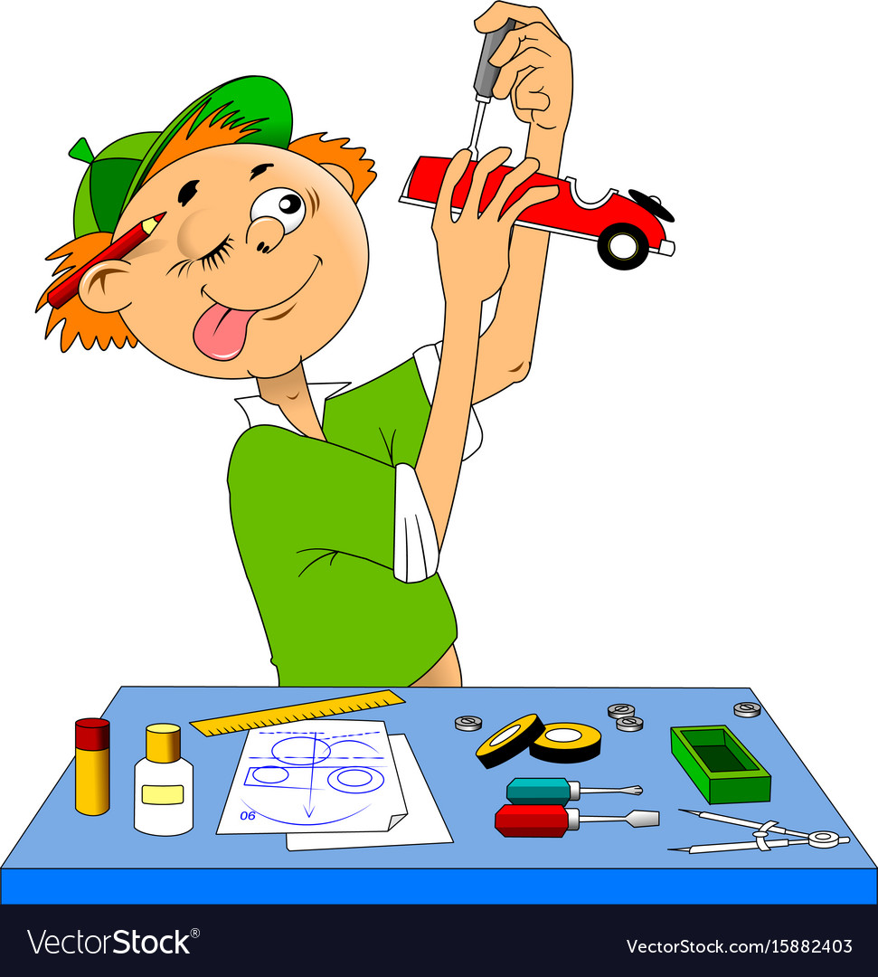
- making models
/ˈmeɪkɪŋ ˈmɒdlz/
: làm mô hình

Slide 11
New words | Pronunciation | Meaning
1. unusual (adj) | /ʌnˈjuːʒuəl/ | khác thường
2. creativity (n) | /ˌkriːeɪˈtɪvəti/ | sự sáng tạo
3. dollhouse (n) | /ˈdɒlhaʊs/ | nhà búp bê
4. cardboard (n) | /ˈkɑːdbɔːd/ | bìa các tông
5. glue (n) | /ɡluː/ | keo dán, hồ
6. making models | /ˈmeɪkɪŋ ˈmɒdlz/ | làm mô hình

Slide 12
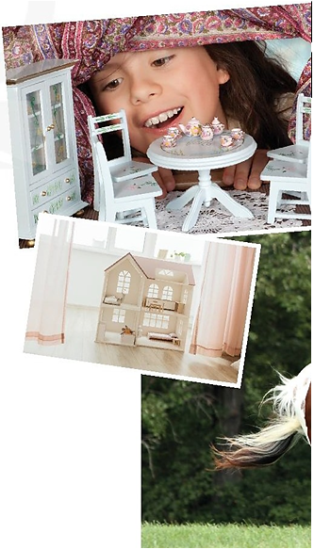
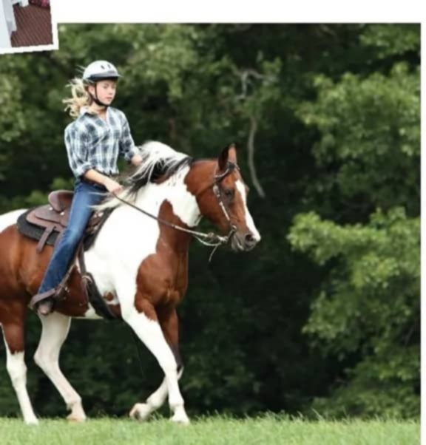
1. LISTEN AND READ
Trang
1. Who are they?
→ Ann and Trang
2. Where are they?
→ Trang’s house
3. What are they talking about?
Ann

Slide 13
1. LISTEN AND READ
Ann: Your house is very nice, Trang.
Trang: Thanks! Let's go upstairs. I'll show you my room.
Ann: I love your dollhouse. It's amazing. Did you make it yourself?
Trang: Yes. I like building dollhouses very much
Ann: Really? Is it hard to build one?
Trang: Not really. All you need is some cardboard and gluue.
Then just use a bit of creativity. What do you do in your free time?
Ann: I like horse riding.
Trang: That's rather unusual. Not many people do that.
Ann: Actually, it's more common than you think. There are
some horse riding clubs in Ha Noi now. I go to
the Riders' Club every Sunday.
Trang: I'd love to go to your club this Sunday. I want to learn how to ride.
Ann: Sure. My lesson starts at 8 a.m.

Slide 14
2. Read the conversation again and and write T (True) or F (False)
 | T | F
1. Trang needs help with building dollhouses. 2. Trang uses glue and cardboard to build her dollhouse. 3. To build a dollhouse, you need to use your creativity. 4. Ann goes to a horse riding club every Sunday. 5. Ann’s lesson starts at 8 p.m.
✓
✓
✓
✓
✓
Ann: Really? Is it hard to build one?
Trang: Not really. All you need is some cardboard and glue. Then just use a bit of creativity.
Ann: I love your dollhouse. It's amazing. Did you make it yourself?
Trang: Yes. My hobby is building dollhouses.
Ann: Actually, it's more common than you think. There are some horse riding clubs in Ha Noi now. I go to the Riders' Club every Sunday.
Ann: Really? Is it hard to build one?
Trang: Not really. All you need is some cardboard and glue. Then just use a bit of creativity.
Trang: I'd love to go to your club this Sunday. I want to learn how to ride.
Ann: Sure. My lesson starts at 8 a.m.

Slide 15
3. Write the words and phrases from the box under the correct pictures. Then listen, check, and repeat.
building dollhouses collecting teddy bears making models | horse riding gardening collecting coins

Slide 16
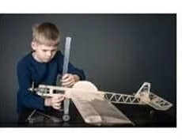
3. Write the words and phrases from the box under the correct pictures. Then listen, check, and repeat.
building dollhouses
collecting teddy bears
making models
horse riding
gardening
collecting coins
making models

Slide 17
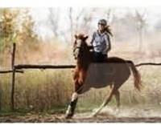
3. Write the words and phrases from the box under the correct pictures. Then listen, check, and repeat.
building dollhouses
collecting teddy bears
making models
horse riding
gardening
collecting coins
horse riding

Slide 18
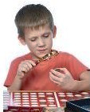
3. Write the words and phrases from the box under the correct pictures. Then listen, check, and repeat.
building dollhouses
collecting teddy bears
making models
horse riding
gardening
collecting coins
collecting coins

Slide 19
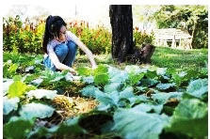
3. Write the words and phrases from the box under the correct pictures. Then listen, check, and repeat.
building dollhouses
collecting teddy bears
making models
horse riding
gardening
collecting coins
gardening

Slide 20
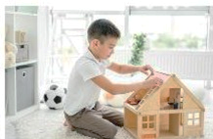
3. Write the words and phrases from the box under the correct pictures. Then listen, check, and repeat.
building dollhouses
collecting teddy bears
making models
horse riding
gardening
collecting coins
building dollhouses

Slide 21
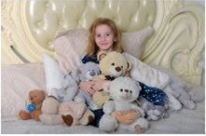
3. Write the words and phrases from the box under the correct pictures. Then listen, check, and repeat.
building dollhouses
collecting teddy bears
making models
horse riding
gardening
collecting coins
collecting teddy bears

Slide 22
4 . Work in pairs. Write the hobbies from 3 in the suitable column
doing things | making things | collecting things
Other hobbies

Slide 23
4 . Work in pairs. Write the hobbies from 3 in the suitable column
doing things | making things | collecting things
- gardening - horse riding | - making model - building dollhouses | - collecting teddy bears - collecting coins
Other hobbies
- listening to music - reading books | - cooking - baking | - collecting stamp - collecting old books

Slide 24
GAME:
Find someone who……
Work in groups
In 3 minutes
Ask your classmates which hobbies they like.
Use structure “Do you like …?”
Write their names in your worksheet

Slide 25
5. Find someone who likes:
 | Names
horse riding
building dollhouses
collecting teddy bears
collecting coins
gardening
making models
…
Nam: Do you like horse riding?
Minh: Yes, I do
Nam: Do you like building dollhouses?
Linh: Yes, I do
Nam: Do you like collecting teddy bears?
Hoa: No, I don’t

Slide 26
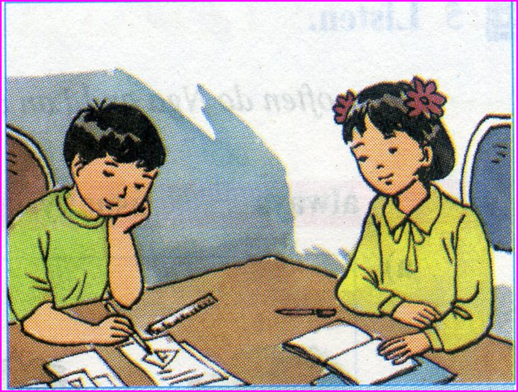
homework
- Learn by heart vocab.
- Do exercises in the workbook.
- Prepare lesson 2 ( A closer look 1)

Slide 27
Mrs Thu Ba

Slide 28
- horse riding /ˈhɔːs raɪdɪŋ/:
- making models /ˈmeɪkɪŋ ˈmɒdlz /:
- gardening /ˈɡɑːdnɪŋ/:
- collecting teddy bears /kəlektɪŋ ˈtedi beə(r)z/:
- collecting coins /kəlektɪŋ kɔɪnz/ :
- making dollhouses /ˈmeɪkɪŋˈdɒlhaʊsiz/:
cưỡi ngựa
làm mô hình
làm vườn
sưu tập gấu bông
sưu tập tiền xu
làm nhà búp bê

Slide 29
* Checking new words
- horse riding :
- making models :
- gardening:
- collecting teddy bears:
- collecting coins :
- making dollhouses :
cưỡi ngựa
làm mô hình
làm vườn
sưu tập gấu bông
sưu tập tiền xu
làm nhà búp bê

