Slide 1


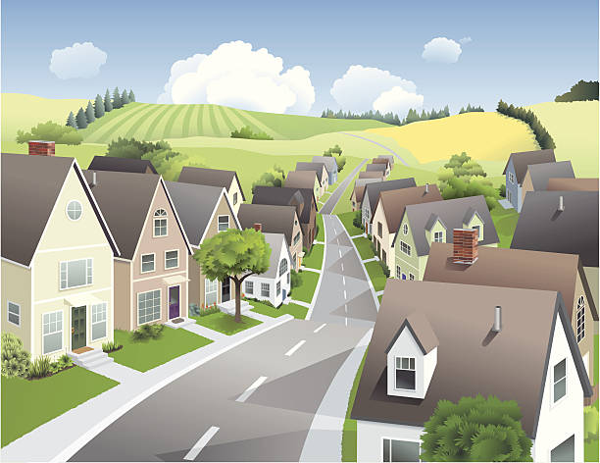
Unit
1
LOCAL COMMUNITY
LESSON 4: COMMUNICATION
1

Slide 2
WARM-UP
Teacher shows pictures, asks students to guess phrasal verbs related to them.
The team that gives more correct phrasal verbs is the winner.
Phrasal verbs revision

Slide 3

WARM-UP
Phrasal verbs revision
FIND OUT

Slide 4
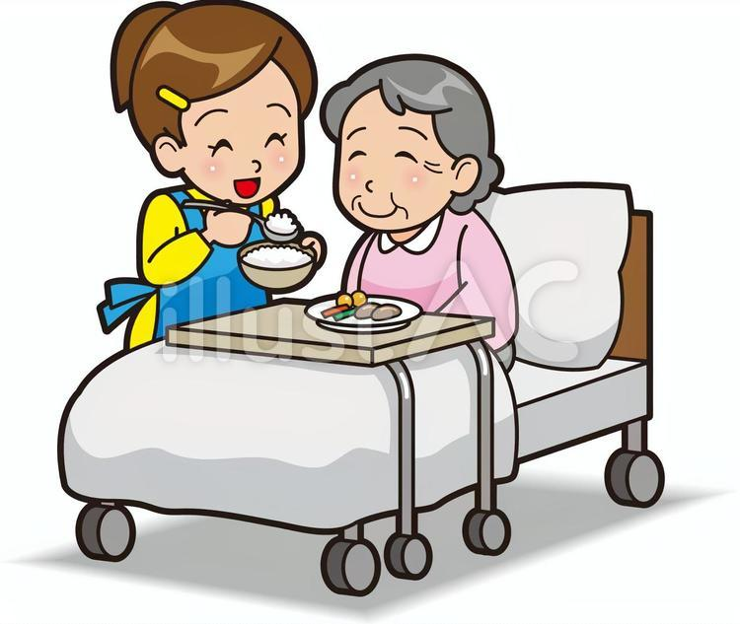

WARM-UP
TAKE CARE OF/
LOOK AFTER
COME BACK

Slide 5


WARM-UP
LOOK FOR
TAKE OFF

Slide 6
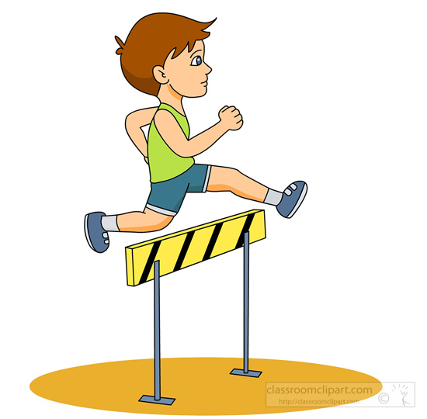
WARM-UP
GET OVER

Slide 7
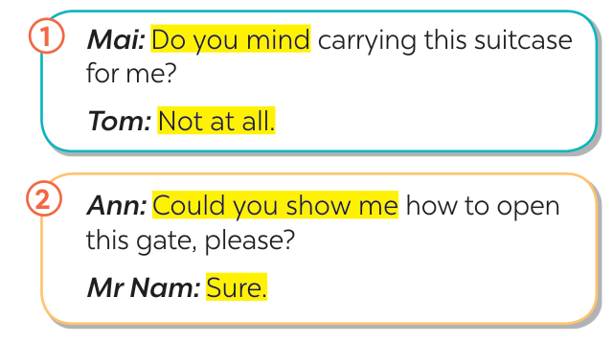

EVERYDAY ENGLISH
1
Listen and read the conversations. Pay attention to the highlighted parts.
Seeking help and responding
(Tìm kiếm sự giúp đỡ và phản hồi)
Do you mind + V-ing?
Could you …?

Slide 8
EVERYDAY ENGLISH
2
Work in pairs. Ask for help and respond in the following situations.
1. You want your friend to lend you her pen.
2. You want your neighbour to tell you the name of the new garbage collector.
3. You want to ask your neighbour where to buy the best fruits and vegetables.
Example:
1. Do you mind lending me your pen?
- Not at all. Here you are.
2. Could you tell the name of the new garbage collector?
- Sure. His name’s Nam.
3. Could you tell me where to buy the best fruits and vegetables in our area?
- Sure. There’s a shop in Le Lai Street.

Slide 9
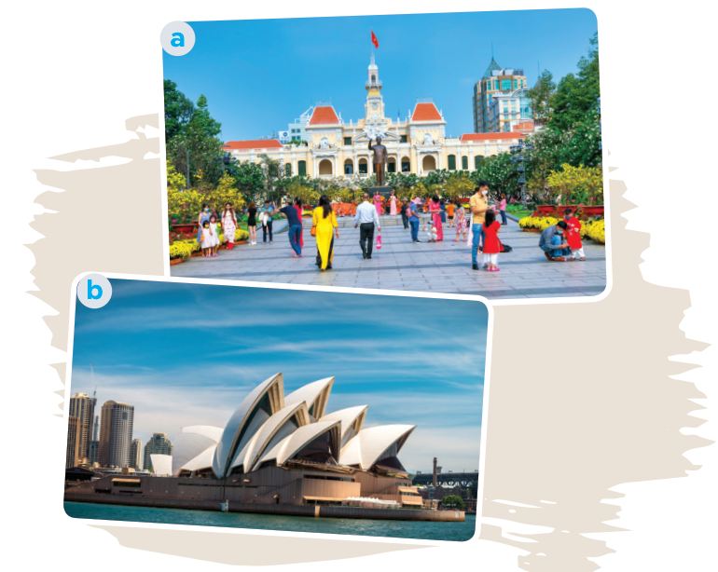
PLACES OF INTEREST
3
Do you know the place in each picture?
- Picture 1: Nguyen Hue Pedestrian Street in Ho Chi Minh City.
- Picture 2: Sydney Opera House in Sydney, Australia.

Slide 10
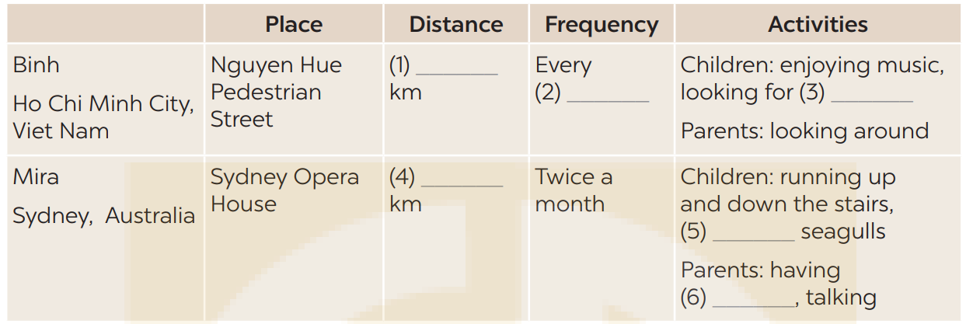
4
Listen to Binh and Mira talking about a place of interest in their community. Fill in each blank with no more than TWO words and / or a number.
one / 1
weekend
favourite books
five / 5
feeding
a drink
* Key: 1. one / 1 2. weekend 3. favourite books 4. five / 5 5. feeding 6. a drink

Slide 11
Audio script:
Binh, from Ho Chi Minh City, Viet Nam
My favourite place of interest is Nguyen Hue Pedestrian Street. It’s in the centre of the city and only a kilometre from our house, so we walk there every weekend. It’s used for pedestrians only and is very
popular especially at weekends and during Tet. My sister and I enjoy the music that street bands play and look for our favourite books while our parents look around.
Mira, from Sydney, Australia
Of all the attractions in Sydney, I love the Opera House the most. It’s one of the most famous performing arts centres in the world. Our family goes there twice a month because it’s about
5 kilometres from our house. My brother and I are fond of running up and down the stairs and feeding the seagulls. Our parents love having a drink and talking to each other.

Slide 12
5
Work in pairs. Ask and answer about your favourite places of interest. Use the questions below.
– What is your favourite place of interest?
– How far is it from your house?
– How often do you go to that place?
– What do you do there?

Slide 13
5
Work in pairs. Ask and answer about your favourite places of interest. Use the questions below.
A: What is your favourite place of interest?
B: My favourite place of interest is My Khe beach
A: How far is it from your house?
B: It’s about 15 kilometres from my house.
A: How often do you go to that place?
B: I go there once a month.
A: What do you do there?
B: When I'm at My ke beach, I usually enjoy walking along the sea, taking photos and enjoy seafood with my family

Slide 14
5
Work in pairs. Ask and answer about your favourite places of interest.
Tell the class about your partner's favourite place of interest .
Example:
Lan’s favourite place of interest is Tao Dan Park. It’s only one kilometre from her house, so she goes there every weekend with her mother and sister. There they walk, do some exercises and enjoy the fresh air. Sometimes they also cycle around the park.

Slide 15
5
Work in pairs. Ask and answer about your favourite places of interest.
Tell the class about your partner's favourite place of interest .
Example:
Nga’s favourite place of interest is My Khe beach. It’s about 15 kilometres from her house, she often goes there once a month with her family. There she usually enjoys walking along the sea, taking photos and enjoy seafood with her family

Slide 16

CONSOLIDATION
What have we learnt in this lesson?
How to seek for help and respond;
Some famous places of interest.

Slide 17

* Homework
Do exercises in the Workbook.
Prepair lesson 5 - Skills 1

Slide 18

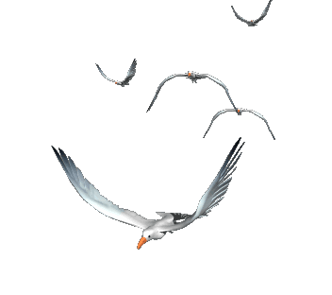






Slide 19
Website: hoclieu.vn
Fanpage: facebook.com/www.tienganhglobalsuccess.vn/

Slide 20
LESSON 4: COMMUNICATION
LESSON 1: GETTING STARTED
WARM-UP
Warm up: Phrasal verbs revision.
Seeking for help and responding.
- Task 1: Listen and read the conversations. Pay attention to the highlighted parts.
- Task 2: Work in pairs. Ask for help and respond in the following situations.
EVERYDAY ENGLISH
- Task 3: Do you know the place in each picture?
- Task 4: Listen to Binh and Mira talking about a place of interest in their community. Fill in each blank with no more than TWO words and / or a number.
- Task 5: Work in pairs. ask and answer about your favourite places of interest. Use the questions below.
PLACES OF INTEREST
CONSOLIDATION
Wrap-up
Homework

