Slide 1
Song Ve secondary school.
ENGLISH 9
Hello everyone !!!

Slide 2
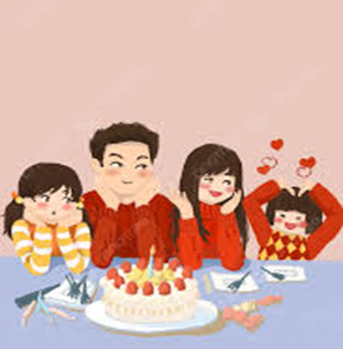
* Warm up:
Crossword puzzle
K
1
F | I | N | I | S | H
F
A
M
I
L
Y
2
P | L | A | Y
3
T | I | M | E
4
B | I | R | T | H | D | A | Y
5
E | A | R | L | Y
6
B | U | Y | S
7
H | E | L | P | S
L
I
F
E
8
L | I | V | E
9
C | O | F | F | E | E
10
D | E | P | E | N | D
1. I have to ………………….all my homework before I go out.
2. Children in my village still ………….traditional games
3. Nowadays Children often spend a lot of …….. playing video games
4. My family often celebrates …………..party for family members.
5. In the past many children had to get up …….. to help their families.
6. Nowadays, My mother ……….. banh chung at Tet instead of making them.
7. My father often ………….my mother with housework.
8. We ……….. in a nuclear family with only my parents and me.
9. My mother likes drinking …………with her friends every morning.
10. People used to use letters for communication, now they …………on smartphones and other electronic devices..

Slide 3
Unit
6
VIETNAMESE LIFESTYLE: THEN AND NOW
LESSON 6: SKILLS 2

Slide 4
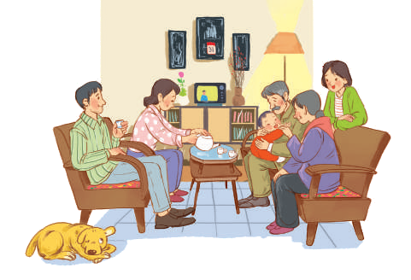
LISTENING
1
You are going to listen to a talk about family life. Work in pairs. Choose the aspect(s) that you think will be mentioned in the talk.
a. Family types
b. Parents’ working places
c. Family holidays
d. Birthday parties
e. Parents-children relations
a. Family types
b. Parents’ working places
c. Family holidays
d. Birthday parties
e. Parents-children relations

Slide 5
2
Listen to the talk and tick (√) the correct column.
- Read the facts (1-5)
- Then, listen for the facts 1-5 and decide if each fact refers to the past or the present.

Slide 6
2
Listen to the talk and tick (√) the correct column.
Facts | The past | The present
1.Popularity of extended families
2. More holidays away from home
3. More time spent doing things together
√
√
√
√
4. More sources to learn from
5. More democratic parent-children relationships
√

Slide 7
3
Listen again and fill in the blank with one word or number.
two
1. The speaker mentions ____________ types of families.
three
2. In an extended family, there is / are ___________ generation(s) living together.
3. The speaker describes Vietnamese people as ____________.
family-oriented
elders
4. Children in the past usually came to their _________ to share their experiences.
5. Today’s children want their parents to respect their independence and ______________.
privacy

Slide 8
Audio-script
Family life has changed a lot over the past 50 years.
Firstly, nuclear families have replaced extended ones. In the past, there were usually three generations living together in a household. Now, there are often two generations only: parents and children.
Secondly, Vietnamese people are traditionally family-oriented. Holidays in the past mostly meant gathering, cooking and eating. Now, more families go out, visit a place, play and eat. Overall, holidays have become more relaxing and less tiring.
Lastly, families in the past spent more time talking and doing things together. Children came to their elders to share their experiences and look for answers to their questions. Today's children have more opportunities to learn from other sources. They do not depend all on their elders. While they listen to their parents, they want their parents to listen to them, too. The relation between parents and children is more democratic. Parents have learned to respect their children's independence and privacy

Slide 9
Transition from Listening to Writing:
- In the coming tasks of writing, you are going to write about the same thing as in the listening: changes in their family over the past five years.

Slide 10
II. WRITING

Slide 11
4
Read the list and tick (√) the thing(s) that has/have changed in your family in the past five years. Make notes of those which have changed.
List | Change
1.Family type / members | Still nuclear. One more member: my brother
2. Home facilities
3.Ways of spending free time
4.Relationships among members
√
better, air conditioner, washing machines,…..
eat out, go on holiday, do chores..
respect each other

Slide 12
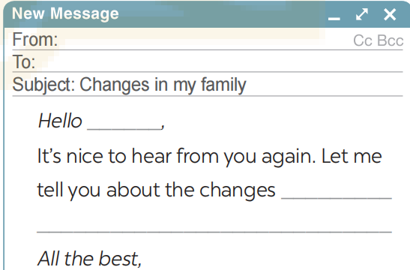
5
Write an email (100 - 120 words) to your penfriend about the changes in your family. Use the ideas in 4
From: Hoa
To: Tom
Subject: Changes in my family
Hello Tom,
It’s nice to hear from you again. Let me tell you about the changes in my family over the past five years. It’s still a nuclear family with two generations. But our living conditions are much better. Two years ago, my father found another job and he earns more money now. We now have an air conditioner and a washing machine. Sometimes we can eat out or go on holiday. My father also spends more time with my brother and me. He teaches us how to do the chores that adult men should be able to do. We act more like friends. My parents respect our independence and privacy. It’s good news, isn’t it?
All the best,
Hoa

Slide 13
From: Hoa
To: Tom
Subject: Changes in my family
Hello Tom,
It’s nice to hear from you again. Let me tell you about the changes in my family over the past five years. It’s still a nuclear family with two generations. But our living conditions are much better. Two years ago, my father found another job and he earns more money now. We now have an air conditioner and a washing machine. Sometimes we can eat out or go on holiday. My father also spends more time with my brother and me. He teaches us how to do the chores that adult men should be able to do. We act more like friends. My parents respect our independence and privacy. It’s good news, isn’t it?
All the best,
Hoa
5

Slide 14
EXTRA ACTIVITY
5
Write your opinion about the role of children nowadays in the family based on the following suggestions:
1. The number of children in a household.
2. The amount of housework they share with their parents.
3. The amount of time they spend on family activities.
4. How much they are obedient to/ independent of their parents.
5. If they are obliged to take care of their parents when their parents get old.

Slide 15
EXTRA ACTIVITY
Nowadays families tend to have fewer children than in the past: just one or two per family. Therefore, parents have more time to take care of their children, resulting in their children doing less housework and having fewer responsibilities in the family. Most parents encourage their children to spend more time on their studies, so they may have less time with families. The internet is also a factor to distract children from engaging with family activities. Children become more independent. However, when their parents get old, most children are willing to take care of them.
5

Slide 16
CONSOLIDATION
What have we learnt in this lesson?
Listen for general and specific information to talk about changes in family life
Write about the changes in one’s family.Write about old school days.

Slide 17
Homework
- Rewrite the paragraph in the notebooks.
- Do exercises in the workbook.

Slide 18
Goodbye.
See you again.

Slide 19
Thank you very much.

Slide 20
Website: hoclieu.vn
Fanpage: facebook.com/www.tienganhglobalsuccess.vn/

Slide 21
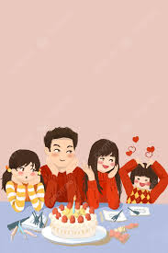
4 . My family often celebrates birthday party for family members
1. I have to finish all my homework before I go out
10.. Children nowadays have more freedom to _____ their interests.
A. pay for B. replace C. know D. pursue
9. In the past, my grandparents used to cook banh chung at Tet
6. Nowadays, My mother buys banh chung at Tet instead of making them.
2. Children in my village still play traditional games
8. We live in a nuclear family with only my parents and me.
3.. Nowadays Children often spend a lot of time playing video games
10. People used to use letters for communication, now they _________on smartphones and other electronic devices.
. Depend
5. In the past many children had to get up early to help their families
9. My mother likes drinking coffee with her friends every morning
Family life
7. My father often helps my mother with housework

Slide 22
WARM-UP
OPTION 1
- List some aspects which you think are related to family life.
Examples:
Family Relationships, Family roles, ....
BRAINSTORM

Slide 23
WARM-UP
OPTION 2
Family Tree Brainstorm

Slide 24
WARM-UP
OPTION 2
Father: Ben
Age: 50
He has taught me many things
Mother: Mary
Age: 45
She always takes care of me
PETER
Brother:............
Sister:.........
.....................
.......:.........

Slide 25
WARM-UP
OPTION 2
- How family dynamics and traditions have evolved over time, and how these changes have impacted your family life?

