Slide 1


ENGLISH 9
Hello everyone !!!
Mrs Thu Ba

Slide 2
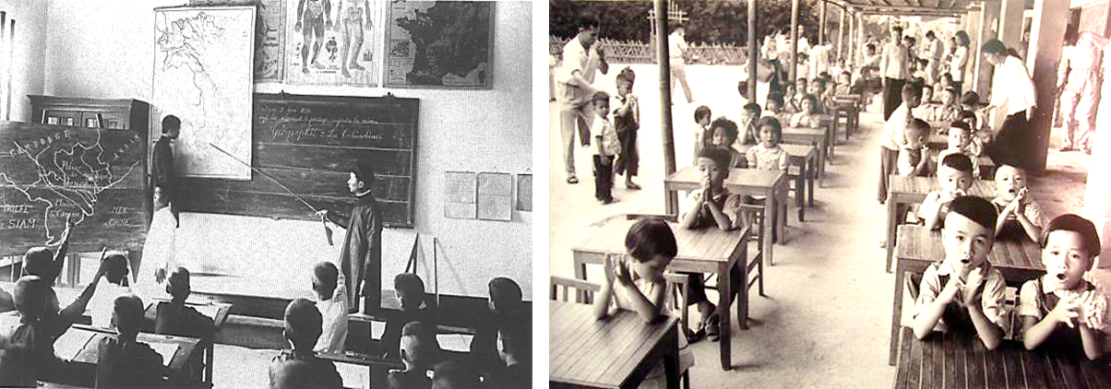
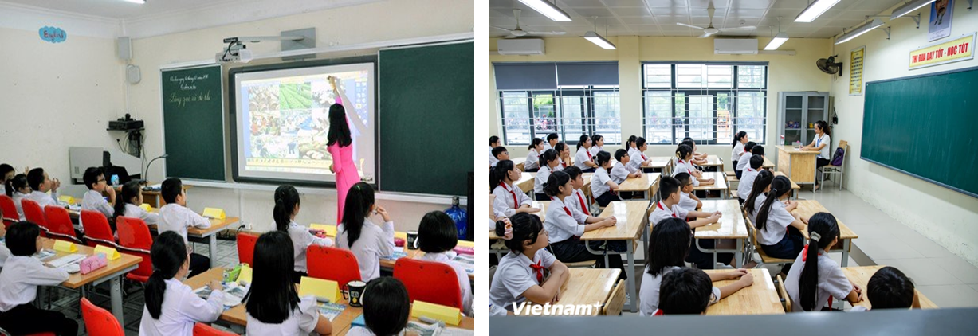
WARM-UP
Some differences between the two pictures
1
- Walk to school
- depends on the teacher and textbook.
- small classroom
- no modern equipment
- do not wear uniform,….
2
- modern learning facilities
( Smart TV connects Internet)
- big and modern classroom, laboratories, Computer labs,
- wear uniform , full school things

Slide 3
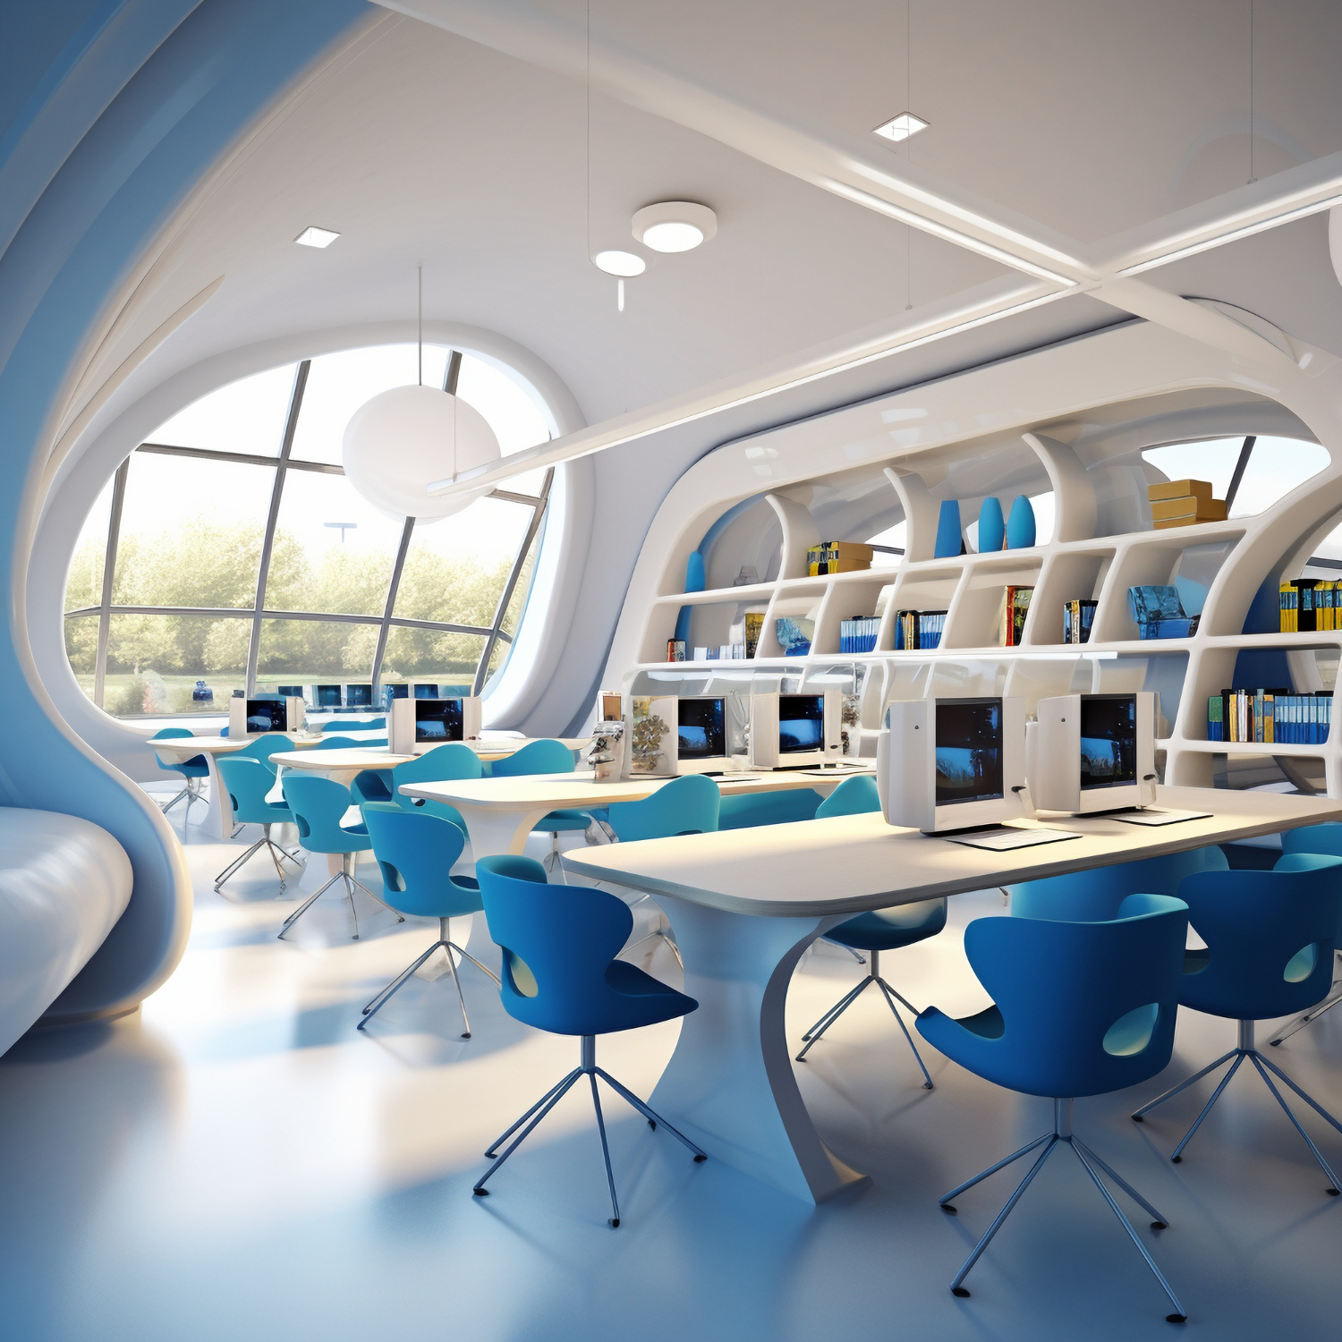
WARM-UP
Question:
- Name some learning facilities you know
Possible answer:
Facilities:
Bookshop, classroom, laboratories, libraries, Computer labs, online learning platforms,…

Slide 4



Unit
6
VIETNAMESE LIFESTYLE: THEN AND NOW
LESSON 5: SKILLS 1

Slide 5
READING
1
Work in groups. Discuss if each of the following phrases describes past or present learning.
- Work in groups.
- Read the phrases about different learning styles and discuss if each is describing the past or the present
Students can also find more sources of information on the Internet, which makes it easier for self-studying and they are less dependent on the teachers

Slide 6
READING
1
Work in groups. Discuss if each of the following phrases describes past or present learning.
Phrases:
– Depending on textbooks
– Using the Internet
– Learning under an oil lamp
– Being independent and active

Slide 7
1
Work in groups. Discuss if each of the following phrases describes past or present learning.
1
Possible answers
Past learning | Present learning
- Depending on textbooks - Learning under an oil lamp | - Using the Internet - Being independent and active

Slide 8

Mr Nam, grandfather, a 70-year-old farmer
I was one of the few children in my village who was still at school at the age of 15. Every dgay, I got up early and walked to school. Learning then depended mostly on our teachers and textbooks. We had no library or lab. The nearest bookshop was six kilometres away. I learned simply by taking notes during class, memorisingthem, and doing the homework. Life then was simple. We rarely travelled outside our village, so we didn’t know much about the world around us.
2
Two people of different generations are talking about their learning styles. Read the passages and choose the correct answer A, B, C, or D.
Mr Nam, grandfather, a 70-year-old farmer
I was one of the few children in my village who was still at school at the age of 15. Every day, I got up early and walked to school. Learning then depended mostly on our teachers and textbooks. We had no library or lab. The nearest bookshop was six kilometres away. I learned simply by taking notes during class, memorizing them, and doing the homework. Life then was simple. We rarely travelled outside our village, so we didn’t know much about the world around us.
Mai, granddaughter, a 15-year-old student
Learning today is very different from my grandfather’s time. It is easier and more convenient. Besides learning from teachers and textbooks, we use the Internet. It provides us with various online sources such as documents, clips, and programmes. Google helps us find the answers to almost any questions we have. The Internet also allows us to pursue our own interests. Learning has become more independent. Although most children in my village have fewer private learning facilities than the students in the city, we are still luckier than my grandfather’s generation. We have TVs to watch at home and a library and computers at school.

Slide 9
1. In Mr Nam’s time, ______.
A. teachers played an important role
B. there were no bookshops
C. students did experiments in labs
D. all children stayed on at school until they were 15
2. Few people travelled outside their village, so ______.
A. life in the village was simple
B. his school didn’t have any learning facilities
C. the villagers didn’t know much about the world around
D. none of the villagers knew about city life

Slide 10
3. Learning now ______.
A. does not require textbooks
B. uses some online programmes
C. depends only on the Internet
D. does not require students to take notes
4. The word “It” refers to ______.
A. learning today
B. my grandfather’s time
C. learning facilities
D. the Internet

Slide 11
5. The word “we” refers to__________.
A. learning facilities
B. students at my grandfather’s generation
C. students in the city
D. children in the village

Slide 12
3
Fill in each blank with ONE word from the passage.
1. Mr Nam learned mainly from teachers and _________.
2. He learned by _________ the information he got in class.
3. Nowadays, students can learn from _________ online sources.
4. An example of an online source is _________.
5. The Internet helps children _________ their interests.
textbooks
memorising
various
documents/clips/programmes
pursue

Slide 13
Transition from Reading to Speaking
- You are going to do the same thing as in the reading: talking about changes in your learning style
- You will talk about your own experience, combining both the past and the present.
- You refer to the reading for any vocabulary, ideas, or structures you may need for their speaking.

Slide 14
SPEAKING
4
Work in groups. Discuss and make a list of the changes in your learning over the past five years.
You can mention:
– number of subjects
– teachers
– learning facilities
– learning style (dependent / independent ...)

Slide 15
4
Work in groups. Discuss and make a list of the changes in your learning over the past five years.
Sample answers:
Aspects | 5 years ago | Now
Number of subjects | Fewer subjects, typically core subjects | More subjects, increased variety, including Literature, Chemistry, Physics, Biology,..
Teachers | three or four teachers teach all the subjects | Different subject specific teachers for various subjects
Learning Facilities: | almost text book | use textbooks and internet, labs…
Learning style | Dependent learning | More independent learning with self-study and research.

Slide 16
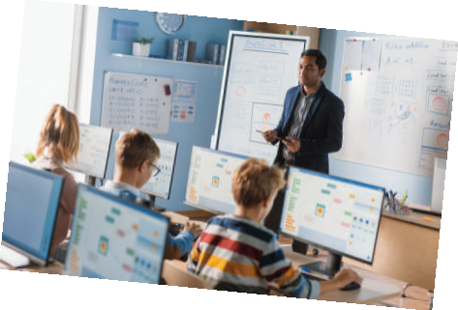
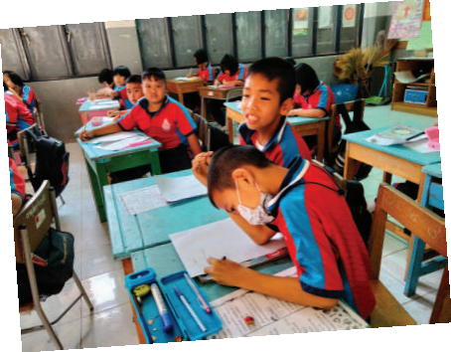
Share with the class the list your group has made in 4
5
- Present the changes that your groups have talked about.
- Listen and give comment or ask questions if you have any.

Slide 17
SPEAKING
Example:
Five years ago, we were at primary school. We had only three or four teachers teaching us all the subjects. We depended on the teachers to tell us everything we needed to do: taking notes in our notebooks, doing homework and preparing for exams. We rarely did anything that the teacher did not request. Now, we have different teachers for different subjects. We have also become more independent and active in our learning. We use the internet to learn about our interests. And it costs little to do it.

Slide 18
EXTRA ACTIVITY
Interview two of your classmates and fill in the table below in notes. Then report your findings to the class.
Questions | Student 1 | Student 2
1. What are the three favourite sources for your learning?
2. What do you prefer: learning by yourself or learning in groups?
3. Do you attend extra classes after school?

Slide 19

CONSOLIDATION
What have we learnt in this lesson?
Read for specific information about the differences in the learning styles of past and present
Talk about changes in one’s learning style

Slide 20

Homework
Do exercises in the workbook.
Prepair lesson 6- Skills 2

Slide 21




Slide 23
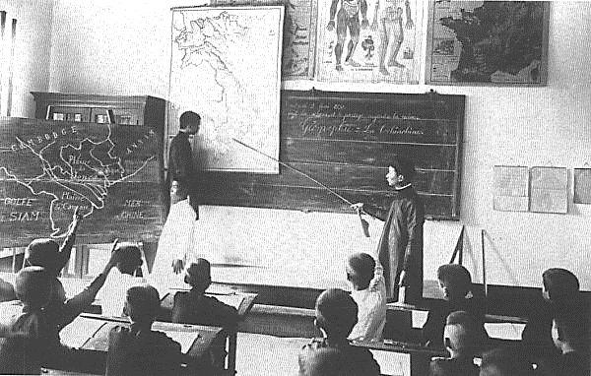
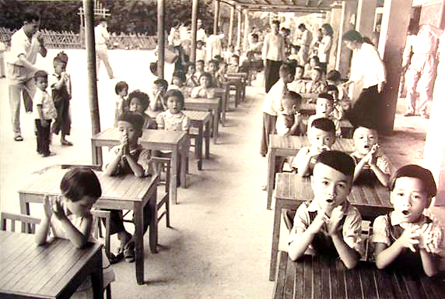
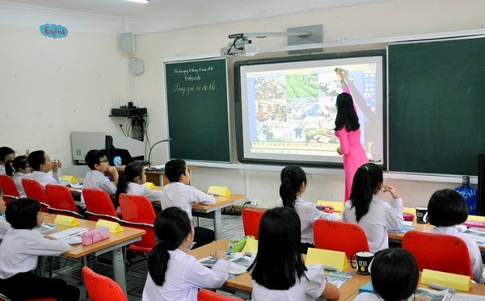
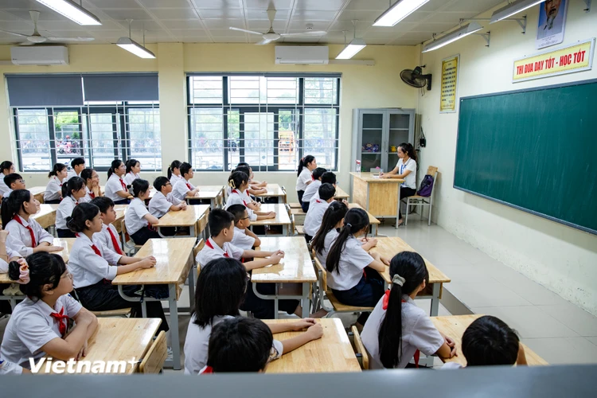
WARM-UP

Slide 24
4
Work in groups. Discuss and make a list of the changes in your learning over the past five years.
Sample answers:
Teachers: three or four teachers teach all the subjects
=> different teachers for different subjects.
Learning Facilities:
almost text book => use textbooks and internet…
Learning style:
dependent => independent

