Slide 1
Song Ve secondary school.
ENGLISH 8
Hello everyone !!!

Slide 2
LET’S PLAY
* WARM-UP
Promise:

Slide 3
Promise chain
- Work in teams
- The first student from each team listen to the teacher.
- The student must then turn to their teammate and repeat the sentence exactly as they heard it.
- The next student in line must repeat the sentence to their teammate, and so on, until the sentence reaches the end of the line.
- The first team to correctly repeat the entire sentence wins points

Slide 4
I promise to be nice
Promise:
I promise to give you 5k
I promise not to trick you.
I promise not to cheat in the test.

Slide 5
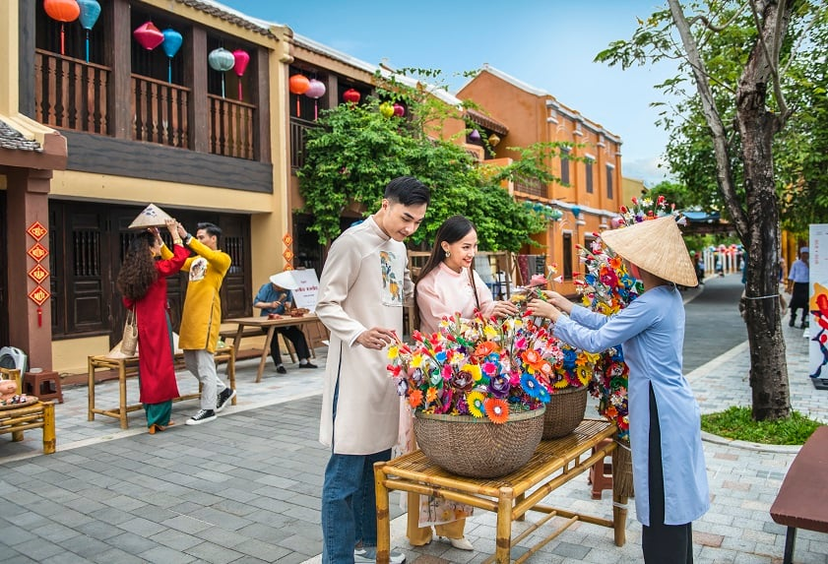
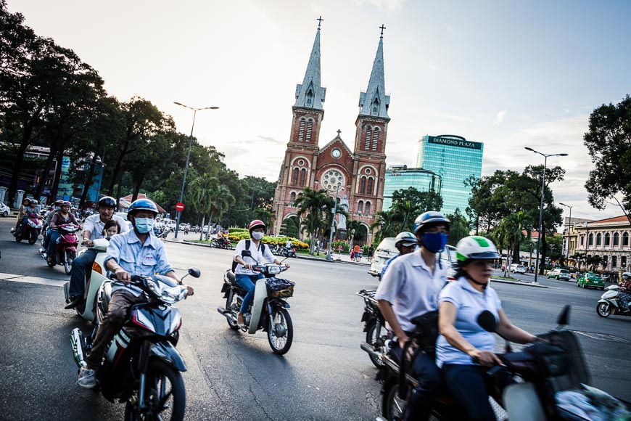
Unit
6
VIETNAMESE LIFESTYLE: THEN AND NOW
LESSON 4: COMMUNICATION

Slide 6
EVERYDAY ENGLISH
1
Listen and read the conversations below. Pay attention to the highlighted parts.
Mike: I will share with you the links about the ancient village of Duong Lam.
Phong: Thank you.
Mi: I promise not to bring my dog to the picnic.
Ann: Great! I appreciate it.
Cảm kích , đánh giá cao

Slide 7
EVERYDAY ENGLISH
Structures:
Making Promises:
I will …
I promise to / not to…
Respond:
Thank you.
I (highly) appreciate it.

Slide 8
EVERYDAY ENGLISH
2
Work in pairs. Make promises for the following situations.
- Work in pairs to make similar dialogues, using the language you have learnt.
1. You are going out with friends. Promise your parents to return before 9 p.m.
2. Promise your friend that you will be on time for the performance.

Slide 9
EVERYDAY ENGLISH
Suggested dialogues:
I will return / I promise to return before 9p.m.
I appreciate it.
I will be / I promise to be on time for the performance.

Slide 10
EVERYDAY ENGLISH
Suggested dialogues:
I will be / I promise to be on time for the performance.
I highly appreciate it

Slide 11
EXTRA ACTIVITY
Some promises you usually make in life.
Ex: I’ll finish all my homework before I go out, Mum.
I promise not to let you down.

Slide 12
CHANGES AROUND YOU
3
Read the passage about changes. Then match the people with the topics they are talking about.
1. Aki from Tokyo
2. Sanjay from New Delhi
Children used to go to temple schools. Monks, samurai, doctors, and people of other professions served as teachers. Nowadays, children study in modern schools with teachers who get professional training in the subjects they teach.
Once, it was easy to say which country a person was from because people wore their own traditional costumes. Now, trends, comfort, and style are more important. More people are wearing western clothes like jeans and T-shirts instead.
2. Sanjay from New Delhi
Once, it was easy to say which country a person was from because people wore their own traditional costumes. Now, trends, comfort, and style are more important. More people are wearing western clothes like jeans and T-shirts instead.

Slide 13
1. Aki from Tokyo
Children used to go to temple schools. Monks, samurai, doctors, and people of other professions served as teachers. Nowadays, children study in modern schools with teachers who get professional training in the subjects they teach.
3
Read the passage about changes. Then match the people with the topics they are talking about.
3. Asim from Cairo
In the past, people used animals such as horses and camels for travelling. Now, airplanes, ships, and trains have replaced them. Transportation has become faster and easier.
In the past, people used animals such as horses and camels for travelling. Now, airplanes, ships, and trains have replaced them. Transportation has become faster and easier.

Slide 14
2. Sanjay from New Delhi
Once, it was easy to say which country a person was from because people wore their own traditional costumes. Now, trends, comfort, and style are more important. More people are wearing western clothes like jeans and T-shirts instead.
3
Read the passage about changes. Then match the people with the topics they are talking about.
PEOPLE | TOPICS
1. Aki | a. Transportation
2. Sanjay | b. Education
3. Asim | c. Clothes

Slide 15
4
Work in groups. Read the passages in 3 again and discuss.
- Work in groups.
- Look at two suggested questions and express your idea.
1) focus on aspects of life in the past and choose the one they would like to experience
2) choose the change which they think is for the better and explain why.

Slide 16
4
Work in groups. Read the passages in 3 again and discuss.
1) focus on aspects of life in the past and choose the one they would like to experience
2) choose the change which they think is for the better and explain why.
In the past, traditional clothing symbolized heritage and cultural identity, promoting community and pride. However, modern transportation, such as trains, ships, and airplanes, has made it more convenient, safe, and quick. This has allowed people to travel farther in less time and spend less money, highlighting the importance of cultural identity and heritage.

Slide 17
4
Work in groups. Read the passages in 3 again and discuss.
The change I think is for the better is “Now, airplanes, ships, and trains have replaced them. Transportation has become faster and easier.” Because this shift has made transportation faster, safer, and more convenient. With modern transportation, people can travel longer distances in shorter amounts of time, saving time and money..

Slide 18
There have been some changes in Lan’s lifestyle. The first change is her…. However, her … has / have not changed over the past five years.
5
Work in pairs. Read the list below. Tell your partners which of them has remained the same and which has changed over the past five years. Take notes of your partner’s answers and report them to the class.
– Your style of clothes
– Your eating habits
– Your hobbies
– Your favourite actor / singer / book / movie

Slide 19
Sample structure:
There have been some changes in ............ lifestyle. The first change is her/his…. However, her/his … has / have not changed over the past five years.

Slide 20
Work in pairs. Read the list below. Tell your partners which of them has remained the same and which has changed over the past five years. Take notes of your partner’s answers and report them to the class.
5
My style of clothes: I've always had a casual style, and it hasn't changed much over the past five years. I still prefer comfortable clothing like jeans and T-shirts .
My eating habits: I focus more on healthy meals with more vegetables than before .
My hobbies: I used to be really into video gaming, but over the past five years I like playing sports more.
I used to like the singer Son Tung most; however, these days, Duc Phuc is her favourite.

Slide 21
CONSOLIDATION
What have we learnt in this lesson?
Know how to make promises
Talk about Changes in Lifestyle

Slide 22
Homework
Do exercises in the workbook.
Prepair lesson 5 – Skills1

Slide 23
Thank you!
Goodbye!

