Slide 1


Song Ve secondary school.
ENGLISH 9
Hello everyone !!!

Slide 2
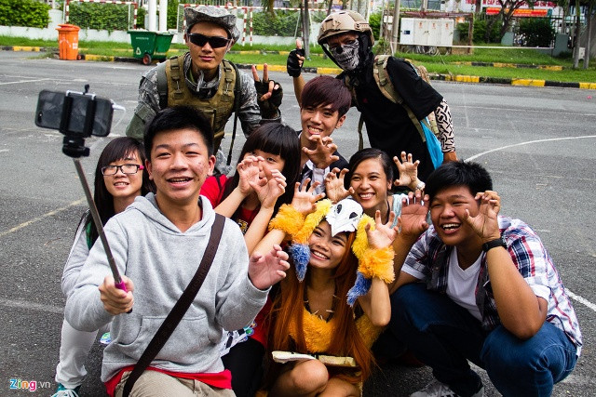
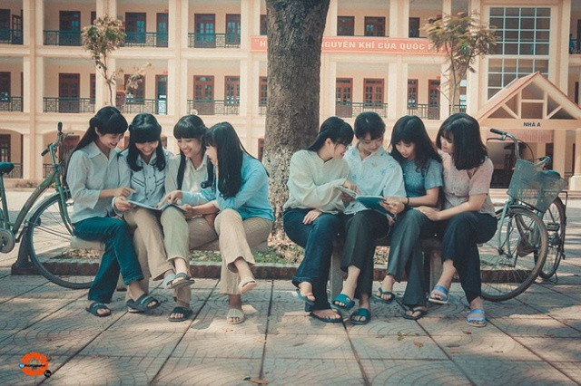
Find the differences between the 2 pictures
Relax by taking photos and selfies
Relax by reading books

Slide 3
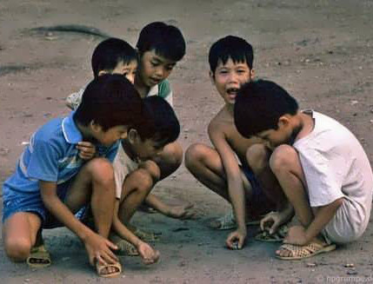
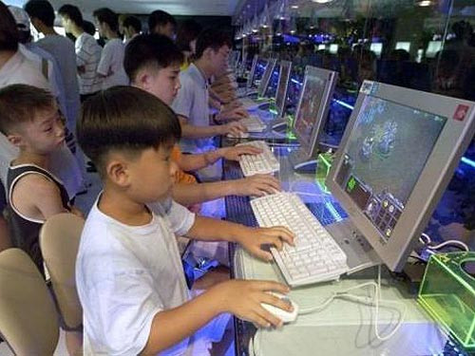
Find the differences between the 2 pictures
video games
Traditional games, folk games
video games

Slide 4
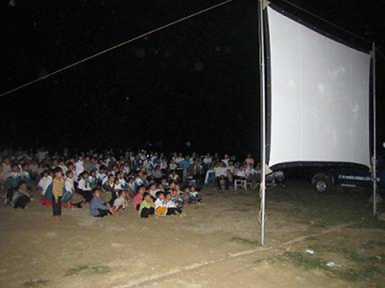
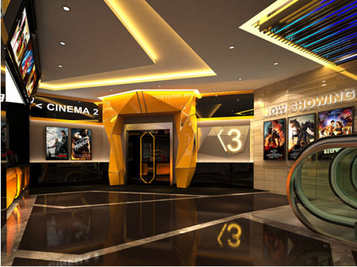
Find the differences between the 2 pictures
Watching big screen movies outdoors
watching movies in the cinema

Slide 5
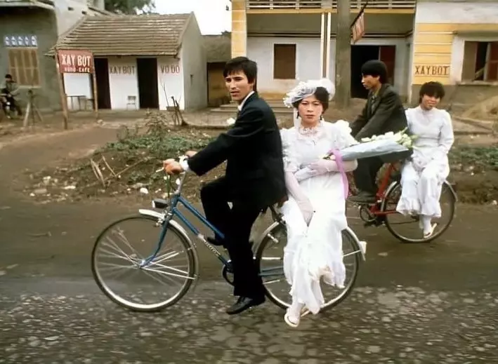
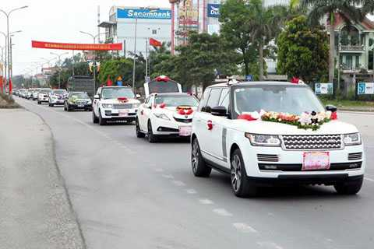
Find the differences between the 2 pictures
Wedding go by bicycle
Weddings go by car

Slide 6
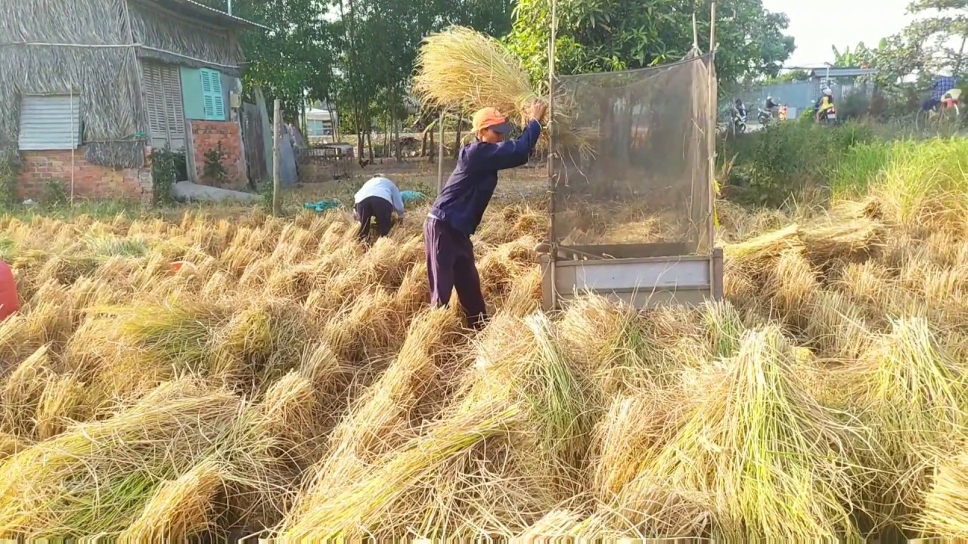
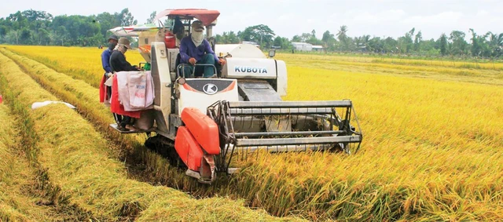
Find the differences between the 2 pictures
cutting and threshing rice by hand
Using a combine harvester

Slide 7
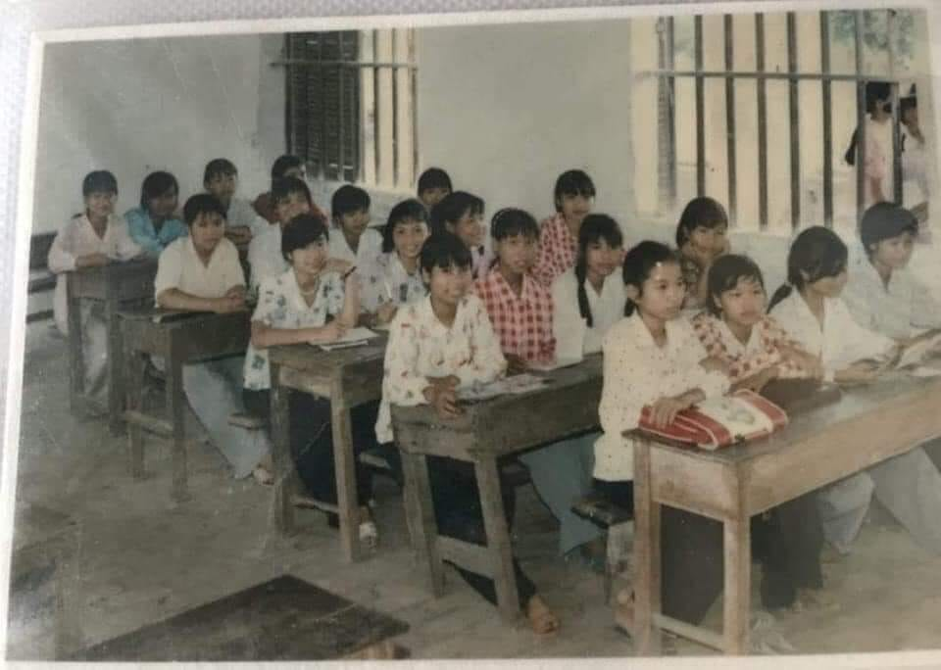
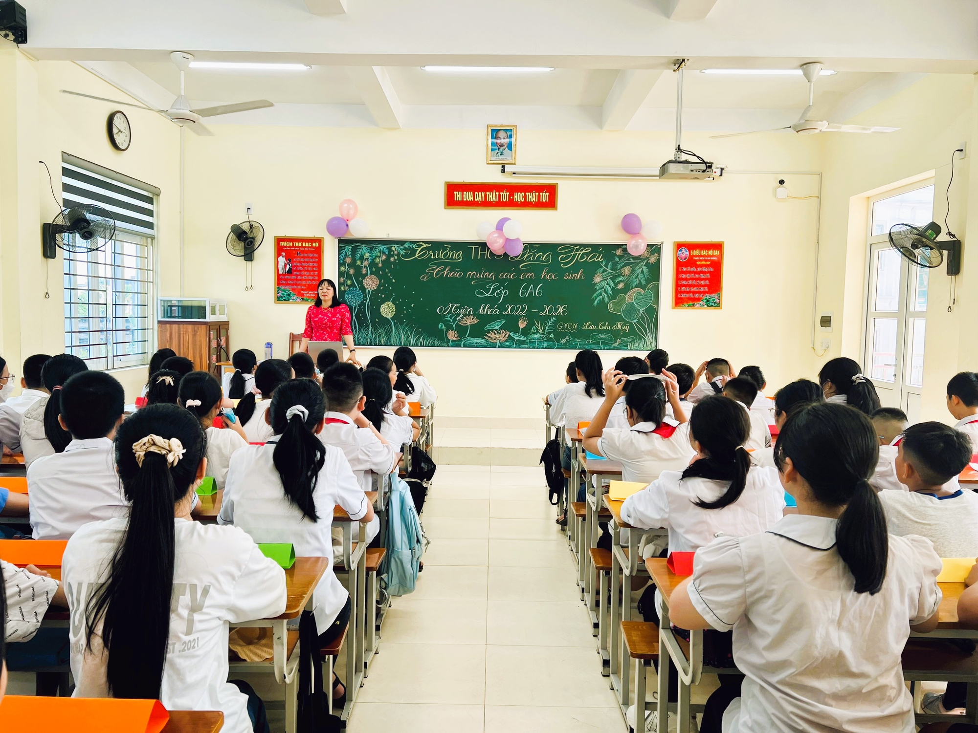
Find the differences between the 2 pictures
Classroom is small, simple .
Students don’t wear uniform
Classrooms are modern and
fully equipped.
Students wear uniform

Slide 8
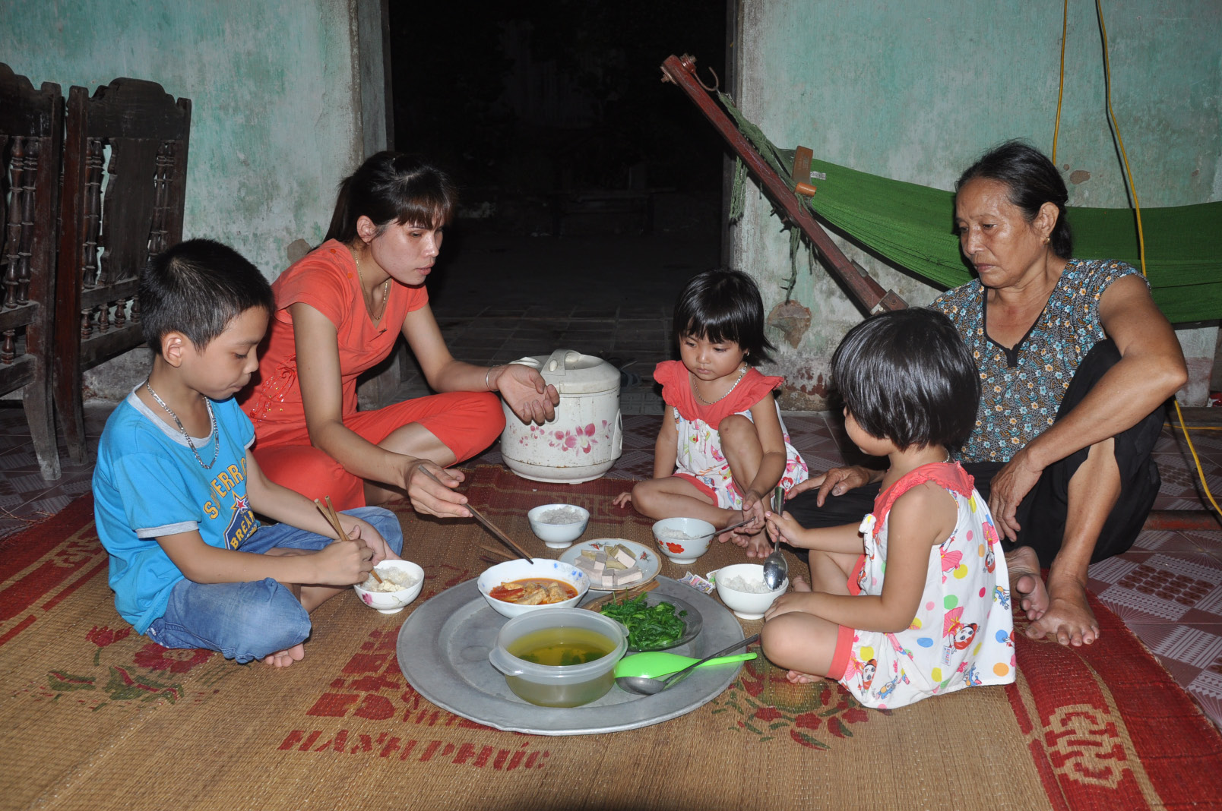
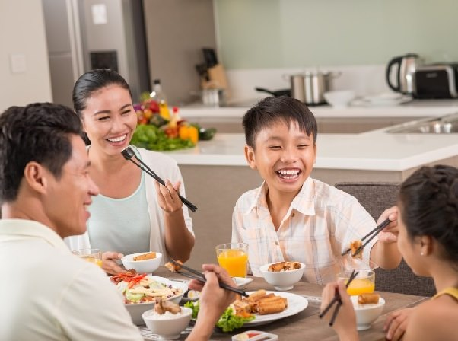
Find the differences between the 2 pictures
The family sits and eats around a mat
The food is simple, and only a few dishes
in the meal
The family sits and eat around a table
The food is very delicious, and many dishes in the meal

Slide 9

WARM-UP
OPTION 1
Answer the questions:
What aspect of life you think has changed (transportation,fashion,entertainment, shopping, travelling, learning…)?
THINK!

Slide 10


Unit
6
VIETNAMESE LIFESTYLE: THEN AND NOW
LESSON 1: GETTING STARTED
We didn’t do it in my day.

Slide 11
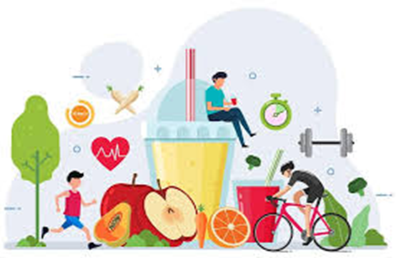

My family has a healthy lifestyle with regular exercise and a balanced diet.
- Lifestyle
/laɪfstaɪl/
lối sống

Slide 12

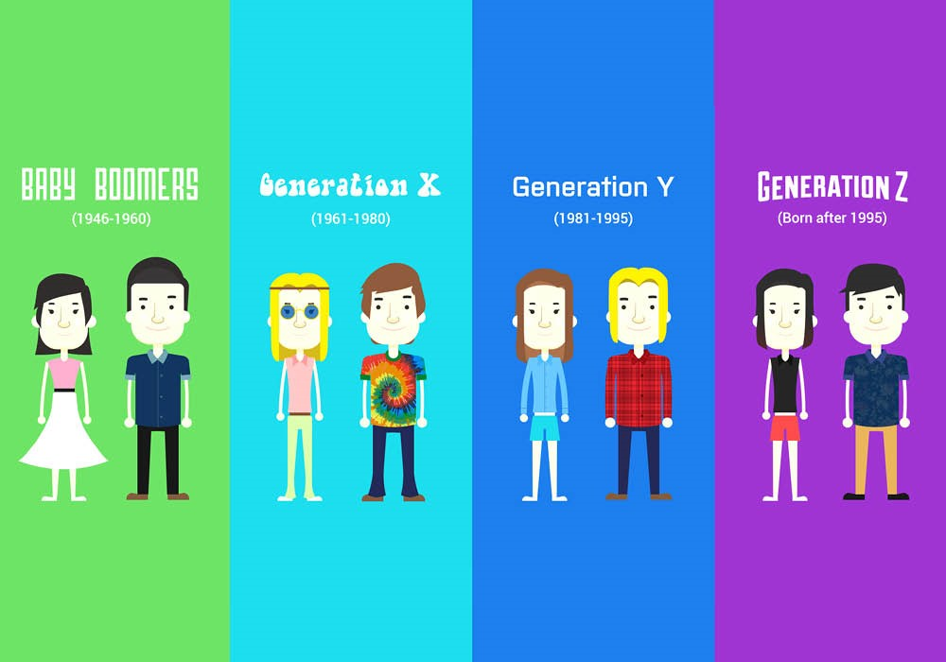
VOCABULARY
- generation (n)
all the people of about the same age within a society
/ˌdʒenəˈreɪʃn/
thế hệ

Slide 13

VOCABULARY
standard of living
- living condition
/ˈlɪvɪŋ kənˈdɪʃənz/
điều kiện sống

Slide 14

VOCABULARY
- opportunity (n)
chance
/ˌɒpəˈtjuːnəti/
cơ hội
Ex: He had a golden opportunity to score in the first half but squandered it.

Slide 15

- support (v)
/səˈpɔːt/
hỗ trợ

Slide 16
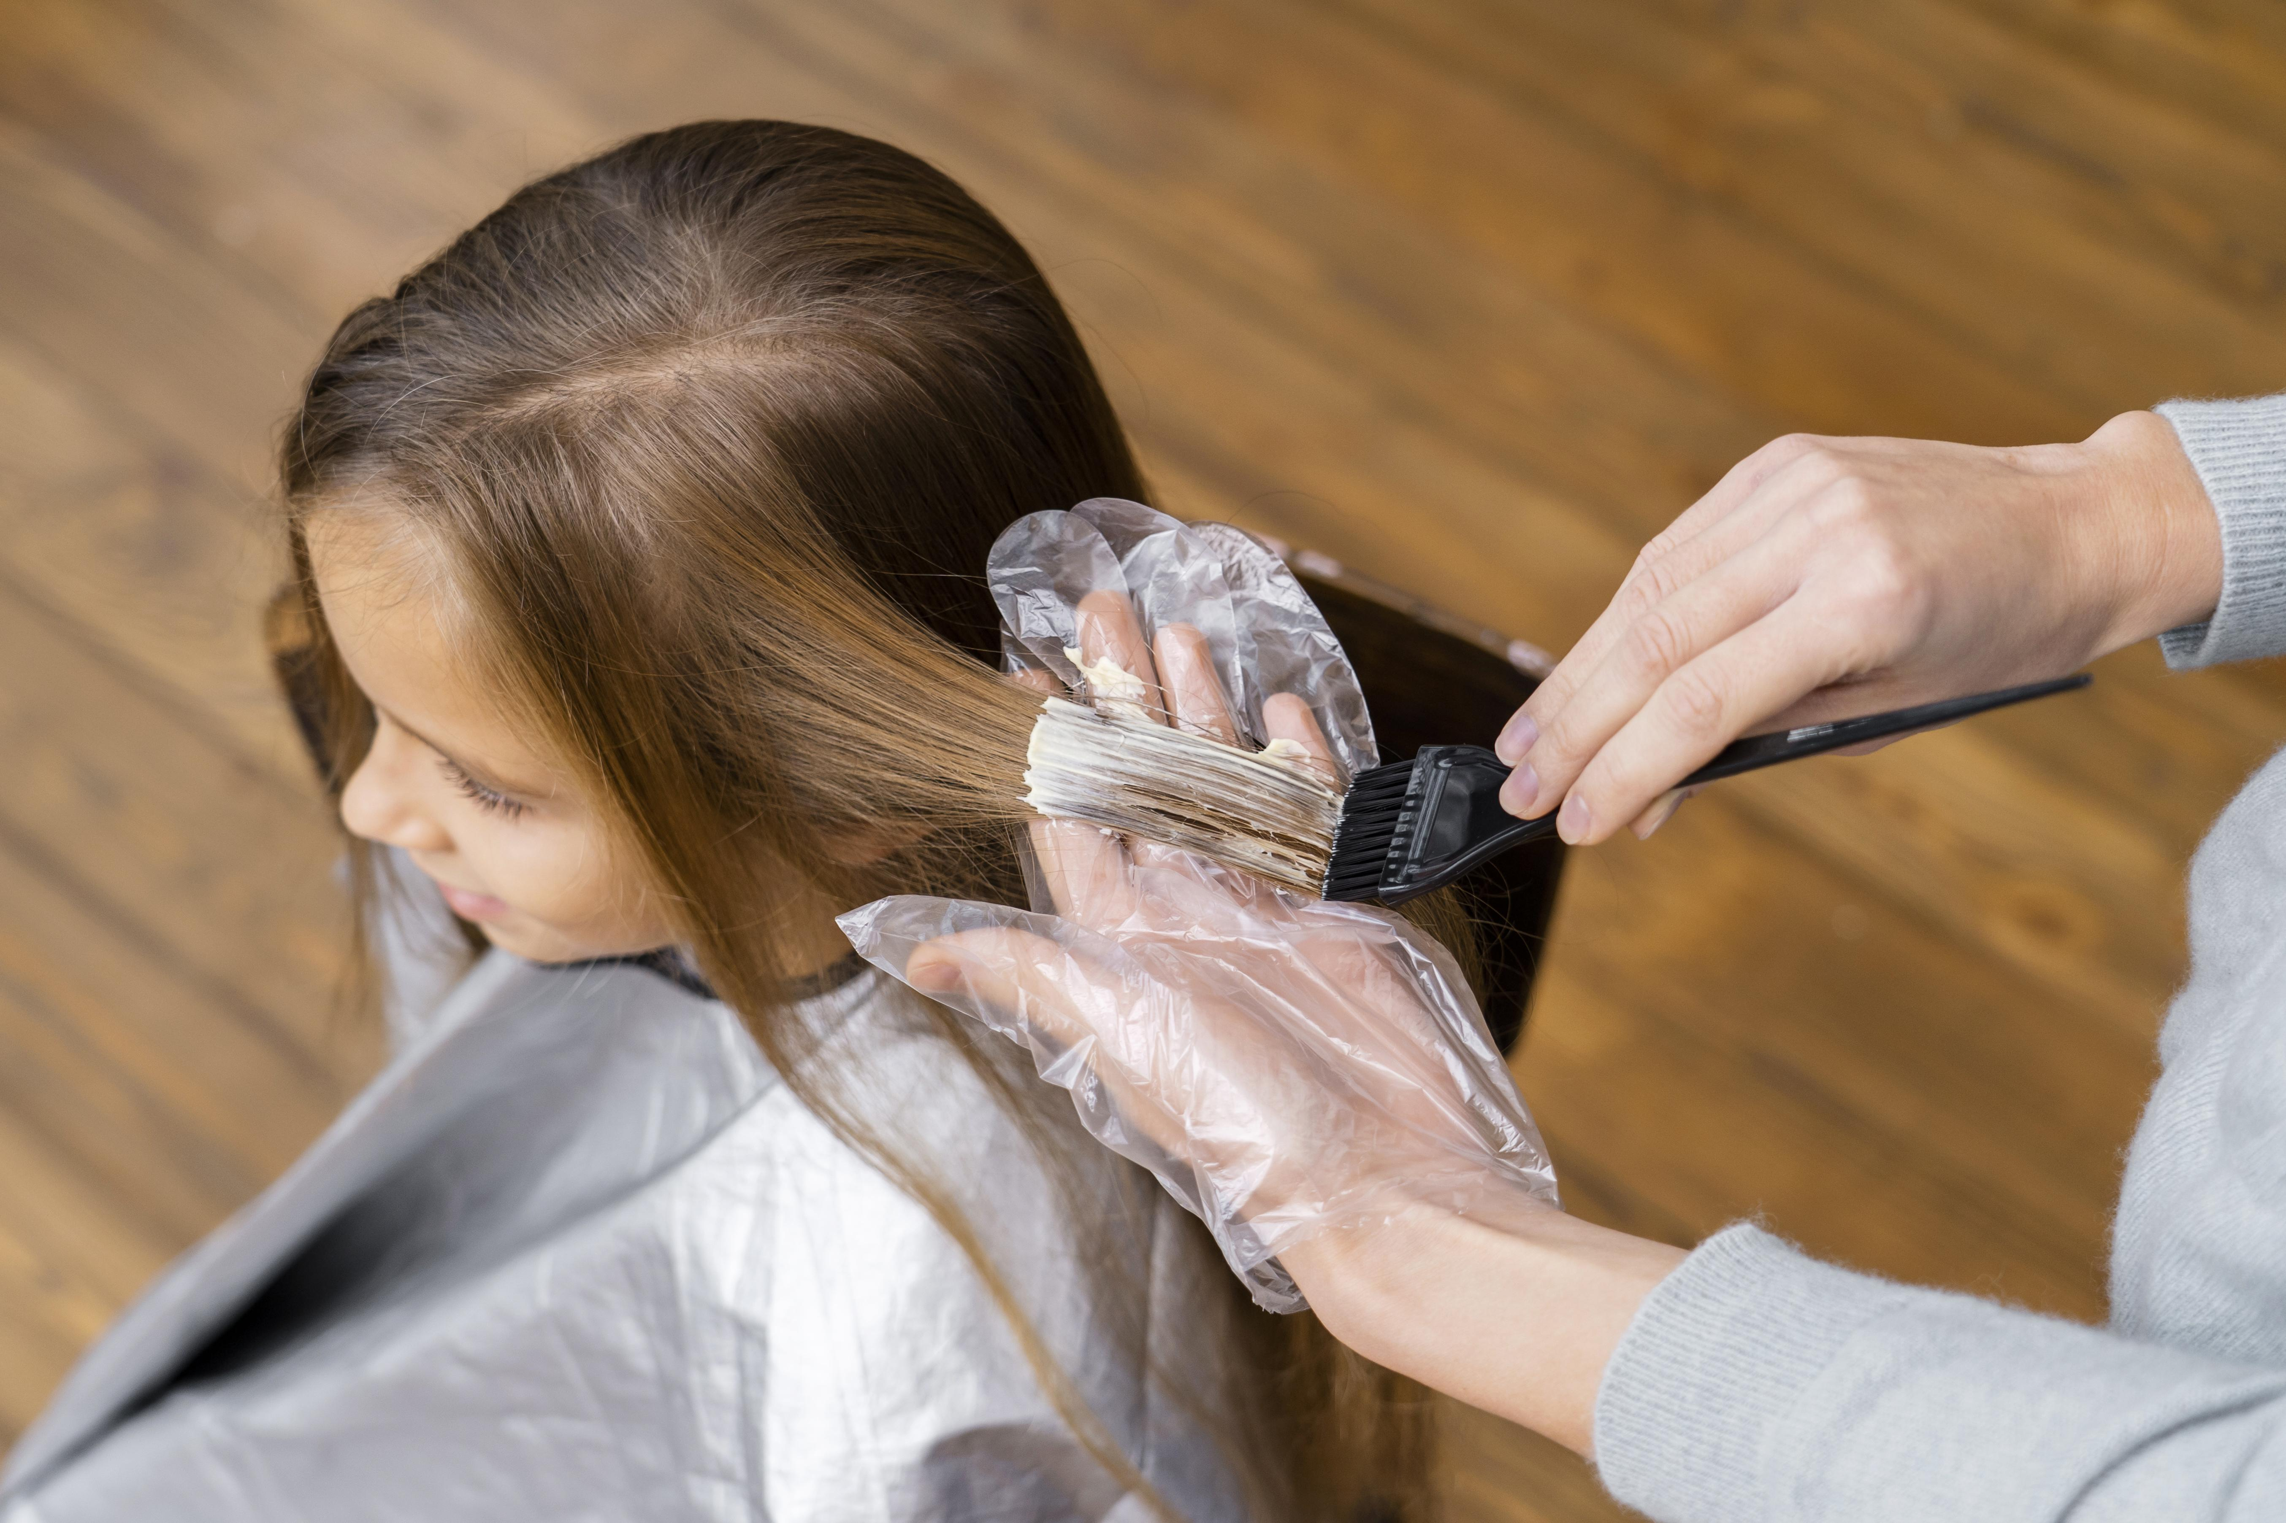
VOCABULARY
to change the colour of sth using a special liquid.
- dye (v)
/daɪ/
nhuộm

Slide 17
VOCABULARY
- depend on (v)
phụ thuộc (vào)
/dɪˈpend ɑːn/

Slide 18
VOCABULARY
New words | Pronunciation | Meaning
1. generation (n) | /ˌdʒenəˈreɪʃn/ | thế hệ
2. living condition | /ˈlɪvɪŋ kənˈdɪʃənz/ | điều kiện sống
3. opportunity (n) | /ˌɒpəˈtjuːnəti/ | cơ hội
4. dye (v) | /daɪ/ | nhuộm

Slide 19
VOCABULARY
New words | Pronunciation | Meaning
1. Lifestyle (n) | /laɪfstaɪl/ | lối sống
2. generation (n) | /ˌdʒenəˈreɪʃn/ | thế hệ
3. living condition | /ˈlɪvɪŋ kənˈdɪʃənz/ | điều kiện sống
4. opportunity (n) | /ˌɒpəˈtjuːnəti/ | cơ hội
5. dye (v) | /daɪ/ | nhuộm
6. depend on (v) | / dɪˈpend ɑːn/ | phụ thuộc (vào)
7. support (v) | /səˈpɔːt/ | Ủng hộ

Slide 20
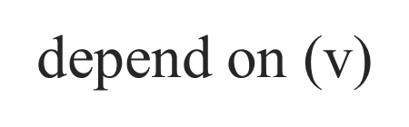
CHECKING VOCABULARY
New words | Meaning
1. | lối sống
2. | thế hệ
3. | điều kiện sống
4. | cơ hội
5. | nhuộm
6. | phụ thuộc (vào)
7. | Ủng hộ
Lifestyle (n)
generation (n)
living condition
opportunity (n)
dye (v)
support (v)

Slide 21
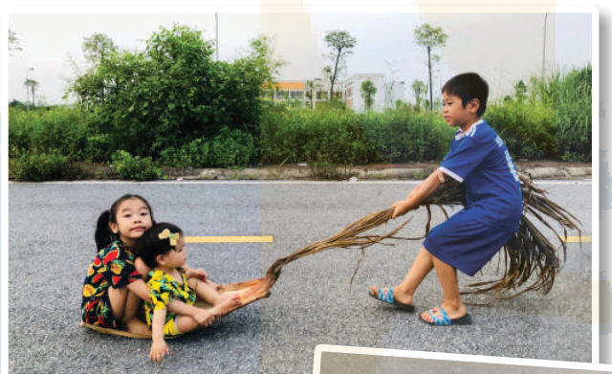
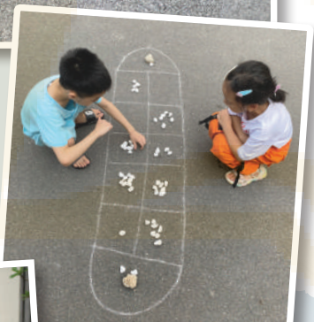
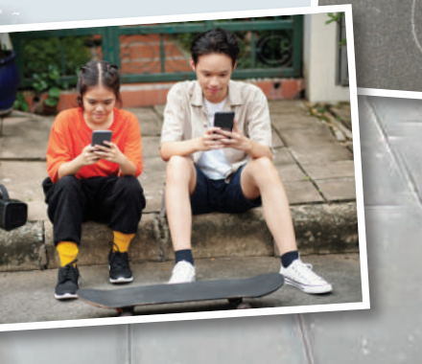
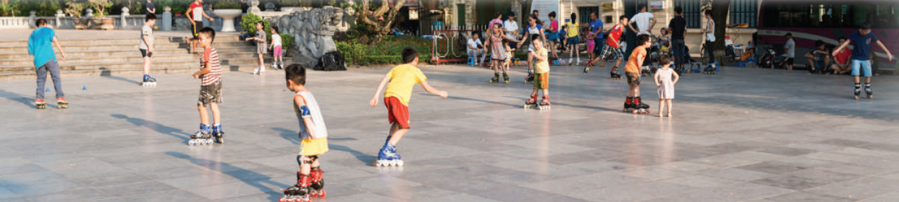
PRACTICE
Look at the pictures on pages 60-61 and answer
- What do you think the children / teens in each picture are doing?
- Do you think the activity in each picture is popular in the past or present?

Slide 22
1
Listen and read
Phong: Grandpa, do you mind telling me how our lives are different from yours in the past?
Grandpa: Well, there are many differences. In my day, we mostly played outdoors. The games were simple and cost little. We made our own toys from natural materials.
Phong: That sounds interesting. Nowadays, most leisure games depend on electronic devices.
Grandpa: Right, but that is mostly true in the city only. Many children in the countryside still play traditional games.
Phong: I know.

Slide 23
1
Listen and read
Grandpa: Another thing is that children nowadays have more freedom of choice. They wear short dresses and jeans with holes. They also dye their hair purple and green.
Phong: Ha ha … Not many, Grandpa.
Grandpa: Hm … And many children of my generation left school early to support their families. Moreover, there were not many schools then.
Phong: You mean we have more opportunities to learn now?
Grandpa: That’s right.
Phong: Do you think these changes are for the better?
Grandpa: Yes, they mostly are. They have improved our living conditions.
Phong: Thank you, Grandpa

Slide 24
2
Read the conversation again and circle the correct answers
1. Phong and his grandpa are talking about some differences between___________________
A. children in the city and the countryside
B. the living standards in the past and now
C. life in the past and now
D. past and present entertainment

Slide 25
a. depend on electronic devices
c. dye their hair
b. leave school early
e. make toys from natural materials
d. have more opportunities to learn
2
Read the conversation again and circle the correct answers
2. Phong’s grandpa mentions _________________differences
A. two
C. four
B. three
D. five
3. Phong’s grandpa sees most of the changes as ______________.
A. positive
C.unnecessary
B. negative
D. necessary

Slide 26
opportunity
freedom
dyed
generations
materials
3
Write the expressions from the conversation in the correct
a. depend on electronic devices
d. have more opportunities to learn
b. leave school early
e. make toys from natural materials
c. dye their hair
THE PAST | THE PRESENT

Slide 27
4
Complete the sentences with the words from the box.
opportunity
freedom
dyed
generation
materials
1. A few teenagers in my village have ____________ their hair brown.
2. Young people’s lifestyle today is different from that of the previous ________.
3. Nowadays, nearly all young people have a(n)____________ to go to school.
4. He wants to live green, so he uses products made from natural ___________ .
5. My parents give me ____________ to pursue my own interests.
Game

Slide 28
Questions: Lucky numbers
1
2
3
4
Team A
Team A
2
4
6
8
2
10
4
6
8
10
5
6
7
8

Slide 29
4
Complete the sentences with the words from the box.
opportunity
freedom
dyed
generation
materials
1. A few teenagers in my village have ____________ their hair brown.

Slide 30
4
Complete the sentences with the words from the box.
opportunity
freedom
dyed
generation
materials
2. Young people’s lifestyle today is different from that of the
previous ____________.

Slide 31


LUCKY NUMBER!
you get 2 plus points

Slide 32
LUCKY NUMBER!
you get 2 plus points

Slide 33
LUCKY NUMBER!
you get 2 plus points

Slide 34
4
Complete the sentences with the words from the box.
opportunity
freedom
dyed
generation
materials
3. Nowadays, nearly all young people have a(n)____________ to go to school.

Slide 35
4
Complete the sentences with the words from the box.
opportunity
freedom
dyed
generation
materials
4. He wants to live green, so he uses products made from natural ___________ .

Slide 36
4
Complete the sentences with the words from the box.
opportunity
freedom
dyed
generation
materials
5. My parents give me ____________ to pursue my own interests.

Slide 37
4
Complete the sentences with the words from the box.
opportunity
freedom
dyed
generation
materials
1. A few teenagers in my village have ____________ their hair brown.
2. Young people’s lifestyle today is different from that of the previous ________.
3. Nowadays, nearly all young people have a(n)____________ to go to school.
4. He wants to live green, so he uses products made from natural ___________ .
5. My parents give me ____________ to pursue my own interests.
theo đuổi

Slide 38
PRODUCTION
5
QUIZ: Work in pairs. Decide if the statements below are TRUE
or FALSE about life in Viet Nam 40 years ago. Share your answers with the class.
40 years ago, ______
1. school children didn’t wear uniforms.
2. no Vietnamese student could go and study abroad.
3. most people wrote letters instead of writing emails or texting messages.
4. bicycles were the main means of transportation.
5. people lit firecrackers at Tet and weddings
False
False
True
True
True
pháo nổ

Slide 39
PRODUCTION
KNOWLEDGE TIME
1. Many schools in Viet Nam had school uniforms since the 1950s.
2. Students in Viet nam could go and study abroad as far back as the 1940s.
5. According to Decision no 406-TTg dated 1 January 1995, there was a complete ban on the production, trade and lighting of firecrackers in Viet Nam (ABOUT 28 YEARS)

Slide 40

CONSOLIDATION
What have we learnt in this lesson?
Use the words related to the topic remembering the past.
Gain vocabulary to talk about some historical places.

Slide 41

Homework
- Do exercises in the workbook.
- Prepare for the Project of the unit

Slide 42

Thank you!
Goodbye!

Slide 43
- Open book p.69, look at the picture and say what the topic of the project is
- Work individually to design a poster.
- You will show and present in Lesson 7 – Looking back and Project.

Slide 44
Step 1: Ask the interviewee the questions about his / her life in the past They may ask questions about different aspects of life or focus on one aspect. You can ask the questions as suggested in the project or create their own questions. For example (with focus on one aspect):
- What school did you go to?
- Did you have to wear a uniform?
- What was learning like then?
- How do you describe the relationship between teachers and students then?
- How did you spend time after school?
Family member | Questions | Answers
 | What school did you goto?
 | Did you have to wear a uniform?
 | What was learning like then?
 | How do you describe therelationship between teachers and students then?
 | How did you spend time after school?

Slide 45
Step 2: Create a table to record their family member’s answers. The table may look like this:
Family member | Questions | Answers
 | What school did you goto?
 | Did you have to wear a uniform?
 | What was learning like then?
 | How do you describe therelationship between teachers and students then?
 | How did you spend time after school?

Slide 46
Step 3: Make the poster.
For the text: You choose only the key information to present in your poster. They must be in short form. The findings should be grouped and presented according to the order of the questions asked.
For the pictures: You may have pictures of the family member individually or with family. Whatever they are, they must illustrate the information in the poster.

Slide 47
Step 4: How to report:
I have interviewed my______ about his / her life in the past when he / she was my age. Here are the findings.”

Slide 48
WARM-UP
OPTION 2
Now, share your ideas.
Questions
- What are some hobbies that you enjoy or want to try?
- How do you balance your hobbies and your work or study?
- What are some benefits or challenges of having hobbies?
- How did you discover or develop your hobbies?
Advantages team | Disadvantages team

