Slide 1
Song Ve secondary school.
ENGLISH 8
Hello everyone !!!

Slide 2
WARM-UP
* BRAINSTORMING:
Work in 4 teams
Write as many adjectives describing experiences as possible in 2 minutes.
Experiences
Example:
- Brilliant
- Exhilarating
- Amazing
- Exciting
- Unpleasant
- Pleasant
- Embarrasing

Slide 3
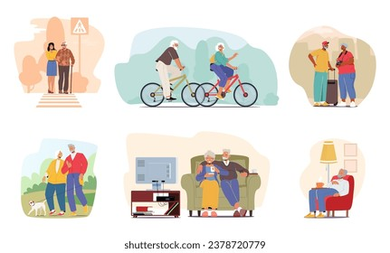
Unit
5
OUR EXPERIENCES
LESSON 7: LOOKING BACK AND PROJECT

Slide 4
VOCABULARY
1
Use the adjectives in the box to describe the experiences. add any other adjectives you can think of.
brilliant exhilarating exciting helpless
special embarrassing amazing
thrilling unpleasant memorable
1. riding a jeep up to the mountain top ______
2. touring an area with mountains and villages ______
3. Being bullied ______
4. joining team building activities ______
5. not revising previous lessons before the exams ______
thrilling
exhilarating
special

Slide 5
VOCABULARY
1
Use the adjectives in the box to describe the experiences. add any other adjectives you can think of.
brilliant exhilarating exciting helpless
special embarrassing amazing
thrilling unpleasant memorable
1. riding a jeep up to the mountain top
thrilling
exhilarating
special

Slide 6
VOCABULARY
1
Use the adjectives in the box to describe the experiences. add any other adjectives you can think of.
brilliant exhilarating exciting helpless
special embarrassing amazing
thrilling unpleasant memorable
2. touring an area with mountains and villages
exciting, amazing, memorable, brilliant, picturesque, enchanting

Slide 7
VOCABULARY
1
Use the adjectives in the box to describe the experiences. add any other adjectives you can think of.
brilliant exhilarating exciting helpless
special embarrassing amazing
thrilling unpleasant memorable
3. Being bullied ______
embarrassing, helpless, distressing

Slide 8
VOCABULARY
Use the adjectives in the box to describe the experiences. add any other adjectives you can think of.
brilliant exhilarating exciting helpless
special embarrassing amazing
thrilling unpleasant memorable
4. joining team building activities ______
exciting, memorable

Slide 9
VOCABULARY
1
Use the adjectives in the box to describe the experiences. add any other adjectives you can think of.
brilliant exhilarating exciting helpless
special embarrassing amazing
thrilling unpleasant memorable
5. not revising previous lessons before the exams ______
unpleasant, embarrassing, regrettable

Slide 10
2
Complete the sentences with the phrases in the box.
went blank exploring a site learnt it by rote an eco-tour team building activities
1. I couldn’t answer her questions because I just ___________.
2. My mind suddenly __________ when she asked me about our plan.
3. The most memorable part of our picnic was _______ by the mountain.
4. We are now more aware of environment protection after we took ______________.
5. After we joined __________________, we all got closer to each other.
Game

Slide 11
Lucky number Game
1
2
Team A
8
Team B
3
2
4
6
8
2
10
4
6
8
10
7
4
6
5
Go

Slide 15
2
Complete the sentences with the phrases in the box.
went blank exploring a site learnt it by rote an eco-tour team building activities
1. I couldn’t answer her questions because I just ______________.
learnt it by rote

Slide 16
2
Complete the sentences with the phrases in the box.
went blank exploring a site learnt it by rote an eco-tour team building activities
2. My mind suddenly _____________ when she asked me about our plan.
went blank

Slide 17
2
Complete the sentences with the phrases in the box.
went blank exploring a site learnt it by rote an eco-tour team building activities
3. The most memorable part of our picnic was _______________ by the mountain.
exploring a site

Slide 18
2
Complete the sentences with the phrases in the box.
went blank exploring a site learnt it by rote an eco-tour team building activities
4. We are now more aware of environment protection after we took ______________.
an eco-tour

Slide 19
2
Complete the sentences with the phrases in the box.
went blank exploring a site learnt it by rote an eco-tour team building activities
5. After we joined _____________________, we all got closer to each other.
team building activities

Slide 20
2
Complete the sentences with the phrases in the box.
went blank exploring a site learnt it by rote an eco-tour team building activities
learnt it by rote
1. I couldn’t answer her questions because I just ______________.
2. My mind suddenly _____________ when she asked me about our plan.
3. The most memorable part of our picnic was _______________ by the mountain.
4. We are now more aware of environment protection after we took ______________.
5. After we joined _____________________, we all got closer to each other.
went blank
exploring a site
an eco-tour
team building activities

Slide 21
GRAMMAR
3
Complete the sentences with the correct present perfect forms of the verbs in brackets.
1. I (invite) ____________ some of my friends to my birthday party.
2. ______ the students (finish) ________ all their assignments yet?
3. Their children (never be) _______________ out of their village before.
4. He won’t go to the cinema tonight. He (see) ________ that film already.
5. She (not cook) _______________ for herself before, so she is not sure about what to do first.
have invited
Have
finished
have never been
has seen
has never cooked

Slide 22
4
Put the verbs in brackets in the present perfect to complete the letter.
Dear Nick,
How are you? Are you having a good time in Ha Noi? We’re having a great time here in London. We (1. be) _________ here for four days and we (2. do) __________ many interesting things. We (3. visit) ____________ the Tower of London and (4. watch) _____________ the traditional Changing of the Guard. It was so wonderful to see it and I took a lot of pictures too….
have been
have done
have visited
have watched

Slide 23
4
Put the verbs in brackets in the present perfect to complete the letter.
We also (5. have) _____________ a ride on the famous London Eye. We were excited to view the whole city. We haven’t checked out the Windsor Castle yet. We also (6. make) _______________ a plan to visit Windsor Castle and Stonehenge, so we’re going there tomorrow. We can’t wait to explore the Windsor Castle and the prehistoric monument - Stonehenge.
See you next week,
Akiko
have (also) had
have (also) made

Slide 24
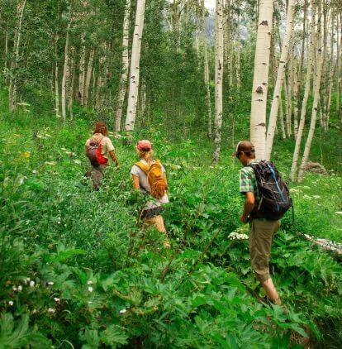
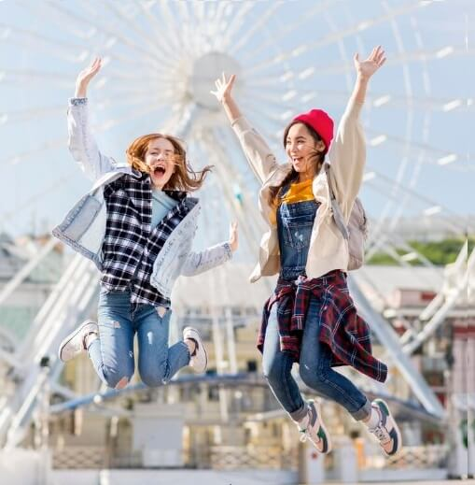
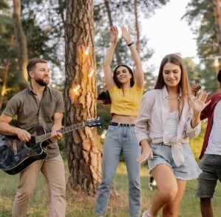
* PROJECT
1
Think of your most memorable experience. use the questions below.
– What is the experience?
– When did it happen? – What did you do then?
– How did you feel?
– Why is it your most memorable experience?

Slide 25
PROJECT
2
Make a poster of your experience with pictures or photos and then present to the whole class.

Slide 26
CONSOLIDATION
What have we learned in this lesson?
Review vocabulary related to experiences
Review the present perfect tense

Slide 27
Homework
Do exercise in workbook.
Prepare : Review 2.
Good bye !

Slide 29
LESSON 7: LOOKING BACK & PROJECT
LESSON 1: GETTING STARTED
WARM-UP
Warm-up
Task 1: use the adjectives in the box to describe the experiences. add any other adjectives you can think of.
Task 2: Complete the sentences with the phrases in the box.
VOCABULARY
Task 3: Complete the sentences with the correct present perfect forms of the verbs in brackets.
Task 4: Put the verbs in brackets in the present perfect to complete the letter.
GRAMMAR
Think of your most memorable experience. use the questions below.
Work in group to make a poster then present it to the class.
PROJECT
CONSOLIDATION
Wrap-up
Homework

