Slide 2
Unit
5
NATURAL WONDERS OF VIET NAM
LESSON 5: SKILLS 1
1

Slide 3
LESSON 5: SKILLS 1
LESSON 1: GETTING STARTED
WARM-UP
Video watching
Vocabulary
Task 1: Make predictions then check.
Task 2: Complete the sentences.
Task 3: Read and answer the questions.
READING
Task 4: Make notes and tell your partner.
Task 5: Tell some interesting things about your place.
SPEAKING
CONSOLIDATION
Wrap-up
Homework

Slide 4
MUI NE
HA LONG BAY
Notes:
Link video:
Mui Ne: https://youtu.be/kTOtS_q0CIY?si=MlsTf56qurqdW88N
Ha Long Bay: https://youtu.be/SpOWgms2uto?si=eyQ2YKriSw4MR_Bl

Slide 5
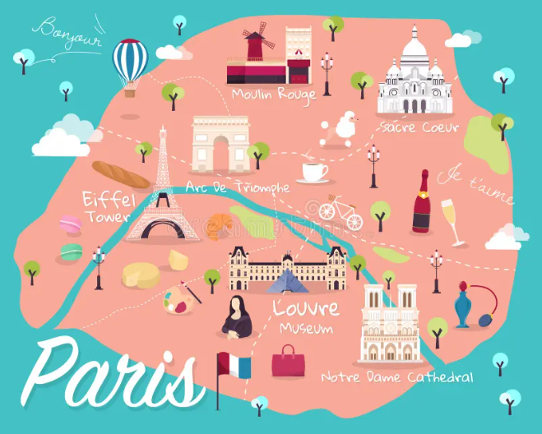
VOCABULARY
tourist attraction
/ˈtʊə.rɪst əˈtrækʃən/
an interesting or lively place to go or thing to do

Slide 6
VOCABULARY
slope (n)
/sləʊp/
a surface that rises at an angle, especially a hill or mountain, or the angle at which something rises

Slide 7
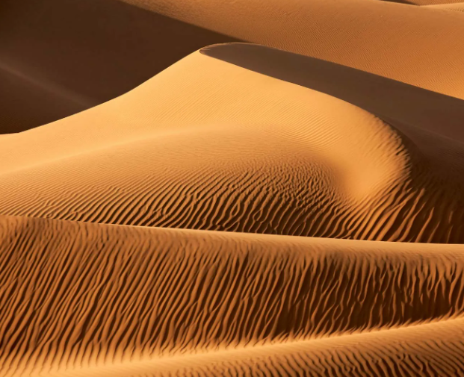
VOCABULARY
sand dune (n)
/ˈsænd ˌdjuːn/
a hill of sand made by the wind on the coast or in a desert

Slide 8
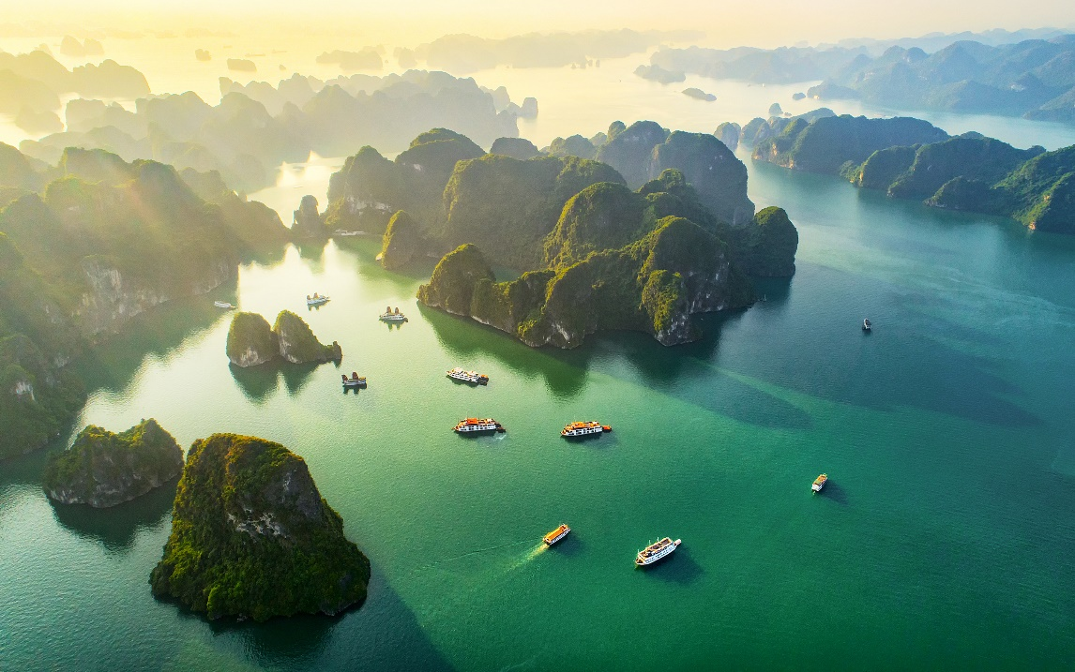
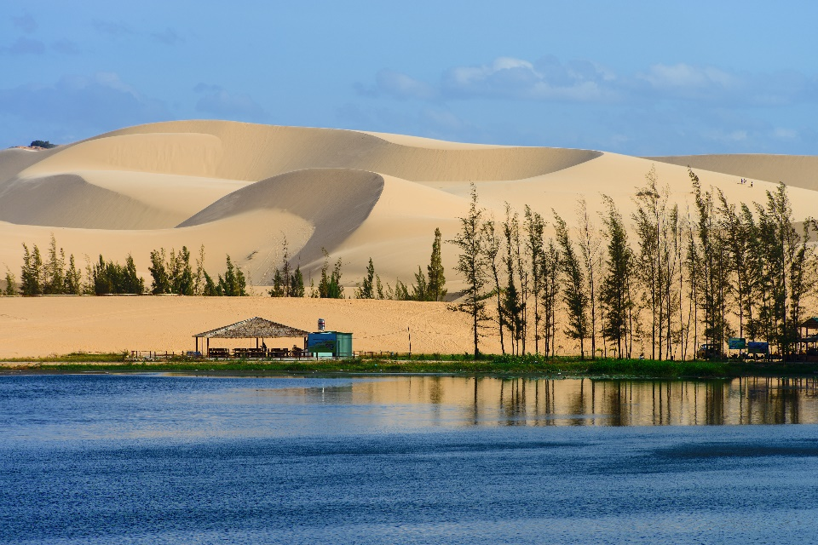
READING
Look at the pictures. Make predictions about the reading. Then read and check your ideas.
1. What is the reading about?
2. What do you know about these places?

Slide 9
READING
Complete the sentences, using the words from the box.
desert wonder
visit islands remember
1. Ha Long Bay is famous for its beautiful
_______.
2. Ha Long Bay is the number one
natural _______ in Viet Nam.
islands
wonder

Slide 10
READING
Complete the sentences, using the words from the box.
desert wonder
visit islands remember
3. A _______ is a large area of land with very little water.
4. __________ to bring an umbrella, as it often rains there.
5. A lot of people _______ Ly Son Island in the summer.
desert
Remember
visit

Slide 11
READING
Read the text again. Answer the following questions.
1.
Where is Ha Long Bay?
2.
What can you do at Ha Long Bay?
3.
Is there a desert in Mui Ne?
4.
Where can you have a picnic in Mui Ne?
5.
What is the best time to visit the Mui Ne Sand Dunes?

Slide 12
READING
1.
Where is Ha Long Bay?
It is in Quang Ninh.
Ha Long Bay is in Quang Ninh. It has many islands and caves.

Slide 13
READING
2.
What can you do at Ha Long Bay?
We can enjoy (great) seafood and join in exciting activities.
There you can enjoy great seafood. And you can join in exciting activities. Ha Long Bay is Viet Nam’s best natural wonder.

Slide 14
READING
3.
Is there a desert in Mui Ne?
No, there isn’t.
Mui Ne is popular for its amazing landscapes. The sand has different colours: white, yellow, red ... It’s like a desert here. You can ride a bike down the slopes.

Slide 15
READING
4.
Where can you have a picnic in Mui Ne?
By the beach.
You can also fly kites, or have a picnic by the beach. The best time to visit the Mui Ne Sand Dunes is early morning or late afternoon. Remember to wear sun cream and bring water.

Slide 16
READING
5.
What is the best time to visit the Mui Ne Sand Dunes?
Early morning or late afternoon.
You can also fly kites, or have a picnic by the beach. The best time to visit the Mui Ne Sand Dunes is early morning or late afternoon. Remember to wear sun cream and bring water.

Slide 17
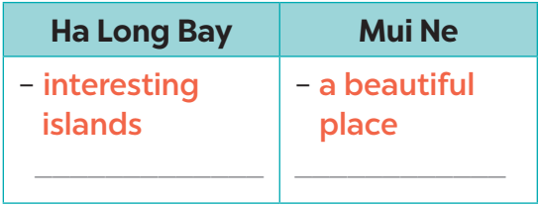
SPEAKING
Make notes about one of the places in the reading. You can add your own ideas.

Slide 18
SPEAKING
Some foreign visitors are visiting your city / town / area. You are their tour guide. Tell them some interesting things about the place as well as what they must and mustn’t do there.
Example:
- You must follow all the rules.
- You mustn’t take photos when you are in the City Museum.

Slide 19
CONSOLIDATION
1
Wrap-up
What have we learnt in this lesson?
Read some information about Ha Long Bay and Mui Ne
Retell about Ha Long and Mui Ne
Tell some information about interesting things about the place as well as what they must and mustn’t do there.

Slide 20
CONSOLIDATION
2
Homework
Do exercises in the workbook.

Slide 21
Website: hoclieu.vn
Fanpage: facebook.com/www.tienganhglobalsuccess.vn/

