Slide 1
Class : 9 A

Slide 2
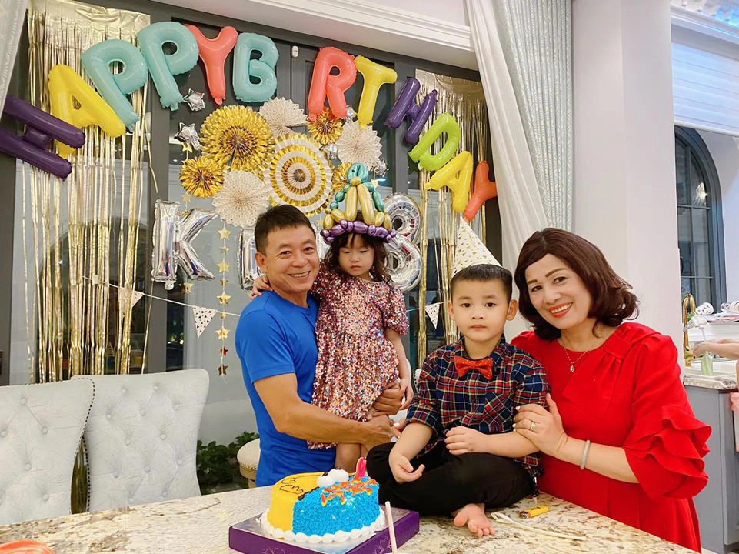
We celebrate each family member’s ……………………….every year.
birthday
HẾT GIỜ

Slide 3
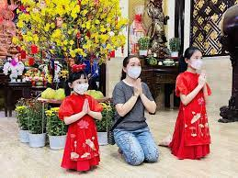
Many Asians go to Buddhist temples to _____ for good luck
HẾT GIỜ
Pray

Slide 4
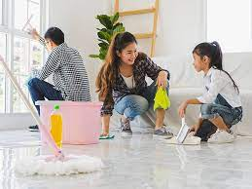
People often ………..…their houses before Tet comes
HẾT GIỜ
clean

Slide 5
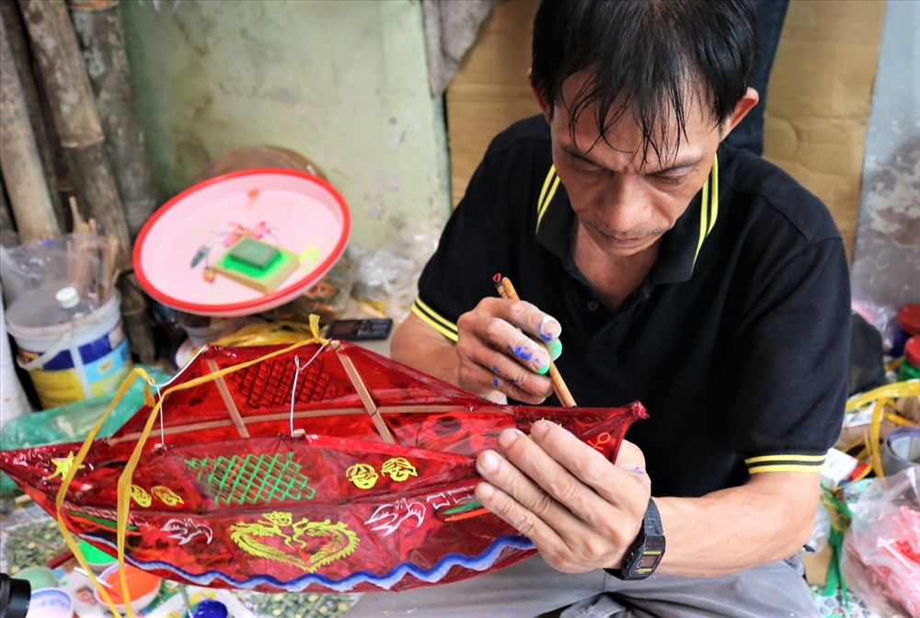
My father often makes me a ……………………....at the
Mid-Autumn Festival
HẾT GIỜ
lantern

Slide 6
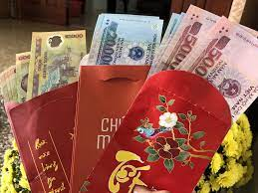
At Tet children often get …………
Lucky money
HẾT GIỜ

Slide 7
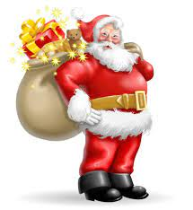
……………….usually brings gifts to children at Christmas
HẾT GIỜ
Santa Claus

Slide 8
Question:
- How do your family keep your traditions alive?

Slide 9
Unit
4
REMEMBERING THE PAST
LESSON 4: COMMUNICATION

Slide 10
VOCABULARY

Slide 11
VOCABULARY
ancestor (n)
A person related to you who lived a long time ago.
/ˈæn.ses.tər/
Ex: There were portraits of his ancestors on the walls of the room.
tổ tiên

Slide 12
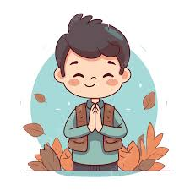
VOCABULARY
the feeling or quality of being grateful.
gratitude (n)
/ˈɡræt.ɪ.tʃuːd/
lòng biết ơn

Slide 13
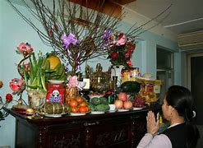
VOCABULARY
People come to this ancient shrine to worship their ancestors.
worship (v)
/ˈwɜːʃɪp/
thờ cúng

Slide 14
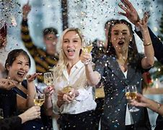
VOCABULARY
We celebrate Lunar New Year with family gatherings and traditional foods.
celebrate (v)
/ˈselɪbreɪt/
tổ chức

Slide 15
Alice: Thanks a lot for telling us about life in the countryside.
Mi: No problem.
VOCABULARY
New words | Pronunciation | Meaning
1. ancestor (n) | /ˈæn.ses.tər/ | tổ tiên
2.gratitude (n) | /ˈɡræt.ɪ.tʃuːd/ | lòng biết ơn
3. worship (v) | /ˈwɜːʃɪp/ | thờ cúng
4. celebrate (v) | /ˈselɪbreɪt/ | tổ chức
Kate: Thank you very much for showing us around Angkor Wat.
Guide: You’re welcome.

Slide 16
EVERYDAY ENGLISH
1
Listen and read the conversations below. Pay attention to the highlighted parts.
Kate: Thank you very much for showing us around Angkor Wat.
Guide: You’re welcome.
Alice: Thanks a lot for telling us about life in the countryside.
Mi: No problem.
Some ways of thank and respond
- Thank you very much
- Thanks a lot for………….
- I’m so grateful
- You’re the best

Slide 17
EVERYDAY ENGLISH
2
Work in pairs. Make similar conversations to express thanks and respond in the following situations.
1. You thank the village head for showing you around the craft workshop.
2. You thank your friend for lending you an interesting book.

Slide 18
2
Work in pairs. Make similar conversations to express thanks and respond in the following situations.
Suggested dialogues:
Situation 1:
You: Thank you very much for showing me / us around the craft workshop.
Friend: You’re welcome.
Situation 2
You: Thanks a lot for lending me your history book.
Friend: No problem.

Slide 19
How our families keep traditions alive
3
Read the passage and complete the table.
Most of Vietnamese families have customs and traditions that they have
observed for many generations. Firstly, they worship their ancestors, and they celebrate their death anniversaries every year. That’s the way they show their gratitude to their ancestors and teach their young children about traditions. Secondly, they take part in many national and regional festivals, for example the Mid-Autumn Festival and the New Harvest Festival. Thirdly, they celebratemany holidays during the year such as Tet
and National Day. In this way, they keep their traditions alive and pass them down to the next generation.
Anniversaries | Festivals | Holidays
1. _____________ anniversaries | 2. _________Festival 3. _________Festival | 4. ___________ 5. ___________

Slide 20
Most of Vietnamese families have customs and traditions that they have
observed for many generations. Firstly, they worship their ancestors, and they celebrate their death anniversaries every year. That’s the way they show their gratitude to their ancestors and teach their young children about traditions. Secondly, they take part in many national and regional festivals, for example the Mid-Autumn Festival and the New Harvest Festival. Thirdly, they celebratemany holidays during the year such as Tet
and National Day. In this way, they keep their traditions alive and pass them down to the next generation.
How our families keep traditions alive
Anniversaries | Festivals | Holidays
1. _____________ anniversaries | 2. _____________ Festival 3. _____________ Festival | 4. ___________ 5. ___________
Death
Mid - Autumn
Tet Holiday
New Harvest
National Day

Slide 21
How our families keep traditions alive
4
Work in pairs. Ask and answer about how your family observes customs and traditions
Examples:
A: What festival(s) does your family celebrate every year?
B: We celebrate Hung Kings’ Temple Festival.

Slide 22
How our families keep traditions alive
4
Work in pairs. Ask and answer about how your family observes customs and traditions
Examples:
A: What holiday(s) does your family celebrate every year
B: We celebrate Tet and National Day.

Slide 23
5
Work in groups. Give a short talk about one of the things in 4 that you and your family do to preserve traditions.

Slide 24
5
Work in groups. Give a short talk about one of the things in 4 that you and your family do to preserve traditions.
* Cues:
You can begin your talk like this:
We celebrate each family member’s birthday every year. When someone’s birthday is coming, all of us happily prepare for it. …

Slide 25
5
Work in groups. Give a short talk about one of the things in 4 that you and your family do to preserve traditions.
* Sample Answers:
We celebrate each family member's birthday every year. When someone's birthday is coming, all of us happily prepare for it. We gather around the kitchen table, rolling out dough and decorating cakes with colorful sprinkles and frosting. We share funny stories, create memories that will last a lifetime. These traditions are precious to us, connecting us to our past and shaping our future.

Slide 26
CONSOLIDATION
What have we learnt in this lesson?
What have we learnt in this lesson?
Know how to thank and respond.
Talk how to keep traditions alive

Slide 27
Homework
Do exercises in the workbook.
Prepair lesson 5: Skills 1

Slide 29
LESSON 4: COMMUNICATION
LESSON 1: GETTING STARTED
WARM-UP
Option 1: Brainstorm
Option 2: Word Scramble
Vocabulary
Task 1: Listen and read the conversations. Pay attention to the highlighted parts.
Task 2: Work in pairs. Make similar conversations to express thanks and respond in the
EVERYDAY ENGLISH
Task 3: Read the passage and complete the table.
Task 4: Work in pairs. Ask and answer about how your family observes customs and traditions.
Task 5: Work in groups. Give a short talk about one of the things in 4 that you and your family do to preserve traditions.
HOW OUR FAMILIES KEEP
TRADITIONS ALIVE
CONSOLIDATION
Wrap-up
Homework

Slide 30
CONSOLIDATION
2
Homework
- Do exercises in the workbook.

Slide 31
OBJECTIVES
By the end of the lesson, students will be able to:
Know how to thank and respond.
Talk how to keep traditions alive

Slide 32
WARM-UP
OPTION 2
Word Scramble

Slide 33
WARM-UP
OPTION 2
How to play:
- There are some pieces of paper in bag/hat/box
- Take turns drawing pieces of paper and unscrambling the phrases.
- Unscrambled a phrase, say it aloud and give an example of when they might use it.

Slide 34
WARM-UP
OPTION 2
LET’S PLAY

