Slide 1
Song Ve secondary school.
ENGLISH 9
Hello everyone !!!

Slide 2
Unit
3
HEALTHY LIVING FOR TEENS
LESSON 7: LOOKING BACK & PROJECT

Slide 3
WARM-UP
KIM’S GAME
RULES:
Work in groups of three or four students
Look at the pictures about Ss’ life and schoolwork on the screen.
They will disappear after 2 seconds, so try to remember all the pictures without writing them down.
After all the pictures disappear, you have 1 minute to write down the words describing Ss’ life and schoolwork in each picture.
2 points for each correct answer.

Slide 4
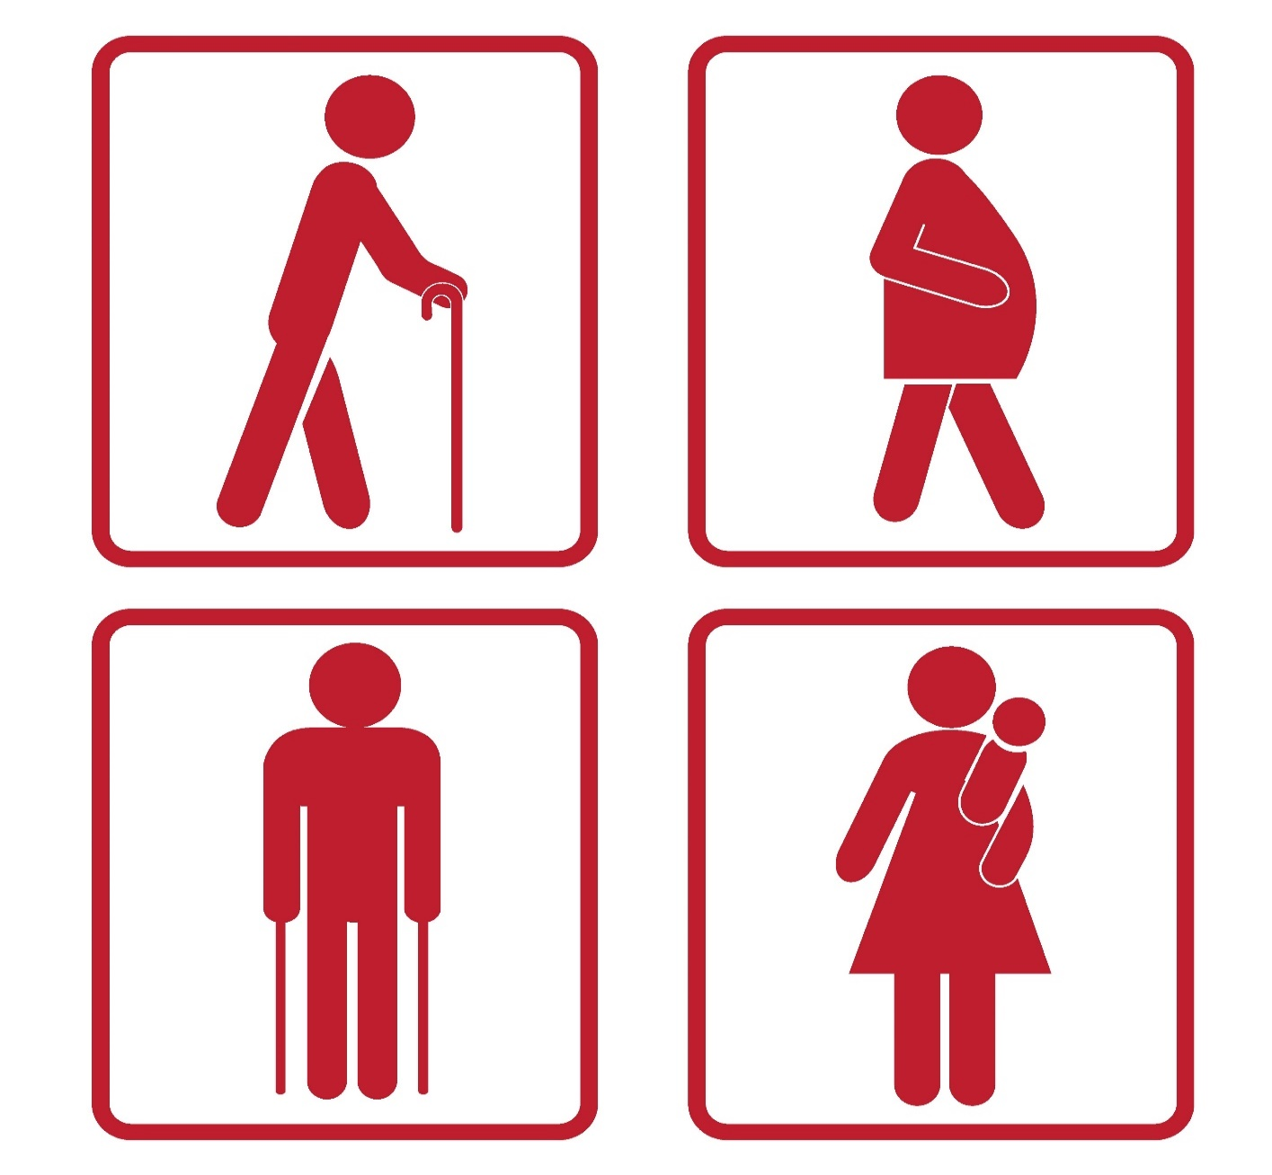
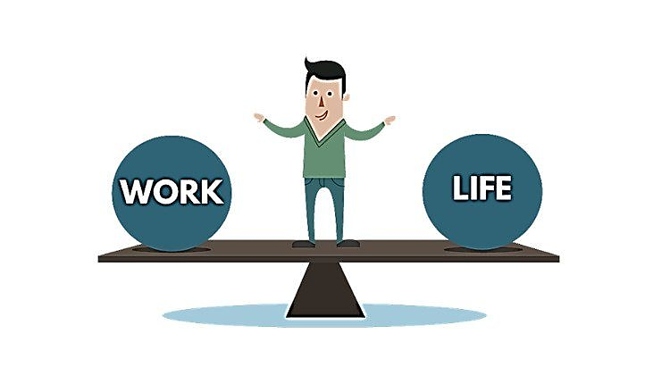
WARM-UP
KIM’S GAME

Slide 5
WARM-UP
KIM’S GAME
well-balanced / balance
anxiety
priority
distraction
advice
deadline / due date

Slide 6
VOCABULARY
1
Complete the sentences with the correct words and phrases in the box.
stressed out priority delay well-balanced due date
well-balanced
1. A ________________meal or diet contains all the different things you need to keep you healthy.
2. The ________________ for the project is next Friday.
3. I’ve got too much to do, and I’m completely ________________.
4. Nick gave ________________ to tasks at his job because he couldn’t do everything he wanted today.
5. You may not feel better if you ________________ going to the doctor.
due date
stressed out
priority
delay

Slide 7
VOCABULARY
2
Choose the correct answer A, B, C, or D.
1. To most people, ______ living means both physical and mental health are functioning well together.
A. healthy B. unhealthy
C. health D. healthily
2. When we ______ our task, we headed home.
A. succeeded B. won
C. accomplished D. managed

Slide 8
VOCABULARY
2
Choose the correct answer A, B, C, or D.
3. She’s in poor health, but she’s ______ about her future.
A. optimistic B. negative
C. pleased D. unhappy
4. There are too many ______ in this classroom – it’s hard for me to pay attention to the lesson.
A. difficulties B. distractions
C. obstacles D. omissions

Slide 9
VOCABULARY
2
Choose the correct answer A, B, C, or D.
5. He was in a good ______ when he got home from school.
A. mind B. feeling
C. attitude D. mood

Slide 10
GRAMMAR
3
Complete the sentences with the correct modal verbs in the box. A modal verb can be used twice.
can must should might
must
1. If you don’t want to get in an accident, you _________ follow these safety
instructions.
2. If you take these pills, you _________ feel better soon.
3. You _________ come and join us if you like.
4. If you feel unwell, you _________ consult a doctor.
5. If she tries hard, she _________ speak English better than you.
might
can
should
can
Notes:
1. must 2. might 3. can 4. should 5. Can

Slide 11
GRAMMAR
4
Circle the most suitable modal verbs to complete the sentences.
1. He shouldn’t / may not / cannot stay up late tonight if he wants to feel awake and alert tomorrow morning.
2. Nick should / can’t / might be very excited if we invite him to our home.
3. Mai can / must / should be good at time management if she takes a training course at school.
4. If you want to save on your electricity bills, you must / can / might turn off all the electric equipment before going out.
5. If you help me tidy our flat this morning, you must / can / can’t go out this afternoon.

Slide 12
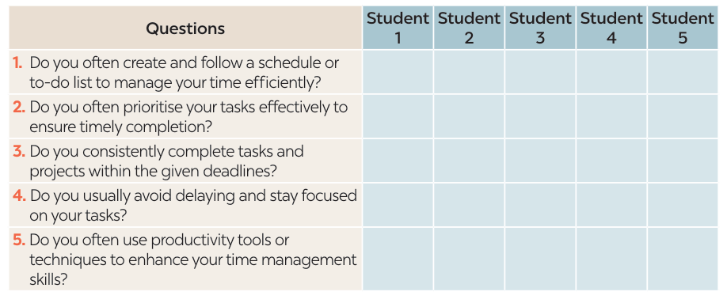
PROJECT
4
Notes:
1. shouldn’t

Slide 13
PROJECT
1. Work in groups. Ask your classmates about how good they are at time management
Notes:
1. shouldn’t

Slide 14
PROJECT
2. Work in groups again. Count the answers you have got for each student.

Slide 15
PROJECT
3. Present your group's findings on how good your classmates are at time management.
Our group has interviewed 10 classmates about how good they are at time management. Only one of them is excellent at time management. Minh creates and follows a schedule or to-do list to manage his time efficiently. He priorities his tasks eﬀectively to ensure timely completion. He consistently completes tasks and projects within the given deadlines. He usually avoids delaying and stays focused on his tasks. ….
Four of the classmates we have interviewed are poor at time management. They always try to complete tasks and projects within the given deadlines. However, they never create and follow a schedule or to-do list to manage their time efficiently. They don’t prioritize their tasks eﬀectively to ensure timely completion. They rarely try to avoid delaying or stay focused on their tasks….

Slide 16
CONSOLIDATION
What have we learnt in this lesson?
Revise the vocabulary items learnt in the unit.
Revise the forms and uses of comparative adverbs.
Develop research and collaboration skills and practise giving an oral presentation.

Slide 17
Homework
Do exercises in the workbook.
Prepair Review 1 ( Language)

Slide 20
WARM-UP
KIM’S GAME

