Slide 1
WARM-UP:
Watch a video and fill in each blank with ONE word.

Slide 2
3. I'm sorry. I still didn’t ___ that.
4. _____ more time?
5. Look! I can't hear a ____ you're saying.
1. I'm sorry, I didn't quite _____ that.
2. Could you ____ that again?

Slide 3
WARM-UP: Watch a video and fill in each blank with ONE word.
catch
1. I'm sorry, I didn't quite _____________ that.
2. Could you _____________ that again?
3. I'm sorry. I still didn’t _____________ that.
4. _____________ more time?
5. Look! I can't hear a _____________ you're saying.
say
get
One
word

Slide 4
Unit
3
HEALTHY LIVING FOR TEENS
LESSON 4: COMMUNICATION
EVERYDAY ENGLISH:
Asking for repetition and responding

Slide 5
EVERYDAY ENGLISH
1
Listen and read the dialogues below. Pay attention to the highlighted sentences.
Mai: Can you open the door, Tom?
Tom: Sorry?
Mai: Can you open the door, please?
Nick: Excuse me. Would you mind showing me the way to the post office?
Woman: I beg your pardon.
Nick: Would you mind showing me the way to the post office?

Slide 6
EVERYDAY ENGLISH
ASKING FOR REPETITION | RESPONDING
Sorry? | Repeat/Simplify what you have said
I beg your pardon.
I'm sorry, I didn't quite catch that.
Could you say that again?
One more time?
Look! I can't hear a word you're saying.

Slide 7
EVERYDAY ENGLISH
EVERYDAY ENGLISH
2
Work in pairs. Make similar conversations for the following situations.
Situation 1: You ask your friend to pass the book, but he / she can’t hear what you say.
Situation 2: A stranger asks you the way to the nearest bus station, but you can’t hear what he / she says.

Slide 8
EVERYDAY ENGLISH
2
Work in pairs. Make similar conversations for the following situations.
Situation 1: You ask your friend to pass the book, but he / she can’t hear what you say.
Suggested answer:
A: Can you pass me the book?
B: Sorry?
A: Can you pass me the book, please?

Slide 9
EVERYDAY ENGLISH
2
Work in pairs. Make similar conversations for the following situations.
Situation 2: A stranger asks you the way to the nearest bus station, but you can’t hear what he / she says.
Suggested answer:
A: Excuse me. Could you tell me the way to the nearest bus station, please?
B: I beg your pardon.
A: Could you tell me the way to the nearest bus station, please?

Slide 10
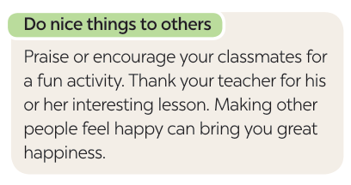
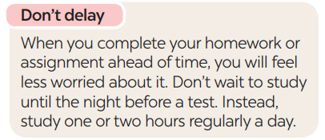
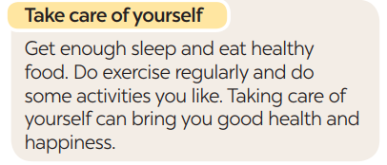
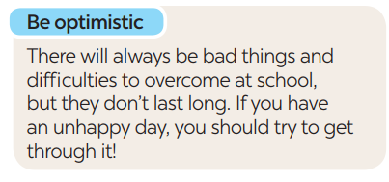
TIPS FOR BEING HAPPY ON SCHOOL DAYS
3
Read the text and complete each sentence that follows with a suitable word.

Slide 11
VOCABULARY
praise (v)
.
/preɪz/
Khen ngợi , ca ngợi
Notes:
Praise (v): to say that you approve of and admire somebody/something

Slide 12
VOCABULARY
overcome (v)
/ˌəʊ.vəˈkʌm/
đánh bại, vượt qua
Notes:
Overcome (v): to defeat or succeed in controlling or dealing with something

Slide 13
VOCABULARY
thankful (adj)
/ˈθæŋk.fəl/
biết ơn
Notes:
Thankful (a): happy or grateful because of something

Slide 14
VOCABULARY
New words | Pronunciation | Meaning
1. praise (v) | /preɪz/ | khen, ca ngợi
2. overcome (v) | /ˌəʊ.vəˈkʌm/ | đánh bại, vượt qua
3. thankful (adj) | /ˈθæŋk.fəl/ | biết ơn

Slide 15
TIPS FOR BEING HAPPY ON SCHOOL DAYS
3
Read the text and complete each sentence that follows with a suitable word.

Slide 16
TIPS FOR BEING HAPPY ON SCHOOL DAYS
3
Read the text and complete each sentence that follows with a suitable word.
happy
1. You should make others feel ______ by giving them encouragement or being thankful to them.
2. You shouldn’t ______ doing your homework or assignment or preparing for a test. This will reduce your stress.
3. Getting enough sleep, eating healthy food, and doing what you like can bring you good health and ___________.
4. You should always be expecting good things to happen and try to ____________ difficulties.
delay
happiness
overcome
Notes:
1. happy 2. delay 3. happiness 4. overcome

Slide 17
TIPS FOR BEING HAPPY ON SCHOOL DAYS
4
Work in groups. Write tips for one of the following situations.
Situation 1: A friend of yours cannot get a good night’s sleep.
Situation 2: A friend of yours does not feel very well.
Situation 3: A friend of yours cannot remember the words he / she learnt.
Notes:
1. happy 2. delay 3. happiness 4. overcome

Slide 18
TIPS FOR BEING HAPPY ON SCHOOL DAYS
4
Work in groups. Write tips for one of the following situations.
Situation 1: A friend of yours cannot get a good night’s sleep.
Avoid too heavy meals, stimulants like caffeine, and electronic devices before
Notes:
stimulants ( chất kích thích)
Notes:
1. happy 2. delay 3. happiness 4. overcome

Slide 19
TIPS FOR BEING HAPPY ON SCHOOL DAYS
4
Work in groups. Write tips for one of the following situations.
Situation 2: A friend of yours does not feel very well.
Relax and take care of yourself. Go see the doctor for advice
Notes:
1. happy 2. delay 3. happiness 4. overcome

Slide 20
TIPS FOR BEING HAPPY ON SCHOOL DAYS
4
Work in groups. Write tips for one of the following situations.
Situation 3: A friend of yours cannot remember the words he / she learnt.
try using the words you've learned in sentences or conversations.
Write words down
Notes:
1. happy 2. delay 3. happiness 4. overcome

Slide 21
TIPS FOR BEING HAPPY ON SCHOOL DAYS
5
Present your tips to the class.
If you are struggling to get a good night's sleep, there are some practical tips to help improve your sleep.
Before going to bed you should not eat too much, you should avoid stimulants such as caffeine, and electronic devices before. Creating a relaxing bedtime routine, such as reading a book or listening to music. This helps you improve the quality of your sleep.

Slide 22
CONSOLIDATION
What have we learnt in this lesson?
Ask for repetition and respond.
Learn about tips to make students feel happy on school days.
Further develop their reading skill for specific information (scanning).
Give presentation of the tips.

Slide 23
Homework
Do exercises in the workbook.
Prepair lesson 5: Skills 1

Slide 25
EMOTION WORD MATCH
GAME
T writes down a list of emotion words on the board.
Each student receives a small piece of paper and write down an emotion word from the list without showing it to anyone.
Ss write 1-2 short sentences about a school-related experience that made them feel that particular emotion.
Collect the pieces of paper and mix them up. Read each sentence out loud one by one without revealing the emotion word and have Ss try to guess which emotion word matches each sentence.

Slide 26
Website: hoclieu.vn
Fanpage: facebook.com/www.tienganhglobalsuccess.vn/

