Slide 1
WARM-UP
WARM-UP
B.I.N.G.O
Work in pairs.
Receive slips of paper with halves of first conditional sentences.
Join two slips of paper together to make meaningful sentences.
Say “Bingo” when finish.
The Ss who are the fastest with more correct answers will be the winner.
RULES

Slide 2
WARM-UP
WARM-UP
B.I.N.G.O
WARM-UP
ANSWER
If she trains harder,
she can run faster than you.
you should balance your study and life.
If you want to have good mental health,
he may / might get a good job.
If he is good at IT,
you can hand it in and leave for home.
If you finish your paper,
If you want to manage your time effectively,
you must get rid of all the distractions.

Slide 3
WARM-UP
WARM-UP
B.I.N.G.O
WARM-UP
ANSWER
If she trains harder,
she can run faster than you.
If you want to have good mental health,
you should balance your study and life.
he may / might get a good job.
If he is good at IT,
you can hand it in and leave for home.
If you finish your paper,
If you want to manage your time effectively,
you must get rid of all the distractions.

Slide 4



Unit
3
HEALTHY LIVING FOR TEENS
LESSON 3: A CLOSER LOOK 2
Grammar: Modal verbs in first conditional sentences

Slide 5
Grammar: Modal verbs in first conditional sentences
 | IF - CLAUSE | MAIN CLAUSE
 | If you do physical exercise regularly, | Your health will improve.
 | If she trains harder, | she can run faster than you.
 | If you finish your paper, | you can hand it in and leave for home.
 | If you want to have good mental health, | you should balance your study and life.
 | If he is good at IT, | he may / might get a good job.
 | If you want to manage your time effectively, | you must get rid of all the distractions.
standard form
ability
permission
advice
possibility
necessity

Slide 6
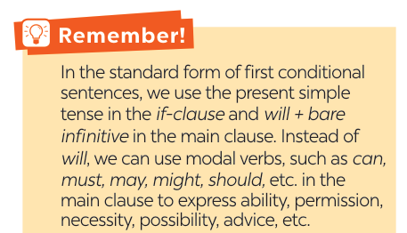
Grammar: Modal verbs in first conditional sentences

Slide 7
Grammar: Modal verbs in first conditional sentences
(Động từ khuyết thiếu trong câu điều kiện loại 1)
Trong dạng chuẩn của câu điều kiện loại 1, chúng ta sử dụng thì hiện tại đơn trong mệnh đề if và will + động từ nguyên thể trong mệnh đề chính.
Thay vì will, chúng ta có thể sử dụng các động từ khuyết thiếu như can, must, may, might, should, v.v. trong mệnh đề chính để diễn tả khả năng (tài năng) , sự cho phép, sự cần thiết, khả năng , lời khuyên, v.v.)
Form:
If + S + V (hiện tại đơn), S + will + V
If + S + V (htđ), S + can/may/should/ought to/have to/must + V

Slide 8
Grammar: Modal verbs in first conditional sentences
(Động từ khuyết thiếu trong câu điều kiện loại 1)
Form:
If + S + V (hiện tại đơn), S + will + V
If + S + V (htđ), S + can/may/should/ought to/have to/must + V
EX:
If it rains, we will stay at home.
If you try your best, you can achieve success.

Slide 9

PRACTICE

Slide 10
mental
counsellor
well-balanced
physical
1
Write the correct form of each verb in brackets.
1. If Mai (not want) _____________________ to gain weight, she shouldn’t eat much fast food.
2. If you stay up too late tonight, you might (feel) __________ tired tomorrow morning.
3. You should (sleep) __________ eight hours a night if you want to be awake and fully alert.
4. If Tom (complete) ___________ his assignment on Friday, he can go out with his friends at the weekend.
5. You must (be) _____ careful if you don’t want to get burnt.
doesn’t want
feel
sleep
completes
be

Slide 11
2
Circle the correct modal verbs to complete the following sentences.
1. She can / should go home early if she finishes her work.
2. If you train hard, you might / shouldn’t win the first prize.
3. If they don’t want to be punished, they must / may follow the rules.
4. If students have an upcoming exam, they shouldn’t / can’t wait to study until the day before it.
5. If you’re having a bad day, you should / may do your best to get through it.

Slide 12
3
Match the first half of the sentence in A with the second half in B.
1. If you spend too much time on the computer,
2. If you put too much sugar in your coffee,
3. If you want to manage your time effectively,
4. If you want to have perfect white teeth,
5. If you take a cooking class,
a. you can make your favourite food at home.
b. you should use a calendar to plan your work ahead.
c. you may put on more weight.
d. you might get shoulder pains.
e. you must brush your teeth regularly.

Slide 13
3
KEY
Match the first half of the sentence in A with the second half in B.
1. If you spend too much time on the computer,
2. If you put too much sugar in your coffee,
3. If you want to manage your time effectively,
4. If you want to have perfect white teeth,
5. If you take a cooking class,
d. you might get shoulder pains.
c. you may put on more weight.
b. you should use a calendar to plan your work ahead.
e. you must brush your teeth regularly.
a. you can make your favourite food at home.

Slide 14
4
What will you say in each situation below? Use first conditional
sentences with modal verbs.
1. Your friend wants to lose weight. You advise him / her to eat less high fat food and do more exercise.
=> If you want to lose weight, you should eat less high fat food and do more exercise.

Slide 15

4
What will you say in each situation below? Use first conditional
sentences with modal verbs.
2. Your friend invites you out for an ice cream, but it’s possible that you will have a sore throat.
=> If I have an ice cream, I may have a sore throat.

Slide 16
4
What will you say in each situation below? Use first conditional
sentences with modal verbs.
3. Your roommate often stays up late at night. You think it is necessary to get enough sleep every night; otherwise, his health will suffer.
=> If you want to have good health, you must get 8 hours of sleep per night.

Slide 17

4
What will you say in each situation below? Use first conditional
sentences with modal verbs.
4. Your little brother wants to go for a swim. You agree but ask him to finish all his homework first.
=> You can go for a swim if you finish all your homework.

Slide 18

4
What will you say in each situation below? Use first conditional
sentences with modal verbs.
5. You’re able to make a delicious pizza when
you have all the needed ingredients.
=> If I have all needed ingredients, I can make a delicious pizza.

Slide 19



PRODUCTION
5
Complete the sentences with your own ideas using the modal verbs you have learnt.
1. If you spend too much time playing computer games, _____________.
2. If you want to get a good night’s sleep,_________________________.
3. If you don’t feel well, ______________________________________.
4. If you want to reduce stress, ________________________________.
5. If you want to be a good student, _____________________________.
6. If you want to become a footballer,
Game

Slide 20
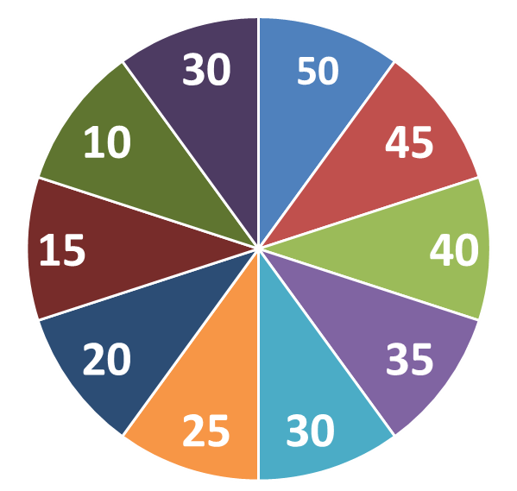
Spinning the number
Work in 2 groups
QUESTIONS
1
2
3
4
5
6

Slide 21
PRODUCTION
5
Complete the sentences with your own ideas using the modal verbs you have learnt.
1. If you spend too much time playing computer games, ________ _____________.
you may feel tired and less energetic

Slide 22
PRODUCTION
5
Complete the sentences with your own ideas using the modal verbs you have learnt.
2. If you want to get a good night’s sleep,______________________.
you should avoid caffeine and electronic devices
before bedtime.

Slide 23
PRODUCTION
5
Complete the sentences with your own ideas using the modal verbs you have learnt.
3. If you don’t feel well, __________________________________.
you should see a doctor

Slide 24
PRODUCTION
5
Complete the sentences with your own ideas using the modal verbs you have learnt.
4. If you want to reduce stress, _____________________________.
You should stop working and relax a bit

Slide 25
PRODUCTION
5
Complete the sentences with your own ideas using the modal verbs you have learnt.
5. If you want to be a good student, _________________________.
You must study hard

Slide 26
PRODUCTION
5
Complete the sentences with your own ideas using the modal verbs you have learnt.
6. If you want to become a footballer,
You must have good health and practice every day

Slide 27

CONSOLIDATION
What have we learnt in this lesson?
Summarise the main points of the lesson.
Make first conditional sentences about yourselves, using modal verbs instead will.

Slide 28

Homework
Do exercises in the workbook.
Start preparing for the Project of the unit.
Prepair lesson 4 : Communication
.

Slide 29

Thank you!
Goodbye!

Slide 31
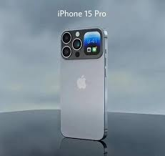
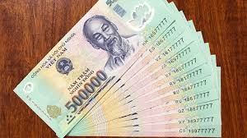

Slide 32
* PRODUCTION
5
Complete the sentences with your own ideas using the modal verbs you have learnt.
SUGGESTED ANSWER
1. If you spend too much time playing computer games, ________________________________________________________
2. If you want to get a good night’s sleep, _____________
________________________________________________________
3. If you don’t feel well, __________________________
________________________________________________________
you might miss out on other important activities like exercising, socialising, and studying.
you should avoid
drinking caffeine or alcohol before bed and try to establish a regular sleep schedule.
.
you should consult a doctor
or a medical professional to get a proper diagnosis and treatment.

Slide 33

EXTRA ACTIVITY
LUCKY NUMBERS
1
2
3
4
5
6
7
END GAME

Slide 34

WARM-UP
LUCKY NUMBERS
You have 2 points.
GO BACK

Slide 35

WARM-UP
LUCKY NUMBERS
Question 2:
Make a first conditional sentence
using the suggested words.
Do exercise regularly.
maintain good health/ can
Have a balanced diet
GO BACK

Slide 36

WARM-UP
LUCKY NUMBERS
Question 3:
Make a first conditional sentence
using the suggested words.
reduce stress/ should
You should stop working and relax a bit
GO BACK

Slide 37

WARM-UP
LUCKY NUMBERS
Question 4:
Make a first conditional sentence
using the suggested words.
mangage time/ must
focus on work
GO BACK

Slide 38
WARM-UP
LUCKY NUMBERS
You have 2 points.
GO BACK

Slide 39

WARM-UP
LUCKY NUMBERS
Question 6:
Make a first conditional sentence
using the suggested words.
balance study and play time/ may
GO BACK

Slide 40

WARM-UP
LUCKY NUMBERS
Question 7:
Make a first conditional sentence using
the suggested words.
delay/ must
GO BACK

Slide 41
PRACTICE
Work in pairs.
Write a short dialogue where you use at least three different modal verbs in first conditional sentences.
Example:
A: If you have time tonight, you should go to the cinema.
B: I agree. If I don’t, I might watch a movie at home……"

