Slide 1


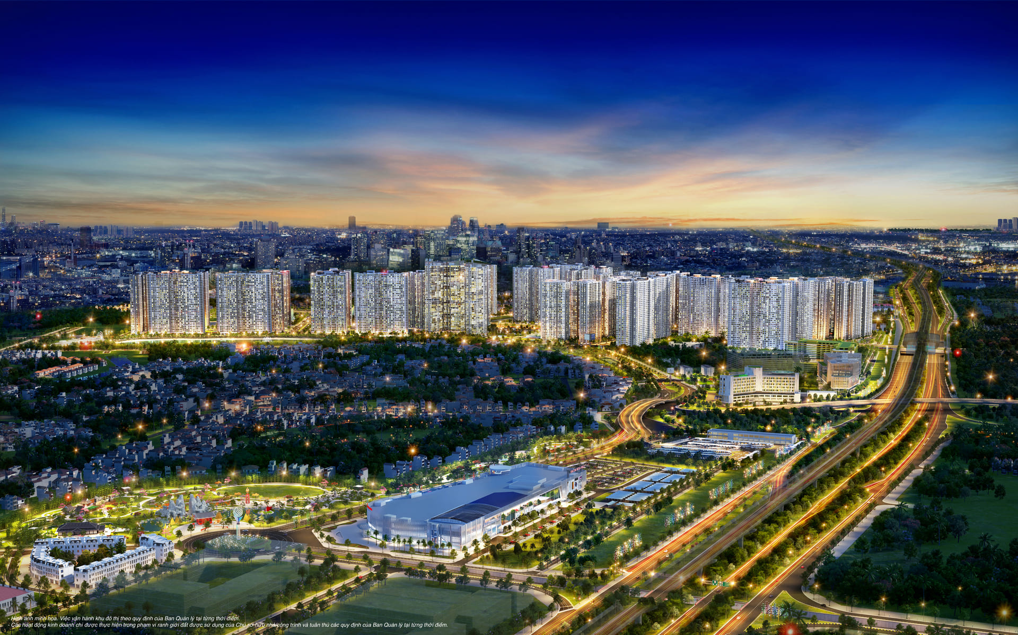
Unit
2
CITY LIFE
LESSON 6: SKILLS 2

Slide 2

Let's watch a video and
write the names of 10 big cities in Vietnam

Slide 3


Slide 4
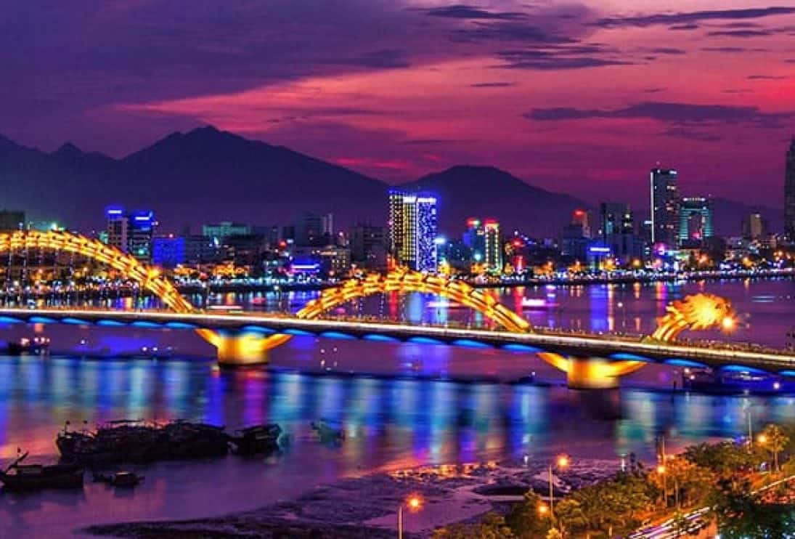
* WARM - UP
Which city is this?
- Do you like this city? Why?

Slide 5

i. LISTENING

Slide 6
1
Work in pairs. Tick (√) the things that you want in your home town. Add more ideas if you have any.
a. Nice parks
b. Modern cinemas
c. Air-conditioned buses
d. Free sports facilities
e. Convenient food stalls
f. Wide roads

Slide 7


2
Listen to an interview with three teenagers about life in their cities. Decide if the statements are true (T) or false (F).
 | T | F
1. There are many facilities for public use in Tom’s city
2. Elena likes spending her free time in shopping malls.
3. Food stalls are not popular in Chi’s city
4. In Chi’s city, many teens like street food more than food prepared at home.
It has good parks, libraries, and cinemas.
The only place teens can find entertainment is a shopping mall but it's very costly, so I don't like
There are food stalls at almost all street corners.
Many teens like street food and are too lazy to cook on their own.

Slide 8
3
Listen again. Choose the correct answer A, B, or C.
1. Where might this interview come from? | 2. What is a problem in Tom’s city?
A. A chat show. B. A documentary. C. The daily news. | A. Some buses don’t have air-conditioners. B. There are no parks. C. Some roads are too wide

Slide 9
3
Listen again. Choose the correct answer A, B, or C.
3. What change does Elena suggest for her city? | 4. Chi thinks that ______ should tell teens about the drawbacks of street food.
A. A new shopping mall. B. More free sports facilities. C. More modern sports centres. | A. parents and the city council B. the city council and schools C. parents and schools

Slide 10


Audio script:
Narrator: In today's show, we ask three teens how they feel about living in their city and how to make it a more liveable place. Hi, Tom. Do you want to start first?
Tom: Hi everyone. I love my city. It has good parks, libraries, and cinemas. However, traffic is getting worse, and the buses are quite old and uncomfortable. I think they should widen the roads and have more air-conditioned buses.
Narrator: Thanks, Tom. How about you, Elena?
Elena: Well, I'm not happy with my city. The only place teens can find entertainment is a shopping mall but it's very costly, so I don't like it. I want more free sports facilities so that we can do physical activities.
Narrator: Nice idea, Elena. And what about your city, Chi?
Chi: It's really convenient living in my city. There are food stalls at almost all street corners. Many teens like street food and are too lazy to cook on their own. I think schools and parents should warn them about the hygiene risks of street food. Parents should also teach their children how to cook.

Slide 11
TRANSITION
Work in pairs and recall information about Tom, Elena and Chi.
Note down the answers to the questions:
 | What does each person like about life in their city? | What does each person dislike about life in their city?
Tom
Elena
Chi
It has good parks, libraries, and cinemas
The traffic is getting worse. The buses are quite old and uncomfortable.
The shopping mall is very costly.
It lacks free sport facilities
There is a shopping mall.
It’s really convenient. There are food stalls at almost all street corners.
Many teens like street food and are too lazy to cook on their own

Slide 12

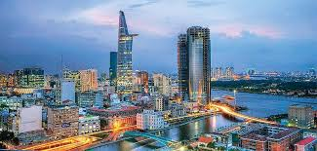
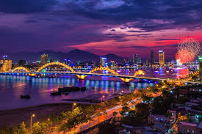
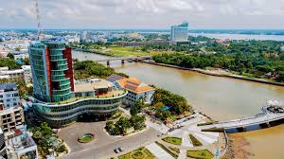
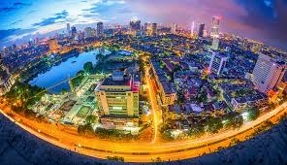
II. WRITING

Slide 13
4
Work in pairs. Put the phrases from the box in the correct column.
too much noise good health service high crime rate beautiful buildings | easy shopping air pollution heavy traffic green space
What I like about city life | What I dislike about city life

Slide 14
4
Work in pairs. Put the phrases from the box in the correct column.
too much noise good health service high crime rate beautiful buildings | easy shopping air pollution heavy traffic green space
What I like about city life | What I dislike about city life
easy shopping
too much noise
good health service
air pollution
beautiful buildings
high crime rate
green space
heavy traffic

Slide 15
Write a paragraph (about 100 words) about what you like or dislike about living in a city. You can use the ideas in 4 or your own ideas.
5
Outline:
I love / dislike city life. First, __________
______________________________
Second, _______________________
______________________________
______________________________
Third, _________________________
______________________________
In conclusion, ___________________
______________________________.

Slide 16
Sample paragraph:
I love city life. First, it is very convenient to live in the city. The public transport system reaches almost all areas of the city, so it is easy for me to get around. In addition, there are many shops that sell all kinds of goods, so I can buy almost everything I need. Second, the city often has many good schools and hospitals. Therefore, people here can enjoy quality education and healthcare. Finally, city life is exciting. There are many entertainment places for me and my friends. For example, we can hang out at shopping malls, watch movies at the cinema, and visit beautiful parks downtown. In conclusion, I find the city a liveable place for me. (120 words)

Slide 17
Sample paragraph:
I love city life. First, the availability of good and reliable health services that are available whenever needed is an important aspect that ensures a sense of security and well-being. Second, the convenience of easy shopping with numerous markets and malls, so that buying daily necessities is quicker and simpler. Third, cities offer a wealth of public amenities, ranging from parks and recreational spaces to cultural institutions and educational facilities, making city living a well-rounded and fulfilling experience. In conclusion, the combination of these factors collectively contribute to a vibrant and livable urban lifestyle, and enhance the quality of city.

Slide 18

CONSOLIDATION
What have we learnt in this lesson?
Listen for specific information in an interview about life in the city.
Write a paragraph about what they like or dislike about city life.

Slide 19

- Rewrite the paragraph in the notebooks.
- Do exercises in the workbook.

Slide 20


Homework
Rewrite the paragraph in the notebooks.
Do exercises in the Workbook.
Prepair lesson 7 ( looking back & Project)

Slide 21




Slide 22

WARM-UP
OPTION 2
PASS THE BALL

Slide 23
WARM-UP
OPTION 2
HOW TO PLAY
- When the music starts, students pass the balls to the students next to them.
- When the music stops, the two students has a ball must stand up to ask and answer the questions on the PPT.

Slide 24
WARM-UP
OPTION 2
PASS THE BALL

Slide 25
WARM-UP
OPTION 2
STOP

Slide 26
WARM-UP
OPTION 2
Question:
Which city do you want to live in? Why?

Slide 27
WARM-UP
OPTION 2
PASS THE BALL

Slide 28
WARM-UP
OPTION 2
STOP

Slide 29
WARM-UP
OPTION 2
Question:
Which city do you want to live in? Why?

Slide 30
WARM-UP
OPTION 2
PASS THE BALL

Slide 31
WARM-UP
OPTION 2
STOP

Slide 32
WARM-UP
OPTION 2
Question:
Which city do you want to live in? Why?

