Slide 1
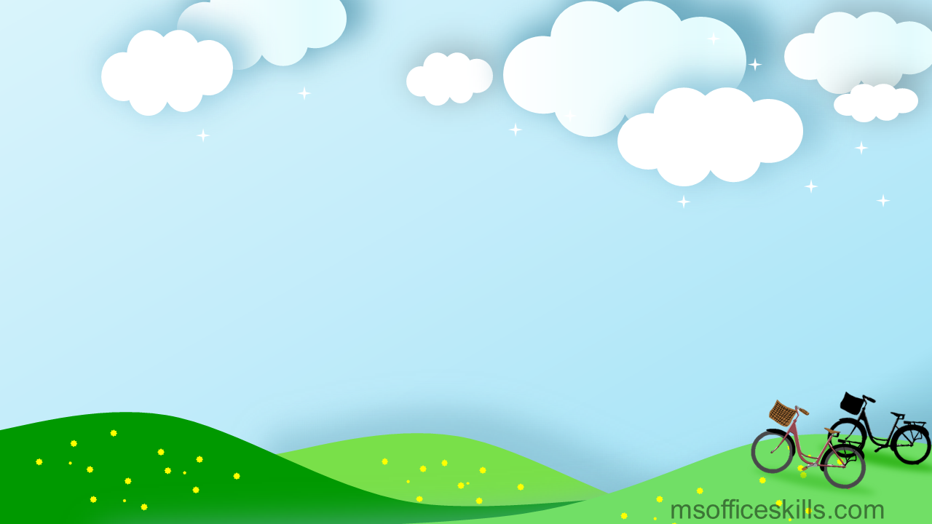

ENGLISH 9
Hello everyone !!!

Slide 2

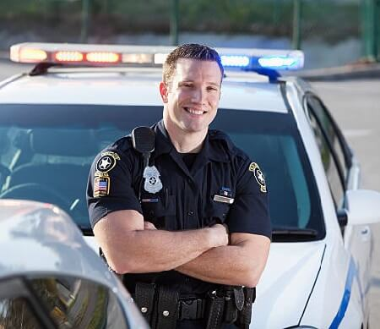
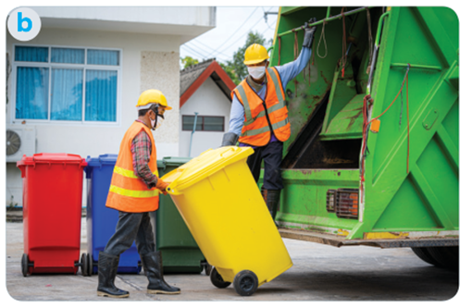
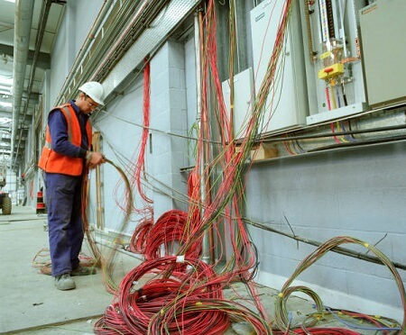
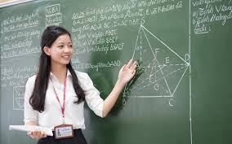
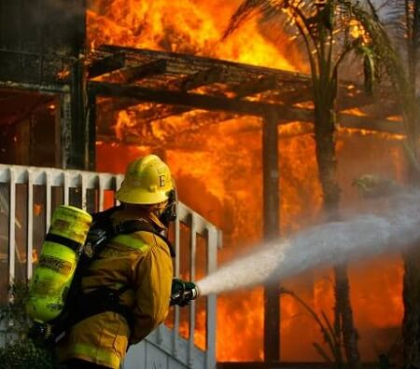
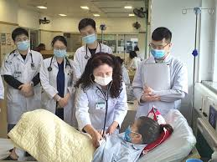
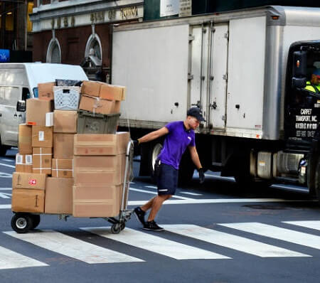
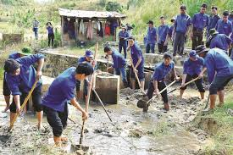
* WARM-UP
community helper
police officer
garbage collector
electrician
teacher
firefighter
doctor
delivery person
Volunteers.

Slide 3
* WARM-UP:
BRAINSTORMING
Who is your favourite community helper?
Why?

Slide 4


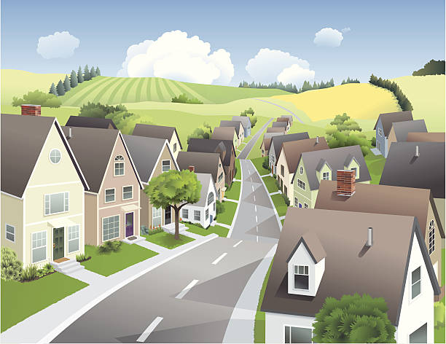
Unit
1
LOCAL COMMUNITY
LESSON 6: SKILLS 2

Slide 5
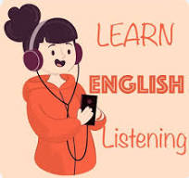
i. LISTENING

Slide 6

1
Work in pairs. Discuss the questions.
1. Who can you see in the pictures?
2. What are they doing?
We can see garbage collectors.
They are taking the garbage away.

Slide 7

2
Listen and fill in each blank with no more than two words.
The name of the writing contest is “ My Favourite ___________ ______”.
2. Mr Vinh is a __________________.
3. He is tall and __________________.
4. He is hard-working, responsible, and _______________.
Community
Helper
garbage collector
slim
friendly

Slide 8
3
Listen again and tick T (True) or F (False).
 | T | F
1. Mr Vinh wears an orange uniform.
2. He arrives at Mi's neighbourhood at 9 p.m. every day.
3. He instructs people to put rubbish in two types of bins.
4. He shares information about his work and the importance of sorting rubbish.





Slide 9

Audio script:
This is An Binh commune radio station. In today's special programme, we will share with you a piece of writing which won first prize in our writing contest test called “My favourite community helper”. This was written by Mi, a grade nine student. There are many great community helpers in our neighbourhood. But my favourite one is Mr. Vinh, the garbage collector. Mr. Vinh is a tall and slim man. He usually wears a green uniform with reflective stripes. He is hardworking and responsible. Every day he goes to our neighbourhood at 06:00 p.m with a garbage cart. He instructs everyone to put garbage in the correct bin, recyclable and nonrecyclable, and then goes to the next neighbourhood at about 09:00 p.m. He comes back and empties all the bins carefully.

Slide 10

II. WRITING
Choose a community helper
you like

Slide 11
4
Work in pairs. Choose a community helper you like and answer the following questions.
- What is his / her job?
– What does he / she look like?
– What is he / she like?
– What does he / she do for the community?
– How do you feel about him / her?

Slide 12
4
Work in pairs. Choose a community helper you like and answer the following questions.
A: What is his job?
B: He is a firefighter. His primary job is to respond to emergencies involving fires and other disasters.
A: What does he look like?
B: He typically wears distinctive uniforms that include protective gear.
A: What is he like?
B: He is a dedicated, brave, and quick-thinking individual.
A: What does he do for the community?
B: He responds to fire incidents, accidents, and natural disasters to protect lives and property for the community. He also engages in public programs, educating people on fire safety and prevention.
A: How do you feel about him?
B: I have immense respect and gratitude for him.

Slide 13
5
Write a paragraph (about 100 words) about your favourite community helper. Use the answers to the questions in 4 to help you.
My favourite community helper is a firefighter. He typically wears specialized uniforms that include protective gear. He is a dedicated, brave, and quick-thinking individual. He responds to fire incidents, accidents, and natural disasters to protect lives and property for communities. He also engages in public programs, educating people on fire safety and prevention. I have immense respect and gratitude for him. He is a true hero in real life.

Slide 14
5
Write a paragraph (about 100 words) about your favourite community helper. Use the answers to the questions in 4 to help you.
My favourite community helper is Mr Nam. He is a delivery person in my neighbourhood. He is a friendly person. Whenever he delivers something to us, he smiles happily. He sometimes asks me about my study. In addition, he is hard-working and responsible. He delivers goods to my family and other families in the neighbourhood despite the weather. Sometimes he has to return twice to deliver us a parcel because we are not at home. I really appreciate his manner. In general, Mr Nam is a very dedicated community helper who makes our life easy and comfortable.

Slide 15


* CONSOLIDATION
* What have we learnt in this lesson?
Listen for specific information about a community helper.
Write a paragraph about a community helper.

Slide 16


Homework
Do exercises in the Workbook.
Prepair lesson 7 ( looking back & Project)

Slide 17




Slide 18
Website: hoclieu.vn
Fanpage: facebook.com/www.tienganhglobalsuccess.vn/

