Slide 1
ENGLISH 8
Hello everyone !!!

Slide 2
Unit
1
LOCAL COMMUNITY
LESSON 5: SKILLS 1

Slide 3
* WARM-UP:
Please watch a video and say the name of the craft village
VIDEO
WATCHING
What do you know about this craft village?

Slide 4
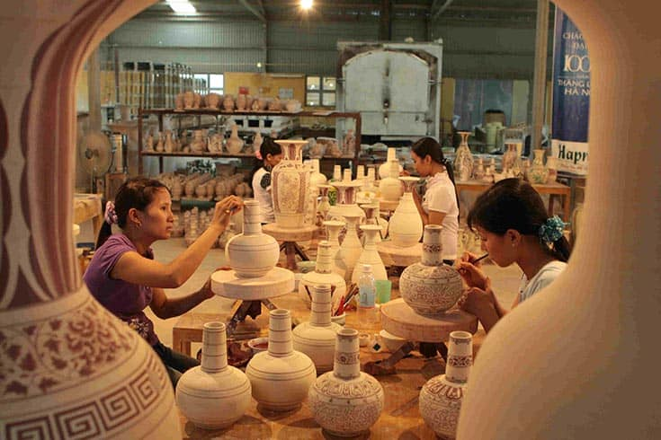
* WARM-UP
BAT TRANG POTTERY VILLAGE

Slide 5
i. READING

Slide 6
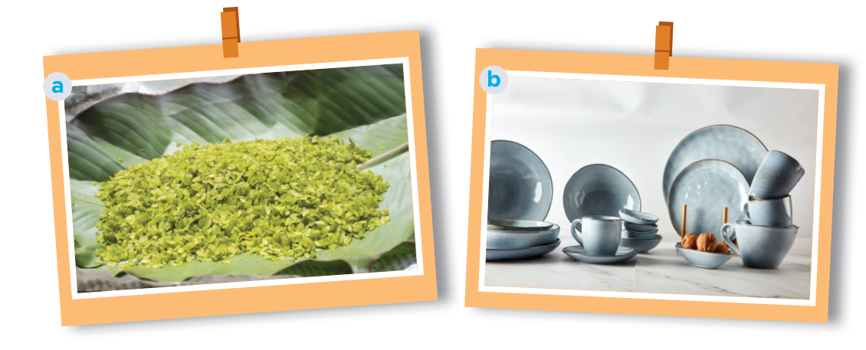
1
Work in pairs. Answer the questions.
What can you see in each picture?
Do you know any place(s) where people make the thing(s)
in each picture?

Slide 7
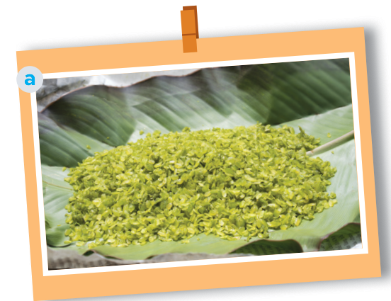
1
Work in pairs. Answer the questions.
Picture a: cốm (young sticky rice)- from Vong Village, Ha Noi
- Another place which makes com: Tu Le Commune in Yen Bai Province

Slide 8
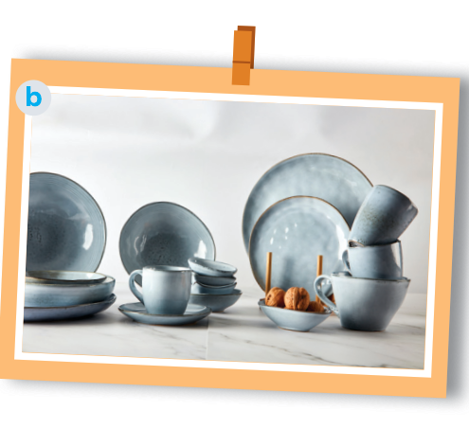
1
Work in pairs. answer the questions.
Picture b:
pottery – from Denby, England.
In Viet Nam, there are some pottery villages: Bat Trang, Bau Truc, Phu Lang, …

Slide 9
* VOCABULARY
preserve (v):
bảo tồn
/prɪˈzɜːv/
maintain (something) in its original
or existing state.

Slide 10
* VOCABULARY
fragrance (n):
hương thơm
/ˈfreɪɡrəns/
a sweet or delicate odor

Slide 11
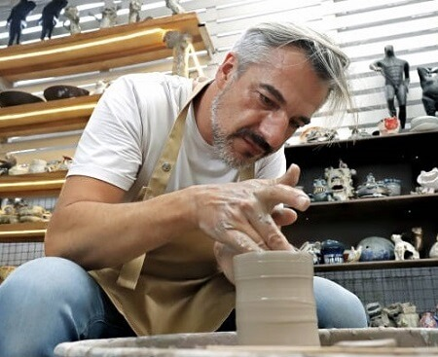
* VOCABULARY
Original (adj)
/əˈrɪdʒənl/
nguyên bản
The pottery artist is known for using original techniques in shaping clay.
Nghệ nhân làm gốm này nổi tiếng với việc sử dụng các kỹ thuật nguyên bản trong việc tạo hình đất sét.

Slide 12
* VOCABULARY
function(n):
/ˈfʌŋkʃn/
chức năng
Pottery can serve a decorative function, adding beauty to our homes.
Đồ gốm có thể phục vụ chức năng trang trí để tăng thêm vẻ đẹp cho ngôi nhà của chúng ta.

Slide 13
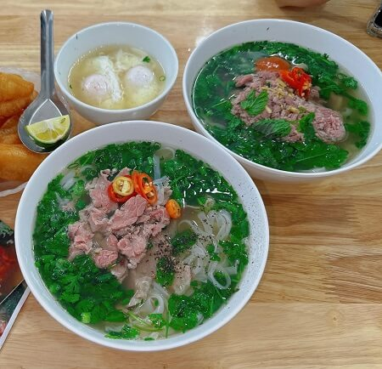
* VOCABULARY
Speciality (n)
/ˌspeʃiˈæləti/
đặc sản
Pho is a popular Vietnamese specialty food that is very popular to foreign tourists.
Phở là món ăn đặc sản nổi tiếng của Việt Nam rất phổ biến với du khách nước ngoài.

Slide 14
* VOCABULARY
New words | Pronunciation | Meaning
1. preserve (v) | /prɪˈzɜːv/ | bảo tồn
2. fragrance (n) | /ˈfreɪɡrəns/ | hương thơm
3. original (adj) | /əˈrɪdʒənl/ | nguyên bản
4. function (n) | /ˈfʌŋkʃn/ | chức năng
5. speciality (n) | /ˌspeʃiˈæləti/ | đặc sản

Slide 15
2
Read the brochure introducing different places with special products. Match each highlighted word with its definition.

Slide 16
2
Read the brochure introducing different places with special products. Match each highlighted word with its definition.

Slide 17
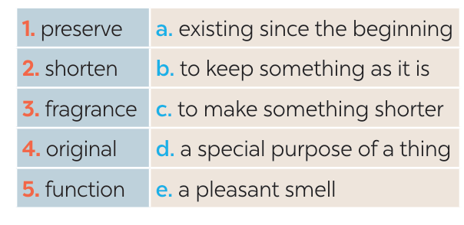
2
Read the brochure introducing different places with special products. Match each highlighted word with its definition.
* Keys:
1. b
2. c
3. e
4. a
5. d

Slide 18
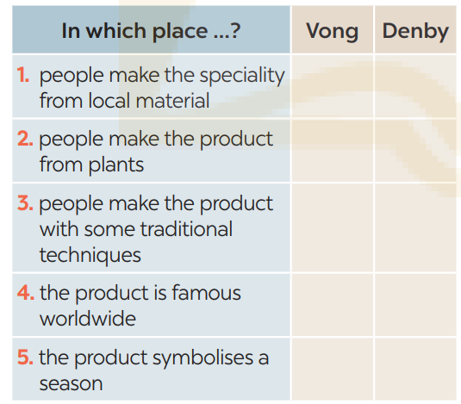
3
Read the brochure again. Decide which place each detail below belongs to
Vong: 2, 3, 5
Denby: 1, 3, 4
✓
✓
✓
✓
✓
✓

Slide 19
II. SPEAKING

Slide 20
4
Work in pairs. Ask and answer about a speciality in your neighbourhood, your home town, or the area you know. Use the questions below.
What speciality is it?
What do people make it from?
Do people make it in the traditional way?
What can people do with it?
Is it well known in only your country or around the world?

Slide 21
4
Work in pairs. Ask and answer about a speciality in your neighbourhood, your home town, or the area you know. Use the questions below.
1. “Phở” is a specialty food in Viet Nam.
2. It is made from rice noodles, beef or chicken and other spices.
3. Yes, it is.
4. People can eat “phở” all day for every meal. Pho is a noodle soup; therefore, it’s better when being added with beansprout.
5. It is famous with both Vietnamese and foreign visitors.

Slide 22
5
Work in groups. Give a short presentation about the speciality you discussed in 4.
I’m from Viet Nam. “Phở” is one of the most famous dish in my country. It is made from rice noodles, beef or chicken and other spices. People can eat “phở” all day for every meal. Pho is a noodle soup; therefore, it’s better when being added with beansprout. It is famous with both Vietnamese and foreign visitors.

Slide 23
5
Work in groups. Give a short presentation about the speciality you discussed in 4.
I live in Tay Ho Village, 12 kilometres from Hue City. My village is famous for its conical hats. We make conical hats from goi leaves. We still follow 15 traditional steps to make a hat. A conical hat protects us from the sun and the rain as well as makes us more graceful. What is special about our conical hats is that each of them carries a poem. Tay Ho conical hats are not only famous in Hue but all over Viet Nam.

Slide 24
* CONSOLIDATION
What have we learnt in this lesson?
Read for specific information about special products in some areas.
Give a short presentation about a speciality.

Slide 25
* Homework
Do exercises in the Workbook.
_ prepair lesson 6 : Skills 2

Slide 28
LESSON 5: SKILLS 1
LESSON 1: GETTING STARTED
WARM-UP
Warm up: Video watching
- Task 1: Work in pairs. Answer the questions.
- Vocabulary teaching
- Task 2: Read the brochure introducing different places with special products. Match each highlighted word with its definition.
- Task 3: Read the brochure again. Decide which place each detail below belongs to.
READING
SPEAKING
- Task 4: Work in pairs. Ask and answer about a speciality in your neighbourhood, your home town, or the area you know. Use the questions below.
- Task 5: Work in groups. Give a short presentation about the speciality you discussed in 4.
CONSOLIDATION
Wrap-up
Homework

Slide 29
Website: hoclieu.vn
Fanpage: facebook.com/www.tienganhglobalsuccess.vn/

