Slide 1
ENGLISH 9
Hello everyone !!!

Slide 2
Unit
1
LOCAL COMMUNITY
LESSON 3: A CLOSER LOOK 2

Slide 3
* WARM-UP
BRAINSTORMING
What do you do when you don’t know
how to get to a place in your neighbourhood?
QUESTION WORDS BEFORE
TO-INFINITIVES

Slide 4
* Grammar
Question words before to-infinitives
– We use a question word such as who, what, where, when, or how before a to-infinitive to express an indirect question about what we should do. – We often use a verb such as ask, wonder, (not) decide, (not) tell, or (not) know before the question word + to-infinitive.
Example:
- We don’t know what to do to help the community.
- She asked how to get to the nearest shopping mall.

Slide 5
Grammar
Question words before to-infinitives
Phrasal verbs

Slide 6
* Grammar
Từ để hỏi trước động từ nguyên thể có “to”
Chúng ta sử dụng từ để hỏi như ai, cái gì, ở đâu, khi nào hoặc như thế nào trước động từ to-infinitive để diễn đạt một câu hỏi gián tiếp về việc chúng ta nên làm gì.
Chúng ta thường sử dụng các động từ như : ask, wonder, (not) decide, (not) tell, hoặc (not) know trước từ để hỏi + to-infinitive.
S + V + từ để hỏi + to V
ask
wonder
(not) decide
(not) tell
(not) know
Example:
- We don’t know what to do to help the community.
- She asked how to get to the nearest shopping mall.

Slide 7
1
Fill in each blank with a suitable question word.
1. I don't know _______ to deal with this problem.
2. My sister wondered _______ to buy the best cakes.
3. Could you tell me _______ to do to get on well with my new neighbours?
4. They asked _______ to take out the rubbish, at 5 or 6 p.m.
5. He can't decide _______ to give his books to
Game

Slide 8
1
Fill in each blank with a suitable question word.
1
2
3
4
5

Slide 9
1
Fill in each blank with a suitable question word.
1. I don't know _______ to deal with this problem.
how

Slide 10
1
Fill in each blank with a suitable question word.
2. My sister wondered _______ to buy the best cakes.
where

Slide 11
1
Fill in each blank with a suitable question word.
3. Could you tell me _______ to do to get on well with
my new neighbours?
what

Slide 12
1
Fill in each blank with a suitable question word.
4. They asked _______ to take out the rubbish, at 5 or 6 p.m.
when

Slide 13
1
Fill in each blank with a suitable question word.
5. He can't decide _______ to give his books to
who

Slide 14
1
Fill in each blank with a suitable question word.
1. I don't know _______ to deal with this problem.
2. My sister wondered _______ to buy the best cakes.
3. Could you tell me _______ to do to get on well with my new neighbours?
4. They asked _______ to take out the rubbish, at 5 or 6 p.m.
5. He can't decide _______ to give his books to
how
where
what
when
who

Slide 15
2
Rewrite the sentences using question words + to-infinitives.
I don't know how I can get to the swimming pool.
→
2. They are wondering where they can buy traditional handicrafts
→
3. She asked what she should give to her new neighbour at his house-warming party.
→
4. I can't decide who I should ask for advice
→
5. Could you tell me when I have to pay the water bill?
→
I don’t know how to get to the swimming pool.
They are wondering where to buy traditional handicrafts.
She asked what to give to her new neighbour at his house-warming party
I can’t decide who to ask for advice.
Could you tell me when to pay the water bill?

Slide 16
Phrasal verbs
– A phrasal verb consists of a verb and one or two particles, such as up, down, back, on, round, …
– A phrasal verb usually has a special meaning.
Example:
go out = leave your house to go to a social event
pass down = give or teach something to your children
cut down on = reduce the amount or number of something
run out of = have no more of

Slide 17
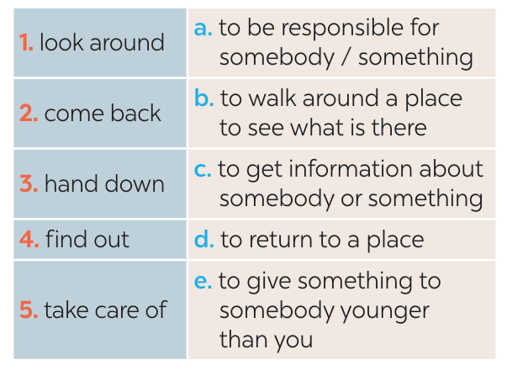
3
Match each phrasal verb with its meaning.
1-b
2-d
3-e
4-c
5-a

Slide 18
4
Complete each sentence using the correct form of a phrasal verb in 3.
hand down came back find out looking around takes care of
We _________ from our home town last Saturday.
The artisans in my village usually __ _______ their skills to their eldest children.
If you want to _________ about our community, you can go to the local museum.
When we aren't at home, our neighbour __________ our cats.
Whenever I go to a new place, I spend time ____________ .
came back
hand down
find out
takes care of
looking around

Slide 19
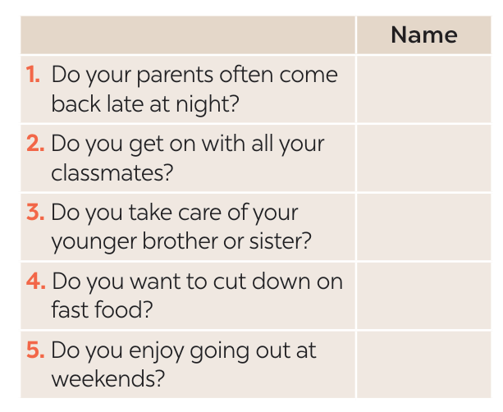
5
Find someone who … Ask as many friends as you can the following questions. Then write their names in the table if they say “yes”.
Tuan, Nga,..

Slide 20
* CONSOLIDATION
What have we learnt in this lesson?
- Use questions words before to-infinitives and some phrasal verbs.

Slide 21
* Homework
Do exercises in the Workbook.
Make 5 sentences using phrasal verbs.

Slide 22
Thanks for your atendance!
Goodbye. See you again
Notes:
22

Slide 23
Website: hoclieu.vn
Fanpage: facebook.com/www.tienganhglobalsuccess.vn/

Slide 24
LESSON 3: A CLOSER LOOK 2
LESSON 1: GETTING STARTED
WARM-UP
Warm up: Brainstorming.
- Question words with to Vinf
- Phrasal verbs
PRESENTATION
Task 1: Fill in each blank with a suitable question word.
Task 2: Rewrite the sentences using question words + to-infinitives.
Task 3: Match each phrasal verb with its meaning.
Task 4: Complete each sentence using the correct form of a phrasal verb in 3.
Task 5: Find someone who … Ask as many friends as you can the following questions. Then write their names in the table if they say “yes”.
PRACTICE
CONSOLIDATION
Wrap-up
Homework

