Slide 1
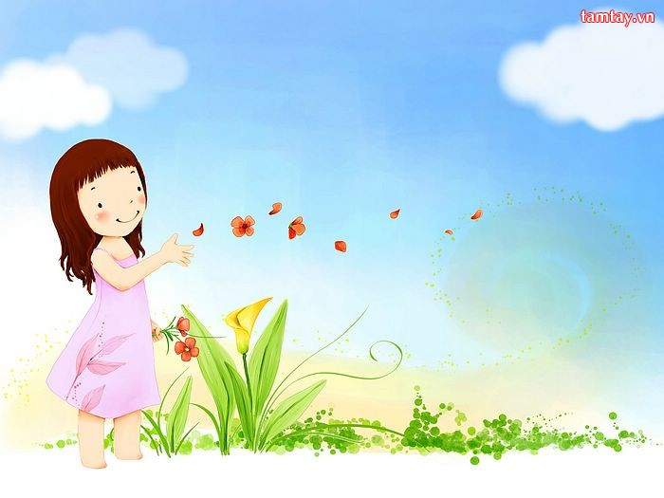


Pho Cuong Primary school
Welcome to
5A!
Teacher: Le Thi Thanh Nga
School: Pho Cuong
Primary School

Slide 2

Play game

Slide 3
Brainstorming

Slide 4
Wed, Feb 19th 2025
Week: 22
Period: 85
Unit 13: Our special days
Lesson 2: Parts 1,2,3 (page 20)

Slide 5
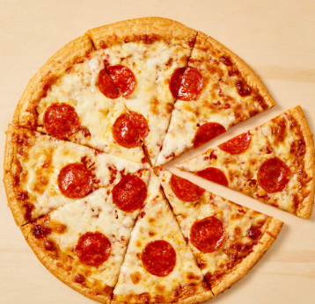
Unit 13: Our special days
Lesson 2: Parts 1,2,3
1. New words:

Slide 6
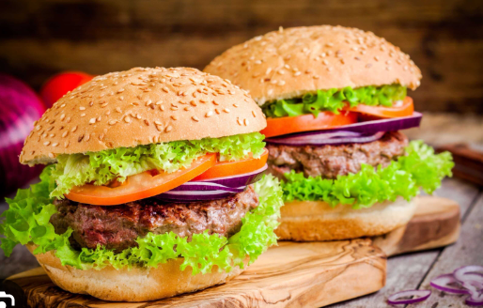
Unit 13: Our special days
Lesson 2: Parts 1,2,3
1. New words:

Slide 7
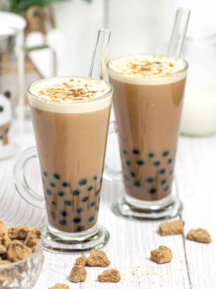
Unit 13: Our special days
Lesson 2: Parts 1,2,3
1. New words:

Slide 8
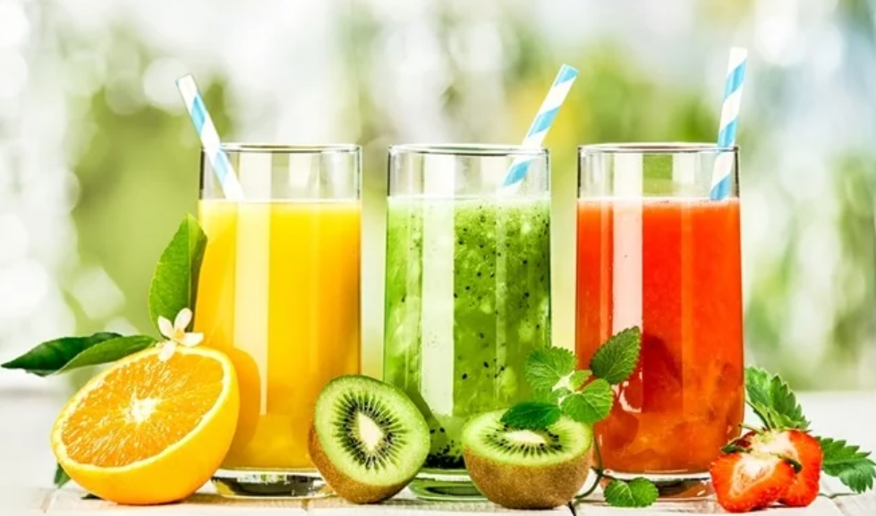
Unit 13: Our special days
Lesson 2: Parts 1,2,3
1. New words:

Slide 9
Unit 13: Our special days
Lesson 2: Parts 1,2,3
1. New words:

Slide 10
Unit 13: Our special days
Lesson 2: Parts 1,2,3
1. New words:
* Look, listen and repeat:

Slide 11
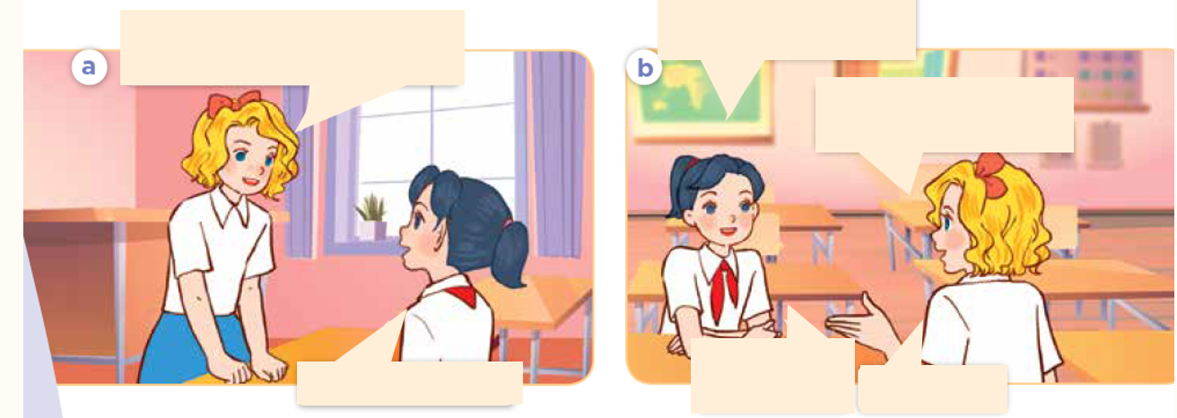
* Look, listen and repeat:

Slide 12

* Look, listen and repeat:
Hi, Mai. Will you come to my birthday party next Sunday?
What drinks will you
have at the party?
We’ll have fruit juice
and milk tea.
Shall I bring
some fruits?
Yes, I will. Thanks!
Yes, please!

Slide 13
* Look, listen and repeat:
What drinks will you
have at the party?
Hi, Mai. Will you come to my birthday party next Sunday?
We’ll have fruit juice
and milk tea.
Shall I bring
some fruits?
Yes, I will. Thanks!
Yes, please!

Slide 14
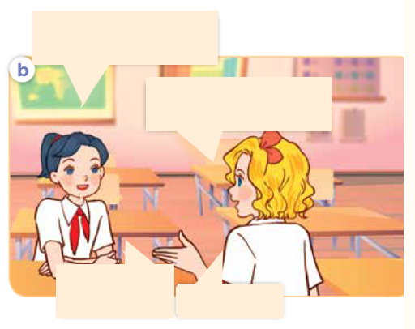
* Look, listen and repeat:
What drinks will you
have at the party?
We’ll have fruit juice
and milk tea.

Slide 15
Unit 13: Our special days
Lesson 2: Parts 1,2,3
2. Model sentences:

Slide 16
+ Listen, point and say:
3. Practice

Slide 17
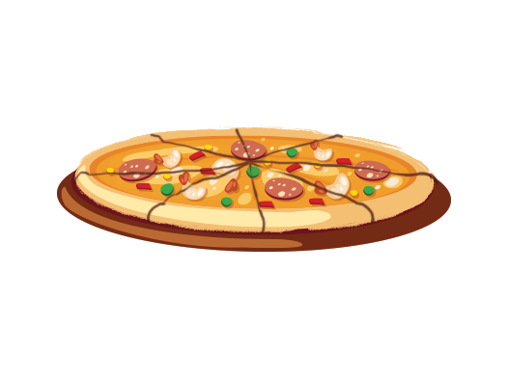
* Listen, point and say:
a. pizza

Slide 18
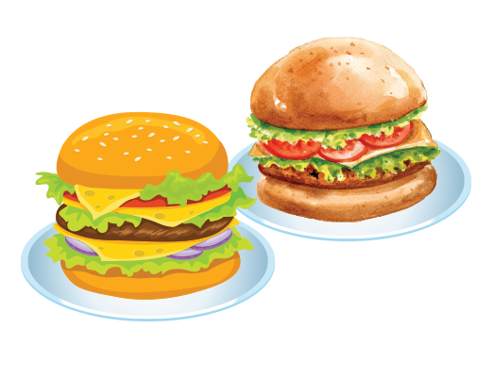
* Listen, point and say:
b. burgers

Slide 19
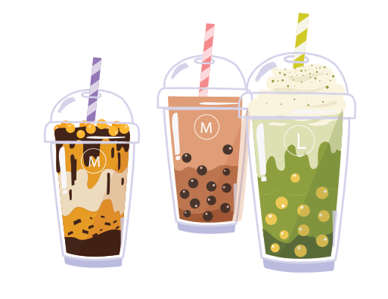
Listen, point and say:
c. milk tea

Slide 20
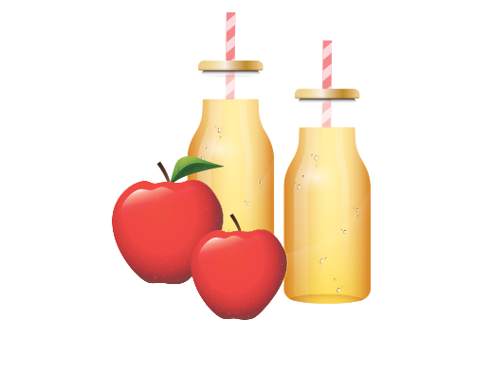
Listen, point and say:
d. apple juice

Slide 21
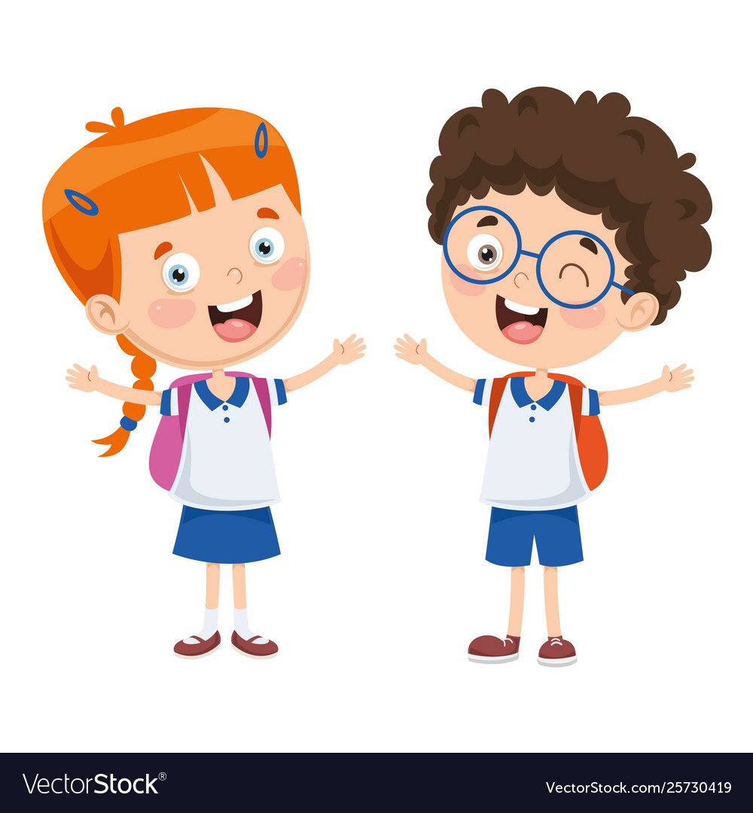
* Listen, point and say:
What food / drinks will you have at the party?
We’ll have ____.

Slide 22
What food will you have at the party?
We’ll have .
pizza

Slide 23
What food will you have at the party?
We’ll have .
burgers

Slide 24
What drinks will you have at the party?
milk tea
We’ll have .

Slide 25
What drinks will you have at the party?
apple juice
We’ll have .

Slide 26
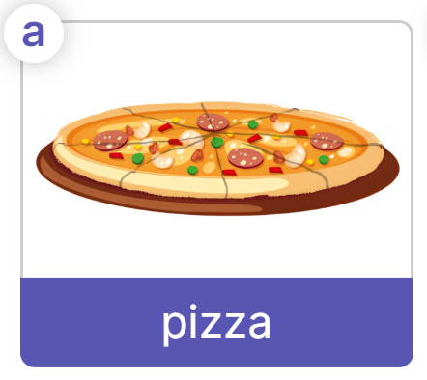
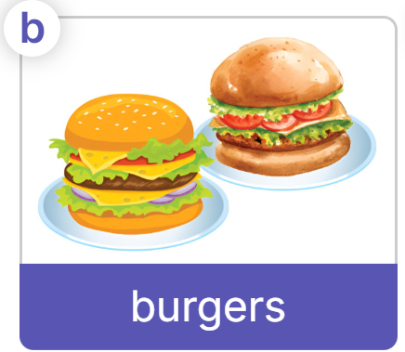
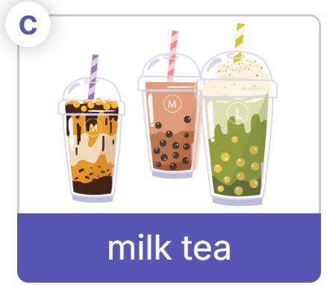
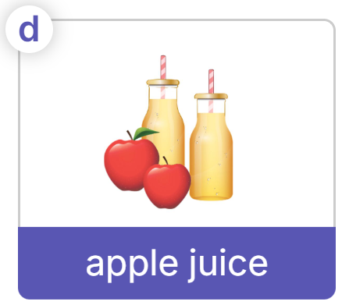
+ Listen, point, and say:
Work in pairs
What food/drinks will you have at the party?
We’ll have .

Slide 27
3. Practice:
+ Listen, point and say:
+ Let’s talk:

Slide 28
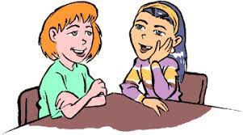
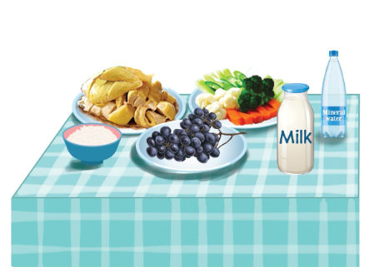
Look and name the food / drinks
vegetables
chicken
water
rice
milk
grapes

Slide 29
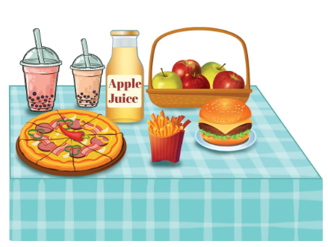
Look and name the food / drinks
apple juice
apples
milk tea
pizza
burgers
chips

Slide 30
+ Let’s talk:
What food / drinks will you have at the party?
__________.

Slide 31
04
+ Let’s talk:
__________
What will you do at/after the party?
play the guitar
play chess
What will you do at/after the party?
dance and sing
play the piano
have nice food and drinks
swim

Slide 32
+ Let’s talk:
Work in pairs
- What food / drinks will you have at the party?
- What will you do at/after the party?
__________.

Slide 33
Fun Corner
05
Play game
Magic wheel

Slide 34




Thank for your attention!
Good bye!

