Slide 2
Monday, February 24th, 2025
Week: 24
Period: 70
UNIT 9 :WORLD ENGLISHES
LESSON 2: A CLOSER LOOK 1

Slide 3
OBJECTIVES
By the end of the lesson, students will be able to:
Use the lexical items related to the topic WORLD ENGLISHES
Pronounce the swords ending in –ion and –ity with correct stress

Slide 4
LESSON 2: A CLOSER LOOK 1
LESSON 2: A CLOSER LOOK 1
WARM-UP
Option 1: Brainstorm
Option 2: Bin it or Keep it quiz
Vocabulary
Task 1: Match a word or phrase in A with its meaning in B.
Task 2: Match a verb in A with a phrase in B to make a meaningful expression.
Task 3: Choose the correct word to complete each sentence.
VOCABULARY
Task 4: Listen and repeat the words. Pay attention to the word stress.
Task 5: Listen and repeat the sentences. Mark the stress in the underlined words
PRONUNCIATION
CONSOLIDATION
Wrap-up
Homework

Slide 5
WARM-UP
OPTION 1
Brainstorm

Slide 6
WARM-UP
OPTION 1
- There are some pictures
- You need to say the words in British English and American English.
HOI AN

Slide 7
WARM-UP
OPTION 1
UK: chips US: French Fries

Slide 8
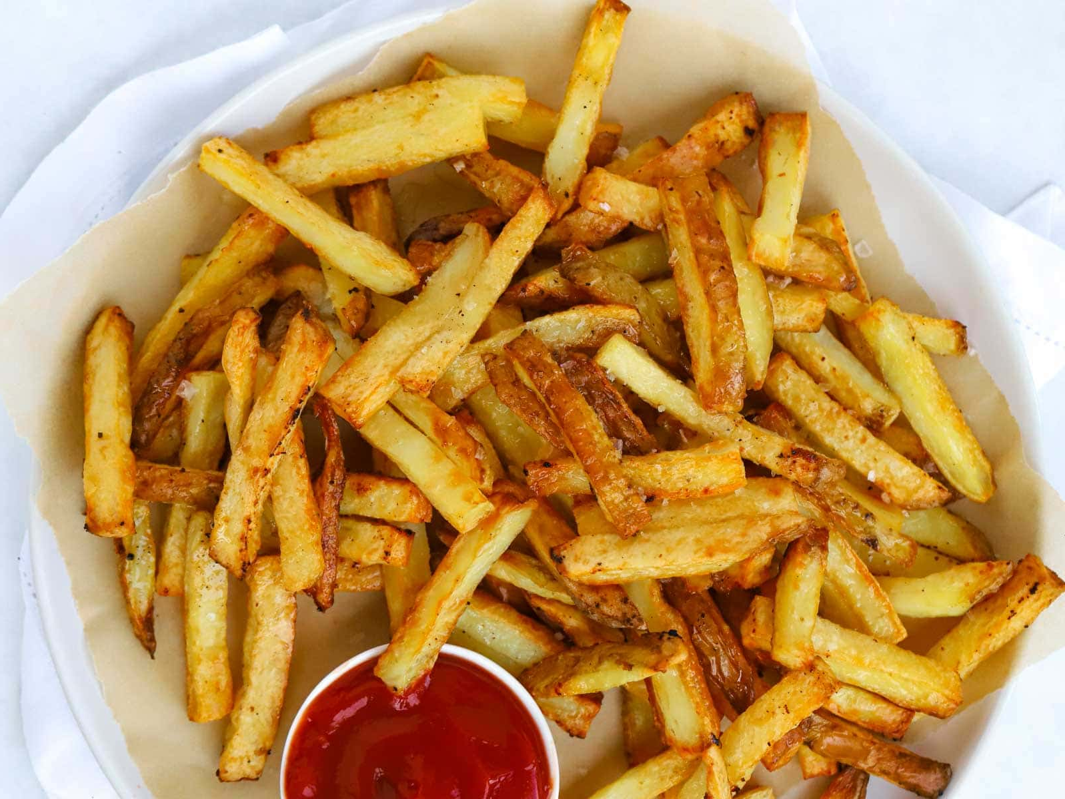
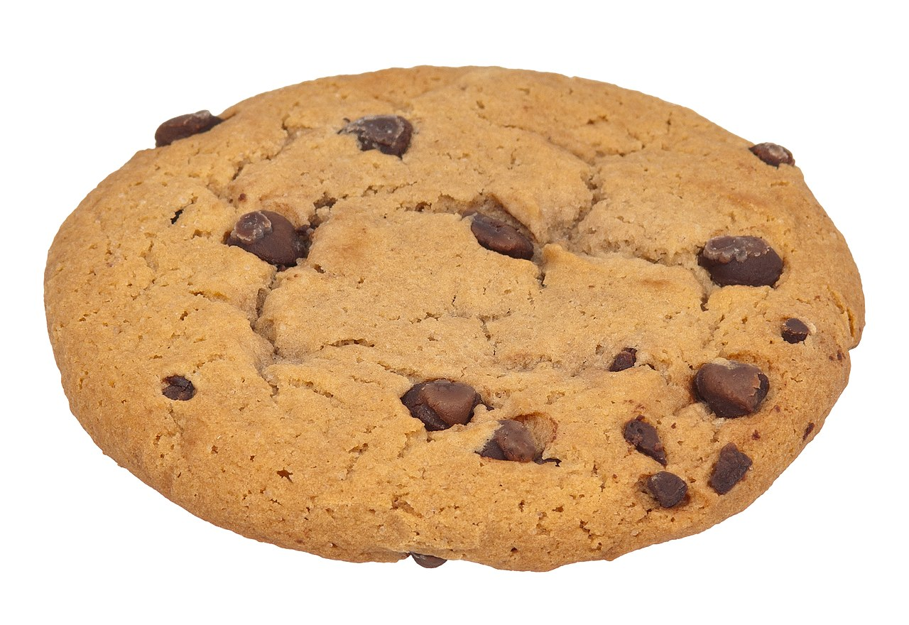
WARM-UP
OPTION 1
UK: flat US: apartment

Slide 9
WARM-UP
OPTION 1
UK: biscuit US: cookie

Slide 10
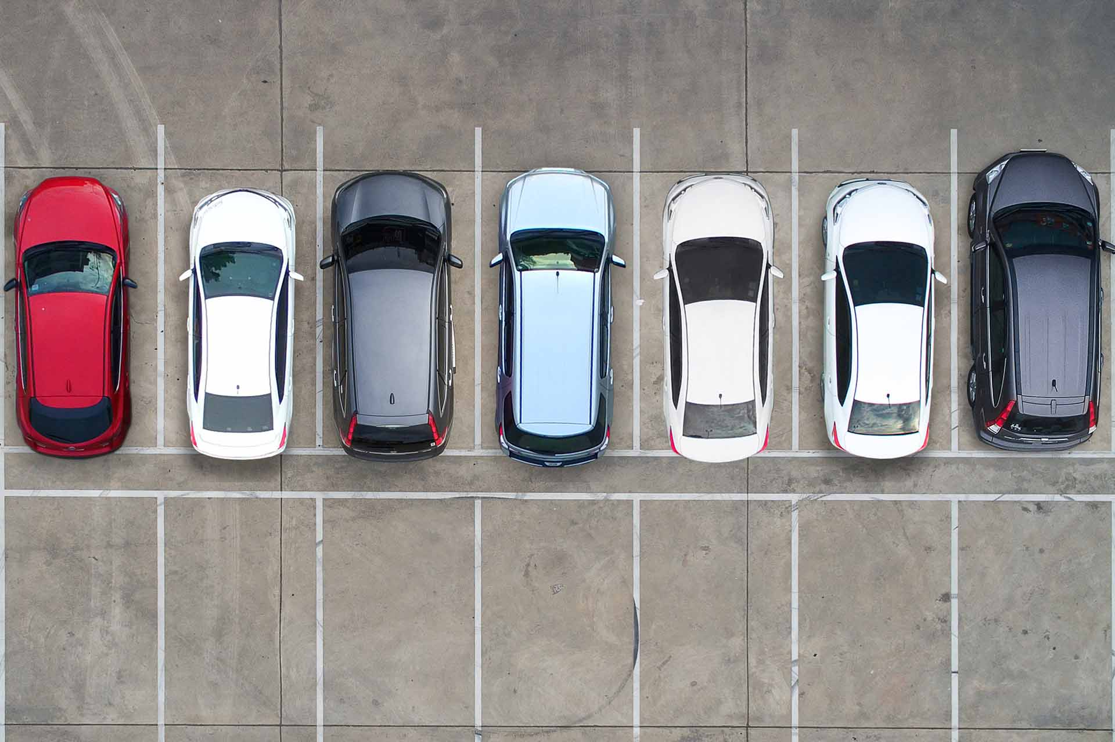
WARM-UP
OPTION 1
UK: dustbin
US: garbage can

Slide 11
WARM-UP
OPTION 1
UK: car park US: parking lot

Slide 12
WARM-UP
OPTION 2
Bin it or Keep it

Slide 13
WARM-UP
OPTION 2
- Work in teams
- There are signs or flashcards labeled "Bin it" and "Keep it."
- There is some sentences.
- You hold up the sign corresponding to your answer: "Bin it" if the sentence is not American English, "Keep it" if it is..

Slide 14
WARM-UP
OPTION 2
The sidewalk is cracked.
Keep

Slide 15
WARM-UP
OPTION 2
Please turn off the tap when you're finished.
Bin
Tap (UK) Faucet (US)

Slide 16
WARM-UP
OPTION 2
Can you pass me the rubber?
Bin
rubber (UK) eraser (US)

Slide 17
WARM-UP
OPTION 2
Let's grab some chips after school.
Keep

Slide 18
VOCABULARY
able to use two languages equally well
bilingual (adj)
/baɪˈlɪŋɡwəl/
sử dụng được 2 ngôn ngữ

Slide 19
VOCABULARY
a different type of something
variety (n)
/vəˈraɪəti/
biến thể/ đa dạng

Slide 20
VOCABULARY
able to speak a language easily and well
fluent (adj)
/ˈfluːənt/
Ex: He's a fluent English speaker.
trôi chảy, thành thạo

Slide 21
VOCABULARY
(of circles and rings) being one inside another and having the same center
concentric (adj)
/kənˈsentrɪk/
đồng tâm

Slide 22
VOCABULARY
to study something again
go over
/ɡəʊ ˈəʊvə/
Ex: I always go over my notes just before I go into an exam.
ôn tập lại

Slide 23
VOCABULARY
to learn a new skill or language by practising it rather than being taught it
pick up
Ex: When you live in a country you soon pick up the language.
/pɪk ʌp/
học (ngôn ngữ tự nhiên)
A | B
1. variety | a. a language which has legal status in a country. | 1.
2. bilingual | b. a different type of something | 2.
3. fluent | c. (of circles) having the same centre | 3.
4. concentric | d. able to speak two languages equally well | 4.
5. official language | e. able to speak, read, or write a language, especially a foreign language, easily and well | 5.

Slide 24
VOCABULARY
New words | Meaning
1. bilingual (adj)
2. variety (n)
3. fluent (adj)
4. concentric (adj)
5. go over
6. pick up
sử dụng được 2 ngôn ngữ
biến thể/ đa dạng
trôi chảy, thành thạo
đồng tâm
ôn tập lại
học (ngôn ngữ tự nhiên)

Slide 25
VOCABULARY
1
Match a word or phrase in A with its meaning in B.
A | B
1. variety | a. a language which has legal status in a country. | 1.
2. bilingual | b. a different type of something | 2.
3. fluent | c. (of circles) having the same centre | 3.
4. concentric | d. able to speak two languages equally well | 4.
5. official language | e. able to speak, read, or write a language, especially a foreign language, easily and well | 5.
b
d
e
c
a

Slide 26
PRACTICE
Match a verb in A with a phrase in B to make a meaningful expression.
2
A | B
1. translate | a. over the grammatical points | 1.
2. copy | b. up a new language | 2.
3. pick | c. up new words in an English-English dictionary | 3.
4. look | d. from Vietnamese into English | 4.
5. go | e. words into a notebook | 5.
d
e
b
c
a

Slide 27
PRACTICE
3
Choose the correct word to complete each sentence.
1. English is a(n) official / first language in Singapore besides Malay, Mandarin, and Tamil.
2. Although he was born in Britain, he is fluent / bilingual in Vietnamese
3.After you pick / look up a word in the dictionary, remember to make an example with it

Slide 28
PRACTICE
3
Choose the correct word to complete each sentence.
4. How many books have you picked /translated from English into Vietnamese?
5. Remember to go / copy over the wordsyou have learnt in class

Slide 29
LESSON 2: A CLOSER LOOK 1
LESSON 2: A CLOSER LOOK 1
WARM-UP
Option 1: Brainstorm
Option 2: Bin it or Keep it quiz
Vocabulary
Task 1: Match a word or phrase in A with its meaning in B.
Task 2: Match a verb in A with a phrase in B to make a meaningful expression.
Task 3: Choose the correct word to complete each sentence.
VOCABULARY
Task 4: Listen and repeat the words. Pay attention to the word stress.
Task 5: Listen and repeat the sentences. Mark the stress in the underlined words
PRONUNCIATION

Slide 30
PRONUNCIATION
4
Listen and repeat the words. Pay attention to the word stress
-ion | -ity
relation | charity
decision | quality
position | clarity
education | ability
operation | obesity
Words ending in -ion and -ity have stress on the syllable immediately before them.

Slide 31
PRONUNCIATION
5
Listen and repeat the sentences. Mark the stress in the underlined words.
1. They had a discussion about the quality of the courses at their language centre.
2. Pay attention to her ability to express herself in English.
3. I have an intention of organising an English class for the community.
4. Let’s do a revision activity before the exam.
5. What is the function of the word ‘identity’ in this sentence?

Slide 32
EXTRA ACTITIVTY
- Work in groups. Ask groups to write as many words ending in –ion and –ity as possible in ............... minutes.
- The group with the most words to the words on the board.
- Other students from other groups go to the board and put stress on the correct syllable in each word written.
Notes:
wish → wish
know → knowledge
decide → decision
damage → damage

Slide 33
LESSON 2: A CLOSER LOOK 1
LESSON 2: A CLOSER LOOK 1
WARM-UP
Option 1: Brainstorm
Option 2: Bin it or Keep it quiz
Vocabulary
Task 1: Match a word or phrase in A with its meaning in B.
Task 2: Match a verb in A with a phrase in B to make a meaningful expression.
Task 3: Choose the correct word to complete each sentence.
VOCABULARY
Task 4: Listen and repeat the words. Pay attention to the word stress.
Task 5: Listen and repeat the sentences. Mark the stress in the underlined words
PRONUNCIATION
CONSOLIDATION
Wrap-up
Homework

Slide 34
CONSOLIDATION
1
Wrap-up
What have we learnt in this lesson?
Use the lexical items related to the topic WORLD ENGLISHES
Pronounce the words ending in –ion and –ity with correct stress.

Slide 35
CONSOLIDATION
2
Homework
Learn by heart the new words.
Find 3 more words that ending with the sounds –ion and –ity and put the stress to the appropriate syllable in each of them.
Do exercises in part A in Workbook.
Prepare new lesson: A closer look 1

Slide 36
Website: hoclieu.vn
Fanpage: facebook.com/www.tienganhglobalsuccess.vn/

