Slide 2
Monday, February 17th, 2025
Week: 23
Period: 67
UNIT 8 :TOURISM
LESSON 6: SKILLS 2

Slide 3
LESSON 2: SKILLS 2
LESSON 1: GETTING STARTED
WARM-UP
UNSCRAMBLED WORDS
Vocabulary
Task 1: Work in pairs. Discuss if these statements are true.
Task 2: A tour guide is announcing the schedule for a one-day trip to the home of the Brontes. Listen and
complete the missing information.
Task 3: Look at the pictures, listen again and tick the two which illustrate the ideas of the listening passage.
LISTENING
Task 4: Work in pairs. Discuss and tick the thing(s) that the tour guide in the listening passage mentions in her announcement at the beginning of the tour.
Task 5: Write a paragraph (100 - 120 words) introducing this half day tour in Hue. Use the clues below.
WRITING
CONSOLIDATION
Wrap-up
Homework

Slide 4
UNSCRAMBLE
Play in 2 teams.
Write unscrambled words in notebook.
Raise hand and say out “FINISH”.
LET’S PLAY!

Slide 5
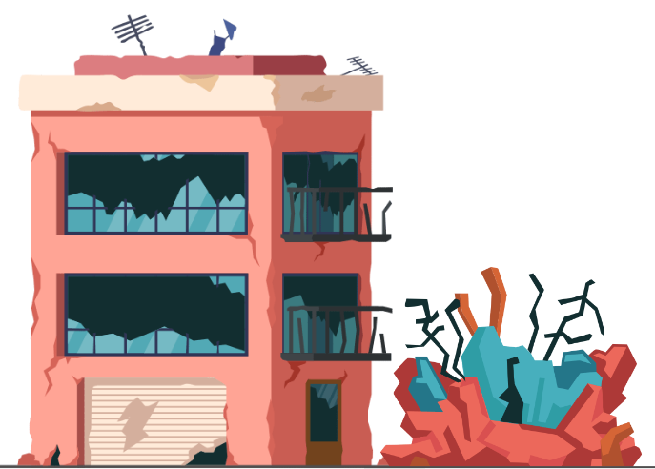
UNSCRAMBLE THE WORD
RUNSIOU
RUINOUS

Slide 6
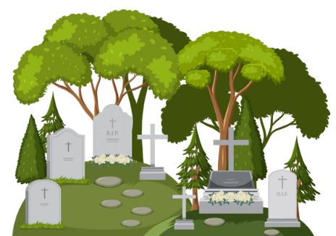
UNSCRAMBLE THE WORD
REVDYAAGR
GRAVEYARD

Slide 7
UNSCRAMBLE THE WORD
HHGI RTTESE
HIGH STREET

Slide 8
UNSCRAMBLE THE WORD
NDWEAR
WANDER

Slide 12
UNSCRAMBLE THE WORD
GETTOAC
COTTAGE

Slide 13
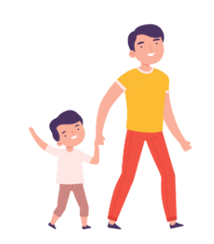
UNSCRAMBLE THE WORD
COPMCYANA
ACCOMPANY

Slide 14
UNSCRAMBLED WORDS
RUINOUS
GRAVEYARD
HIGH STREET
WANDER
COTTAGE
ACCOMPANY

Slide 15
LISTENING
graveyard (n)
.
/ˈɡreɪv.jɑːd/
nghĩa địa
Notes:
a place, often next to a church, where dead people are buried

Slide 16
LISTENING
wander (v)
.
/ˈwɒn.dər/
đi lang thang
Notes:
to walk around slowly in a relaxed way or without any clear purpose or direction:

Slide 17
LISTENING
accompany (v)
.
/əˈkʌm.pə.ni/
đồng hành
Notes:
to go with someone or to be provided or exist at the same time as something:

Slide 18
LISTENING
New words | Pronunciation | Meaning
1. graveyard (n) | /ˈɡreɪv.jɑːd/ | nghĩa địa
2. wander (v) | /ˈwɒn.dər/ | đi lang thang
3. accompany (v) | /əˈkʌm.pə.ni/ | đồng hành

Slide 19
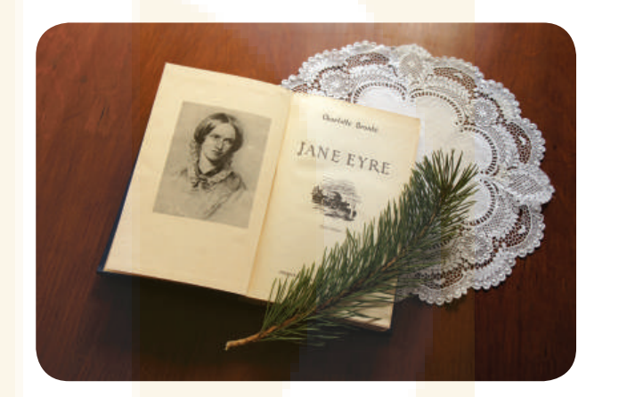
SPEAKING
1
Work in pairs. Discuss if these statements are true.
1. The Brontes is a family of world-famous writers. True
2. Together, the three sisters wrote Jane Eyre.
3. You can read some of their novels in Vietnamese. True

Slide 20
LISTENING
2
A tour guide is announcing the schedule for a one-day trip to the home of the Brontes. Listen and complete the missing information.
DAY TRIP Haworth and the Brontes
Trip will take: | (1) ___________ hours
Jane Eyre: | (2) a _______________ book
At Haworth, we see: | the Brontes’ house, school, and (3) ________
The tour includes | (4) ___________ ticket to the house
The Brontes lived in Haworth: | (5) ___________ years ago
The main street of the village: | has witnessed little (6) ___________
9 / nine
world-famous
graveyard
entrance
150
change
Notes:
1. 9 / nine 2. world-famous 3. graveyard
4. entrance 5. 150 6. hardly

Slide 21
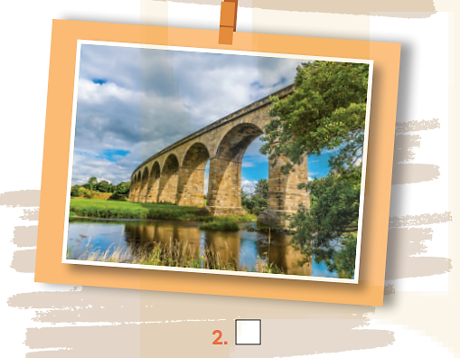
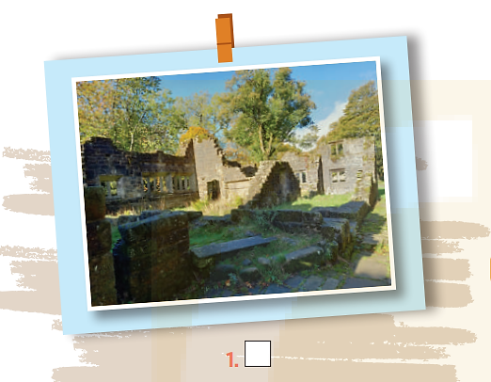
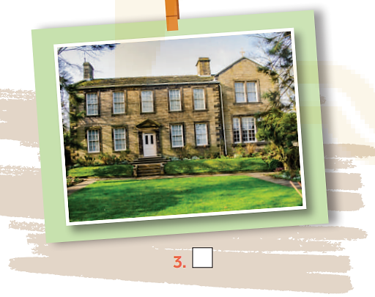
LISTENING
3
Look at the pictures, listen again and tick the two which illustrate the ideas of the
listening passage.
Notes:
1 and 3

Slide 22
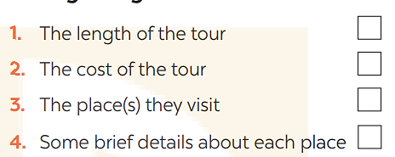
WRITING
4
Work in pairs. Discuss and tick the thing(s) that the tour guide in the listening passage mentions in her announcement at the beginning of the tour.
Notes:
Key: 1. c 2. a 3. b

Slide 23
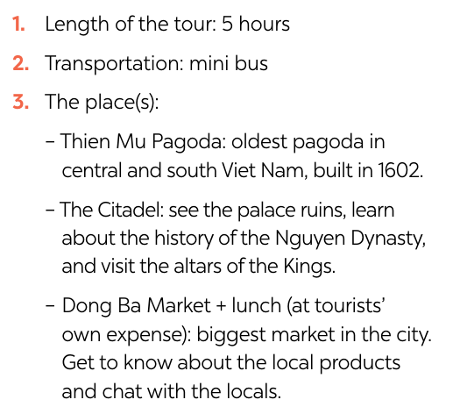
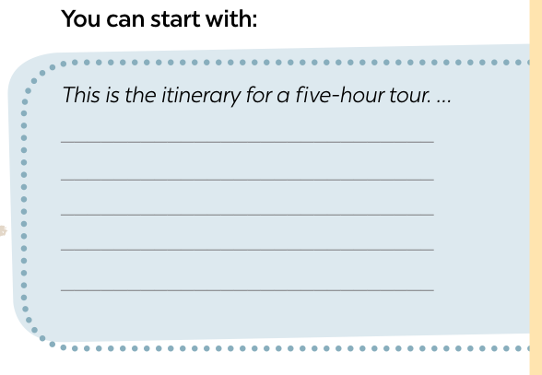
WRITING
5
Write a paragraph (100 - 120 words) introducing this half day tour in Hue. Use the clues below.
Notes:
Key: 1. c 2. a 3. b

Slide 24
WRITING
5
Write a paragraph (100 - 120 words) introducing this half day tour in Hue. Use the clues below.
Sample
Hi, my name is Nam and I’m going to be with you on a five-hour tour of Hue city. Our first visit is Thien Mu Pagoda. It’s the oldest pagoda in central and south Viet Nam and built in 1602. Then we drive on to the Citadel, where we can see the palace ruins, learn about the local history of the Nguyen Dynasty, and visit the altars of the Kings. The last visit is to Dong Ba Market. It’s the biggest market in the city, where you’ll see local products and chat with the locals. You can have lunch in or around the market before the tour ends.
Notes:
Key: 1. c 2. a 3. b

Slide 25
CONSOLIDATION
1
Wrap-up
What have we learnt in this lesson?
Listening for specific and general information;
Writing a paragraph introducing a half day tour in Hue.

Slide 26
CONSOLIDATION
2
Homework
Learn by heart new words.
Do exercises in part E in the workbook.
Prepare the next lesson: Looking back & project.

Slide 27
Website: hoclieu.vn
Fanpage: facebook.com/www.tienganhglobalsuccess.vn/

