Slide 2
LESSON 4: COMMUNICATION
LESSON 1: GETTING STARTED
WARM-UP
Chatting
Task 1: Listen and read the conversations. Pay attention to the highlighted parts.
Task 2: Work in pairs. Express obligation in the following situations.
EVERYDAY ENGLISH
Task 3: Read what people say about their travels. Then complete the table.
Task 4: Work in groups. Share with your partners an unforgettable holiday you’ve taken.
Task 5: Report partner’s travel.
MY TRAVEL
CONSOLIDATION
Wrap-up
Homework

Slide 3
Tuesday, February 11th, 2025
Week: 22
Period: 65
UNIT 8 :TOURISM
LESSON 4: COMMUNICATION

Slide 4
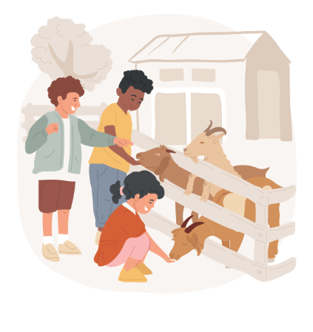
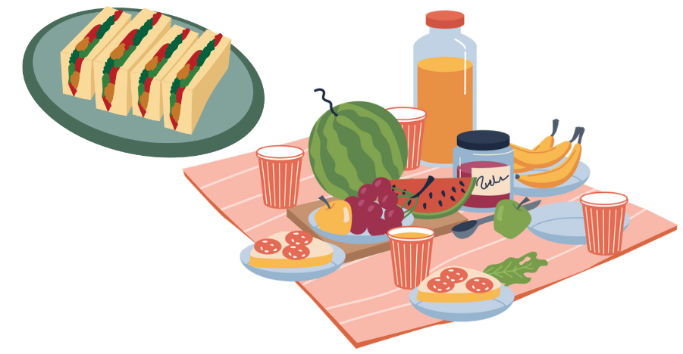
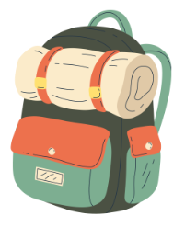
WARM–UP: CHATTING
Supposing your team was preparing for the school field trip and as a team leader, you needed to assign tasks to your teammates.
What would you say in that case?

Slide 5
EVERYDAY ENGLISH
1
Listen and read the conversations. Pay attention to the highlighted parts.
Mother: Lan, you must hurry up or we’ll miss the train.
Lan: Yes, Mum. I’m coming.
Nick: Is it necessary for us to wait in the queue?
Stranger: I’m sorry, it is.

Slide 6
EVERYDAY ENGLISH
To express obligation, you can use | To respond you can use
- You must ... - It’s necessary that you ... | - I got it. - Yes, I will. - I’m sorry.

Slide 7
EVERYDAY ENGLISH
2
Work in pairs. Express obligation in the following situations.
Situation 1: You ask your younger brother to make a list of the things he will pack for his holiday so that he does not forget anything.
Situation 2: The teacher asks the class to strictly follow the factory regulations while visiting.

Slide 8
EVERYDAY ENGLISH
2
Work in pairs. Express obligation in the following situations.
Situation 1 : You ask your younger brother to make
a list of the things he will pack for his holiday so that he does not forget anything.
Suggested answer:
It’s necessary that you make a list of the things you will pack for your holiday.
Notes:
Suggested answers:
1. It’s necessary that you make a list of the things you will pack for your holiday.
2. You must strictly follow the factory regulations while visiting.

Slide 9
EVERYDAY ENGLISH
2
Work in pairs. Express obligation in the following situations.
Situation 2: The teacher asks the class to strictly
follow the factory regulations while visiting.
Suggested answer:
You must strictly follow the factory regulations while visiting.

Slide 10
ROLE-PLAY
GAME
Work in pairs. Take turns to say obligations and respond in the following situations.
1. Tell your brother to turn off the TV when he finishes watching the cartoon.
2. Tell your friends that you all must finish the project by Tuesday.
3. Tell your friend Mark not to be late again for class.
4. Tell your sister to put the toys back to the shelf.

Slide 11
ROLE-PLAY - KEY
GAME
Tell your brother to turn off the TV when he finishes watching the cartoon.
– You must turn off the TV when you finish watching the cartoon.
– Yes, I will.
2. Tell your friends that you all must finish the project by Tuesday.
– It’s necessary that we finish the project by Tuesday.
– We got it. Don’t worry.
3. Tell your friend Mark not to be late again for class.
– Mark, you must not be late again for class.
– I’m sorry. I won’t be late again.
4. Tell your sister to put the toys back to the shelf.
– You must put the toys back on the shelf after playing with them.
– Yes, bro. I won’t forget.

Slide 12
MY TRAVEL
low season (n)
.
/ˈləʊ ˌsiː.zən/
mùa ít khách
Notes:
the period in the year when the fewest people visit a place and when the prices are at their lowest level

Slide 13
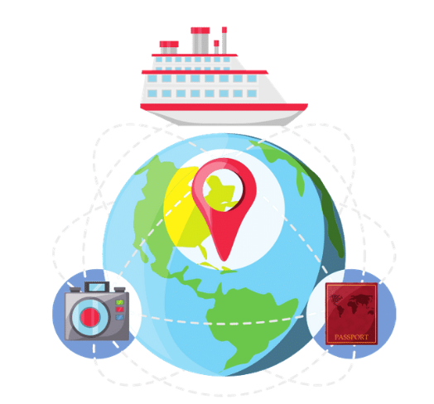
MY TRAVEL
cruise (n)
.
/kruːz/
cuộc đi chơi biển (bằng tàu thuỷ)
Notes:
a journey on a large ship for pleasure, during which you visit several places:

Slide 14
MY TRAVEL
historical (adj)
.
/hɪˈstɔːr.ɪ.kəl/
có liên quan đến sự kiện của quá khứ
Notes:
connected with studying or representing things from the past

Slide 15
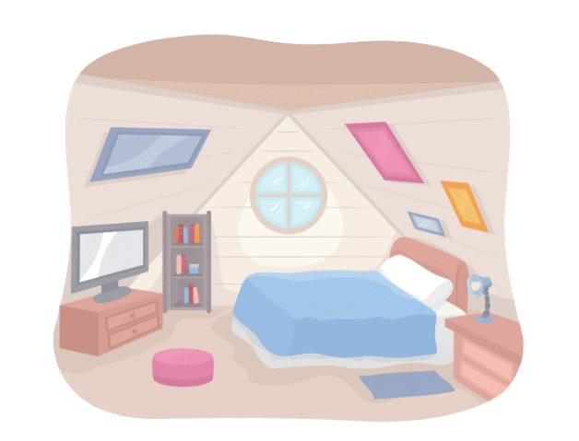
MY TRAVEL
loft (n)
.
/lɒft/
gác xép
Notes:
a space at the top of a building under the roof used for storing things and usually entered by a ladder, or sometimes made into a room for living in

Slide 16
VOCABULARY
New words | Pronunciation | Meaning
1. low season (n) | /ˈləʊ ˌsiː.zən/ | mùa ít khách
2. cruise (n) | /kruːz/ | cuộc đi chơi biển (bằng tàu thuỷ)
3. historical (adj) | /hɪˈstɔːr.ɪ.kəl/ | có liên quan đến sự kiện của quá khứ
4. loft (n) | /lɒft/ | gác xép

Slide 17
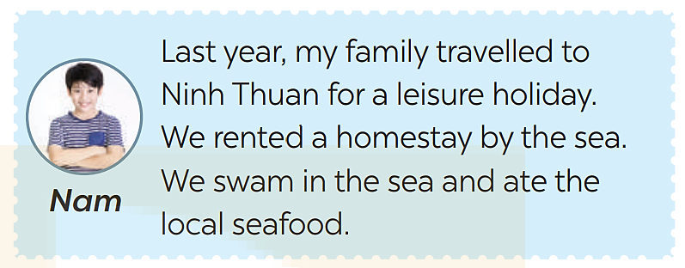
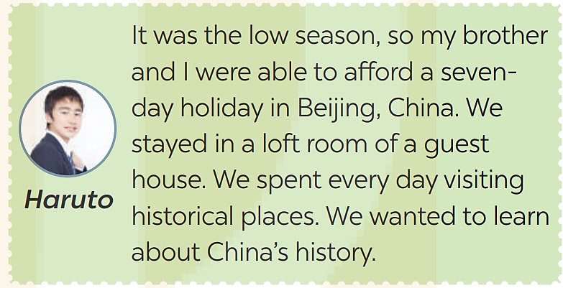
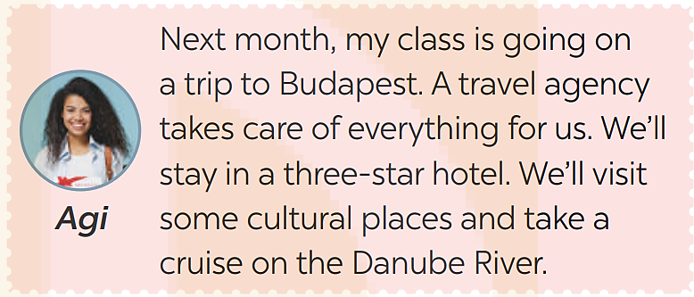
MY TRAVEL
3
Read what people say about their travels. Then complete the table.

Slide 18
MY TRAVEL
3
Read what people say about their travels. Then complete the table.
People | Accommodation | Activities
Nam
Agi
Haruto
- swimming
- eating local food
homestay
- visiting cultural places
- taking a cruise on the Danube River
three-star hotel
loft room
- visiting historical places

Slide 19
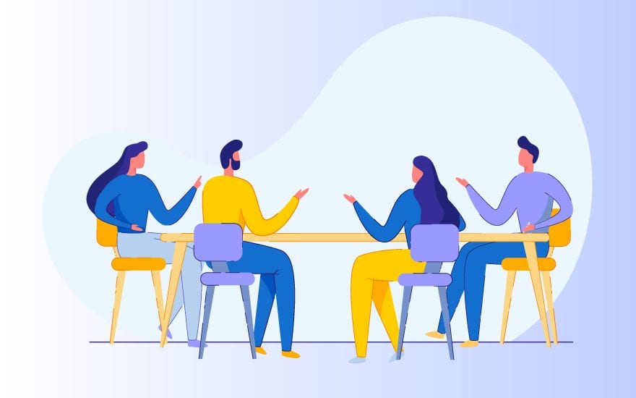
MY TRAVEL
4
Work in groups. Share with your partners an unforgettable holiday
you’ve taken. In your talk, you can mention:
– holiday destination
– travel transportation
– accommodation
– activities

Slide 20
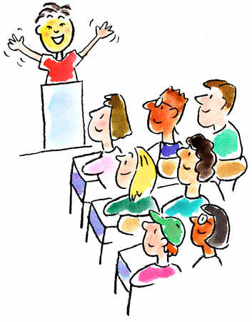
MY TRAVEL
5
Report your partners’ travel to the class.
Notes:
Suggested list:
1. time (date, the number of days for holiday)
2. place
3. transport
4. accommodation
5. activities
6. cost
7. things to bring

Slide 21
CONSOLIDATION
1
Wrap-up
What have we learnt in this lesson?
Say obligations and respond;
Talk about their travel and summarise the information in a table;
Talk about an unforgettable holiday;
Report partners’ travel.

Slide 22
CONSOLIDATION
2
Homework
Learn by heart the new words.
Do exercises in part C in the workbook
Prepare the next lesson: Skills 1.

Slide 23
Website: hoclieu.vn
Fanpage: facebook.com/www.tienganhglobalsuccess.vn/

